Slide 1

EOVSA Antennas and Array configuration
Dale E. Gary
Professor, Physics, Center for Solar-Terrestrial Research
New Jersey Institute of Technology

Slide 2
outline
2-m Antennas
Eight new antennas ordered (first delivery Oct. 2011)
Uniform vs. dissimilar antennas
27-m Antennas
Array Configuration
Imaging Study
Conclusion

Slide 3
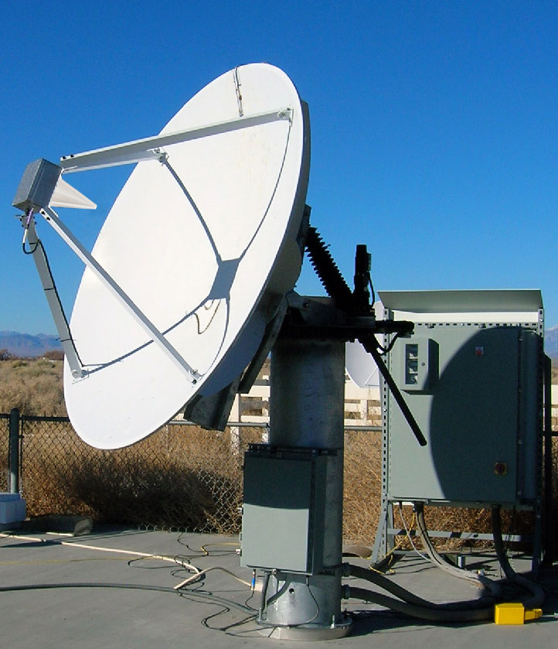
New 2-m antennas
Patriot (now Cobham, but ordered from InterTronic Solutions)
Alt-Az mount
2.1 m reflector
Precise pointing (of order 20”)
Control will be via cRIO devices inside the antenna controller, as described by Gelu.

Slide 4
Uniform vs. dissimilar antennas
With dissimilar antennas:
40 out of 78 baselines have dissimilar feeds, one rotating with respect to the other. Digital correction for non-ideal behavior is difficult due to time-dependence. Non-parallel hands means no linear polarization on these baselines (although R,L is possible, after correcting for phase shift).
Limited sky coverage (±4 hours) on equatiorial dishes vs. 10º elevation limit sums to 32% less time on the Sun over the year.
Less time on the Sun limits joint observations with Europe and Asia.
Dropping from N = 13 to N = 8, drops #baselines from 78 to only 28.
Maintenance is more difficult (more downtime), calibration is more complex, the control system is more complex, and the analysis software is more complex.
We must find the $ more 5 additional azel antennas! NASA proposal…

Slide 5
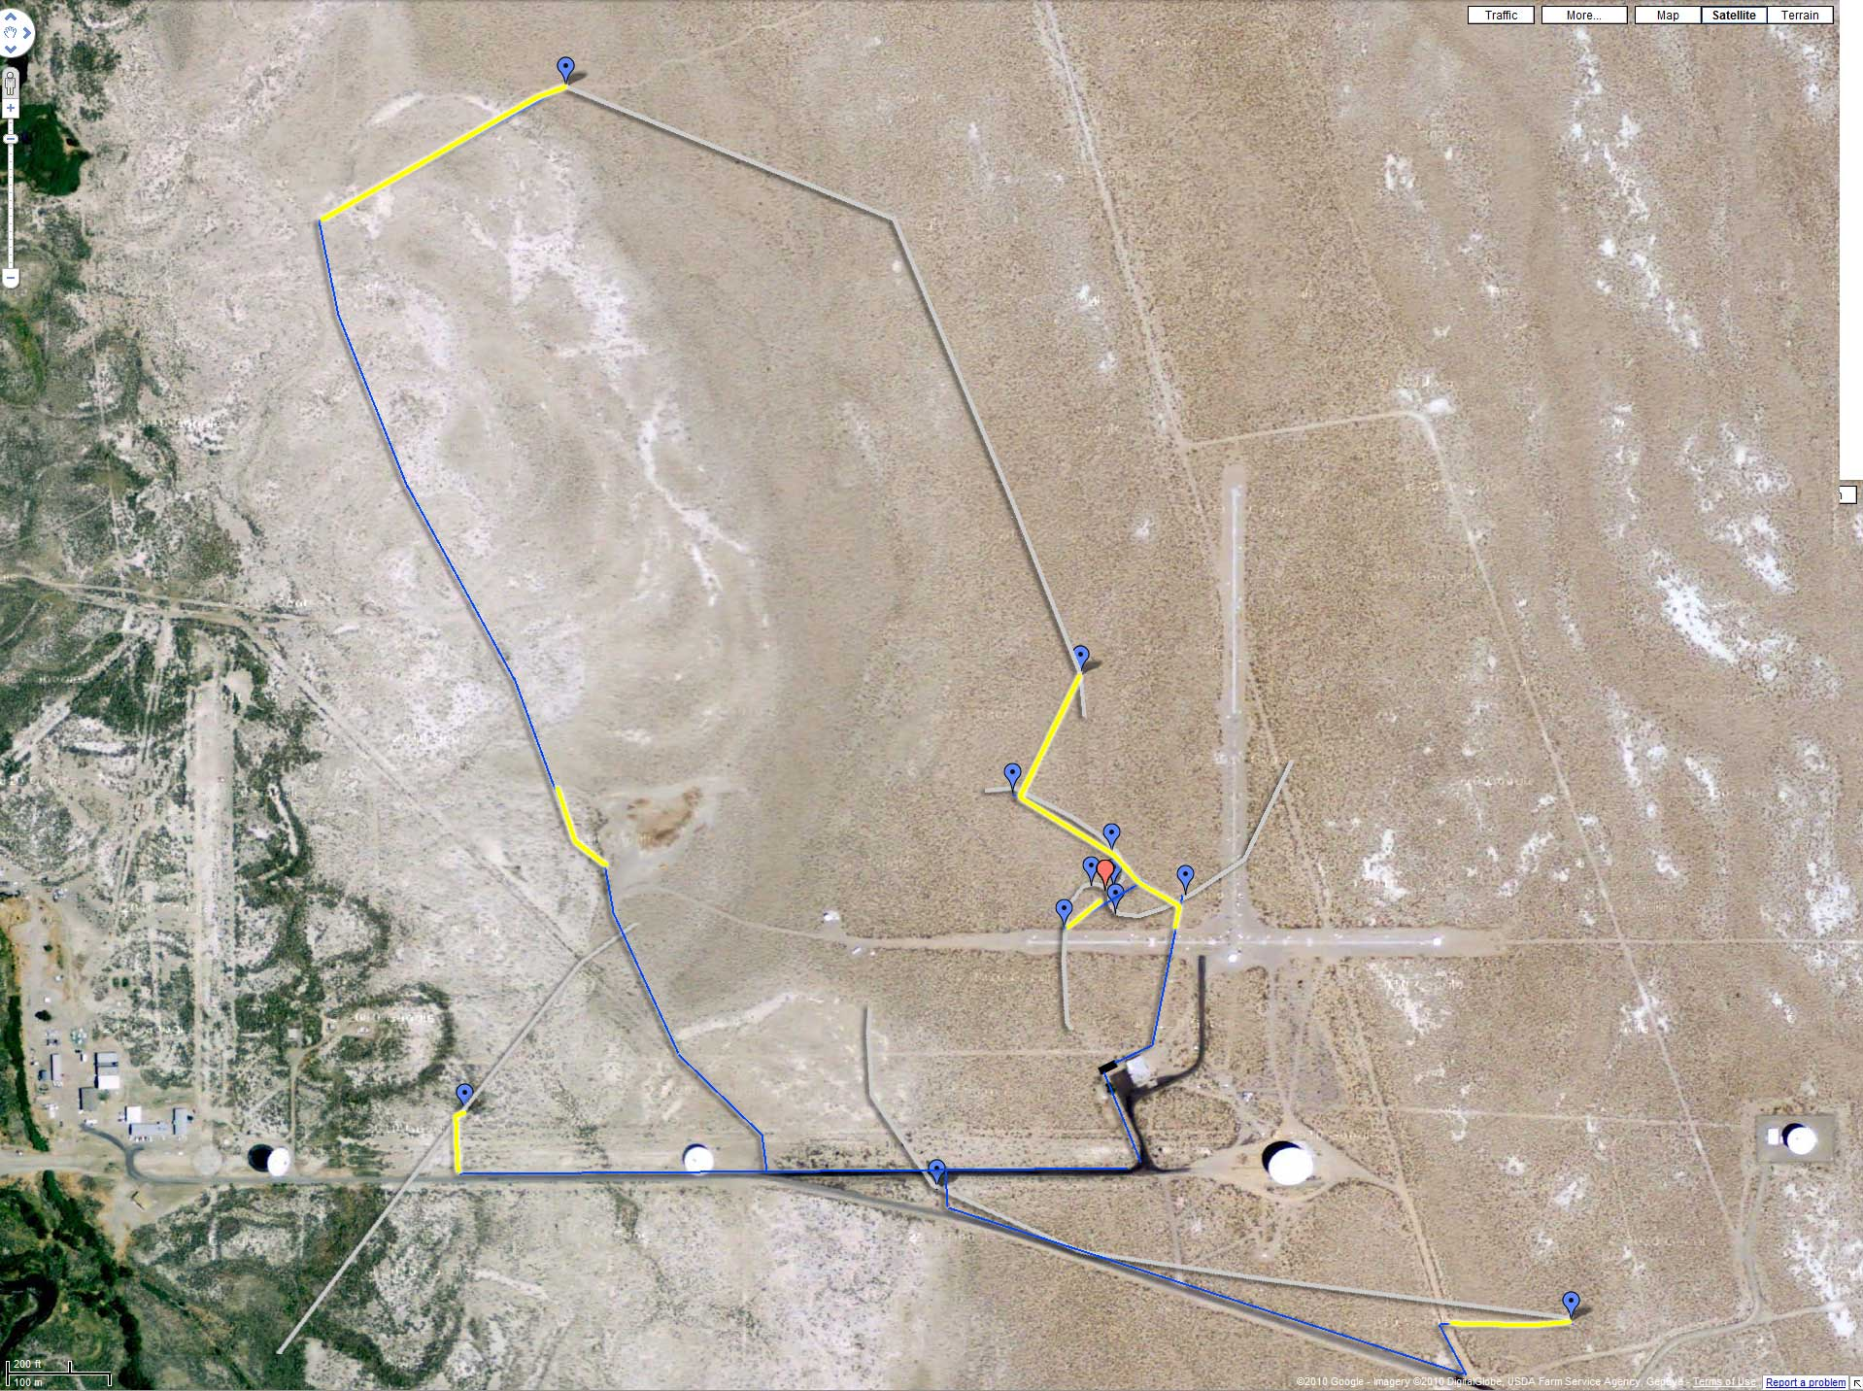
Array configuration

Slide 6
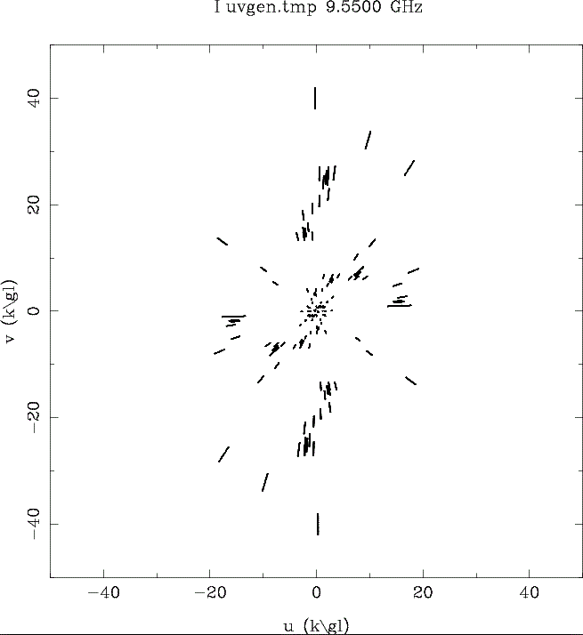
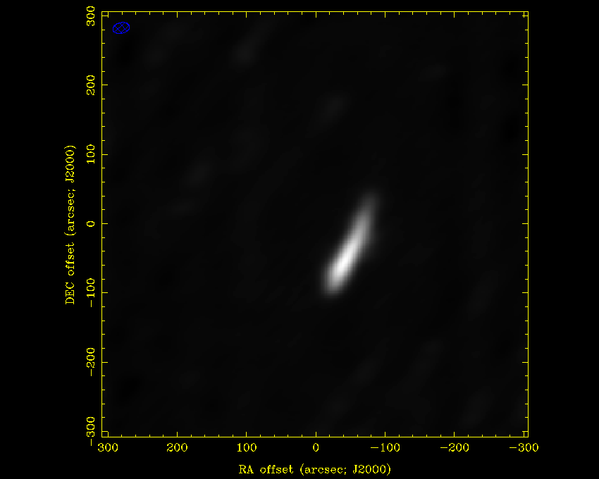
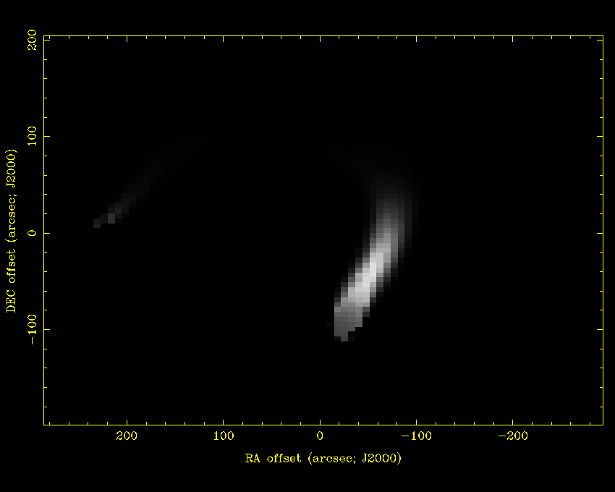
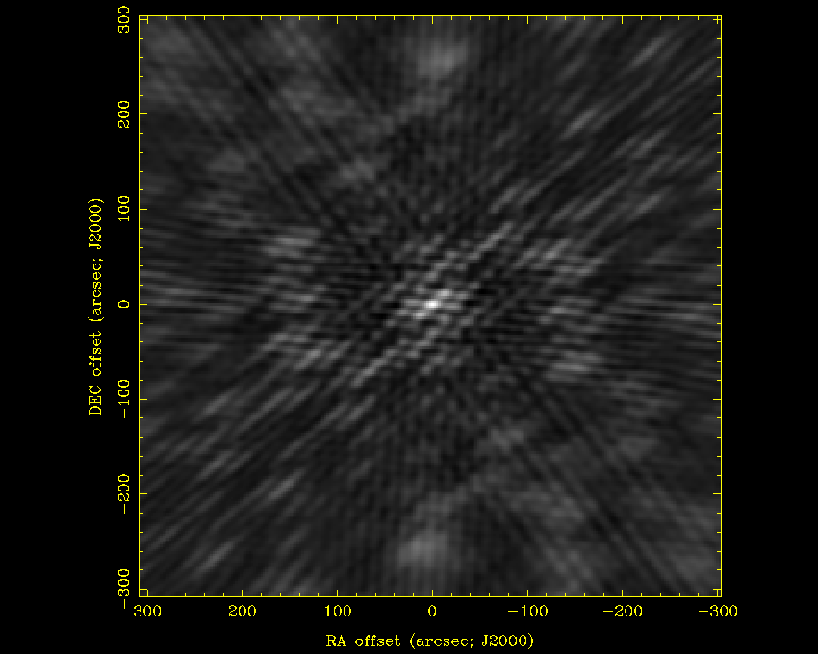
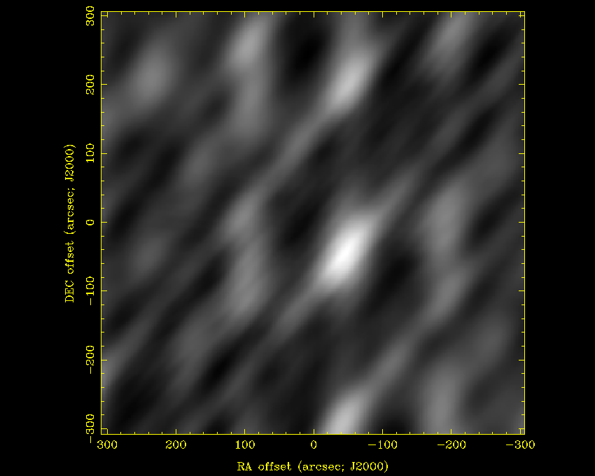
Snapshot, HA -3:30, Dec 15 deg

Slide 7
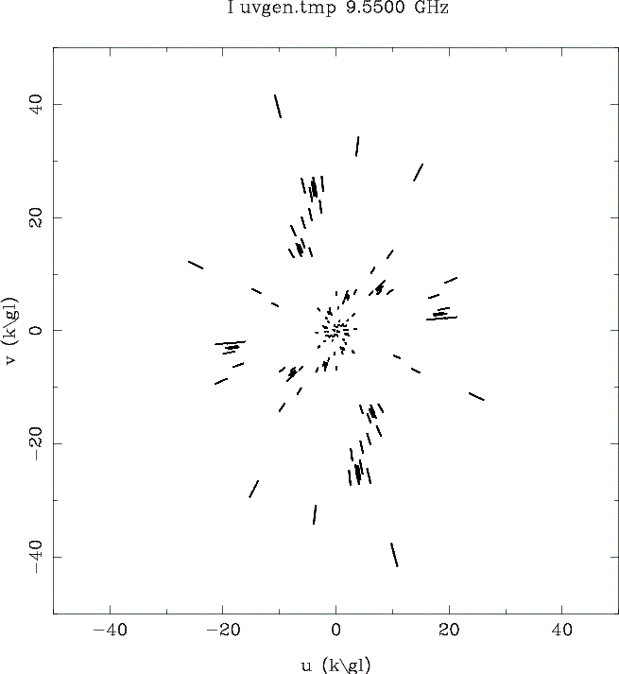
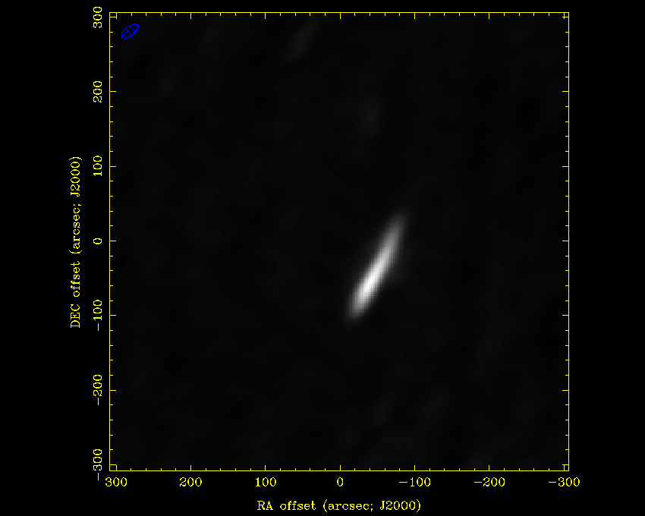
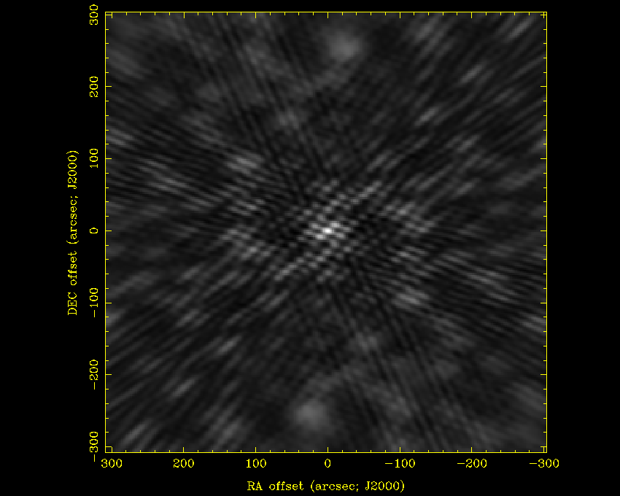
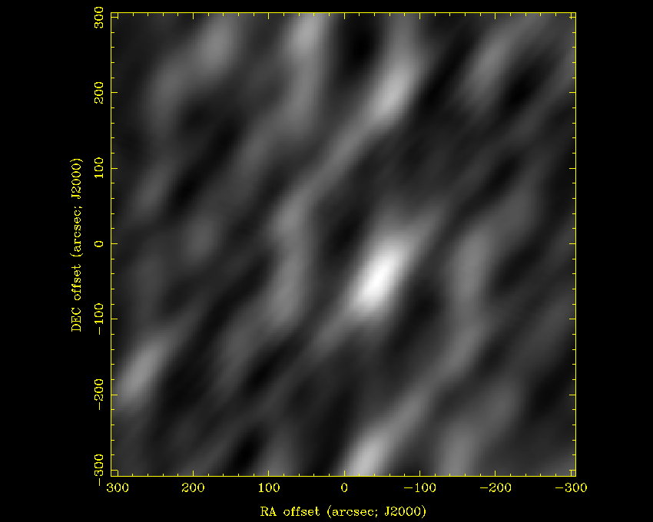
Snapshot, HA -2:30, Dec 15 deg

Slide 8
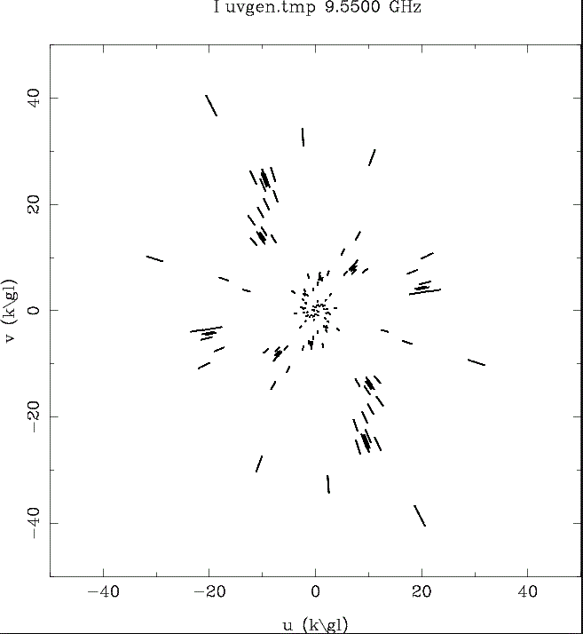
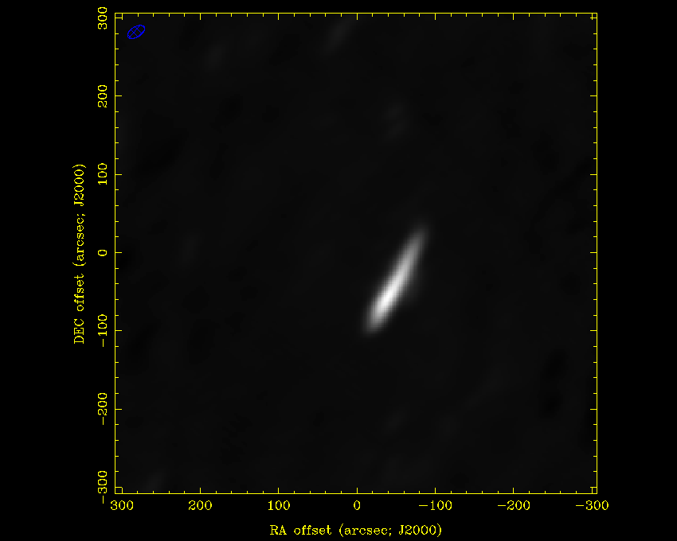
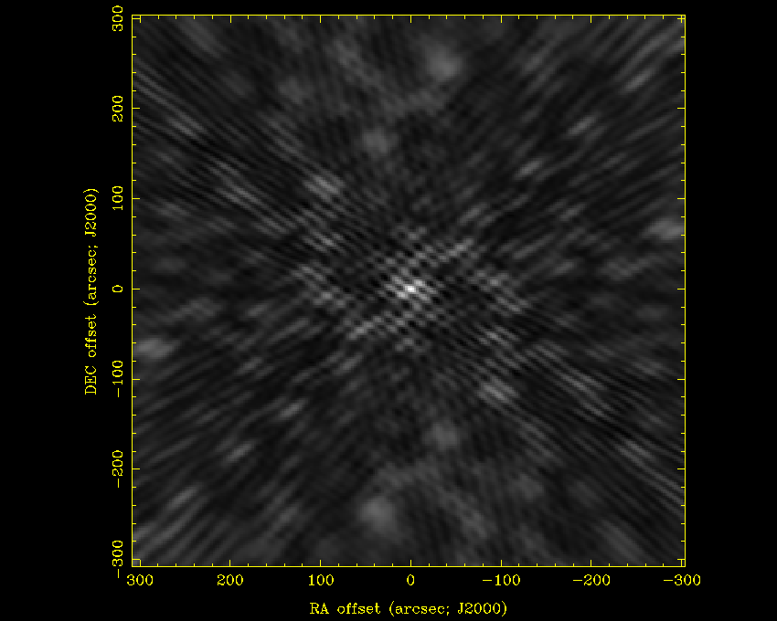
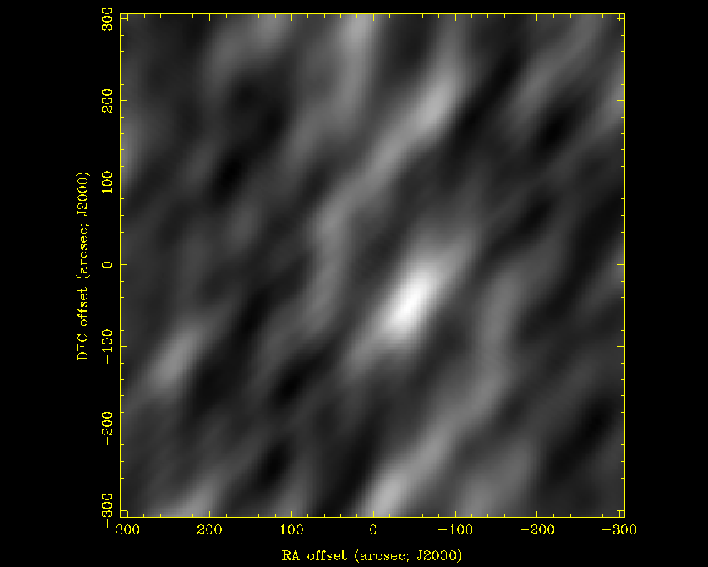
Snapshot, HA -1:30, Dec 15 deg

Slide 9
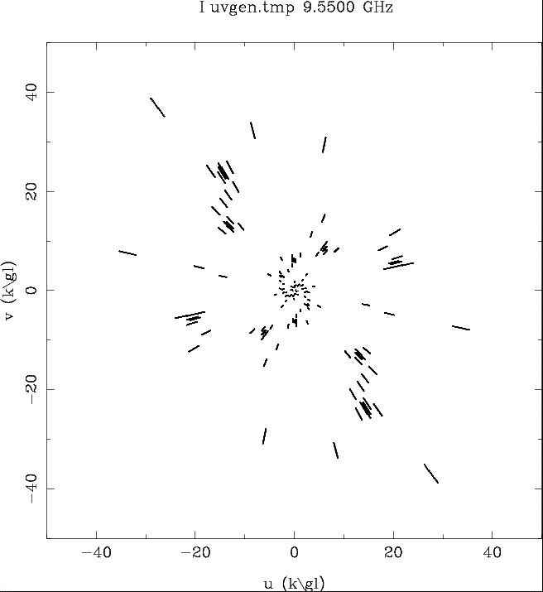

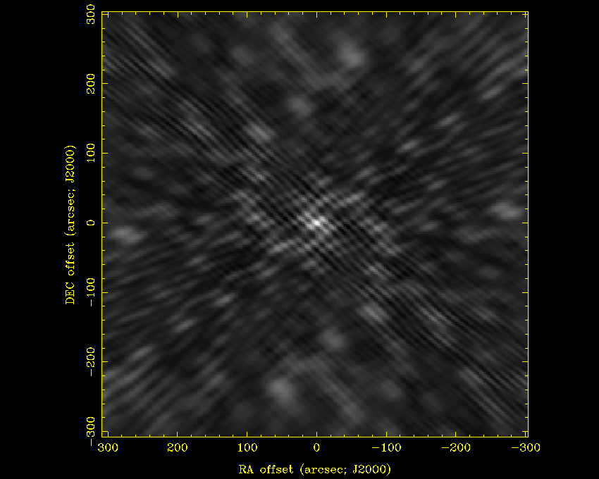
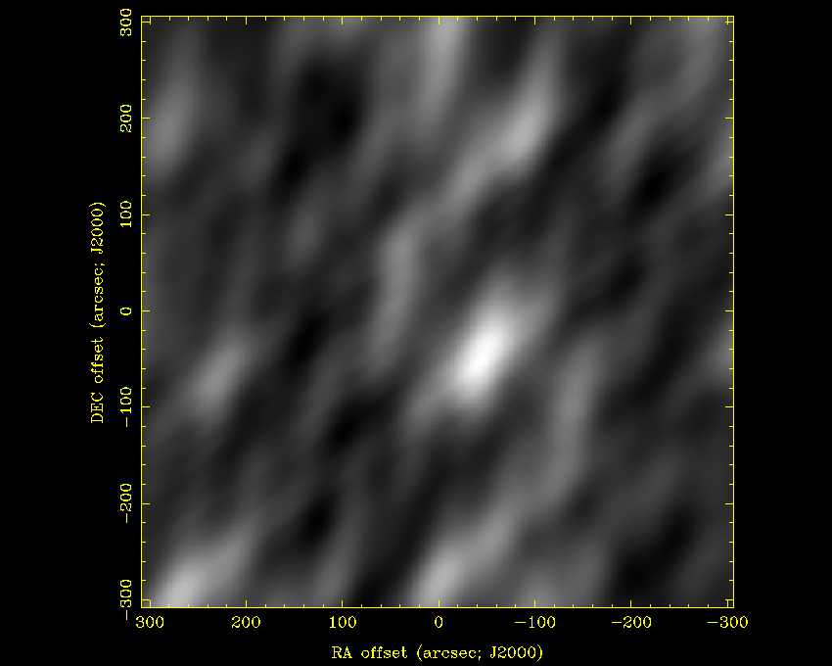
Snapshot, HA -0:30, Dec 15 deg

Slide 10
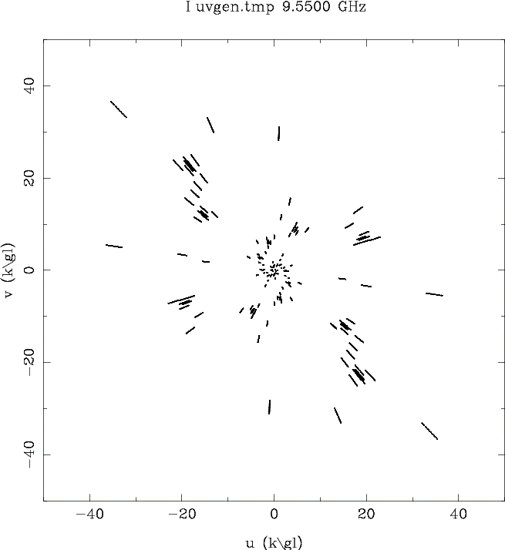
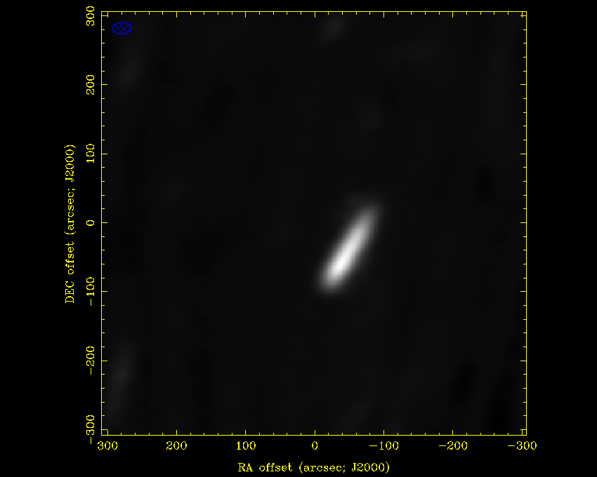
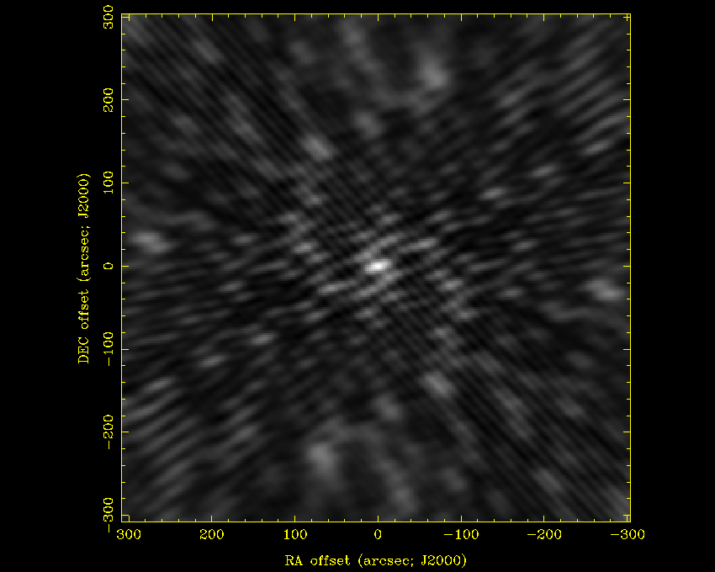
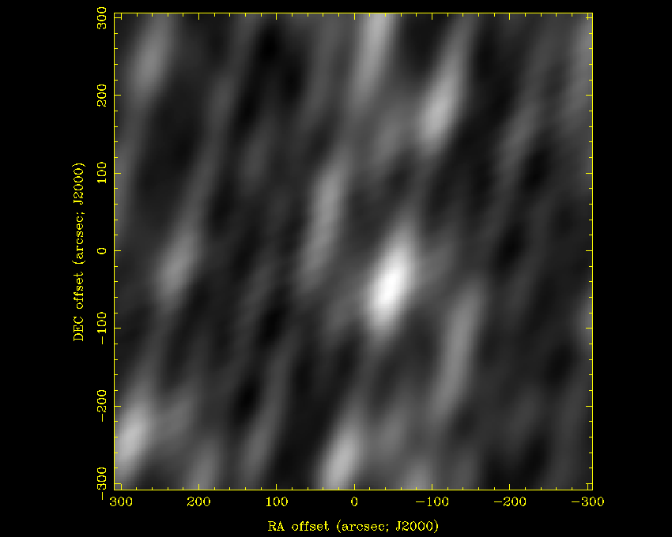
Snapshot, HA +0:30, Dec 15 deg

Slide 11
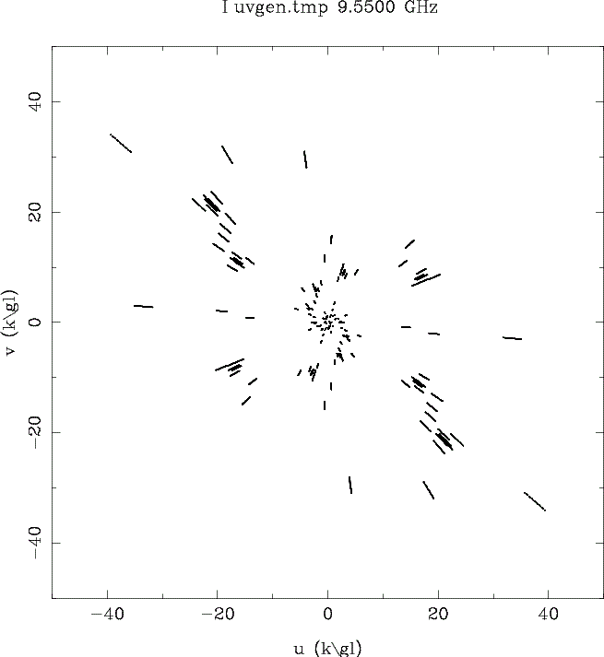
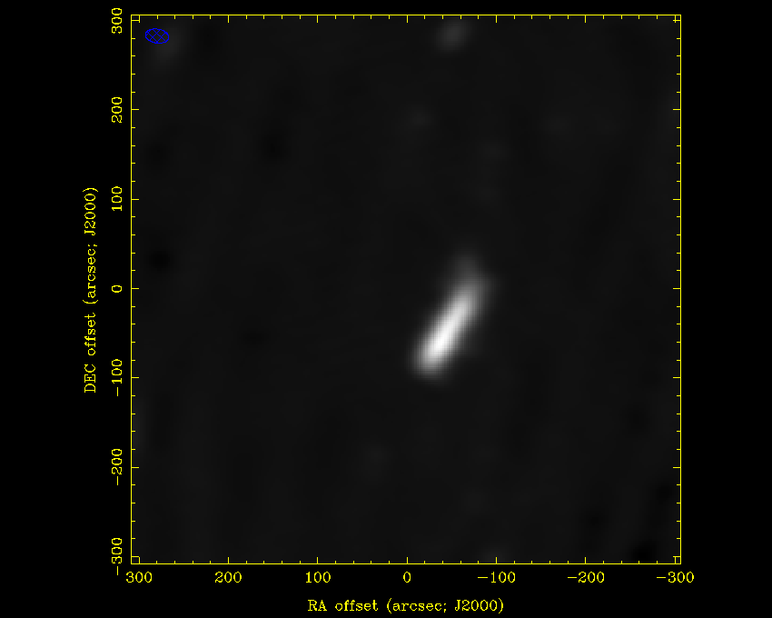
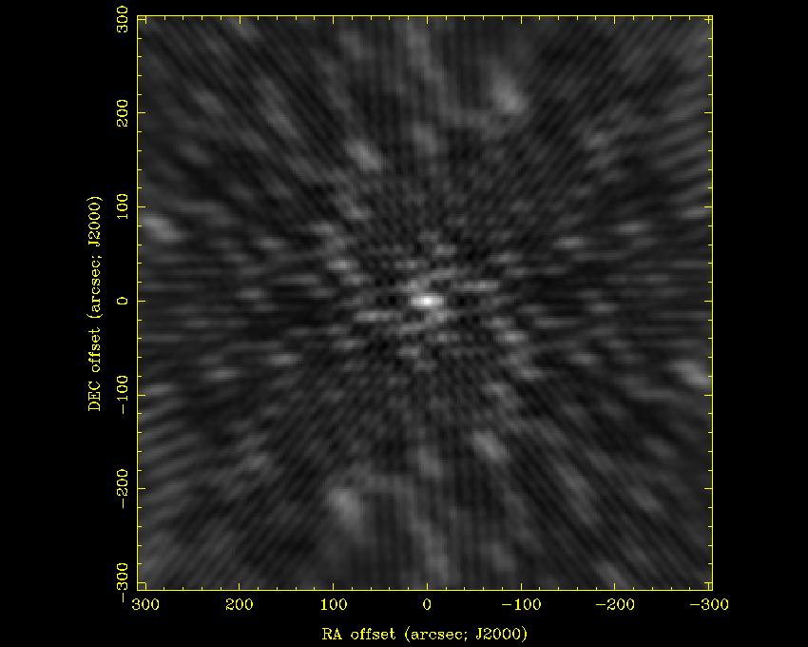
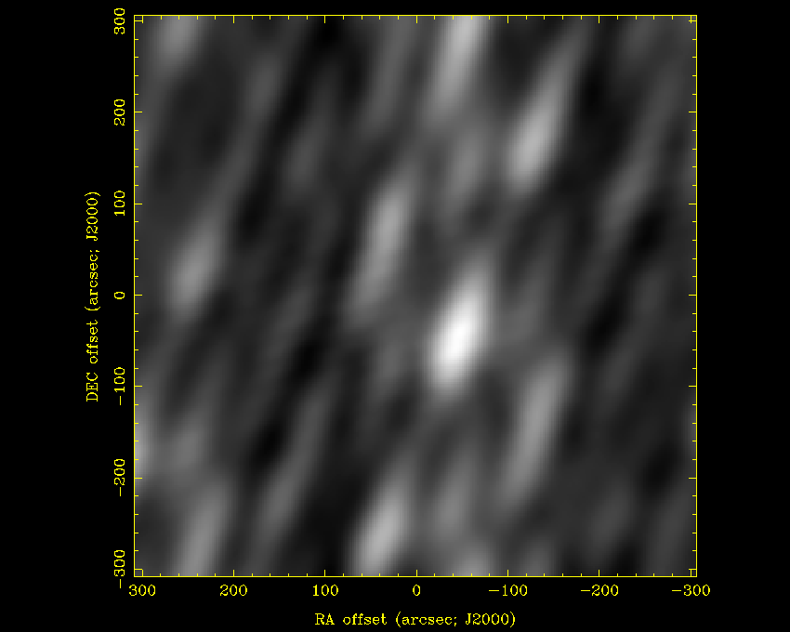
Snapshot, HA +1:30, Dec 15 deg

Slide 12
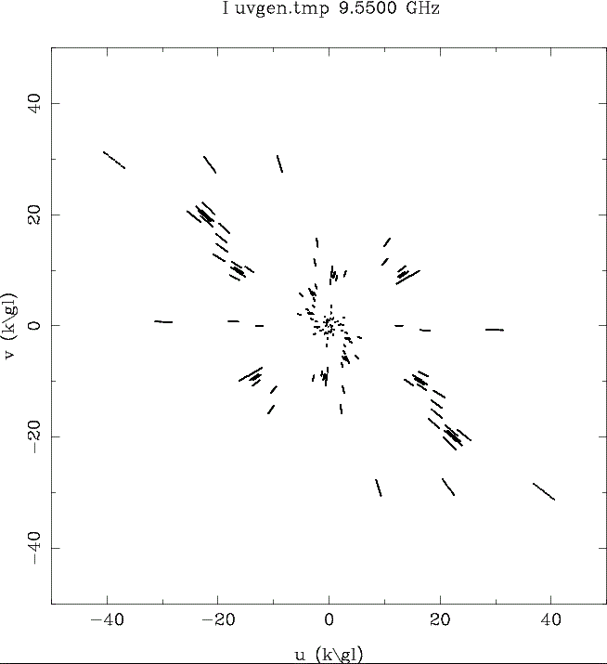
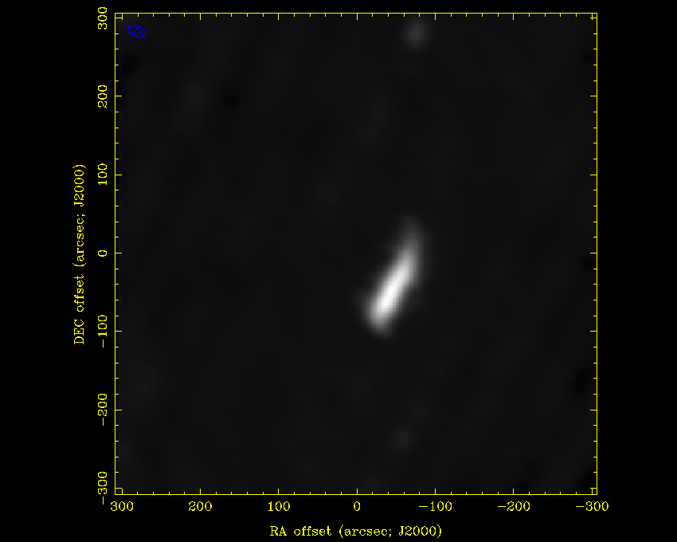
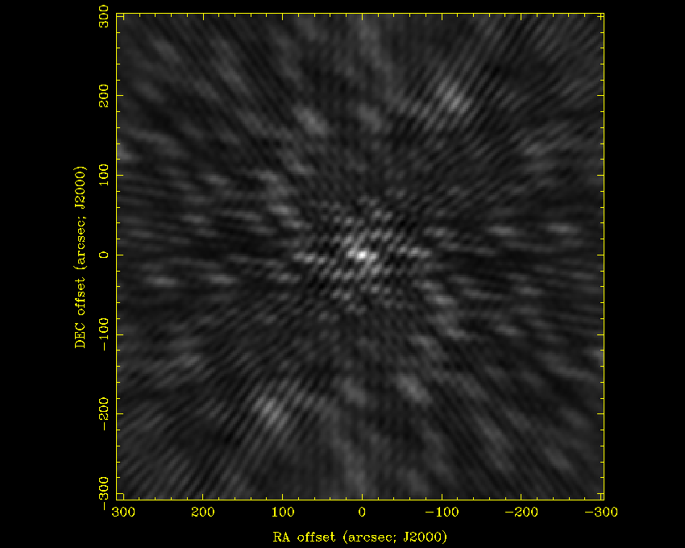
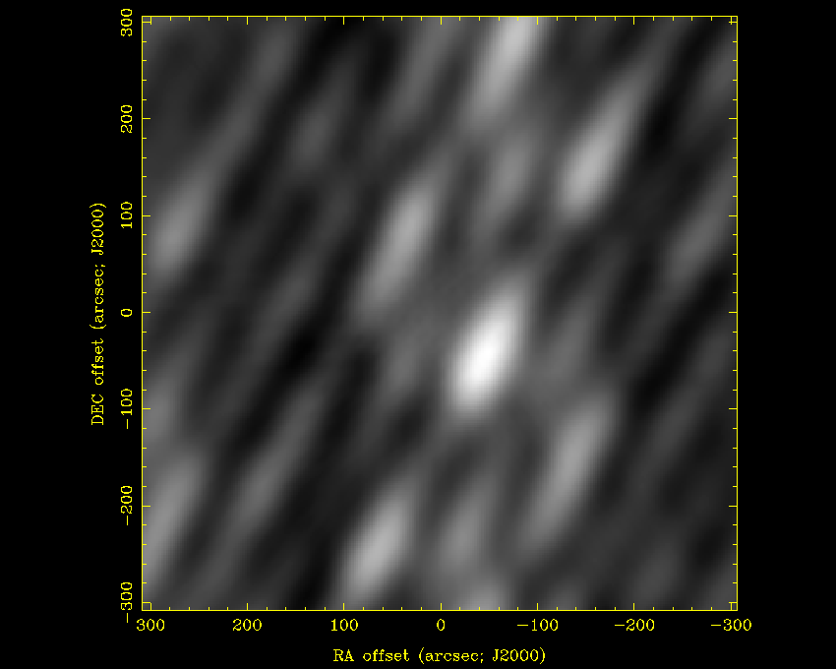
Snapshot, HA +2:30, Dec 15 deg

Slide 13
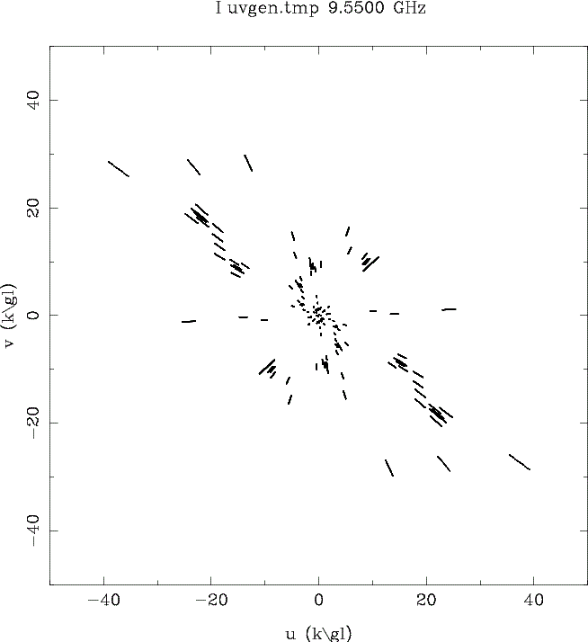
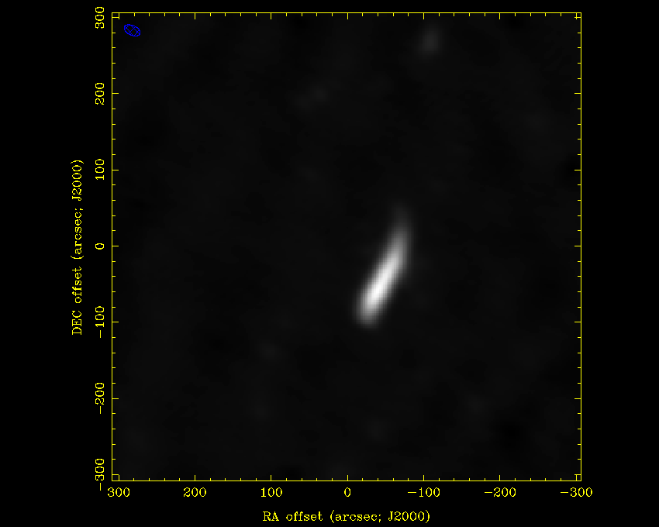
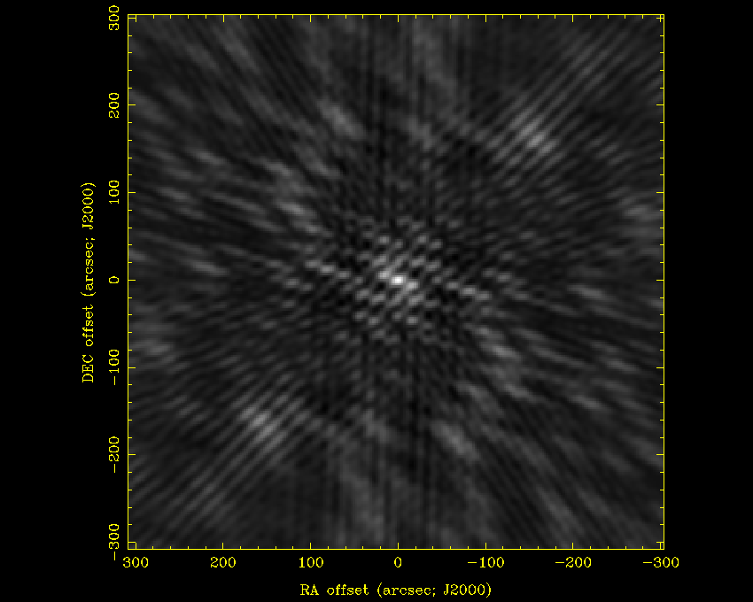
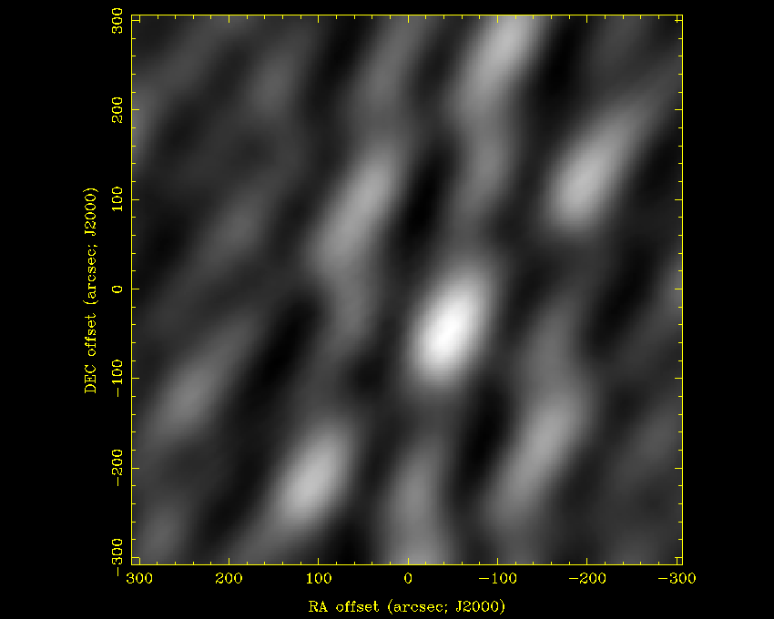
Snapshot, HA +3:30, Dec 15 deg

Slide 14
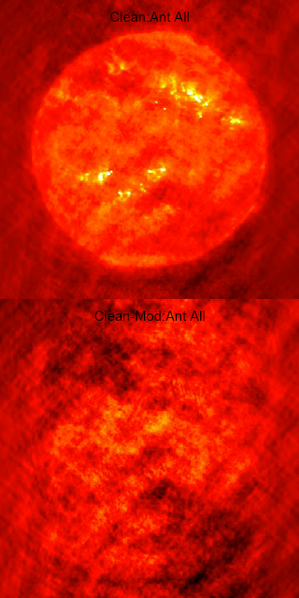
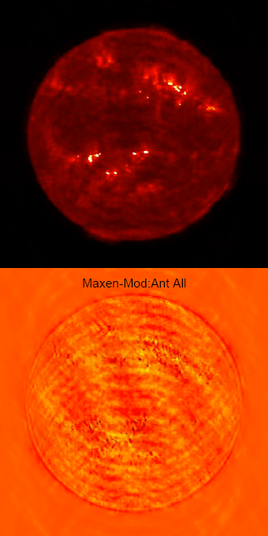
all

