Slide 1

Digital FX Correlator
EOVSA Technical Design Meeting
Nimish Sane
Center for Solar-Terrestrial Research
New Jersey Institute of Technology, Newark, NJ

Slide 2
Overview
ADC
F-Engine
X-Engine
P, P²
^{Calculation}
No. of antennas | 16
No. of polarizations | 2
No. of frequency channels (subbands) | 4096
Integration time (ms) | 20 (possibly, tunable)
IF (MHz) | 600

Slide 3
F-Engine
256 odd + 256 even channels
X0
Fix 8_7
Polyphase filter bank (PFB) – FIR - Real
FFT
Coarse Delay
X1
X7
Phase Switching
P, P² Calculation + Quantization/Scaling + Accumulation
?
DPP
F – engine : 4096 Channel
Phase Switching
Where? How: Input?
“Rate required 1.25 ms”?
Phase switching is difficult on FPGA. Dan suggests doing it before ADC, and then undoing it on FPGA.

Slide 4
F-Engine
No. channels
4096 for now
At what point do we throw 100 MHz? (≈ 672 channels)
Generating the spectral kurtosis power and power-squared in the F-engine
P (32-bit): Data rate: 819200 bytes/sec
P² (64-bit): Data rate: 1638400 bytes/sec
Total data rate per Roach board: 9830400 bytes/sec ≈ 78.6 Mbps
Use 100 Mbps link?

Slide 5
uv coverage showing the baseline lengths in nsec for a source at +30 declination

Slide 6
F-Engine
Amount of coarse delay needed
-5000 to 5000 ns (Since we can only introduce positive delays, the actual delays will be 0 to 10000 ns)
This should be possible. It may affect resource utilization, but should not be a constraint
“Correlator does all phase crrections such as fringe rotation, fine delay, as well as conversion from X, Y to R, L
How to do this?
Coarse delay on FPGA, fine delay off-line
ATA memo on fringe stopping after FFT
GMRT does fringe stopping + coarse delay + fine delay + (possibly) phase switching, but not at 600 MHz

Slide 7
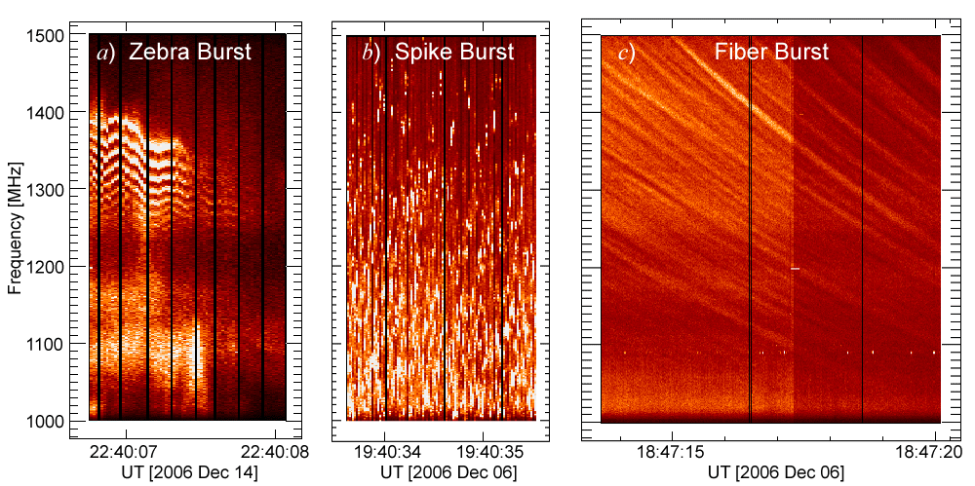
F-Engine

Slide 8
F-Engine
Issue of channel-flattening gain compensation to keep the digitized signals in a 4-bit range
It is quite easy for the Sun to produce very narrow spectral features of high intensity
These features will put the affected channels out of range for 4-bit correlation --- large corrections in software. How?
Per-channel scaling
Required for P, P², Correlation
How to determine the per-channel gain?
Transmit all gain values in the header?
4-bit correlation:
Nothing special in CASPER tutorial. Using rounding and saturate while converting data to fewer bits (and clipping data out of range)

Slide 9
Header
FST
40 bytes
Header length (1 byte)
Accumulation length (2 bytes)
Packet number within an accumulation (1 byte)
Accumulation number (4 bytes)
Delay0, Delay1, Delay2 (4 bytes each)
Gain ( 4 bytes)
FFT Shift (4 bytes)
Stokes coeff scaling, Kurtosis scaling factors (P, P²) (4 bytes each)
Additional delay3
Per-channel “gain” or scaling factor?
SPEAD protocol
Seems what we want, but have not found its implementation
Documentation on Casper Wiki

Slide 10
X-Engine
UFix M ?
Scaling and Quantization
Correlation
Complex Multipliers = 480
Vector Accumulation
Fix N_3 ?
(64)
(960)
X – Unit
Each Roach board will have 1 X-unit, and each X-unit will handle 4096/8 = 512 frequency channels (256 even and 256 odd channels)
No. of complex multipliers in each X-unit correlator block
= No. of visibilities x No. of polarizations x Simultaneous even and odd channels per F-unit
= 120 x 2 x 2 = 480

Slide 11
X-Engine
F, X on FPGA
No GPU
Current state of art:
F and X engines on different boards
F + X on the same board: (1) Can we fit the design? (2) Can F + X work in tandem?
Use full-duplex bidirectional capacity of 10 GbE link: Send output of F – engine to a switch that will distribute it to X – engines (even if F and X are on the same board)

Slide 12
X-Engine
No. of F-engines per Roach board = 4 (2 antennas dual polarization)
Output of an F-engine: Complex (even and odd channels), each with 18-bit real and 18-bit imaginary; Output data of F-engines per Roach board per FPGA clock cycle = 72 x 4 bits
Total data rate out of F-engines per Roach board = 72 x 4 x 300 x 10⁶ = 86.4 Gbps (for 300 MHz FPGA clock)
Data rate from F-Engine to 1 X-engine = 10.8 Gbps
Roach2 supports 8 x 10 GbE ports. So this will not be possible.
If we only transmit 3424 channels (~ 500 MHz band) to X-engine, then total data rate out of F-engines per Roach board = 86.4 x 10⁹ x 1712 / 2048 = 72.225 Gbps
Data rate from F-Engine to 1 X-engine = 9.03 Gbps
Plus header information.
Should we employ scaling/quantization in F-engine and transmit just 8-bit complex number (4-bit real and imaginary) to X-engines? This will reduce data rates by a factor of 18x
For X – engine: (input) M = ? 36 or 8
For X – engine: (output) N = ?
Accumulation length (for 20 ms, 300 MHz clock, 256 channels) = 23437 < 2¹⁵
N ≥ 19
X-unit output data per integration = 480 x 2 x 256 x 19 bits = 4669440 bits
Total data rate at the output of X-unit per Roach board = 983040 x 50 = 233.472 Mbps (assuming integration time of 20 ms)

Slide 13
F and X-engine Connections
What happens when a signal exceeds the 4-bit quantization?
Data is lost.
Dale: We may be better off scaling for 3 bits and leaving at least 1 bit of headroom. At least the Van Vleck correction can apply to fewer bits, and while we lose efficiency we do not lose the data itself.
We may also need to figure out how to detect when channels are clipping
some sort of statistical measure: Gelu?

Slide 14
General Comments/Issues
Synchronization with external clock
“No need for solar or geometrical coordinates. Only delay (sum of delay center and geometric delay) and delay rate information is needed for corrections. What update rate is necessary?” (?)
“Need to set sign convention in correlator to make u, v come out in standard way.” (?)
Open question: “Should the subchannel have simple bandwidths (e.g. 0.5 MHz by setting clock speed appropriately)?”

Slide 15
References
https://casper.berkeley.edu/wiki/ROACH2
P. McMahon, et al. “CASPER Memo 017: Packetized FX Correlator Architectures,” September 2007.

