Slide 1
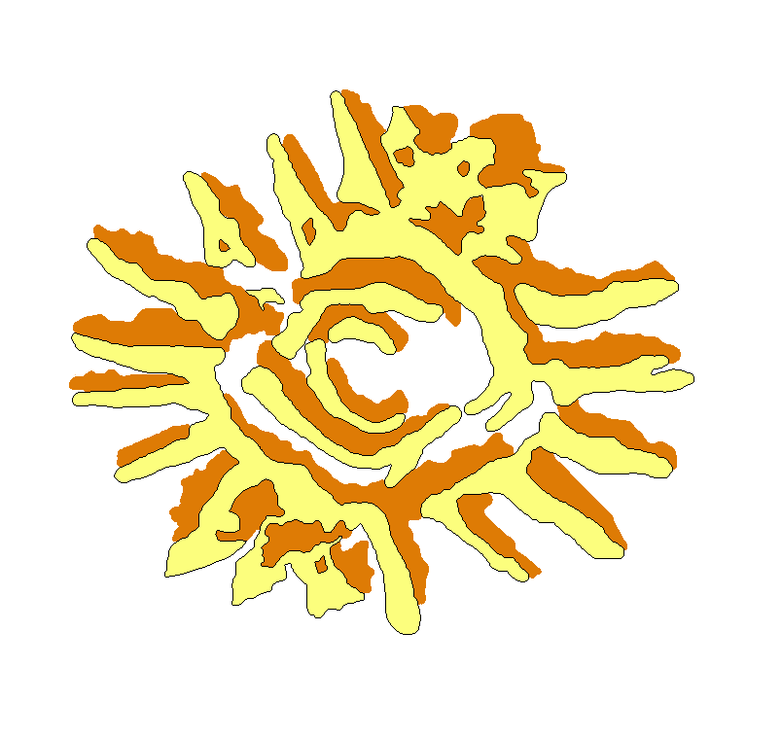
EOVSA ANTENNAS and Controllers
Dale E. Gary
Professor, Physics, Center for Solar-Terrestrial Research
New Jersey Institute of Technology

Slide 2
outline
27-m Antenna Summary
2.1-m Antenna Summary
Array Considerations
Controllers
Feed/Polarization Issue

Slide 3
27-M antenna summary
Refurbishment is going well, and involves replacement of motors, encoders, limit-switch system, all new wiring, and of course installation of new, smart controllers (described shortly). Completion of this work should be as soon as end of April, 2012. Rework of the power to the antennas is also planned.
Work has been done and will continue on evaluation of the mechanical state of the antennas, but due to budget constraints we may not be able to act on the findings any time soon.
Cryogenic infrastructure (compressor, helium lines) will be installed during 2012 (no schedule yet).
Holography and panel adjustment is likely to be necessary, but will have to await installation of the feed and focus electronics, so will be done very near (or after) the end of construction.
We hope to be able to clean up and repaint them, but this depends on the budget constraints as well, and the outcome of the testing.

Slide 4
2.1-m antennas
Six of the eight new antennas are already delivered, with the remaining ones to arrive in a few weeks. These are all equipped with the smart controllers. These dishes have elevation limits 10-88 degrees.
Optical pointing measurements were done with one of the new antennas (next slide)
We still hope and plan to replace the remaining five older, equatorially-mounted dishes with new ones, but this will require $300 k that must be applied for separately. Will discuss these efforts later.
If we must use the existing antennas, then we need to design our own controllers to look and act like the new controllers. Some work in this direction has already begun. We also would like to add the same reflectors as the new antennas. Cost per antenna for full upgrade:
$9500 for new reflector
$4500 for new Heidenhain encoders
$1100 for encoder interface
$3000 for controller parts (guesstimate)
Lots of labor for design work

Slide 5
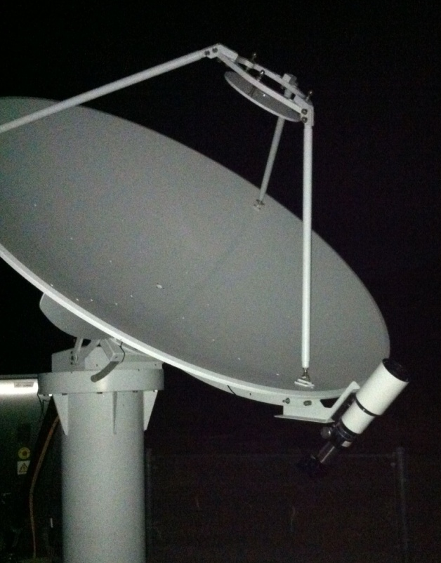
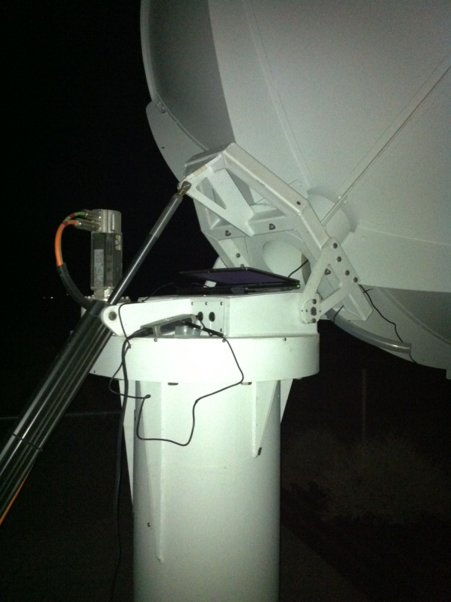
Setup/software
Described in OpticalStarPointing.doc:
from Coordinates import *
from datime import *
from readbsc import *
num, ra, dec, mag = readbsc()
lla = Coordinates(Dec_Angle(-118.284846,'degrees'), Dec_Angle(37.233839,'degrees'), Length(1200.))
d = datime(dt.datetime(2012,1,8,23,22)) # Edit for desired start date/time
ids = selectbsc(d, num, ra, dec, mag, [5.2,5.3], lla)
names = getbscnames(num[ids])
startracktable(d, names, num[ids], ra[ids], dec[ids], mag[ids], lla)

Slide 6
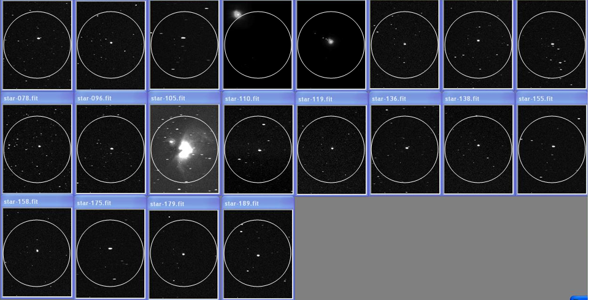
Optical pointing after correction
RMS residual was 0.012 degree, or 43”,
compared to spec of 0.020 degree.

Slide 7
Radio pointing as a function of freq
The beam pattern of the wide-band feeds on the 2.1-m antennas cannot be precisely controlled at all frequencies, and we have evidence from OVSA that the pointing can vary significantly with frequency.
We have a radio-pointing calibration procedure that scans the Sun in two directions and fits the primary beam for position and beam-width as a function of frequency. This will be affected by solar features, so we need to make this measurement with a reasonably quiet, clear Sun.
The nominal pointing parameters will be those that point the dishes at some suitably weighted location, probably favoring high frequencies where the pointing is most critical.
The beam width will be very different for linear vs. circular polarization, with linear showing a rather elliptical beam.

Slide 8
Antenna controllers
The new 2.1-m dishes and the 27-m dishes will use the same basic control system, except that the small dishes have a native Alt-Az drive system while the 27-m antennas are equatorial. However, even this difference is relatively minor because the controller has both Alt-Az and Equatorial modes for providing coordinate tables.
We will place cRIO real-time controller systems in each controller box, which will close the fast loops at the antenna. These cRIOs will allow the interface to the old dishes (if needed) to look like that for the new controllers. The cRIOs will also control front end switching (ND, attenuator) accurately with respect to the 1 s tick, and will monitor both antenna and front end state.
Some details of the control of the front end still remain to be worked out, because Wes is planning to use an embedded processor in the front end with ethernet link to the cRIO (to avoid having too many wires—an alternative is a serial link.

Slide 9
Impact of dissimilar antennas
The fact that we may have to use different styles of 2.1-m antennas has some significant drawbacks:
Some linear feeds will rotate wrt others=>need for phase correction (for parallactic angle changes) and added complexity in polarization calibration (note that with 8 and 5 antennas in the two types, 40 of the 78 baselines are compromised)
Restricted sky coverage for the five older dishes (limited to ±4 h in HA and < +45 Dec) amounts to loss of 32% of time on the Sun, integrated over the year, and reduced overlap with Europe and Asia
If, as planned, we place the older antennas in the outer stations, the times of restricted coverage will give much-reduced spatial resolution (dropping from 13 to 8 antennas means going from 78 to 28 baselines)
A uniform array yields other benefits, such as easier maintenance (less downtime), better calibration, a simpler, more robust control system, and less complicated analysis software.
We definitely want to replace the older antennas with new ones, so I will be seeking either DURIP or NSF ATI funds for this purpose.

Slide 10
Feeds and polarization
The 2.1-m antennas will use the Tecom log-periodic, dual linear feed (need to decide on orientation of hands—parallel and perpendicular to horizon, or at 45 degrees?)
The new and old antennas will suffer differential rotation of the feeds, and even if we do manage to buy all new antennas their feeds will rotate wrt to the 27-m antennas
An Australia Telescope memo describes a procedure for measuring leakage and gain parameters for such a crossed-linear feed, but relies on rotation of the linear feed angle wrt the sky. The feeds on the old 2.1-m and the 27-m antennas will not rotate wrt the sky. We need to go through the description in the AT memo and see what parameters can and cannot be measured if the feed angle does not rotate. A feed rotator mechanism would be required on the 27-m antennas if rotation is critically needed.
The 27-m antennas will use dual linear feed horns (two horns of overlapping bands with about 6:1 frequency ratio). This dissimilarity of feeds between the 2.1-m and 27-m antennas should not cause a problem given a correct polarization calibration procedure, because the gains and leakage terms can be determined in antenna-based form.

