Slide 1

EOVSA CAlibration
Dale E. Gary
Professor, Physics, Center for Solar-Terrestrial Research
New Jersey Institute of Technology

Slide 2
outline
Calibration Task List
Antenna pointing calibrations
Delay calibrations
Full array delays wrt 27-m antennas
Single antenna delay wrt 27-m antennas
Full array delays on Sun
Bandpass calibration
Reference complex gain calibration
Daily phase calibration
Gain/attenuator/linearity calibration (TBD)
Polarization calibration (TBD)
RFI identification (TBD)
Total power absolute calibration on Moon/Cas A

Slide 3
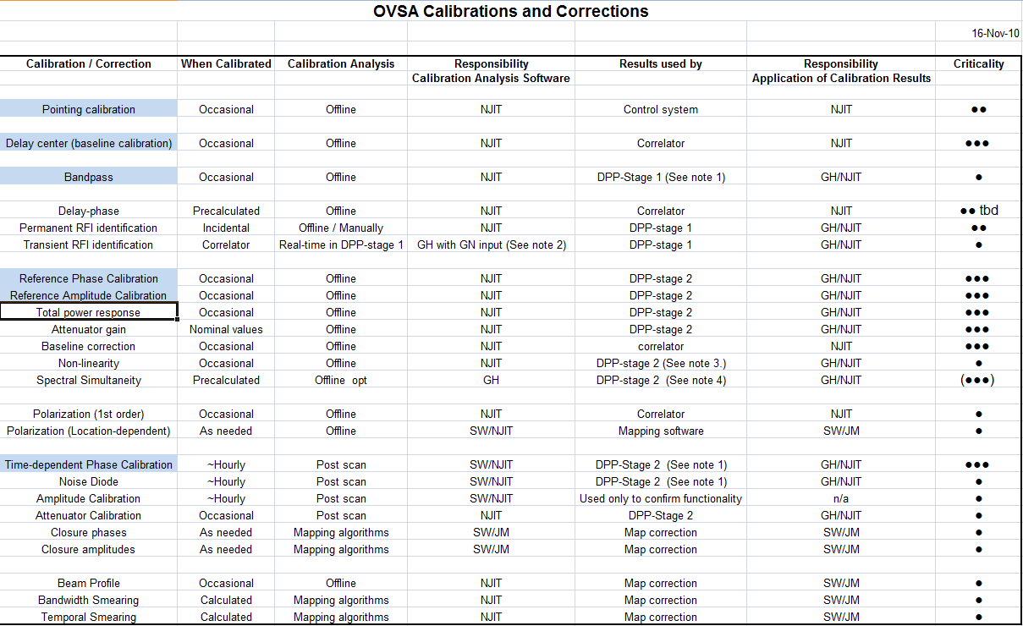
New 2-m antennas
See CalibrationSummary.xls

Slide 4
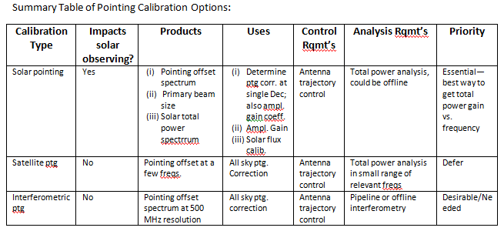
Pointing calibrations
See EOVSA_Calibration.doc

Slide 5
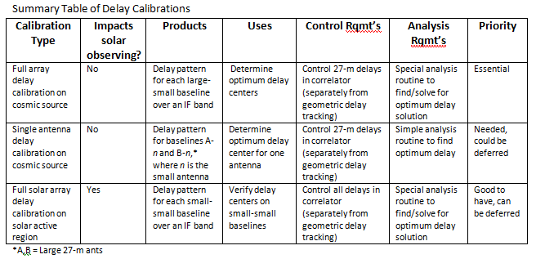
Delay calibrations

Slide 6
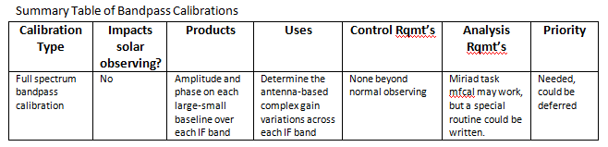
Bandpass calibration

Slide 7
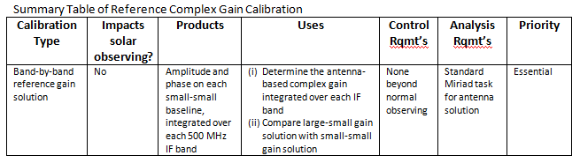
Reference complex gain calibration

Slide 8
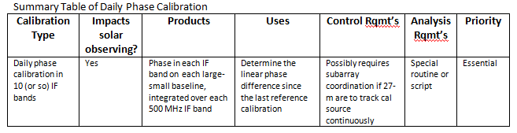
Daily phase calibration

Slide 9
Gain/attenuator/linearity calib.

Slide 10
Polarization calibration

Slide 11
Rfi identification

