Slide 1
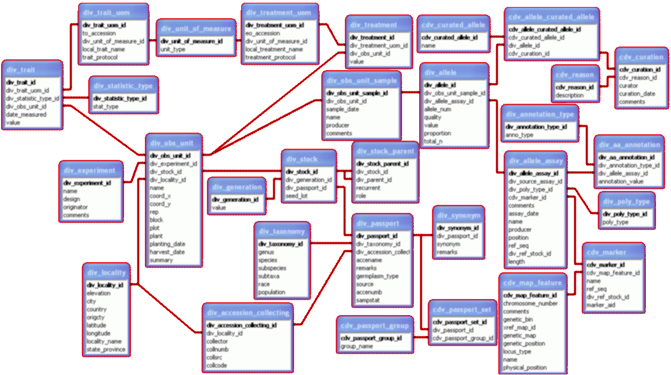
EOVSA Prototype Review
MONITOR DATABASE
GIL JEFFER

Slide 2
INTRO
Brand new to your domain, it’s a learning event for me.
      I’ve read the 2004 CARMA document
      Dale answered high-level questions
At this point, I can’t offer much in the way of specifics.
Yesterday’s meeting served as a welcome introduction.
I saw color-coded slides to show status; so I’ll do the same.
Black indicates “Yet to be started”

Slide 3
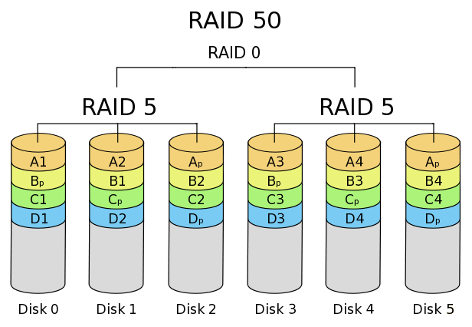
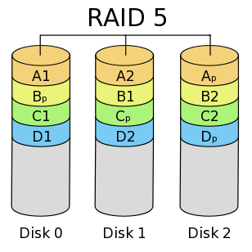
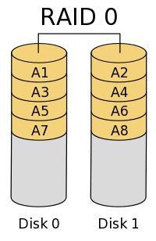
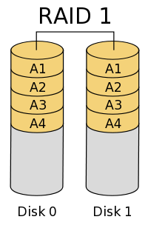
HARDWARE
Minimum…
Multicore server with plenty of memory (12 GB+).
RAID 5/50/10 disk subsystem for database storage.
RAID 0 disk subsystem for volatile TempDB.
  (memory and fast disk more important than fast CPU)
Downsides…
No redundancy except for disk subsystem.
Any maintenance / failure takes the system offline.
RAID 50
RAID 0

Slide 4

HARDWARE
Better…
Two near-identical systems.
Linked with dedicated 1 GBe crossover cable to ports.
Set up as SQL Replication between systems.
Advantages…
Full hardware redundancy.
Can set up Fallover Cluster; automatic switch on failure.
Distribute loading (collection on one, reporting on other).
Effectively serves are real-time database backup.

Slide 5
DESIGN
Not Quite Yet!…
Need to study data schema (structure) first.
Need to determine in what way it will be interrogated.
  In a way, need to see both ends to design the middle.
Feeding the database…
Can accept many data types (text, binary, XML, etc).
Set up parent/child relational hierarchies (settings/data).
Primary keys to relate tables, records carry timestamps.
Insert (instead of) triggers can help handle processing.
Programming language…
Transact-SQL built into database engine.
Used for ad-hoc queries, triggers, stored procedures, etc.

Slide 6
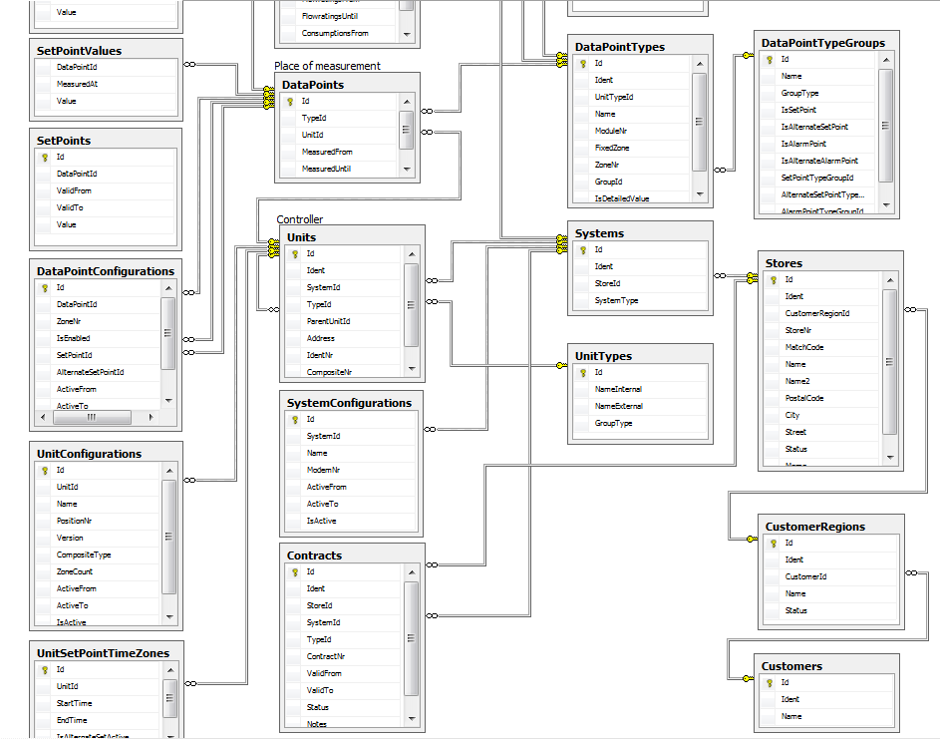
DESIGN

Slide 7
REPORTING
Accessing the database externally…
Create executables in most any programming language.
    Tabular reports or graphics using any tool/language.
Create web applications
    Get data, build in browser
    Build on server, deliver to browser
      Often determined by which pushes less data across
Reporting tool built into SQL Server…
SQL Reporting Services used to build web-based reports.
Includes tools for tabular, graphic, or gauge reports.
End-user can select data sources, date ranges, etc.
Some examples (from NJIT’s Antarctic AGO stations)…

Slide 8
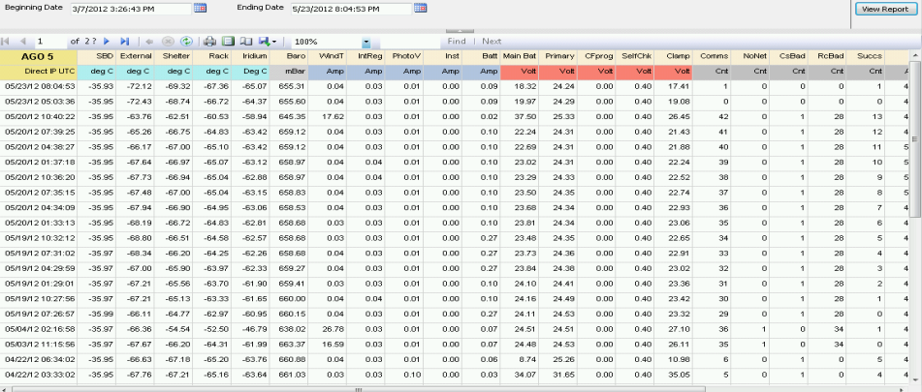
TABULAR: RptSvcs
Reporting Services…
Builds report on server, delivers it to end-user.
Does not require end-user to download a web app.

Slide 9
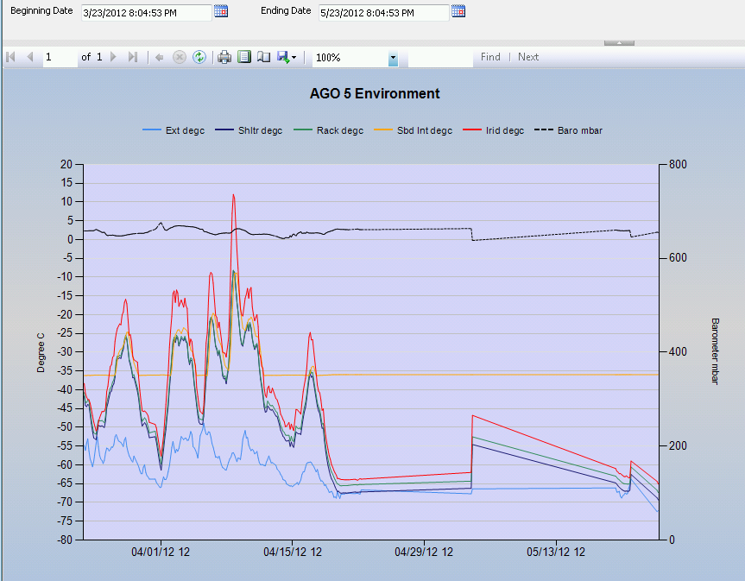
GRAPHICS: RptSvcs

Slide 10
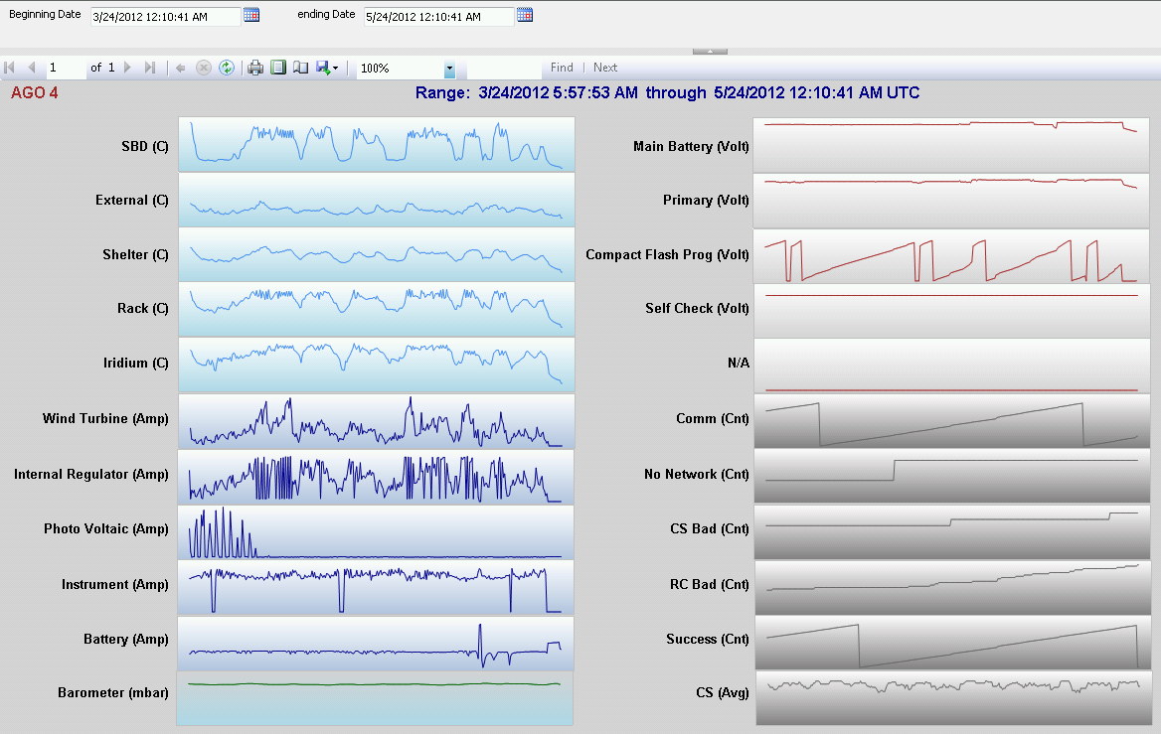
SPARKLINES: RptSvcs

Slide 11
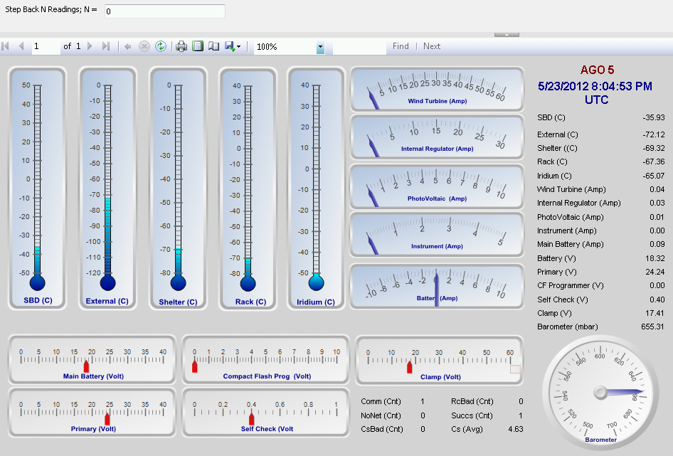
GAUGES: RptSvcs

