Slide 1

EOVSA timing sychronization
Dale E. Gary
Professor, Physics, Center for Solar-Terrestrial Research
New Jersey Institute of Technology

Slide 2
outline
Timing Specifications
SRS Rubidium Clock
GPS Clock
Timing Distribution—NTP
Synchronization—1 PPS
Timestamps and State Frame

Slide 3
Timing specifications
The technology exists to essentially eliminate timing inaccuracies to much better than a ms, system-wide, and EOVSA’s timing system should be designed to take advantage of it.
If we assume a goal of 1 ms “dead-time” between tunings, we will need to control system timing to better than this—suggest 100 us as a specification for tuning synchronization.
This will require distributing a timing pulse, which we will specify at 1 PPS. This is conveniently available from GPS clocks and the Stanford Research Systems Rubidium Clock.
All other timing should be derived from this 1 PPS timing pulse, with time-of-day information distributed via NTP (Network Time Protocol).
Most systems can get their time-of-day information from the current State Frame, with the timestamp of the State Frame being written by the real-time control system.

Slide 4
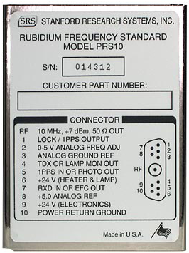
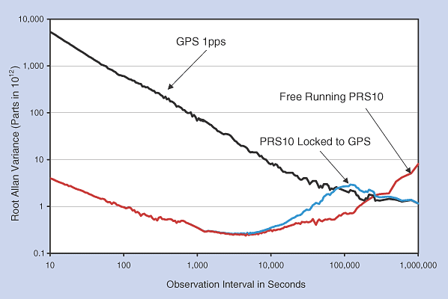
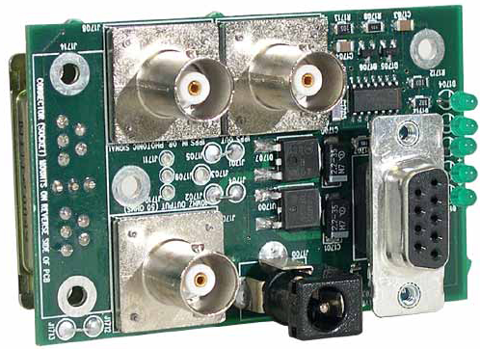
Srs prs10 rubidium Clock
The Stanford Research Systems PRS10 Rubidium Frequency Standard will be the heart of the timing system (because we already have one).
It can produce both a 1 PPS output and a 10 MHz stable reference frequency. It can phase lock to a GPS-derived 1 PPS for long-term stability and accuracy to 1 ns.

Slide 5
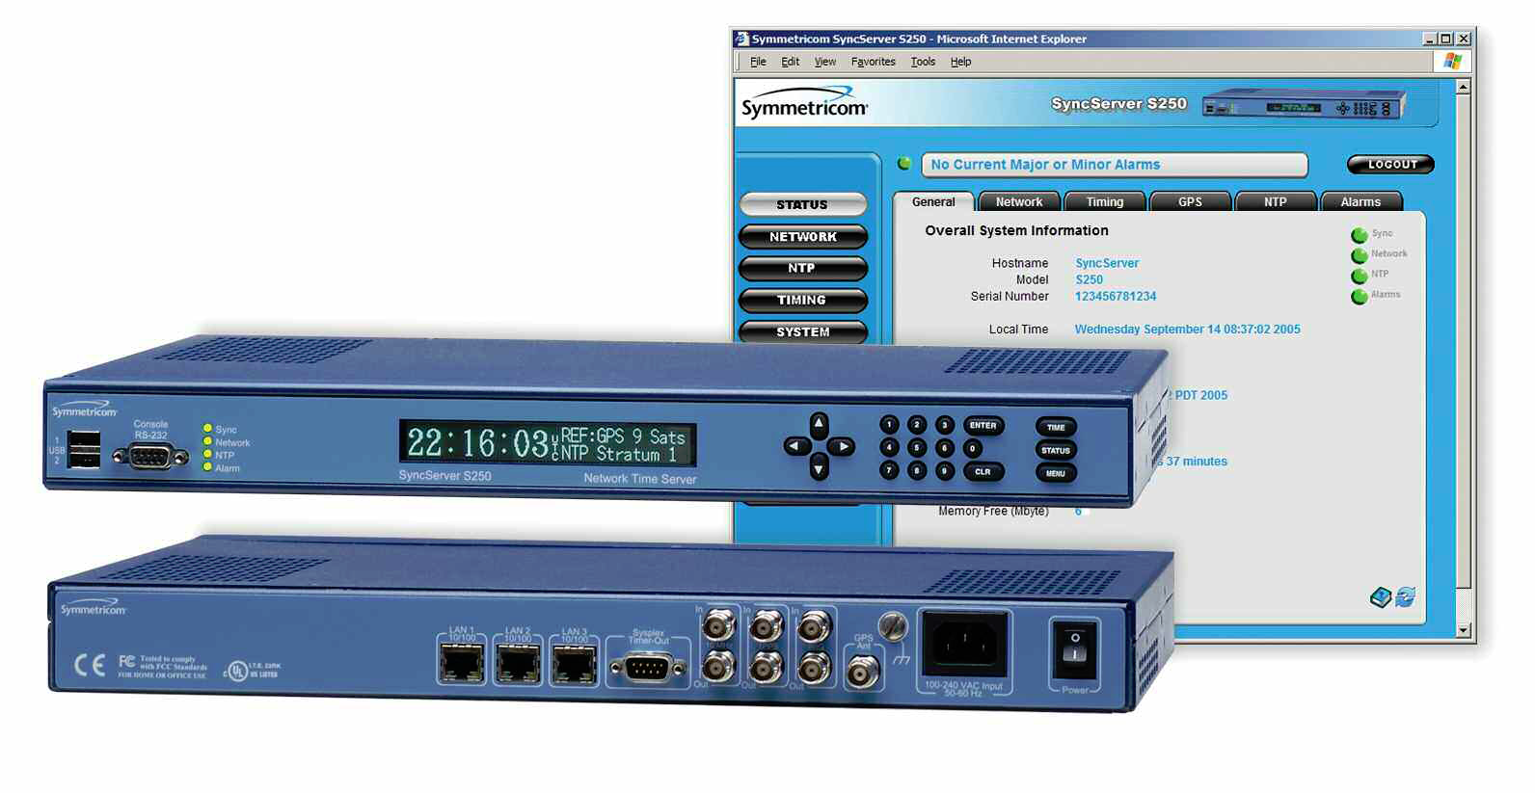
Gps clock
There are many, many GPS clock solutions out there.
As an example, the Symmetricon SyncServer S250 provides NTP in UTC timescale, 1 PPS output (also can include a Rb upgrade, for all in one solution). It also have 1 PPS and 10 MHz time reference input, so I suppose it can be further stabilized by outputs from the PRS10. It can serve 3200 requests per second.

Slide 6
Timing distribution—ntp
The antenna controllers use SNTP for setting their time, so we must distribute NTP to the antenna controllers. PCs and other devices generally can also set their time to NTP, so it is a natural choice for distributing the absolute time.
However, the sytem-wide timestamp must derive from a single authority, which will be the real-time control system.
This system will get the time-of-day from NTP, and accurately generate a State Frame once per second, synchronized to the 1 PPS. Other subsystems will obtain the State Frame and write their information into it. For those subsystems that need to report with accurate timing, their information can be synchronized to the 1 PPS, and although written later, will correspond to the timestamp of the State Frame. If their information needs a separate timestamp, it can be provided as data into the State Frame. Alternatively, they could provide an offset to the State Frame timestamp (actually, an offset to the 1PPS).
The display system, fault system, and others need not rely on their own clock at all, but can work with the State Frame timestamp for all displayed information.

Slide 7
Synchronization—1 pps
The PRS10 1 PPS signal must be distributed to each antenna via half-duplex single-mode optical links. The cRIO in each antenna controller has a clock accurate to 1 us that can sync to such a pulse. We have yet to identify the link hardware.
The 1 PPS signal will need to be distributed also to key hardware subsystems in the control room, via copper coax. Signal amplitude will have to be specified, possibly differently for each subsystem.
Transmission times for the 1 PPS signal should be negligible, but this should be checked. Exact synchronization to the 100 us spec should be easily achievable.

Slide 8
Timestamps and state frame
It has already been noted that the State Frame needs to have a timestamp written by a single authority, which is the control computer. It is critical that the NTP time be accurate for this computer. Typically NTP time is accurate to 2 ms on the LAN. The 1 PPS to the real-time control computer’s clock board will be used for a timestamp accuracy of 1 us.
Other subsystems that have to write into the State Frame, with time-critical information, can provide an offset to the time in the State Frame, calculated locally with reference to the 1 PPS.
No subsystem should write information to a State Frame with an offset more than 1 s—if information is more than 1 s old, it should be written into the appropriate previous State Frame, archived for the purpose.
Subsystems such as the correlator or DPP that need time-critical information may need to calculate or store it ahead of time and apply it at the correct moment in time.

