Slide 1

EOVSA monitor and Control—System-wide issues
Dale E. Gary
Professor, Physics, Center for Solar-Terrestrial Research
New Jersey Institute of Technology

Slide 2
outline
State Frame Concept
Access to the State Frame
Flow of State Frame information
Format of State Frame

Slide 3
State frame concept
The idea of the State Frame is to give complete information about the state of the entire system once each second. This information is available to any client to read (parts or all of it), and so multiple displays can be instantiated that display whatever is wanted in essentially real time. The state of the system can also be recorded easily in a monitor database by simply writing the State Frame.
Some parts of the system need to provide their information to the State Frame, so a mechanism for adding information to the State Frame is needed. Since this can take time, a buffer of State Frames is used to provide a history of up to 5 s.
The State Frame has a static structure, but needs to be easily extensible and self-describing, as new monitor points are defined over time. It may be that XML could be used.
A monitor point is a bit of information that can have a value, a defined max-min range, a flag (set by the Fault System if out of range), an average value (if the value is an array), and a valid flag (to indicate that it has been written).

Slide 4
Access to the state frame
The State Frame requires a system for distributing the information around to the various subsystems. One approach is to use LabVIEW shared variables, which are read and written via ethernet LAN. The use of structures would allow blocks of related data to be read.
Care has to be taken to ensure appropriately low latency, but it should be possible to avoid the need for tight timing by using the 1 PPS, and making sure that time-critical information is calculated or stored ahead of time.
The real-time control system writes the initial State Frame, assembling it promptly from information sent to it from the cRIO in each antenna.
Another subsystem could either send its information independently to the real-time control system, or write its information directly into the State Frame (by writing to the LabVIEW socket). Since subsystems can in general have dissimilar operating systems (certainly not all LabVIEW), the mechanism for writing the data has to be developed.

Slide 5
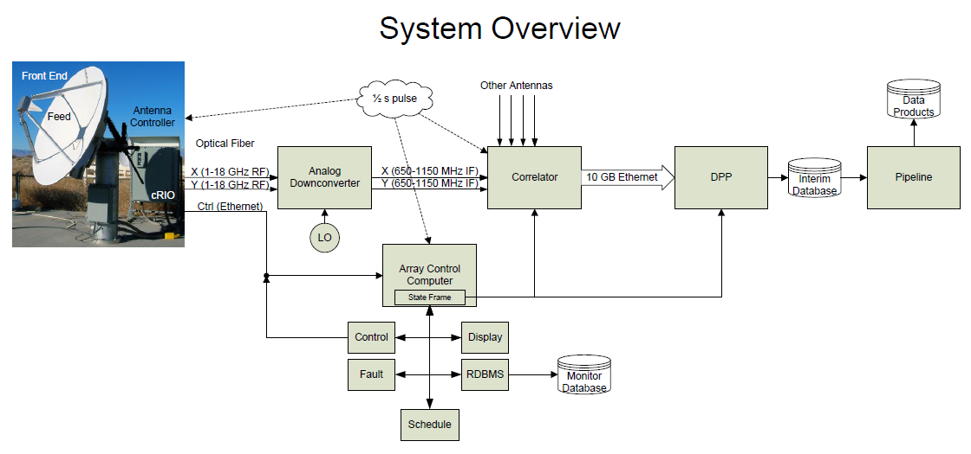
Flow of state frame information
1

