Slide 1
EOVSA Control and monitor System
Gelu M. Nita
NJIT

Slide 2
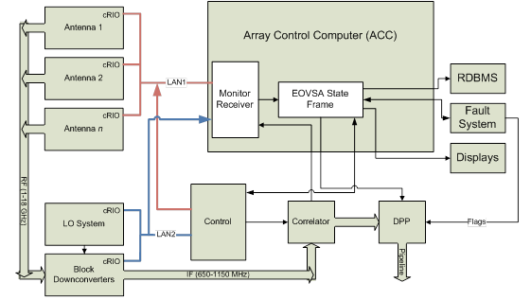
EOVSA M&C System
OUTADATED

Slide 3
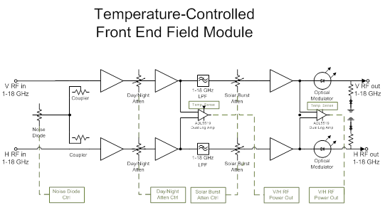
Temperature-Controlled Front End Field Module
Temperature Sensors
OUTADATED
Noise Diode
Control
Day/Night
Attn. Ctrl.
Solar Burst
Attn. Ctrl.
V/H RF Power Out
Attn. Ctrl.

Slide 4
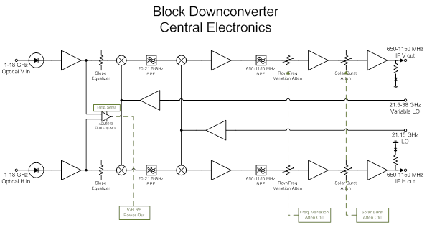
Block Downconvertor Module
Solar Burst Attn. Ctr.
OUTADATED
V/H Power Out
Freq. Var. Attn. Ctrl

Slide 5
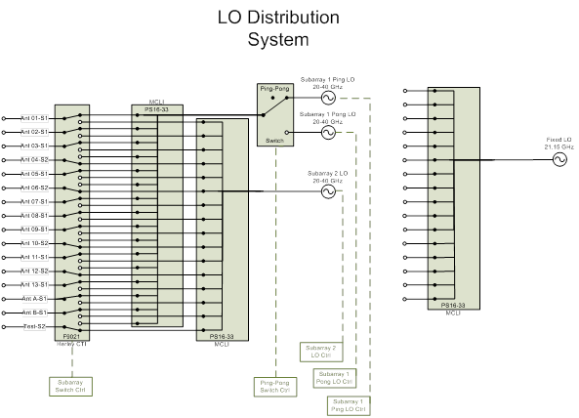
LO Distribution System
Ping/Pong LOs
OUTADATED
Subarray 2 LO
Subarray Switch Ctr.
Ping-Pong Switch?

Slide 6
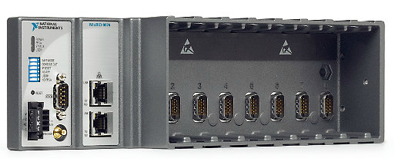
Compact Reconfigurable Input/Output (cRIO) Real Time Module: flexible solution for implementing the control/monitor of the EOVSA Antennas
Control and monitor systems of the antenna front end, and the refurbished OVSA antennas motion control system
Automatic NTP server system time synchronization
Dedicated 1PPS SMB input for automatic system clock drift correction
Rugged, embedded control and monitoring system
400 MHz industrial real-time processor for control, data logging, and analysis
128 MB of DRAM for embedded operation
256 MB of nonvolatile memory for data logging
2M gate, 8-slot FPGA chassis for custom I/O timing, control, and processing
-20 to 55 °C operating temperature range
19 to 30 VDC power supply input
RS232 serial port for connection to peripherals
Two 10/100BASE-T Ethernet ports
Full Price: $2800/controller
With Academic Discount: $840/controller

Slide 7
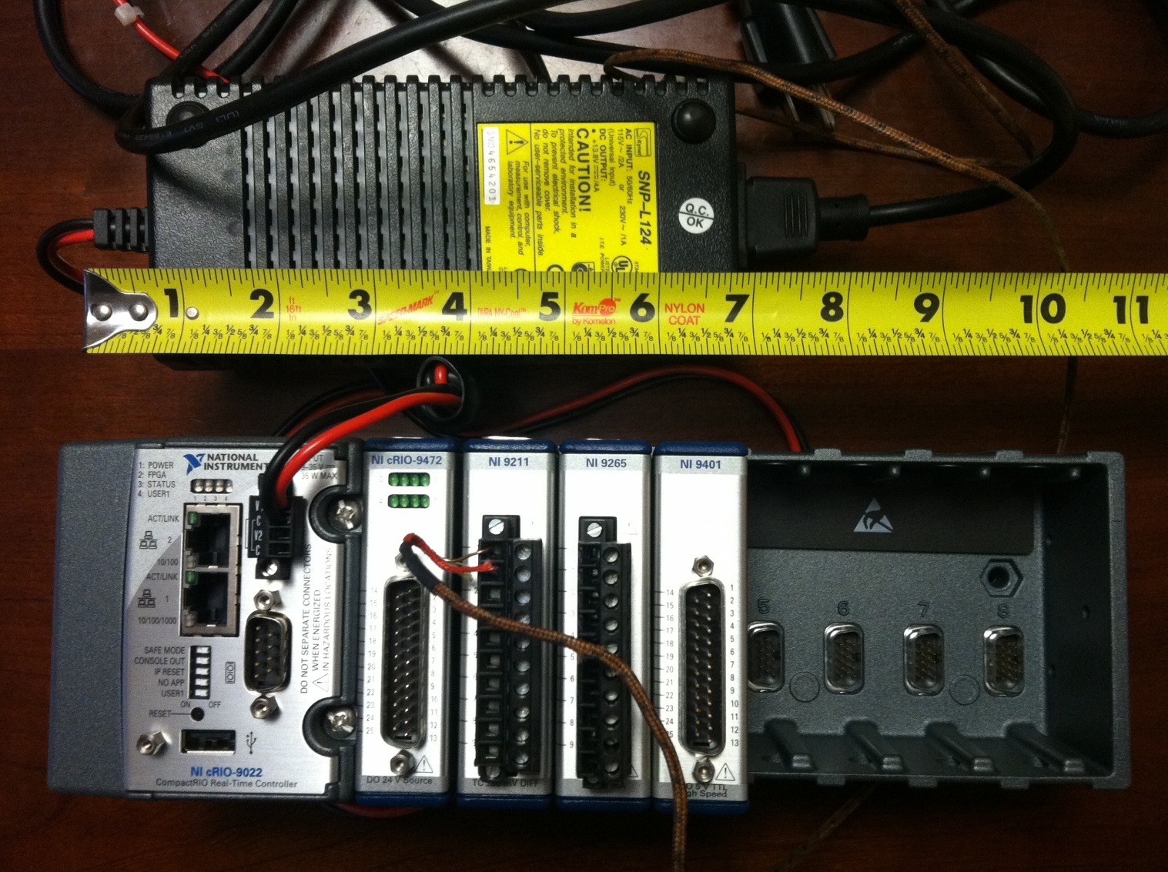
NI cRIO-9074

Slide 8
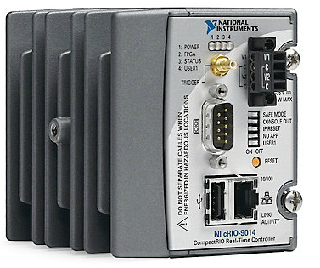
Alternative Controller: NI cRIO-9014 (no FPGA)
Automatic NTP server system time synchronization
Dedicated 1PPS SMB input for automatic system clock drift correction
400 MHz processor
2G nonvolatile storage
128 MB DRAM memory
10/100BASE-T Ethernet port with embedded Web and file servers with remote-panel user interface
Full-speed USB host port for connection to USB flash and memory devices
RS232 serial port for connection to peripherals
dual 9 to 35 VDC supply inputs
-40 to 70 °C operating temperature range
$2,800 Full Price
$2,500 Academic Discount

Slide 9
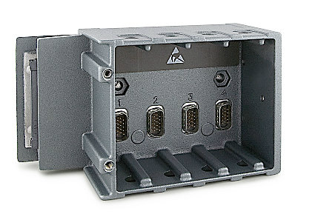
NI cRIO-9113: 4-Slot, Virtex-5 LX50 CompactRIO Reconfigurable Chassis
4-slot reconfigurable embedded chassis that will be attached to the cRIO ACC
3M gate Xilinx Virtex-5 reconfigurable I/O (RIO) FPGA core
Ability to automatically synthesize custom control and signal processing circuitry using LabVIEW
DIN-rail mounting options
-40 to 70 °C operating range
$ 1999 Full Price
$ 600 with Academic Discount
cRIO RT Controller+ FPGA Chassis Total Price: $3,100 with Academic Discount

Slide 10
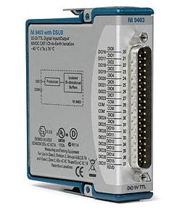
NI 9403 C Series 32-Ch Bidirectional Digital I/O Module
32-channel digital I/O module for CompactRIO
5 V/TTL, sinking/sourcing digital I/O
Bidirectional, configurable by line
1000 Vrms transient isolation, ±30 V overvoltage protection
Hot-swappable operation
-40 to 70 °C operating range
$340/module

Slide 11
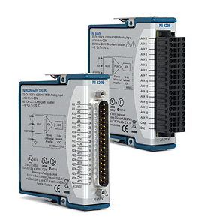
NI 9205 32-Ch Analog Input Module
32 single-ended or 16 differential analog inputs
16-bit resolution; 250 kS/s aggregate sampling rate
±200 mV, ±1, ±5, and ±10 V programmable input ranges
Hot-swappable operation; overvoltage protection; isolation;
NIST-traceable calibration
-40 to 70 °C operating range
Spring terminal or D-Sub connectivity
$740/module

Slide 12
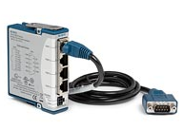
NI 9871: 4-Port, RS485/RS422 Serial Interface Module for cRIO
4 RS485/RS422 (TIA/EIA-485/422) ports for CompactRIO
Baud rates from 14 baud to 3.684 Mbaud;
-40 to 70 °C operating range
Data bits: 5, 6, 7, 8; Stop bits: 1, 1.5, 2;
Flow control: XON/OFF, RTS/CTS, None
Individual 64 B UART FIFO buffers per port
Transceiver modes: 4-wire, 2-wire DTR controlled, 2-wire DTR controlled with echo, 2-wire auto
8 to 28 VDC externally powered;
PC-MF4-PT cable included
$470/module

Slide 13
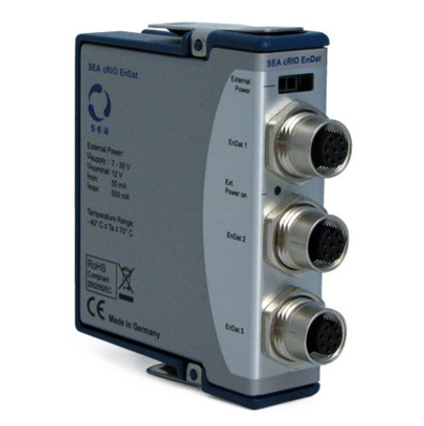
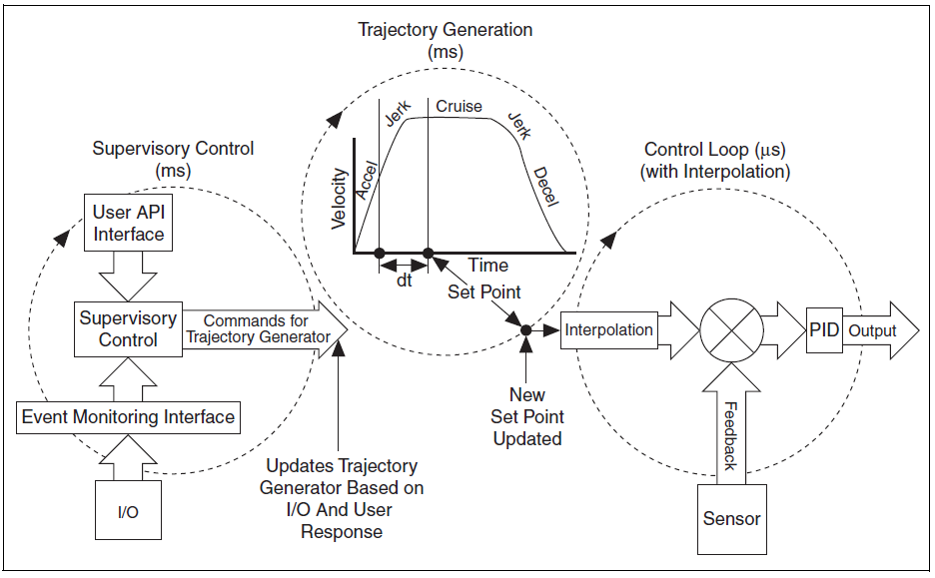
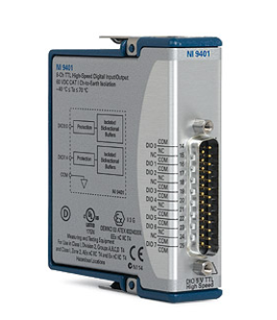
Motion Control System for the refurbished OVSA antennas (hopefully not needed)
Solution:
NI Soft Motion toolkit in conjunction with cRIO motion control modules ($1300/controller)

Slide 14
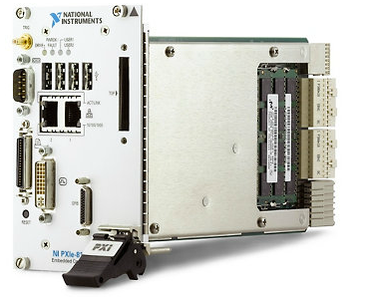
ANTENNA CONTROL COMPUTER NI PXIe-8133 RT 1.73 GHz Intel Core i7-820 Quad-Core With LabVIEW Real-Time
Deployment platform for NI LabVIEW Real-Time
May run in parallel Windows XP Embedded on a dedicated core
2 GB (1 x 2 GB DIMM) dual-channel 1333 MHz DDR3 RAM standard, 4 GB maximum
High-bandwidth PXI Express embedded controller with up to 8 GB/s system and 2 GB/s slot bandwidth
Two 10/100/1000BASE-TX (Gigabit) Ethernet
4 Hi-Speed USB
ExpressCard/34, GPIB, serial, and other
Dedicated 1PPS SMB input for task triggering
$ 6,200 Full Price
$ 5,600 with Academic Discount

Slide 15
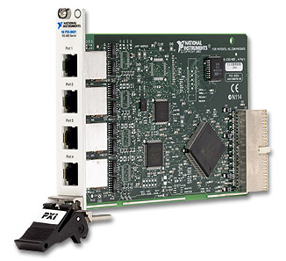
NI PXI-8431/4 (RS485/422) 4-Port Serial Interface for PXI
Compatible with Windows and LabVIEW Real-Time OSs
Minimal CPU overhead with high-speed DMA interface; multicore processor and hyperthreading support
Flexible standard and nonstandard baud rates from 57 baud to 3,000,000 baud
128 B transmit and receive FIFOs
Selectable 4- and 2-wire transceiver modes for full- and half-duplex communication
4 converter cables (10P10C (RJ50) to DB9 male)
$ 617 Full Price
$ 555 with Academic Discount

Slide 16
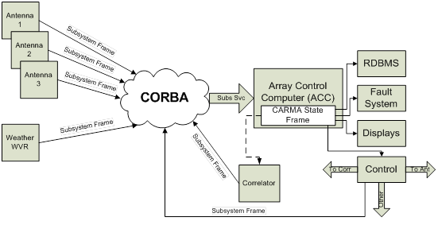
CARMA like Architecture
NI-SVE

Slide 17
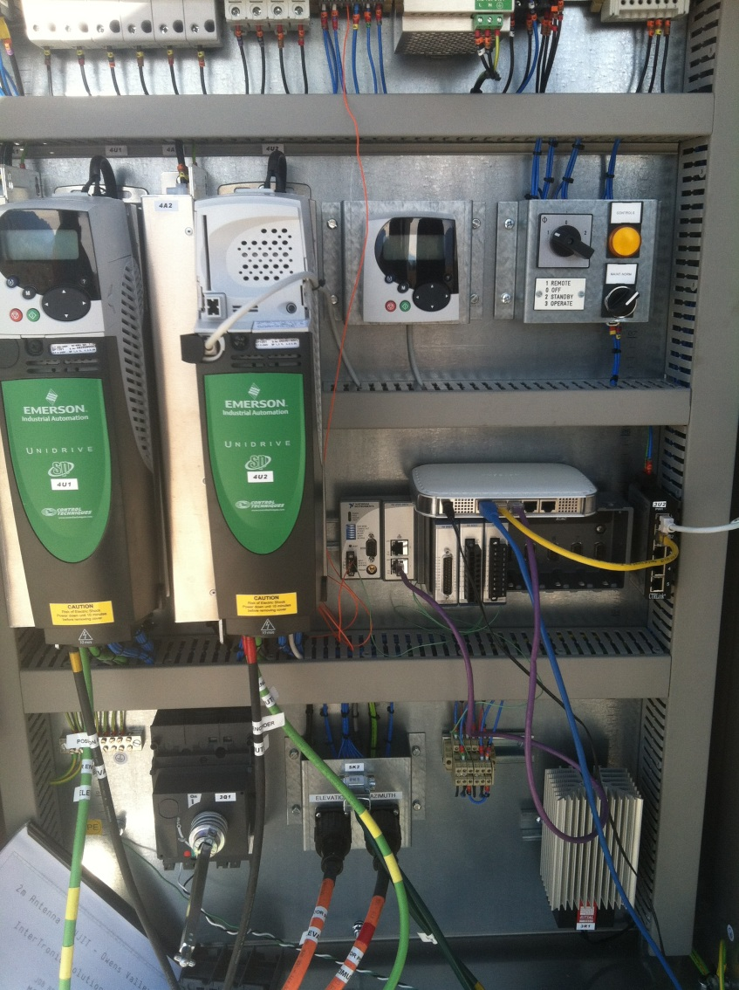
Field Point cRIO Controllers
Local MODBUS over TCP/IP communication between the cRIO controller and Antenna Controllers
Local MODBUS over TCP/IP or RS485 communication between the cRIO and a front-end embedded processor used to control/monitor the analog system
cRIO will generate a local 50PPS signal continuously aligned with the distributed 1PPS signal
The local 50PPS trigger will be used to schedule any control task and to fill-in the 50 state frame monitor slots.
The one-second assembled State Sub-Frame will be transmitted via TCP/IP to the ACC on a TBDx50PPS tick following the next 1PPS pulse

Slide 18
Overview of the EOVSA Control/Monitor Communication Protocols
Antenna Controller: MODBUS over TCP/IP between the Antenna Controller and its Field Point dedicated cRIO-RT Module.
Field Point Modules: TCP/IP between the Antenna Control Computer (ACC) and the field point cRIO-RT modules
LO and DC control systems: MODBUS over RS485 between LO and DC embedded controllers and the ACC system.
ACC to other EOVSA subsystems (e.g. DPP) and observer interface: TCP/IP to read/write the EOVSA state frame as binary stream preceded by a self describing XML template

Slide 19
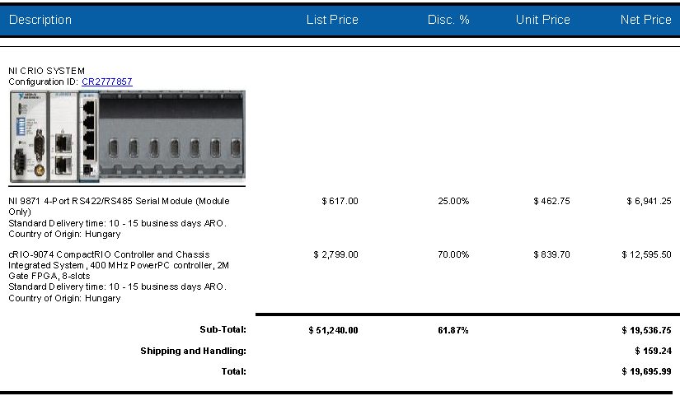
Quote for a 15 Antenna minimal(?) configuration

Slide 20
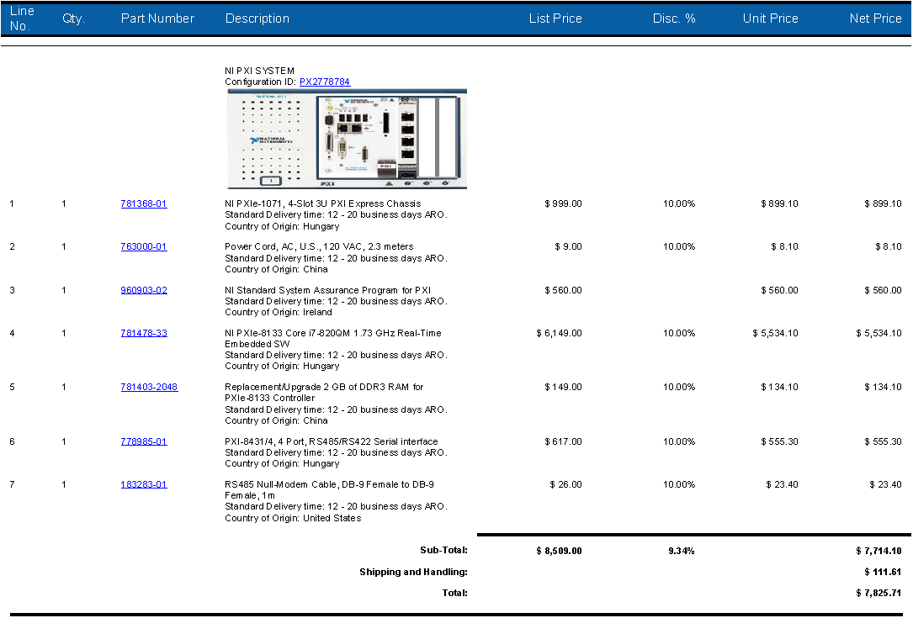
Potential ACC System Quote

