Slide 1

EOVSA interfaces
Dale E. Gary
Professor, Physics, Center for Solar-Terrestrial Research
New Jersey Institute of Technology

Slide 2
outline
General Interface Issues
Reminder of Interface Docs from April Mtg
Updating the Interface Document
Documenting Interface Requirements

Slide 3
General interface issues
It is obviously essential for teams in charge of different subsystems that talk to each other to agree on the detailed signals and their content, levels, allowed ranges, timing, etc. This requires a detailed interface document for each subsystem interface.
At a system level, it is also necessary to ensure that all information needed to debug, calibrate and maintain the system is defined and recorded in a way that fulfills these needs. This requires a system-level document that describes all of the interfaces, and may place requirements on the interfaces that are not strictly dependent on subsystem inter-communication.

Slide 4
Reminder of interface docs from April meeting
During and after the April meeting, I created a diagram and spreadsheet that attempted to organize all of the interfaces.
The diagram simply shows all of the subsystems, identifies who is “in charge” of each subsystem, and for those subsystems that have to interact it shows arrows labeled with Excel spreadsheet cells.
On the corresponding spreadsheet, there are two worksheets. One is a matrix that shows all possible interactions. The subset of possible interactions that are actually needed form a set of cells that correspond to the labels on the diagram arrows.
In the cell for each needed interaction, an attempt was made to enumerate and label the different signals.
The second worksheet is a table that lists each interaction cell, indicates the flow (From/To), and direction (In/Out) of signals, gives a unique signal name, indicates the type of signal and its mode of transmittal, allowed ranges, connector type, frequency or data rate, and timing precision.

Slide 5
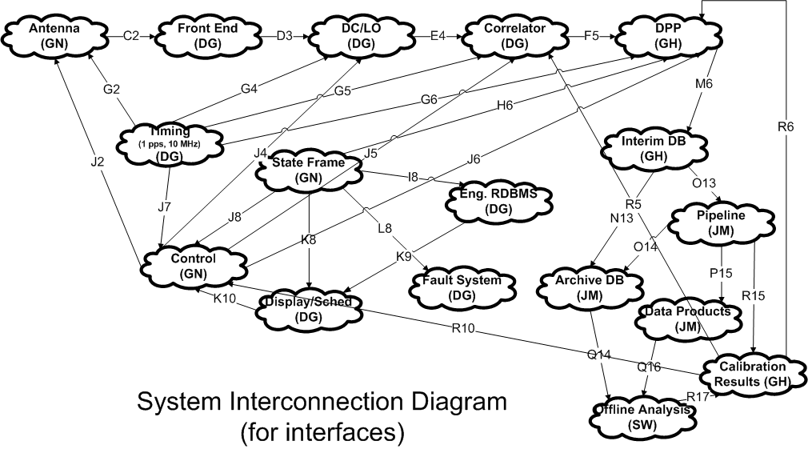
Diagram

Slide 6
Portion of worksheet 1 as example
 | Antenna (GN) | Front End (DG) | DC/LO (DG) | Correlator (DG) | DPP (GH) | Timing (DG) | StateFrame (GN) | Eng. RDBMS (DG) | Control (GN) | Display (DG)
Antenna (GN) |  | 2 RF, Atten Ctrl, ND Ctrl, Fan/Cooler Ctrl, 2 RF LogPower, 3 Temp |  |  |  | 1 pps |  |  | Ant. Commands, Status, Front End Ctrl, Coords, Time, Date
Front End (DG) | 2 RF, Atten Ctrl, ND Ctrl, Fan/Cooler Ctrl, 2 RF LogPower, 3 Temp |  | 2 RFs 1-18 GHz
DC/LO (DG) |  | 2 RFs 1-18 GHz |  | 2 IFs 650-1150 MHz |  | 1 pps; 10 MHz, 50 Hz |  |  | Tuning, Subarray setting, Atten Ctrl
Correlator (DG) |  |  | 2 IFs 650-1150 MHz |  | 16 S1, 16 S2, 256 correlations + metadata | 1 pps; 10 MHz, 50 Hz |  |  | Sync, Delay, Delay Rate, Subarry, Sample Intval, Tuning
DPP (GH) |  |  |  | 16 S1, 16 S2, 256 correlations + metadata |  | 1 pps; 50 Hz | StateFrame, DPP SubFrame |  | Source info
Timing (DG) | 1 pps |  | 1 pps; 10 MHz, 50 Hz | 1 pps; 10 MHz, 50 Hz | 1 pps; 50 Hz |  |  |  | 1 pss
StateFrame (GN) |  |  |  |  | StateFrame, DPP SubFrame |  |  | StateFrame | StateFrame, Ctrl Subframe | StateFrame
Eng. RDBMS (DG) |  |  |  |  |  |  | StateFrame |  |  | StateFrame History, DB Query
Control (GN) | Ant. Commands, Status, Front End Ctrl, Coords, Time, Date |  | Tuning, Subarray setting, Atten Ctrl | Sync, Delay, Delay Rate, Subarry, Sample Intval, Tuning | Source info | 1 pss | StateFrame, Ctrl Subframe |  |  | Schedule Macro-commands, Ctrl Commands
Display (DG) |  |  |  |  |  |  | StateFrame | StateFrame History, DB Query | Schedule Macro-commands, Ctrl Commands

Slide 7
Portion of worksheet 2 as example
Box | From | To | Signal Name | Direction | Type | Mode | Range Max | Range Min | Unit | Connector | Frequency | Timing Precision
C2 | Antenna (GN) | Front End (DG) | X Pol from Ant | In | RF Power | Analog Elec | -35 | -70 | dBm | SMA | 1-18 GHz | N/A
 |  |  | Y Pol from Ant | In | RF Power | Analog Elec | -35 | -70 | dBm | SMA | 1-18 GHz | N/A
 |  |  | ND Ctrl | In | Bool | Digital Elec | 28 | 0 | V | TBD | 1 Hz | 1 ms
 |  |  | Atten Ctrl 1 | In | 8-bit | Digital Elec | 5 | 0 | V | TBD | 1 Hz | 1 ms
 |  |  | X Pol Level 1 | Out | RF LogPower | Analog Elec | 1.4 | 0.6 | V | TBD | 50 Hz | 1 ms
 |  |  | Y Pol Level 1 | Out | RF LogPower | Analog Elec | 1.4 | 0.6 | V | TBD | 50 Hz | 1 ms
 |  |  | Temp 1 | Out | Temperature | Analog Elec | 2 | 1 | V | TBD | 1 Hz | 1 s
 |  |  | Atten Ctrl 2 | In | 8-bit | Digital Elec | 5 | 0 | V | TBD | 1 Hz | 1 ms
 |  |  | X Pol Level 2 | Out | RF LogPower | Analog Elec | 1.4 | 0.6 | V | TBD | 50 Hz | 1 ms
 |  |  | Y Pol Level 2 | Out | RF LogPower | Analog Elec | 1.4 | 0.6 | V | TBD | 50 Hz | 1 ms
 |  |  | Temp 2 | Out | Temperature | Analog Elec | 2 | 1 | V | TBD | 1 Hz | 1 s
 |  |  | Fan/Cooler Ctrl | In | TDB | Analog Elec | TDB | TDB | V | TBD | 1 Hz | 1 s
G2 | Timing (DG) | Antenna (GN) | 1 pps | In | Pulse | Analog Fiber | 5 | 0 | V | SC Fiber | 1 Hz | 10 us
J2 | Control (GN) | Antenna (GN) | Ant Commands | In | Ethernet | Digital Fiber | N/A | N/A | N/A | Ethernet | 1000 Mb/s | 500 ms
 |  |  | Ant Status | Out | Ethernet | Digital Fiber | N/A | N/A | N/A | Ethernet | 1000 Mb/s | 500 ms
D3 | Front End (DG) | DC/LO (DG) | X Pol from FE | In | RF Power | Analog Fiber | -35 | -30 | dBm | SC/APC | 1-18 GHz | N/A
 |  |  | Y Pol from FE | In | RF Power | Analog Fiber | -35 | -30 | dBm | SC/APC | 1-18 GHz | N/A
E4 | DC/LO (DG) | Correlator (DG) | X Pol from DC | In | IF Power | Analog Elec | -5 | -2 | dBm | SMA | 650-1150 MHz | N/A
 |  |  | Y Pol from DC | In | IF Power | Analog Elec | -5 | -2 | dBm | SMA | 650-1150 MHz | N/A
G4 | Timing (DG) | DC/LO (DG) | 1 pps | In | Pulse | Analog Elec | 5 | 0 | V | BNC | 1 Hz | 1 us
 |  |  | 10 MHz Ref | In | CW | Analog Elec | 2 | -2 | V | BNC | 10 MHz | N/A
 |  |  | 50 Hz Sync | In | Pulse | Analog Elec | 5 | 0 | V | BNC | 50 Hz | 1 us
J4 | Control (GN) | DC/LO (DG) | LO Ctrl | In | 8 I/O bits | Digital Elec | 5 | 0 | V | TBD | 50 Hz | 10 us
 |  |  | Atten Ctrl | In | 8 I/O bits | Digital Elec | 5 | 0 | V | TBD | 50 Hz | 10 us
 |  |  | Subarray Setting | In | 16 I/O bits | Digital Elec | 5 | 0 | V | TBD | ~1/day | 1 s
F5 | Correlator (DG) | DPP (GH) | S1 | In | Spectral Power Sum | Digital Number | 32-bit | 0 | Arb. Unit | Ethernet | 1000 Mb/s | 1 us
 |  |  | S2 | In | Spectral Power-Squared Sum | Digital Number | 32-bit | 0 | Arb. Unit | Ethernet | 1000 Mb/s | 1 us
 |  |  | Corr. Data | In | 256 spectral visibilities + metadata | Digital Number | 32-bit | 0 | Arb. Unit | Ethernet | 10 GigE | 1 us

Slide 8
Updating the interface document
Obviously, the details of this have to be revisited, added to and probably improved to be more useful.
For those with more experience in working with large projects, is this approach useful? Is there a better way to accomplish this?
In its current form, this could be hard to keep up to date. How can we make this or its replacement easily updatable? What protocols should we follow to ensure that it stays current?

Slide 9
Documenting interface requirements
The foregoing is merely a summary of the true interface requirements. Each interface will obviously need much more detailed information, probably in the form of a written interface document (Word or Latex).
We should define a standard form for such documents (perhaps some of you can provide a template from previous projects).
The spreadsheet could contain links to the more detailed documents, so that anyone could quickly find the relevant document for any interface by starting with the spreadsheet (or an equivalent web page).

