Slide 1
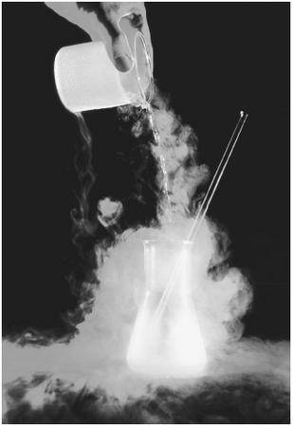
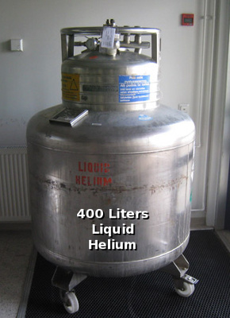
CRYOGENICS
Stephen Muchovej
Caltech

Slide 2
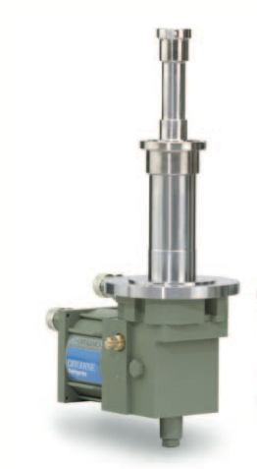
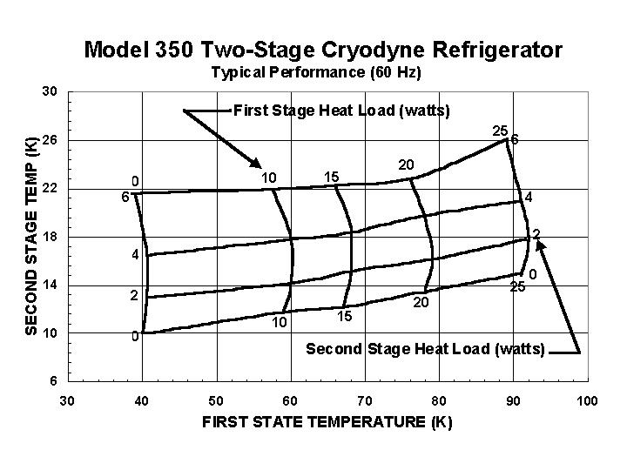
CTI Cold Head
CTI 350: 4W at 20K and 20 watts at 77K
CTI 1020: 12W at 20K and 35 watts at 77K
Could use Oxford cryogenic too

Slide 3
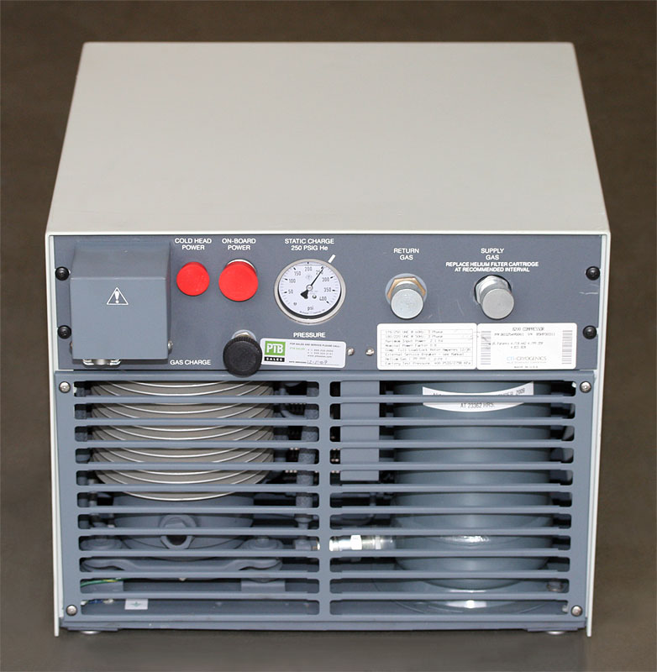
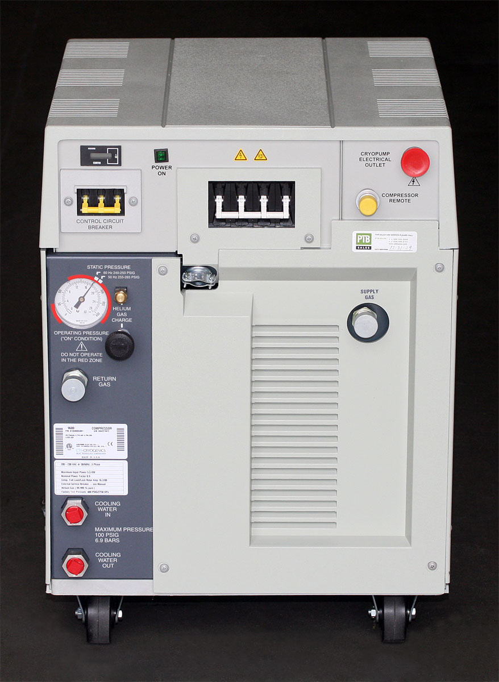
CTI Compressor
CTI 350 (~$4K) uses either Model 8200 (~$5K) or 9600 (~$8K)
CTI 1020 (~$5K) only works with Model 9600, which is water chilled
Helium lines are typically ~$30/foot + couplings

Slide 4
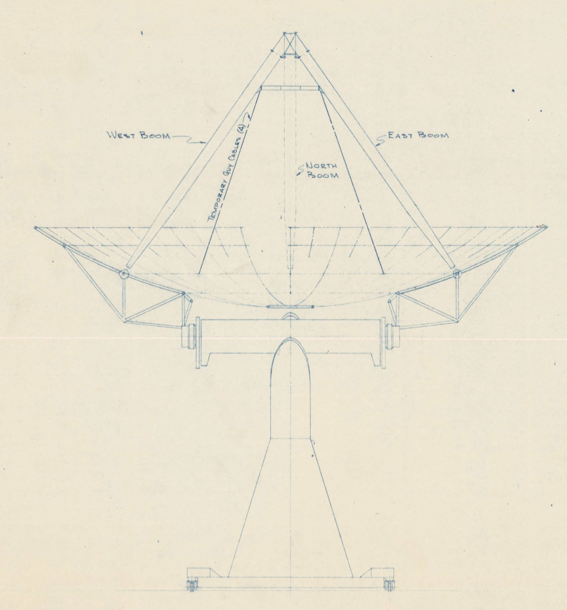
Installation
Compressor in pedestal.
He lines in the equatorial mount need a 4-port rotary union ($~5K)
Slack inside the el axis
Cables need to come out here

Slide 5
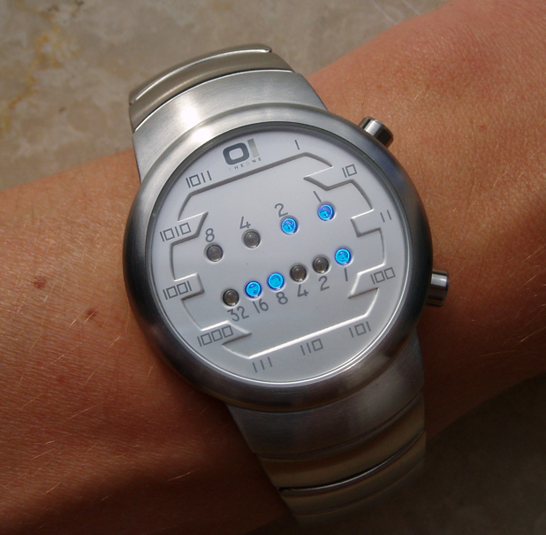
Timeline
Other people involved are Russ Keeney (design/concept) and Tomi Hovatta (machining/installation)
April/May: Inspection of telescope and design of cable feedthroughs
May 15: Order all helium cables/compressor/fridge head
July-August: Machining of clamps/whatever else necessary for installing the lines
September-October: Installation.

