Slide 1

EOVSA OVERview and GOALS OF Co-DR
Dale E. Gary
Professor, Physics, Center for Solar-Terrestrial Research
New Jersey Institute of Technology

Slide 2
outline
Goals of the Meeting
Agenda
Conceptual Design
EOVSA System Overview

Slide 3
Goals of the meeting
Investigate each system and subsystem at maximum level of detail.
Identify and document interfaces for signals/data, control and monitoring.
Consider system-level process intercommunication
Completeness
Timing
Throughput
Consider operational viability
Operator interface and scheduler
Calibration methods and flow
Maintenance and spares
Consider data format, data quality, data volume, data analysis

Slide 4
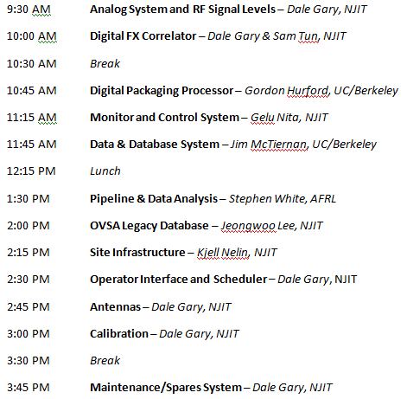
Agenda
Subsystem summaries

Slide 5

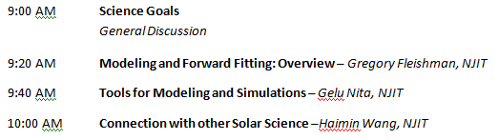
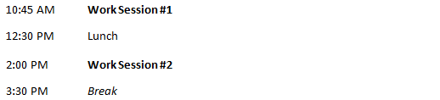
Agenda
Planning for Tuesday Work Sessions
Science
Work Sessions

Slide 6


Agenda
Assembling and Documenting the Concept
Testing and Wrap-Up

Slide 7
Conceptual design
What is it?
Putting together and documenting a plan that will work
Identifying every part of the plan, and how the parts interact, leaving nothing out
Identifying existing components (algorithms) that can do the job, but not to the level of part numbers (software elements)
What to take away from the meeting
Overview of entire system
List of interface elements for each subsystem (number, type, ranges)
Understanding of system timing requirements
Priority list of issues to resolve
What is next? Preliminary Design (part numbers, software, ready to purchase/implement for the prototype)

Slide 8
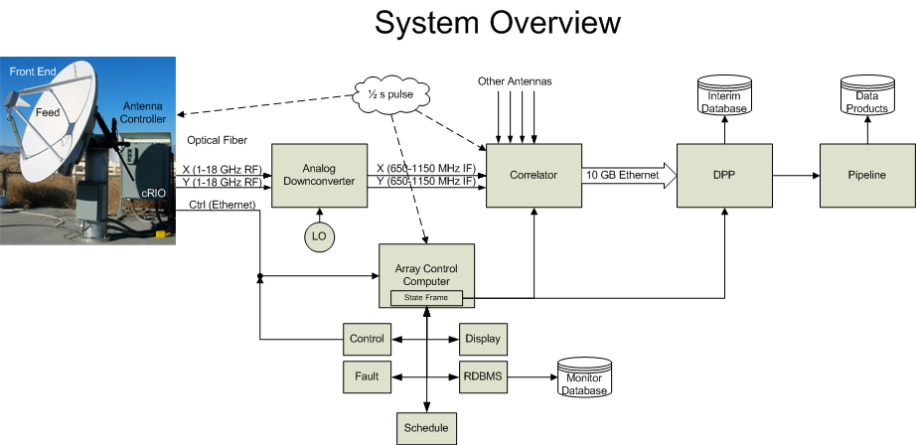
EOVSA System overview

Slide 9
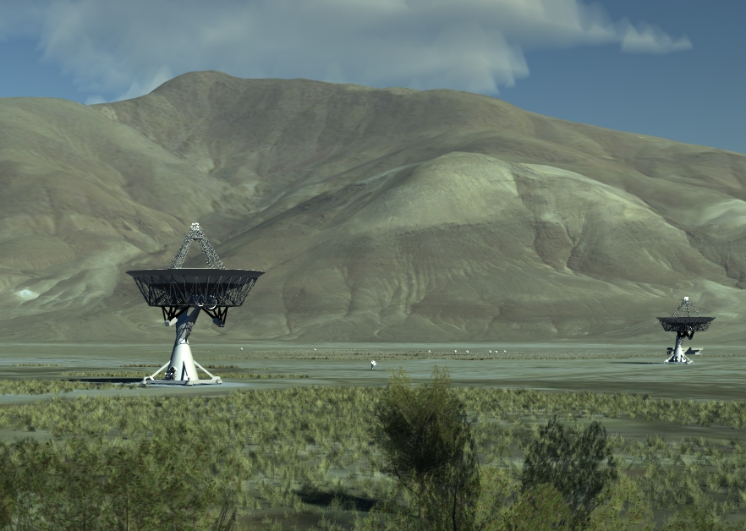
final array

