Slide 1

EOVSA OVERview and GOALS OF technical design meeting
Dale E. Gary
Professor, Physics, Center for Solar-Terrestrial Research
New Jersey Institute of Technology

Slide 2
outline
Goals of the Meeting
Agenda
Science Overview
Instrument Requirements
System Overview

Slide 3
Goals of the meeting
The primary goal is to bring the engineers up to speed on the project and get them on the same page
Additional goals:
Revisit all aspects of the conceptual design with the engineering expertise we now have on the project
Update and extend the conceptual design with new information gained since the April meeting
Start anew to define a schedule that gets the project completed on time
Identify what is needed to rapidly complete a prototype of 2-3 antennas/receivers
Conceptual Design
Hardware elements
System-level interfaces for signals/data, monitoring and control
Operations
Calibration
Data System

Slide 4
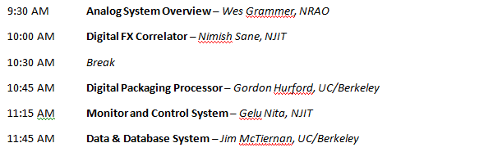
Agenda
Quick Overview of System Elements

Slide 5
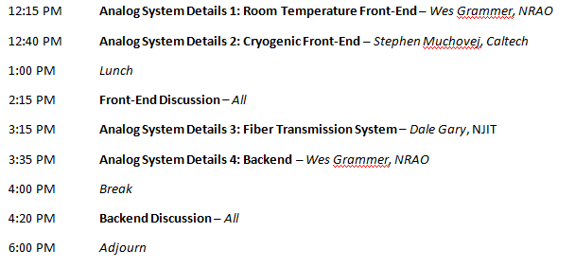
Agenda
Details of Analog System

Slide 6
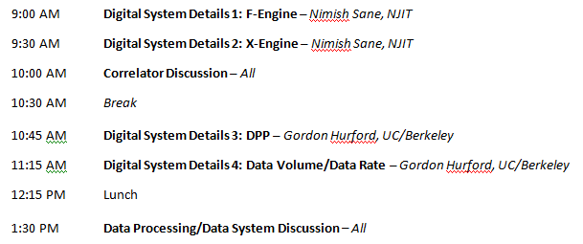
Agenda
Details of Digital/Data System

Slide 7
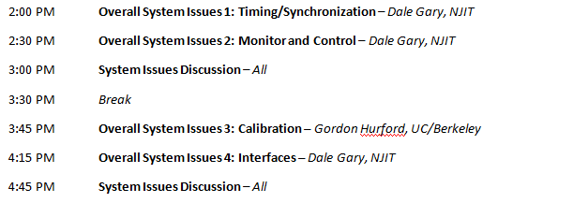
Agenda
System-Wide Issues

Slide 8
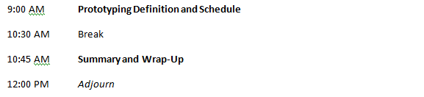
Agenda
Rapid Completion of a Prototype, and Summary

Slide 9
Science
Four science goals:
Flaring loops and particle acceleration in solar flares
Magnetic and plasma structure of active regions
Drivers of space weather
Nighttime observation of variable and transient sources
Flaring loops:
High temporal and spatially-resolved-spectral resolution (EOVSA is the first and only instrument capable of doing this routinely)
Spatially-resolved spectra provide physical measurements of magnetic field strength and direction, electron energy and pitch-angle distribution, ambient plasma parameters
Science targets are acceleration site, acceleration mechanism, initiation mechanism, transport processes, plasma processes

Slide 10
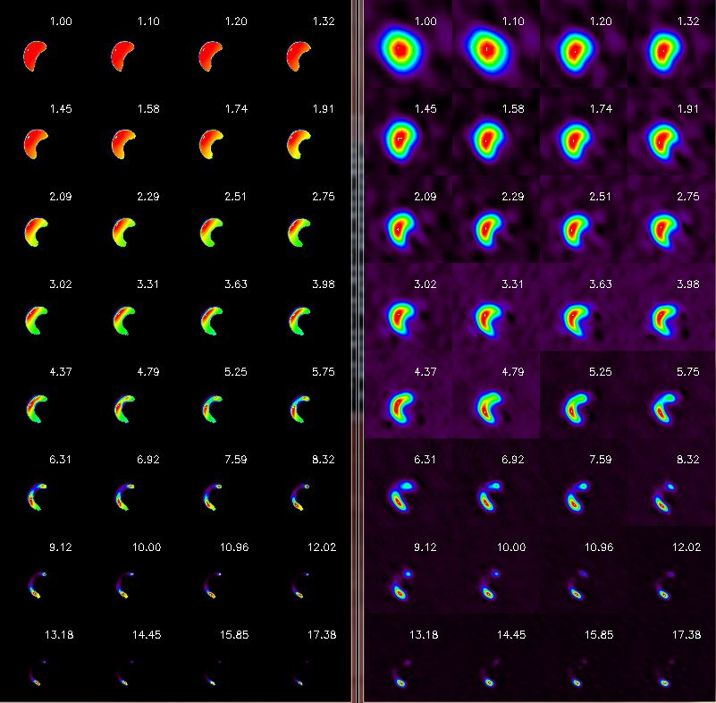
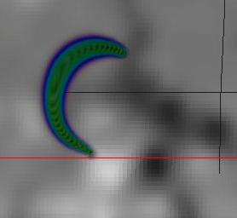
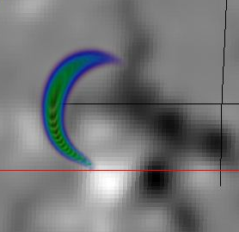
Flaring loop modeling/simulation

Slide 11
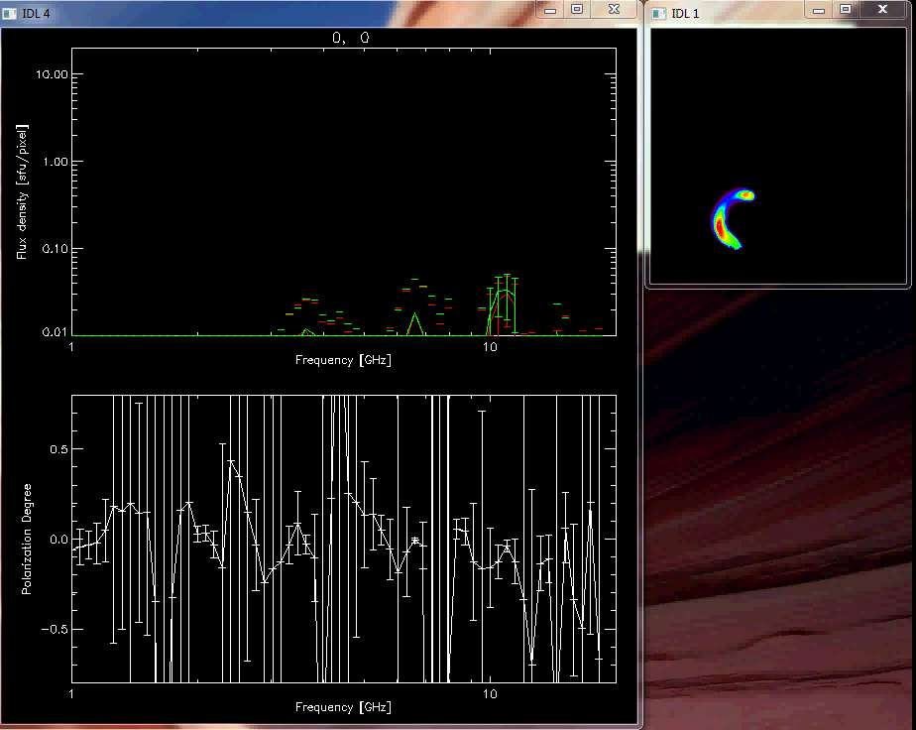
Loop Radio Spectrum movie

Slide 12
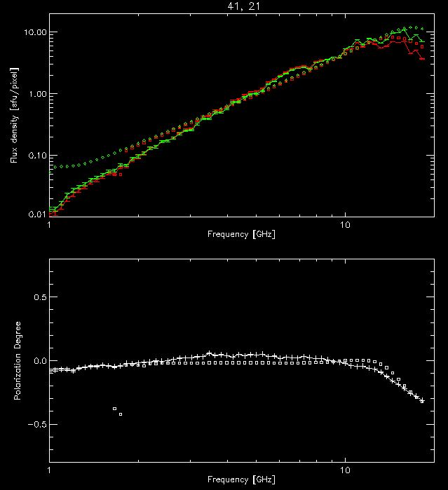
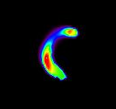
Measuring Flare Magnetic Fields
+

Slide 13
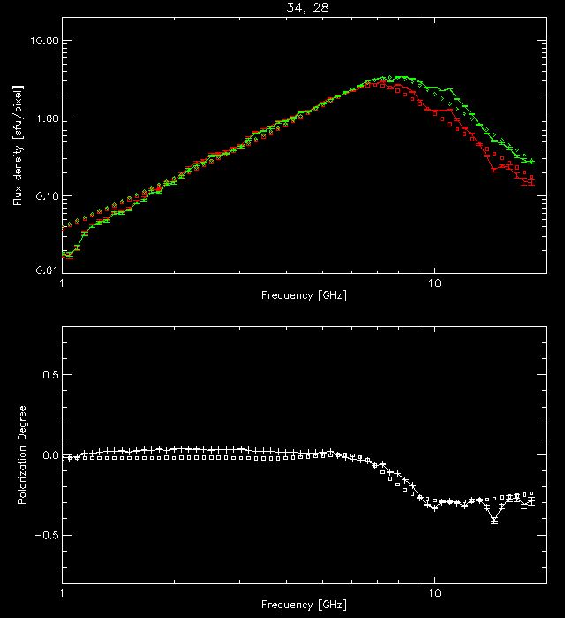
Measuring Flare Magnetic Fields
+

Slide 14
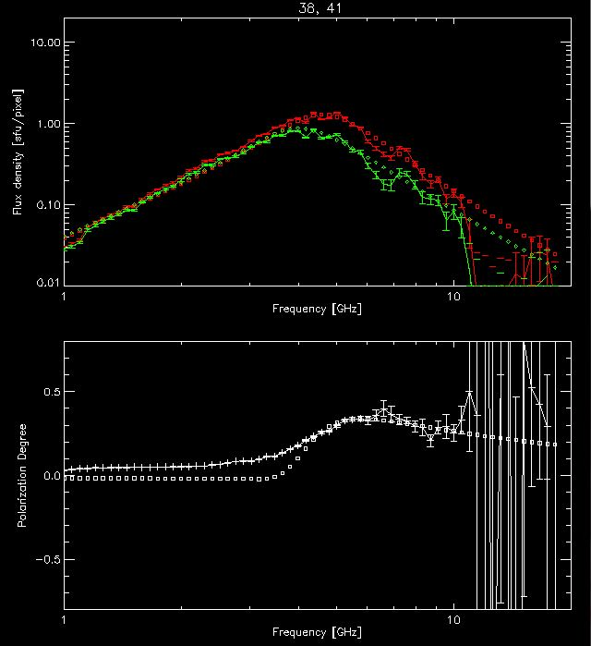
Measuring Flare Magnetic Fields
+

Slide 15
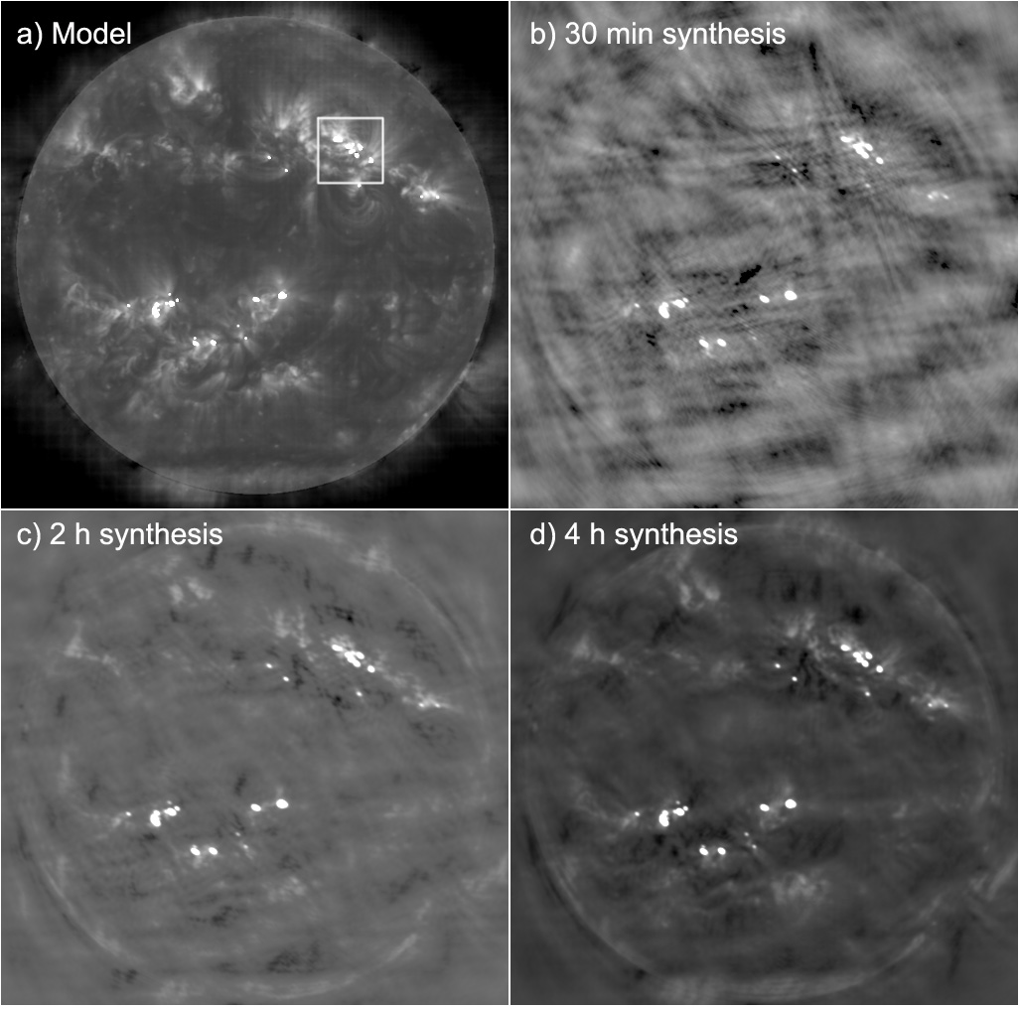
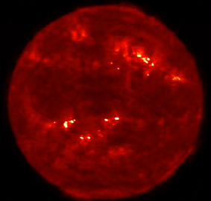
magnetic and plasma structure of active regions

Slide 16
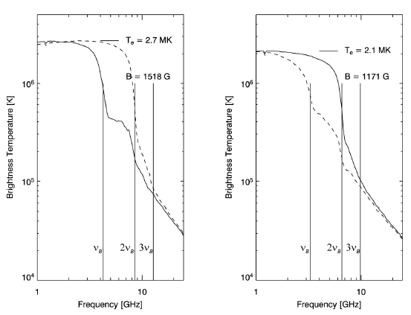
Active region/sunspot Spectra
With really excellent imaging, and fine frequency resolution, modeling (confirmed by observation) predicts lots of interesting structure in the radio spectra.
Resolving this structure will give magnetic field strength measurements in the corona, something ONLY radio can do.
Other plasma parameters (temperature, density) are also derivable from these spectra.

Slide 17
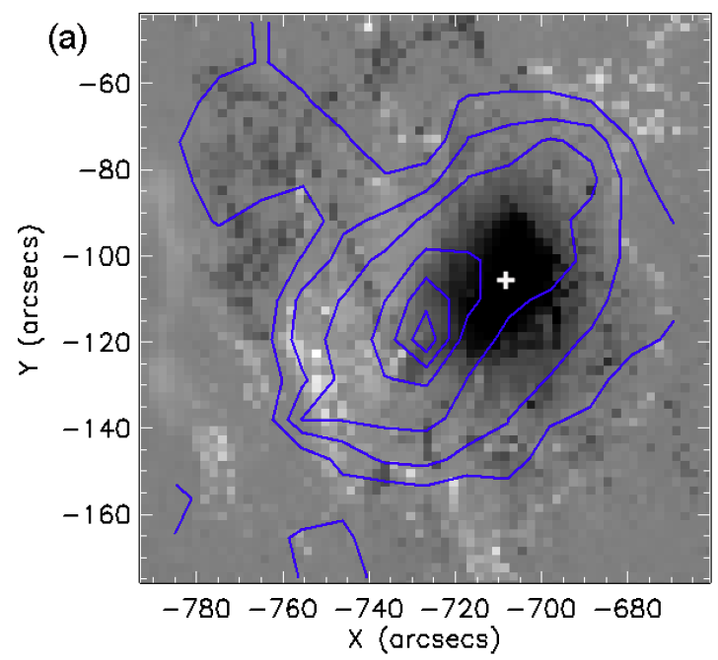
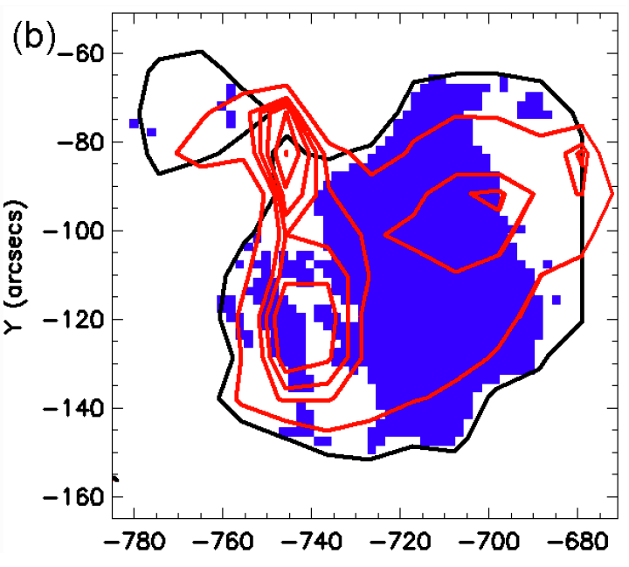
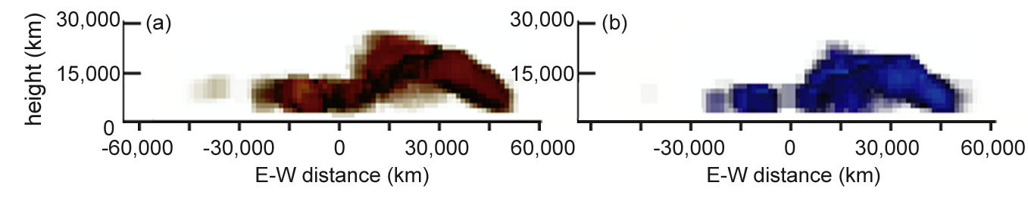
Three-dimensional structure of active regions
Recent OVSA/VLA study:
The highest magnetic field is offset from the sunspot (?)
The potential field extrapolation model does not fit the radio data.
The radio data and the extrapolation, used together, give height information.
Sunspots have cool plumes, coronal heating in surroundings!
Science targets are 3D active region structure, nonthermal signatures of energy release in active regions, flare and CME initiation

Slide 18
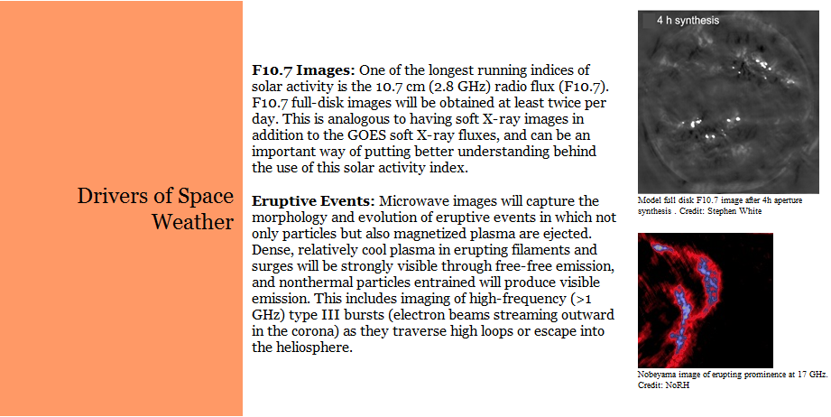
Drivers of space weather

Slide 19
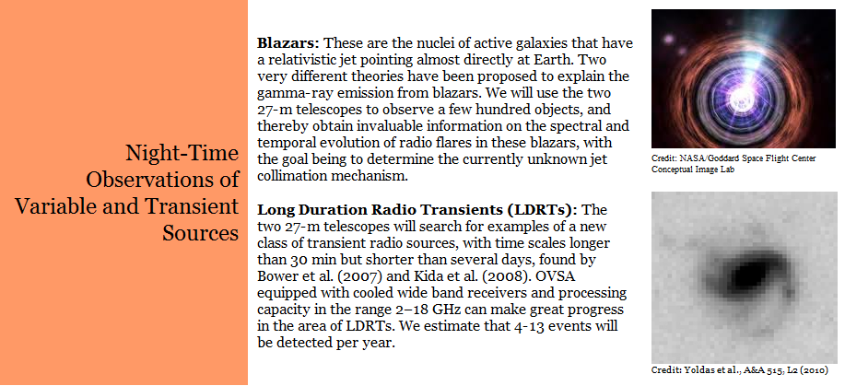
Night-time science

Slide 20
Instrument/Facility requirements
Rapid measurement of 1-18 GHz spectrum (20 ms sample time, <1 s cycle time, ~1 ms dead time)
Excellent amplitude and phase stability (1% amplitude stability—0.04 dB; 1º phase stability, each IF)
Excellent polarization accuracy (15 dB isolation, 20 dB after calibration, 2% overall accuracy)
Excellent calibration (system temperature goals 400 K for 2.1 m antennas, 50 K for 27-m, or equivalent, all bands).
Excellent 27-m sensitivity (15 K system temperature in core bands?)—note 27-m surface accuracy is an issue.
High up-time fraction=>ease of maintenance, 2 subarrays, real-time diagnostics, spares
Real-time data products=>pipeline processing (images, burst spectra, time profiles, web-based data serving)
Community access=>offline analysis package, science center

Slide 21
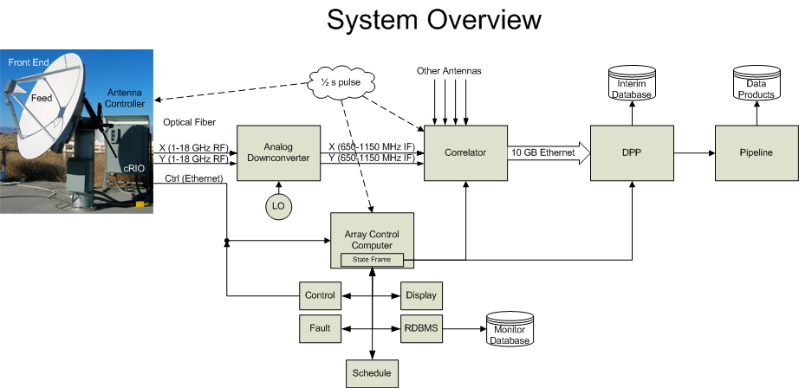
EOVSA System overview

Slide 22
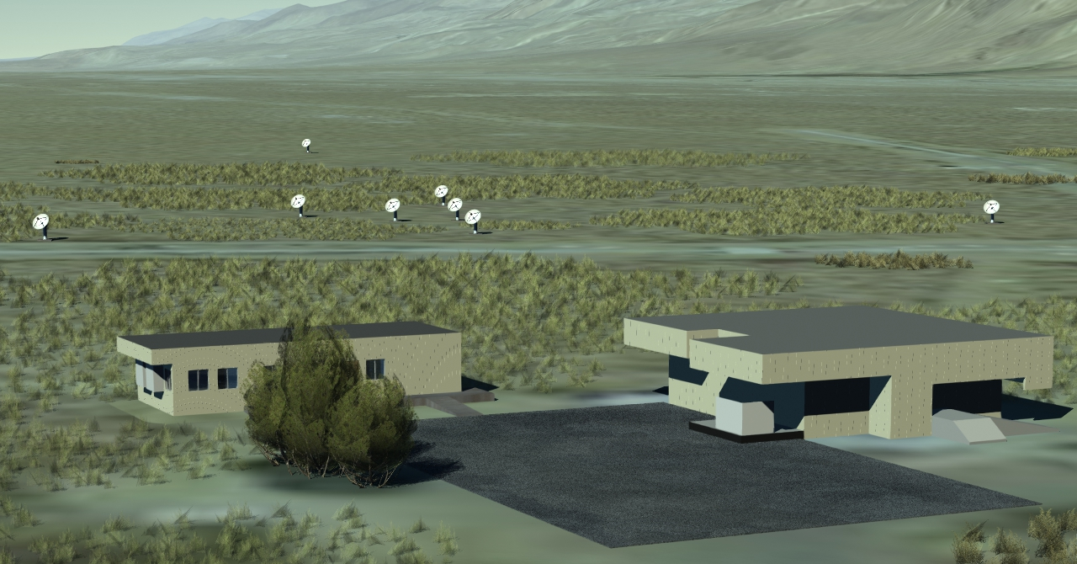
EOVSA construction

Slide 23
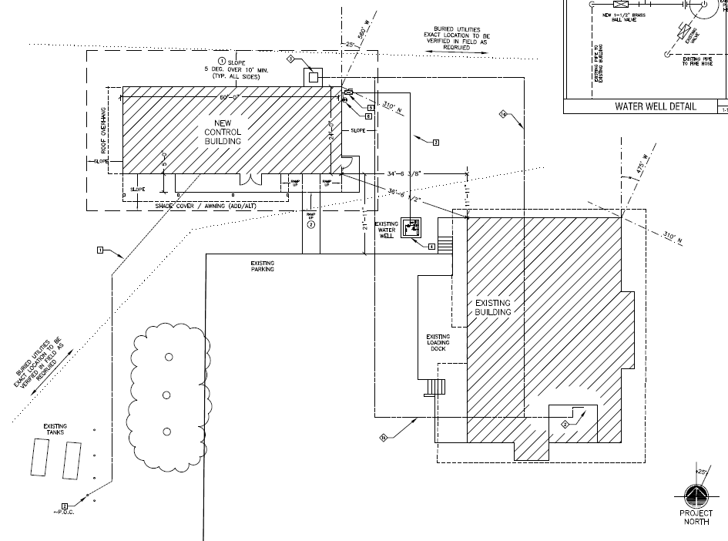
Building Site plan

Slide 24
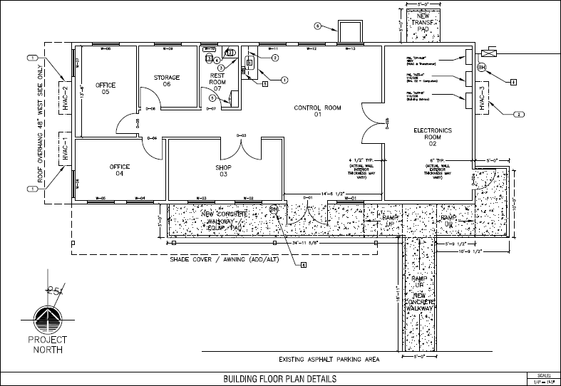
Building floor plan

Slide 25
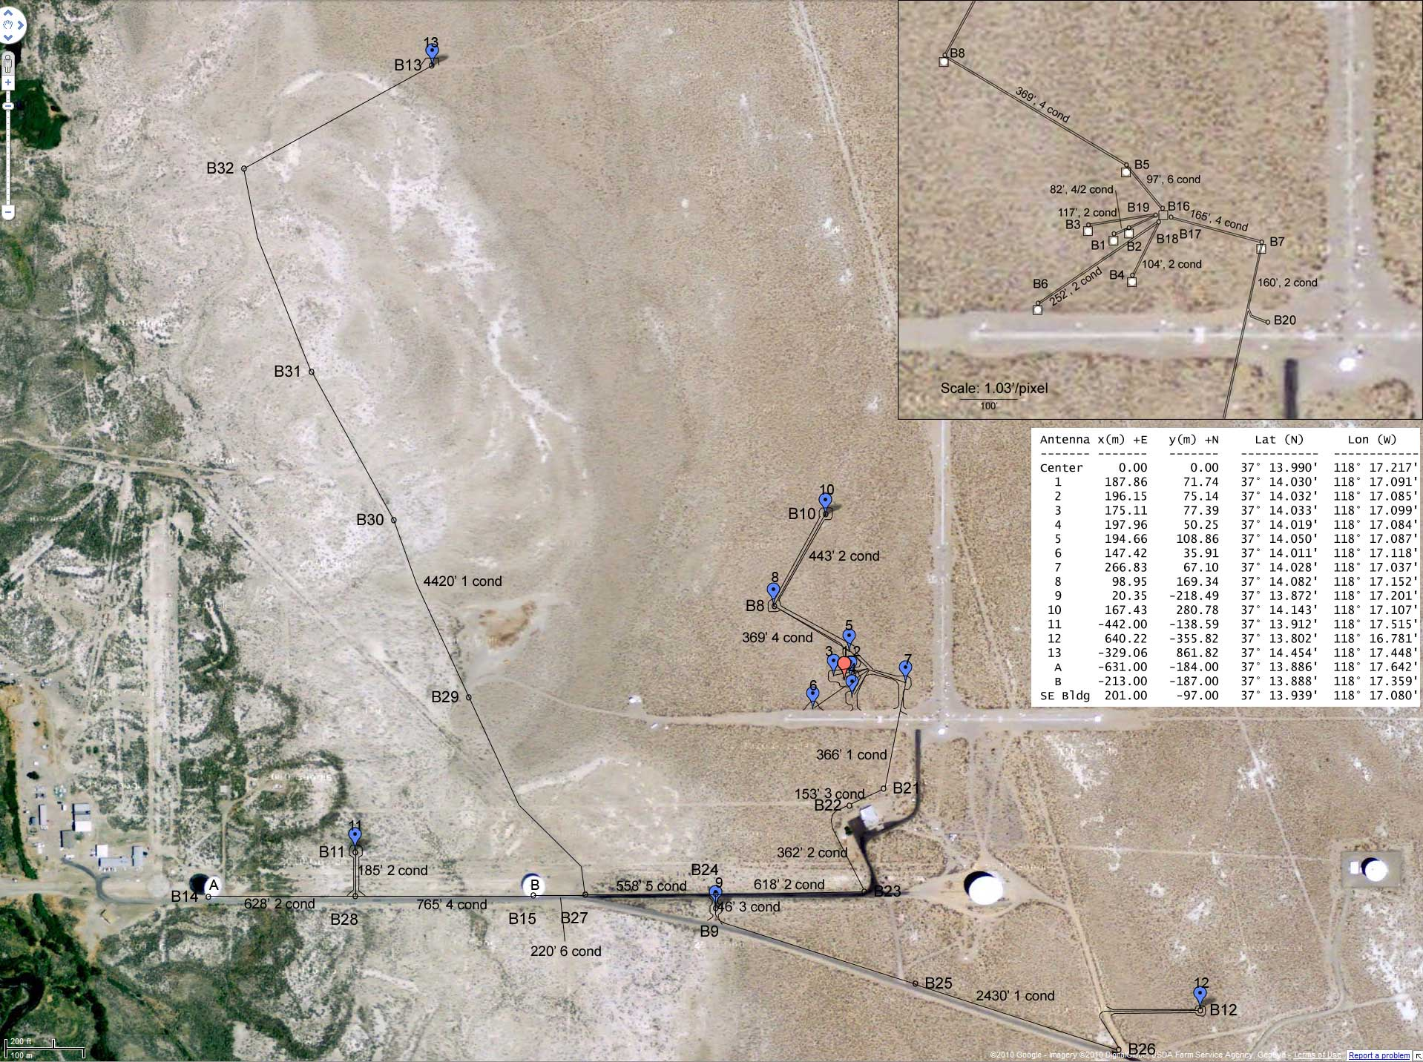
Array layout

Slide 26
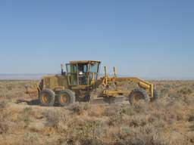

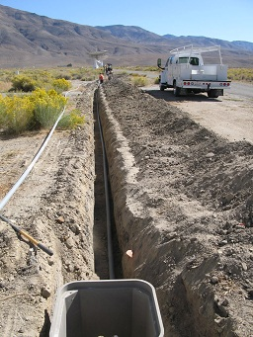
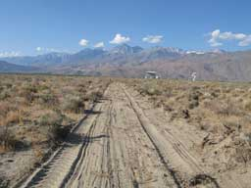
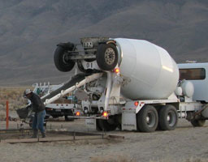
Construction progress—7 November 2011
Road construction is done
Trenching and burial of conduit/pull boxes is done
Concrete pads are being poured, completion this week.
Fencing contract is set, work to be started mid-November.
Central breakout shed contract is set, work to be done in November
Building bid package is out.

Slide 27
Remaining construction schedule
2.1 m antennas
Arrive in pairs Nov. 2011, Jan., Feb., Mar. 2012. First installed at old Ant 7 pad, second installed at new #1 pad (photo op).
Test of cRIO control, pointing, Dec. 2011
27-m work
Non-destructive testing starts Dec. 2011
Rip-out of old wiring starts Dec. 2011
FEA analysis complete by Jan. 2012, repair plan developed.
Installation of new wiring Mar.-Apr. 2012
Installation of new control systems Apr.-May 2012
Repair, painting, surface analysis TBD
Building installation, Jan. 2012 (must be done before Mar. 15, 2012)
Central array cabling, Feb.-Mar. 2012
Refurbishment of existing 2 m antennas—latter half of 2012

Slide 28
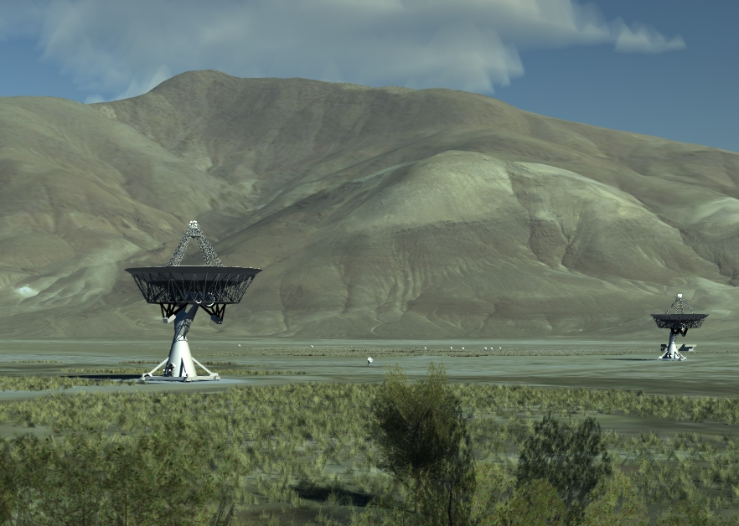
final array

