Slide 1

EOVSA system-level review
Dale E. Gary
Professor, Physics, Center for Solar-Terrestrial Research
New Jersey Institute of Technology

Slide 2
outline
Goals of the Meeting
Science Overview and Challenges
System Overview

Slide 3
Goals of the meeting
The primary goal of this PDR is to get to the point that we are ready to purchase parts and build a prototype. My desire is to complete the prototype by Sept. 1, which is an aggressive time-table
Additional goals of the meeting:
Revisit all aspects of the conceptual design and the interfaces between subsystems to ensure completeness.
Identify to the part level what hardware must be purchased for the prototype, and identify any gaps
Thoroughly specify the software elements of the system, and identify any gaps
Revisit the scope of the calibration and data analysis challenge

Slide 4
Science
Four science goals:
Flaring loops and particle acceleration in solar flares
Magnetic and plasma structure of active regions
Drivers of space weather
Nighttime observation of variable and transient sources
Flaring loops:
High temporal and spatially-resolved-spectral resolution (EOVSA is the first and only instrument capable of doing this routinely)
Spatially-resolved spectra provide physical measurements of magnetic field strength and direction, electron energy and pitch-angle distribution, ambient plasma parameters
Science targets are acceleration site, acceleration mechanism, initiation mechanism, transport processes, plasma processes

Slide 5
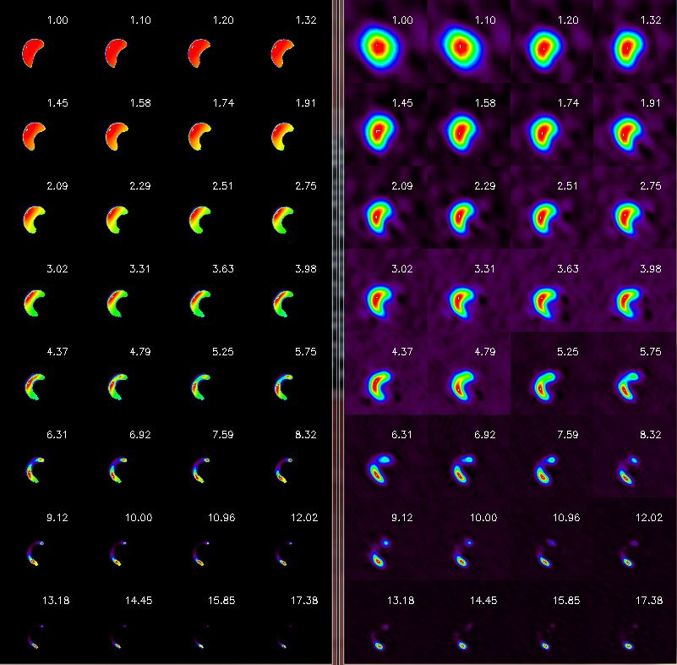
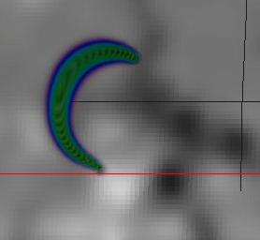
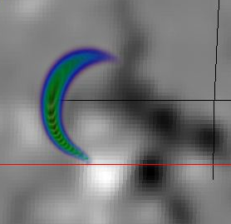
Flaring loop modeling/simulation

Slide 6
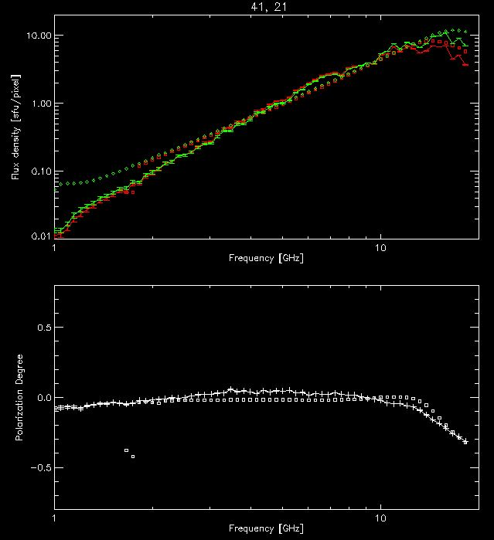
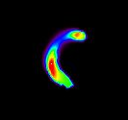
Measuring Flare Magnetic Fields
+

Slide 7
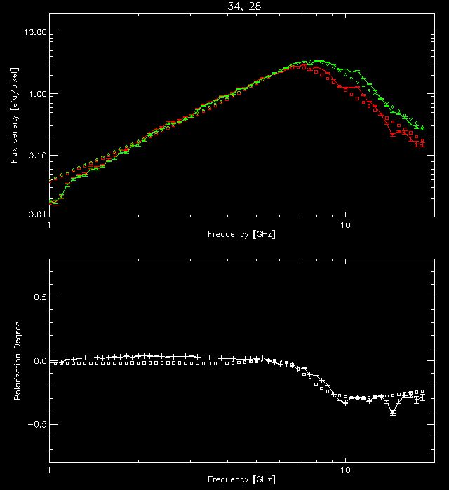
Measuring Flare Magnetic Fields
+

Slide 8
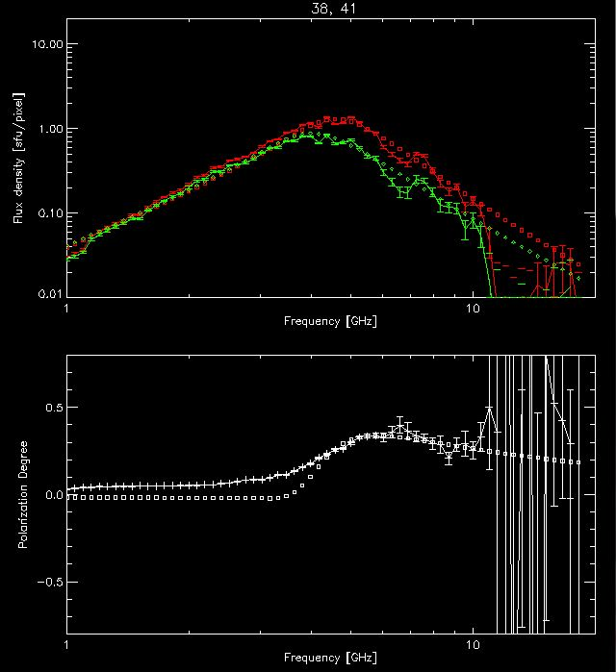
Measuring Flare Magnetic Fields
+

Slide 9
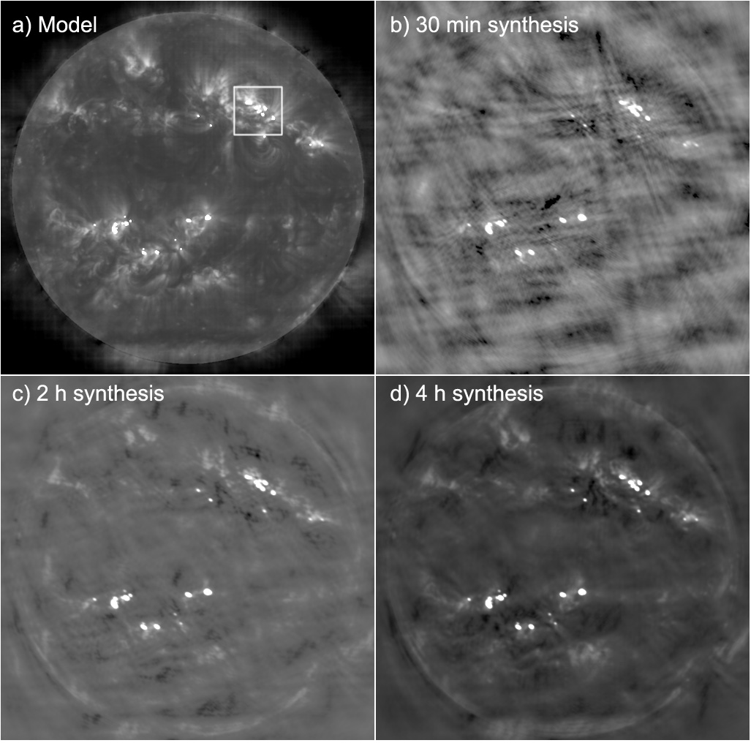
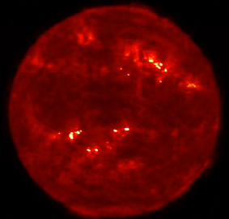
magnetic and plasma structure of active regions

Slide 10
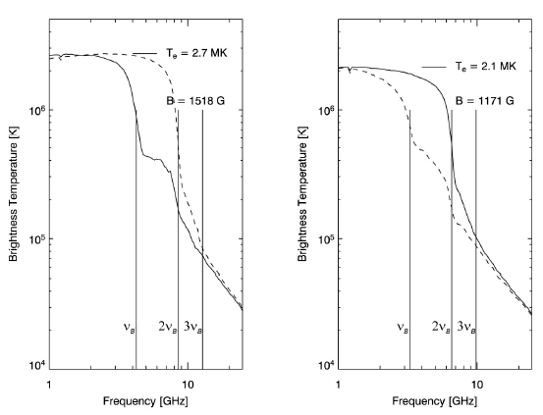
Active region/sunspot Spectra
With really excellent imaging, and fine frequency resolution, modeling (confirmed by observation) predicts lots of interesting structure in the radio spectra.
Resolving this structure will give magnetic field strength measurements in the corona, something ONLY radio can do.
Other plasma parameters (temperature, density) are also derivable from these spectra.

Slide 11
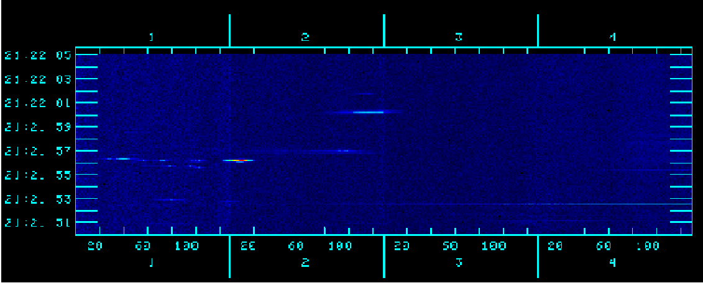
The new VLA's first solar obs. (bin Chen, Tim Bastian)
Time
1.000
1.128
1.256
1.384
1.512
Frequency (GHz)
17 antennas in D configuration, L band (1-2 GHz), 30~70'' resolution
1024 1-MHz channels, 0.1 s time resolution, dual polarization
Observed for ~4 hours, obtained ~600 GB data
Caught an M-class and several small C-class flares, recorded several type III bursts

Slide 12
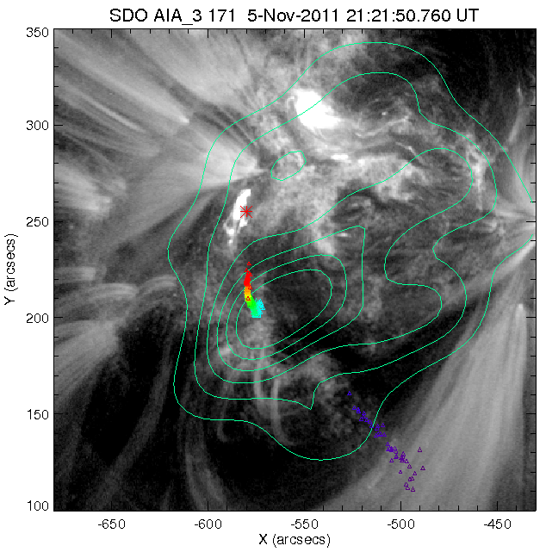
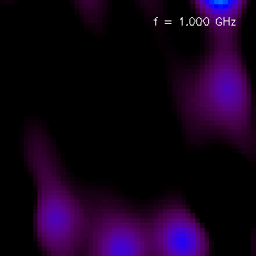
Source locations of Type III bursts
Type III images vs frequency at a given time (1024 images, 1 MHz apart)
Type III emission centroids vs frequency

Slide 13
The analysis challenge
On Saturday, Mar. 03, 2012, the JVLA, observing with 15 antennas, caught a long-lived C-class flare with decimetric emission over at least 18:00-19:30 UT, with 1 MHz frequency resolution, 100 ms time resolution, over 1-2 GHz. The burst contains fibers, RS bursts, pulsations, zebras, spikes…
The EST was also observing (fixed on 1-1.5 GHz), and sees exactly the same structure, at higher time resolution (20 ms).
The JVLA data could be used to make 40,000 images/s!
We are going to need new, highly automated approaches to making multi-spectral images. This challenge is shared directly by EOVSA (and even more so by FASR).

Slide 14
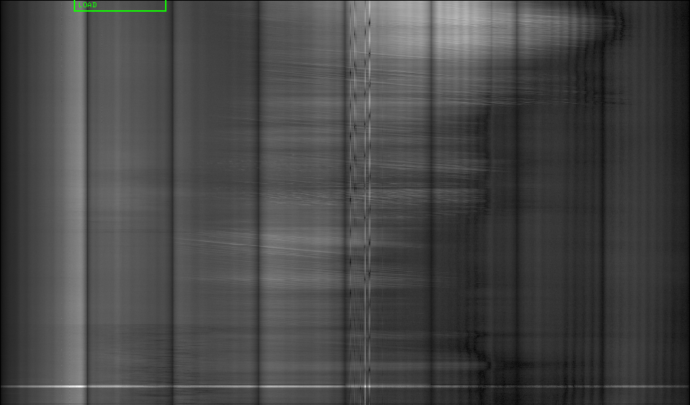
More jvla data (Sat. Mar 03, 2012)
2000
Frequency [MHz]
2 minutes
1000

Slide 15
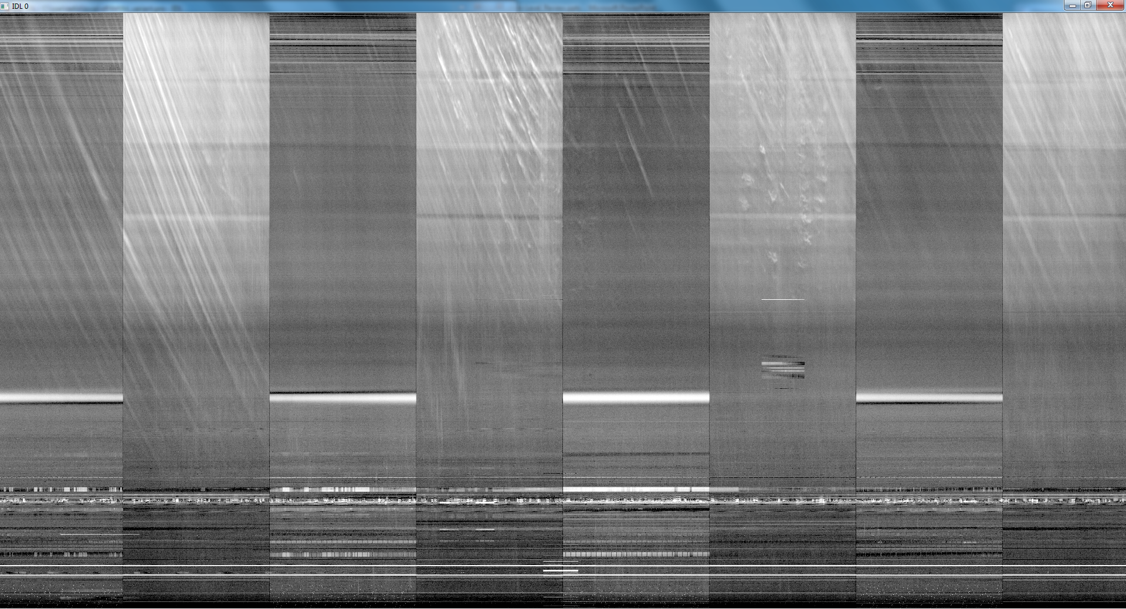
EST Data for (part of) same period
The JVLA can image all of this, but how do we organize this much spectral imaging?

Slide 16
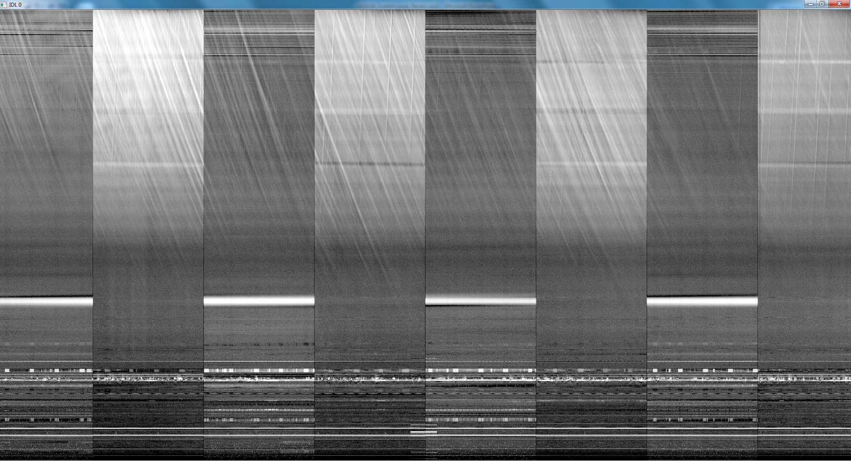
More est data
What are these
RS bursts?

Slide 17
Instrument/Facility requirements
Rapid measurement of 1-18 GHz spectrum (20 ms sample time, <1 s cycle time, ~1 ms dead time)
Excellent amplitude and phase stability (1% amplitude stability—0.04 dB; 1º phase stability, each IF)
Excellent polarization accuracy (15 dB isolation, 20 dB after calibration, 2% overall accuracy)
Excellent calibration (system temperature goals 400 K for 2.1 m antennas, 50 K for 27-m, or equivalent, all bands).
Excellent 27-m sensitivity (15 K system temperature in core bands?)—note 27-m surface accuracy is an issue.
High up-time fraction=>ease of maintenance, 2 subarrays, real-time diagnostics, spares
Real-time data products=>pipeline processing (images, burst spectra, time profiles, web-based data serving)
Community access=>offline analysis package, science center

Slide 18
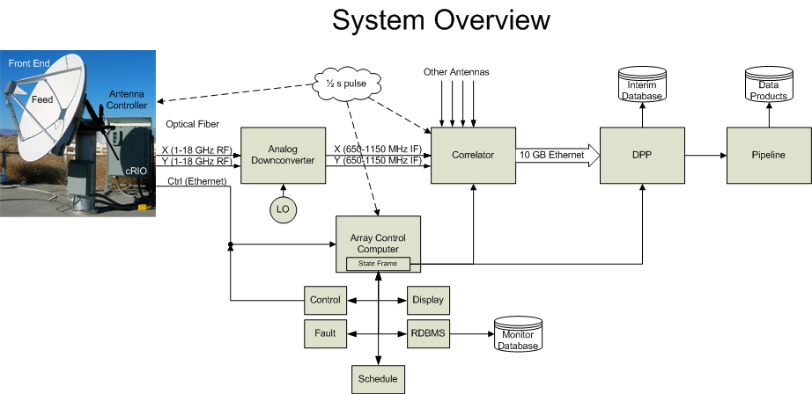
EOVSA System overview

Slide 19
Current statuS
2.1 m antennas
Six are on site, two remaining to be shipped in March.
One is installed at array center, two others to be put on pads 7 and 8 for prototype.
27-m work
Rip-out of old wiring is done.
Installation of new wiring is underway (60% complete), to be done by end of Mar. 2012.
Installation of new control systems Apr. 2-18, 2012.
Repair, painting, surface analysis TBD.
Building installation, Mar.-Apr. 2012 (to be complete by early May. 15)
Central array cabling, Feb.-Mar. 2012
Refurbishment of existing 2 m antennas—latter half of 2012

Slide 20
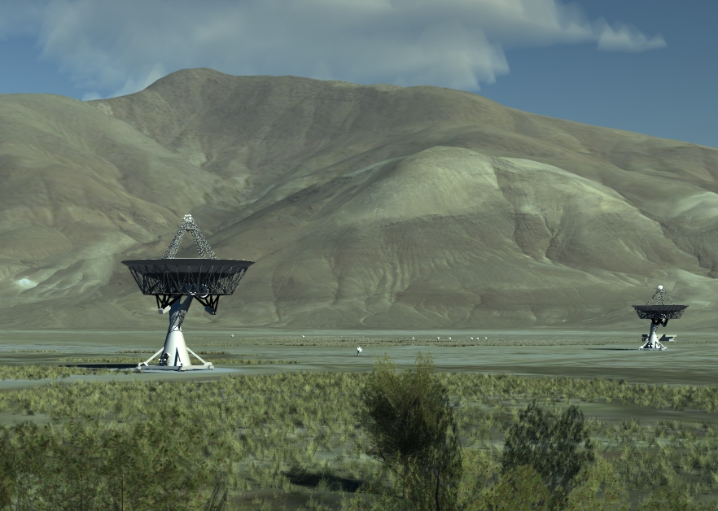
final array

