Slide 1

EOVSA system-level review
Dale E. Gary
Professor, Physics, Center for Solar-Terrestrial Research
New Jersey Institute of Technology

Slide 2
outline
Goals of the Meeting
Science Overview and Challenges
System Overview

Slide 3
Goals of the meeting
This marks the beginning of the final year of the project.
The primary goal of this meeting is to review construction of the three-element prototype, software status, and discuss plans and schedule for evaluation and test leading to a CDR and final build-out of the array.
Additional goals of the meeting:
Examine the budget to ensure that we both spend out the funds by 2013 Sept. 30, and do not fall short in any area.
Revisit all aspects of the design and the interfaces between subsystems to ensure completeness and compatibility.
Thoroughly review the software elements of the system, and identify remaining challenges to prototype operation.
Begin to formulate the database details for the final project.
Revisit the scope of the calibration and data analysis challenge

Slide 4
Science
Four science goals:
Flaring loops and particle acceleration in solar flares
Magnetic and plasma structure of active regions
Drivers of space weather
Nighttime observation of variable and transient sources
Flaring loops:
High temporal and spatially-resolved-spectral resolution (EOVSA is the first and only instrument capable of doing this routinely)
Spatially-resolved spectra provide physical measurements of magnetic field strength and direction, electron energy and pitch-angle distribution, ambient plasma parameters
Science targets are acceleration site, acceleration mechanism, initiation mechanism, transport processes, plasma processes

Slide 5
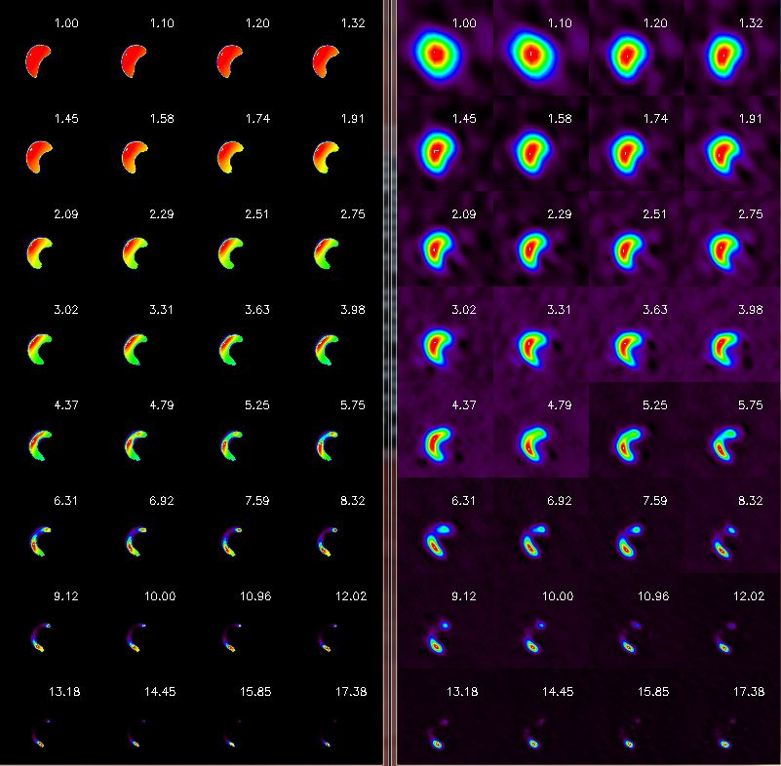
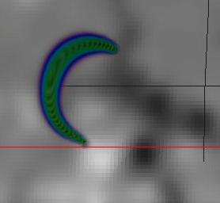
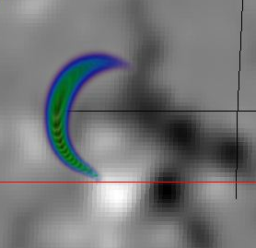
Flaring loop modeling/simulation

Slide 6
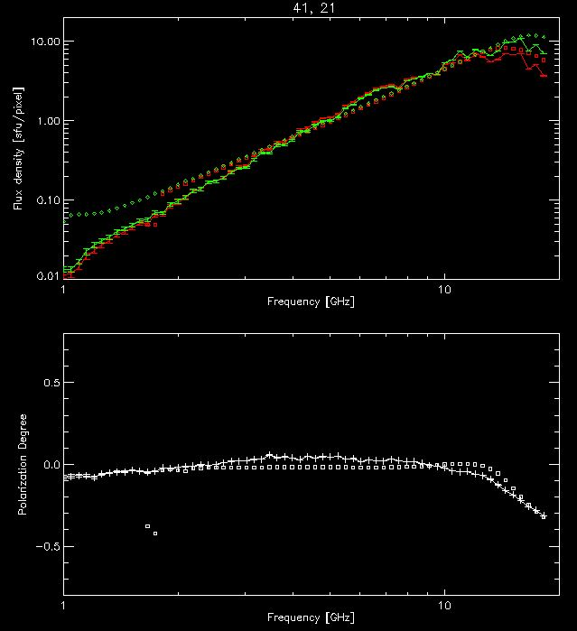
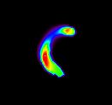
Measuring Flare Magnetic Fields
+

Slide 7
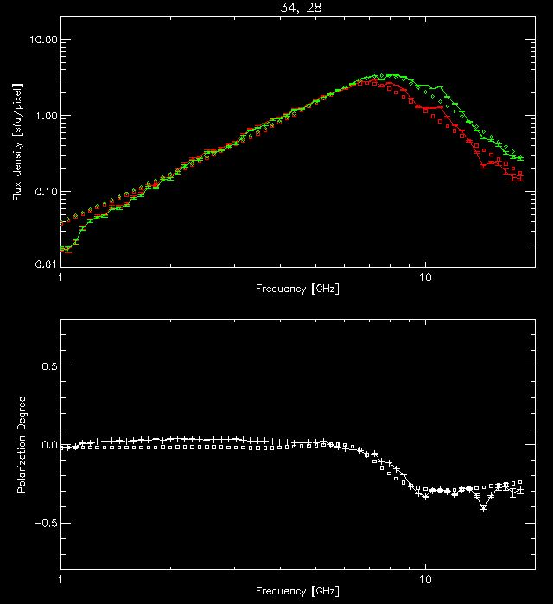
Measuring Flare Magnetic Fields
+

Slide 8
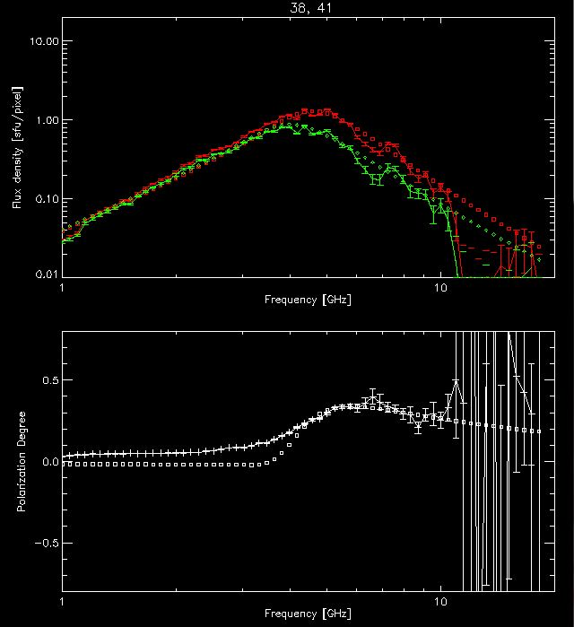
Measuring Flare Magnetic Fields
+

Slide 9
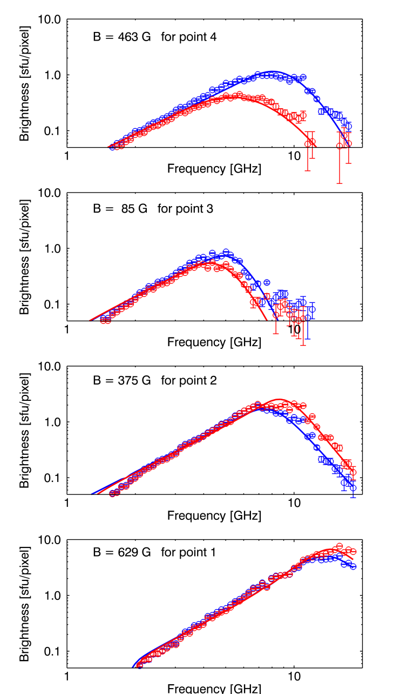
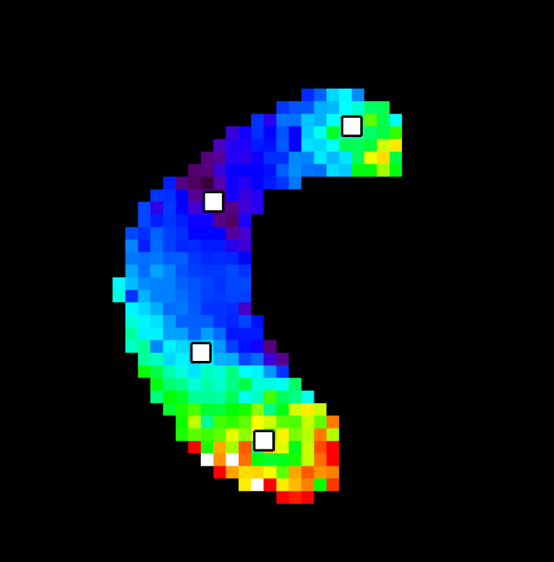
Magnetic Field

Slide 10
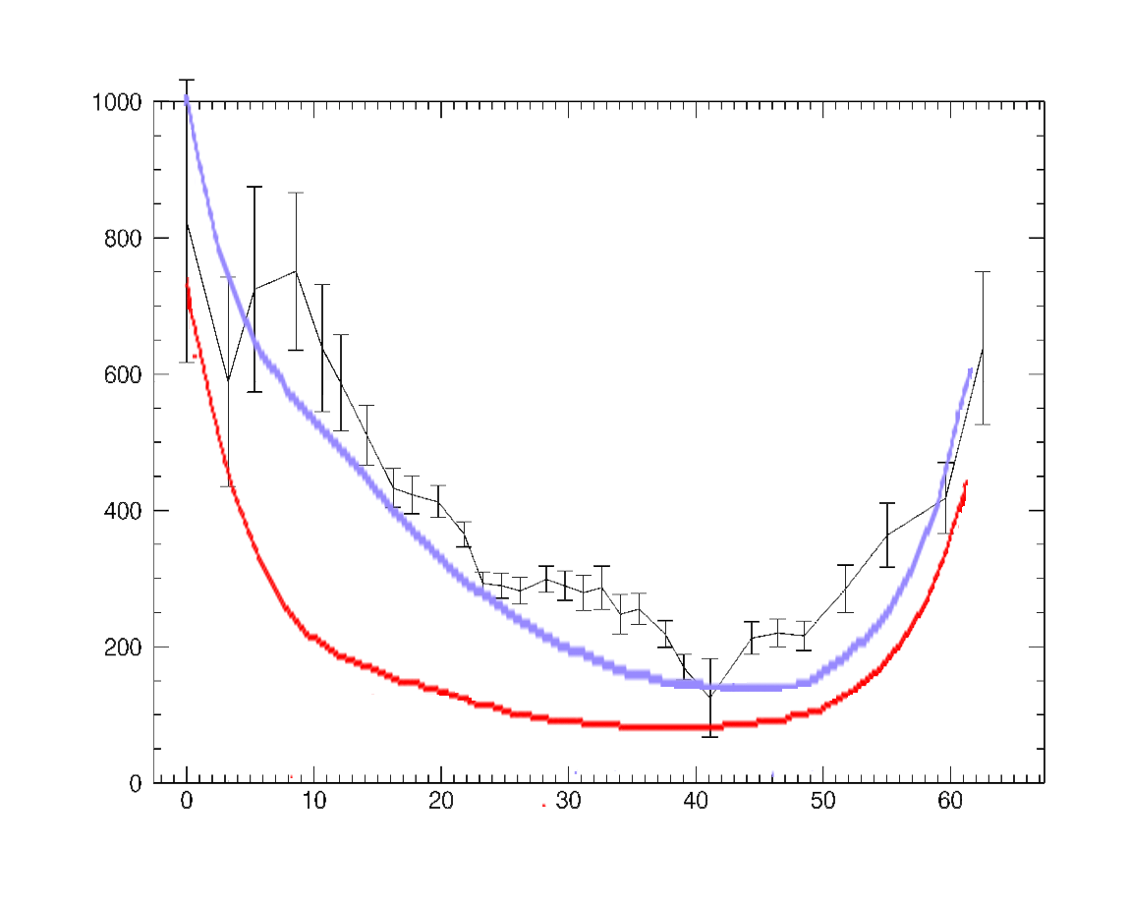
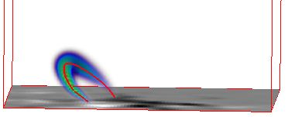
Quantitative Comparison
Fitted B
Perspective View
Model B Max
Model B along axis

Slide 11
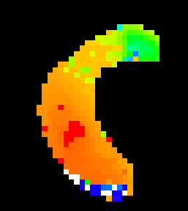
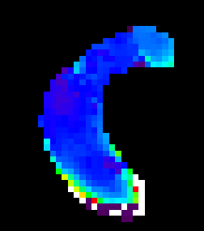
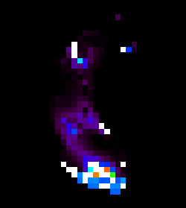
Other Fitted Parameters
LOS Angle
to B
Power-law
Index
Relativistic
Density

Slide 12
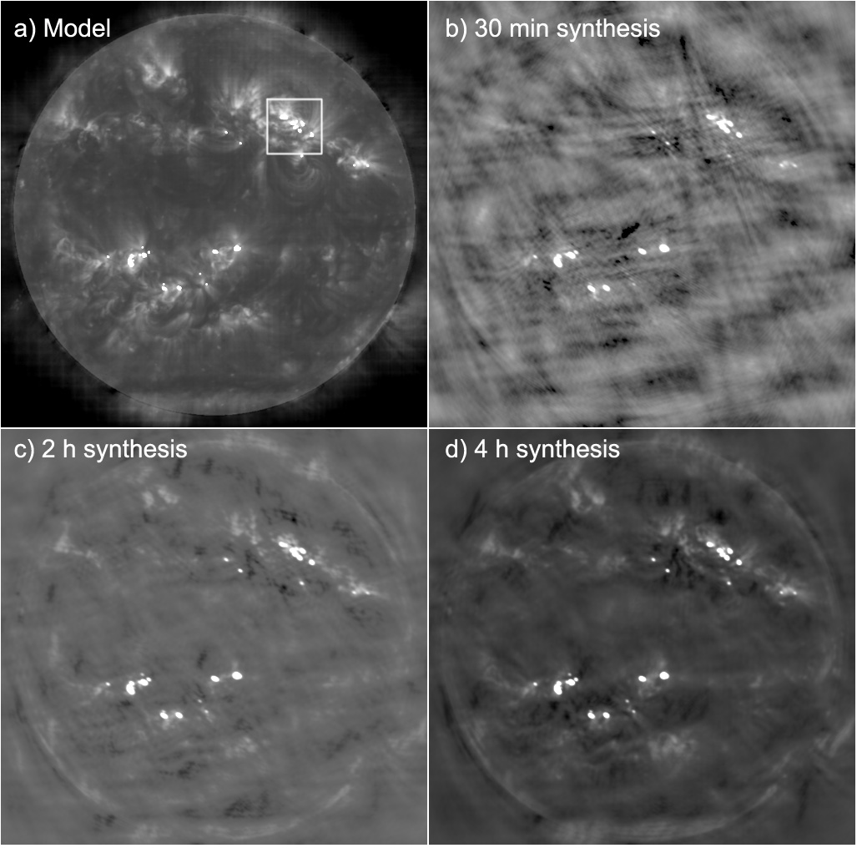
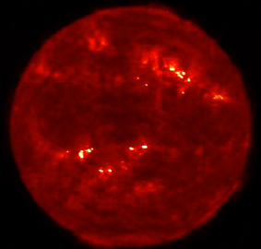
magnetic and plasma structure of active regions

Slide 13
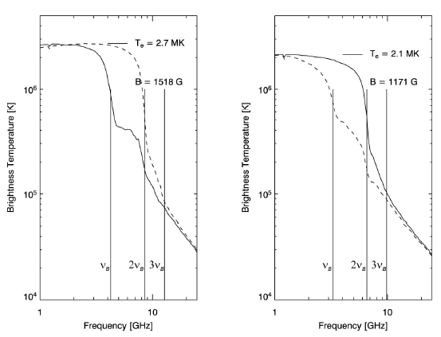
Active region/sunspot Spectra
With really excellent imaging, and fine frequency resolution, modeling (confirmed by observation) predicts lots of interesting structure in the radio spectra.
Resolving this structure will give magnetic field strength measurements in the corona, something ONLY radio can do.
Other plasma parameters (temperature, density) are also derivable from these spectra.

Slide 14
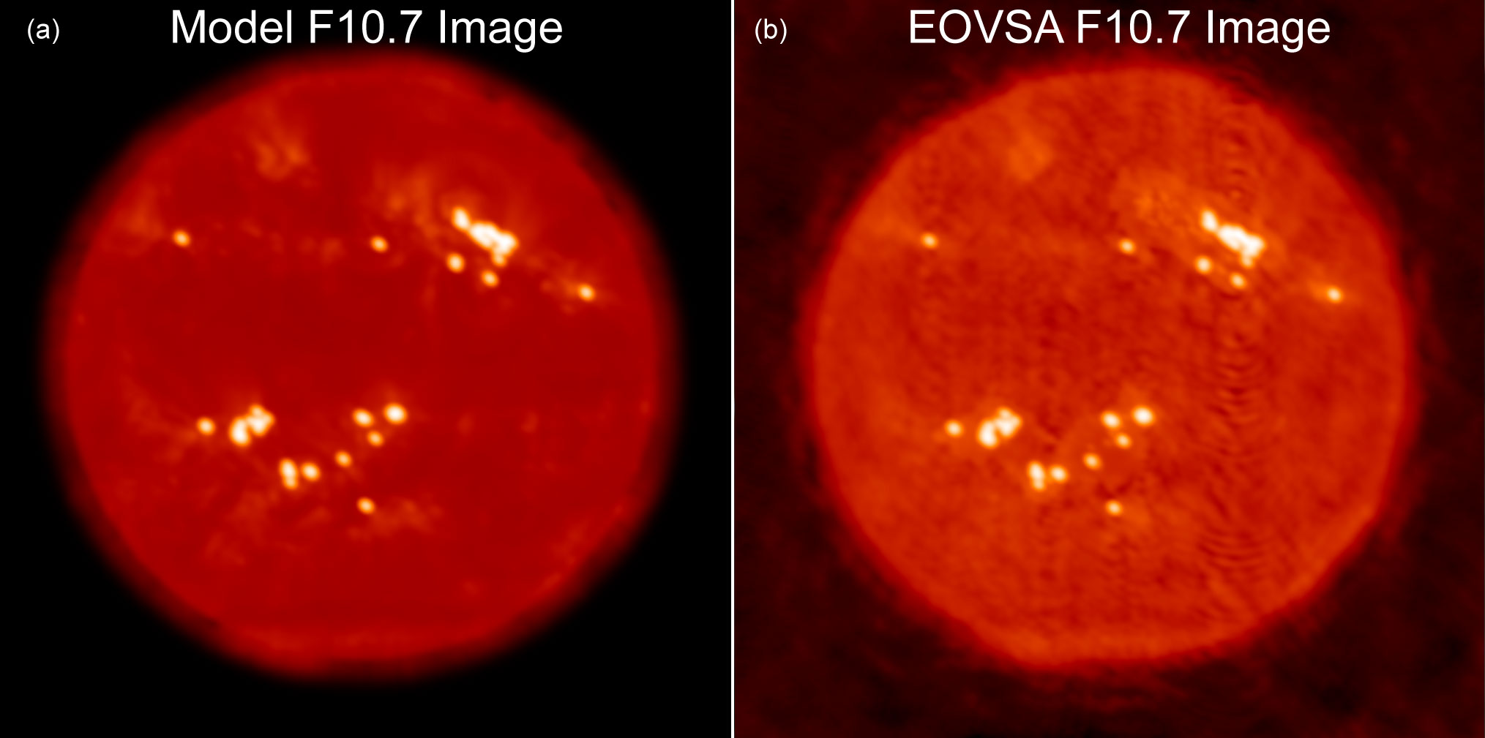
F10.7 images (2.8 GHz)

Slide 15
F10.7 images
The F10.7 solar activity index is a critical component of many models:
As a proxy for the ionizing solar radiation that produces the ionosphere
To gauge space weather effects on satellite orbits and on satellite and low-frequency communication
As input to ionospheric effects on GPS navigation
After a tight correlation of F10.7 on sunspot number and other indicators of solar cycle variability over several cycles, F10.7 seems to have deviated from them at the beginning of cycle 24.
The index is useful because it combines both thermal and magnetic activity. Images permit the separation of these two effects of solar activity, for a more thorough understanding of underlying causes of solar activity variation.

Slide 16
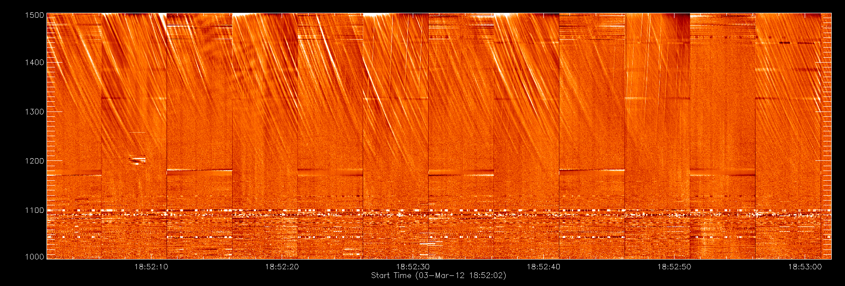
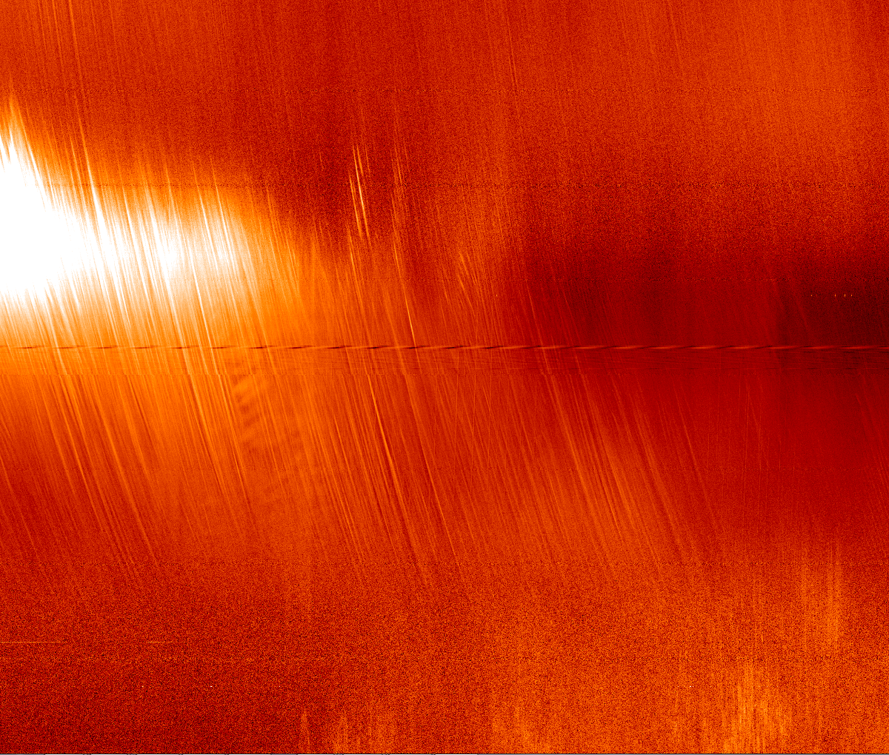
EST Data
JVLA Data
Finally, can image these enigmatic
bursts for the first time. JVLA can
make an image for every time-frequency
bin on this dynamic spectrum

Slide 17
Instrument/Facility requirements
Rapid measurement of 1-18 GHz spectrum (20 ms sample time, <1 s cycle time [0.2 s for 1-3 GHz], ~1 ms dead time)
Excellent amplitude and phase stability (1% amplitude stability—0.04 dB; 1º phase stability, each IF)
Excellent polarization accuracy (15 dB isolation, 20 dB after calibration, 2% overall accuracy)
Excellent calibration (system temperature goals 400 K for 2.1 m antennas, 50 K for 27-m, or equivalent, all bands).
Note: warm receiver is coming in at 570 K, which means cool receiver must be no higher than 35 K. Current design is showing about 15 K, but coupler has to be tested.
Excellent 27-m sensitivity (15 K system temperature in core bands)—note 27-m surface accuracy is an issue.
High up-time fraction=>ease of maintenance, 2 subarrays, real-time diagnostics, spares
Real-time data products=>pipeline processing (images, burst spectra, time profiles, web-based data serving)
Community access=>offline analysis package, science center

Slide 18
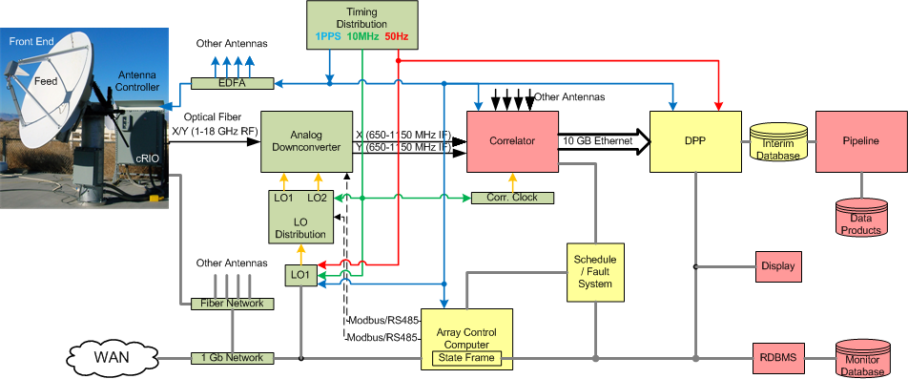

System block diagram

Slide 19
Current Site infrastructure statuS
2.1 m antennas
All have arrived on site. Four are installed, with the three needed for the prototype now available by TCP/IP over fiber.
27-m infrastructure work
Rip-out of old wiring and installation of new wiring is done.
Installation of new control systems is done, but tweaking of controller is still to go (November 2012).
Surface analysis is done—no significant problems reported. The few spots on the backing structure that need repair have had new welding patches.
Final power to antennas yet to be done.
Fiber to antenna B yet to be done.
27-m cryo work
Feed drive mechanism designed, with tweaks pending final feed design.
Final feed design expected soon, but brackets to accommodate range.
Receiver component choices expected this week.
Building is done!
Network rack is fully installed.
Optical fiber from central array to rack is installed.
Equipment racks to be delivered in October.
Refurbishment of existing 2 m antennas—no action yet (DURIP proposal submitted)

Slide 20
Current analog system statuS
I will let Wes describe the status, but essentially all parts for the prototype are ordered, most already delivered, boxes, brackets, etc., are being made, and assembly will begin soon.
The electronics room components (LO distribution module, Timing distribution module, correlator clock module, and the three downconverters) will be done first.
The front-end module will lag somewhat, but attention will be turned to that shortly.

Slide 21
Current digital system status
Nimish will describe this in more detail.
ROACH-2 boards on order (should receive within 2 weeks!) Includes:
Enclosures (2) with fans, power supply
KATADC digitizers (2)
CX-4 mezzanine cards (4)
F-Engine design completed at 150 MHz, not tested.
X-Engine design partially completed, not tested.
NFS boot procedure needs to be tested—will happen next week (during Oct. 1-11).
Additional control via KATCP needs to be developed and tested.

Slide 22
Current monitor/control status
Gelu will describe this in more detail.
Basic plan has been established, and general approach using xml to describe stateframe has been tested.
Communication between cRIO and ACC has been tested.
Actual control of antennas will be developed next week (during Oct. 1-11). Goal is to be able to track the Sun under Schedule control with the three prototype antennas by then.
Schedule infrastructure has been designed and some parts tested, more to be done Oct. 1-11.
Coordinate calculation will use Aipy Python software, to generate delays and u,v,w coordinates. Aipy also includes some Miriad data handling and may be useful for pipeline scription.

Slide 23
Digital packaging processor
Gordon and Jim will describe this in more detail. I may not have the details right, but the following is my understanding:
Software can receive data from two sources (two files, but simulates two UDP ports) and assemble them correctly, and present them to the packaging processor.
The packaging processor averages frequency channels and has hooks for phase and amplitude corrections, and writes out valid Miriad data files.
Also can form SK and create/apply RFI flags.
How will DPP receive and use 1 pps and 50 Hz hardware signals? Has a suitable digital i/o board been identified?

Slide 24
Budget Status
CATEGORY | AMOUNT BUDGETED | TOTAL EXPENDED | ENCUMBERED | PROJECTED | REMAINING | PERCENTAGE REMAINING
Salaries | 906,293.00 | 401,403.50 | 127,962.24 | 142,443.46 | 234,483.80 | 25.87%
Fringe | 221,660.00 | 109,354.77 | 41,065.15 | 34,837.40 | 36,402.68 | 16.42%
Equipment | 2,299,786.00 | 1,176,466.61 | 196,359.69 | - | 926,959.70 | 40.31%
Supplies | 23,000.00 | 15,640.33 | 4,365.62 | - | 2,994.05 | 13.02%
Travel | 66,500.00 | 39,514.82 | - | - | 26,985.18 | 40.58%
Other | 12,500.00 | 11,502.40 | 1,782.00 |  | (784.40) | -6.28%
Consultants | 200,585.00 | 77,316.94 | 70,628.06 | 52,640.00 | - | 0.00%
Subcontracts | 476,338.00 | 111,548.08 | 230,282.92 | 134,507.00 | - | 0.00%
Capital Improvements | 79,758.00 | 74,129.62 | - | - | 5,628.38 | 7.06%
Tuition | 119,465.00 | 38,278.00 | - | 11,574.00 | 69,613.00 | 58.27%
Indirect Costs | 715,699.00 | 325,693.98 | 133,869.18 | 94,078.61 | 162,057.23 | 22.64%
TOTAL | 5,121,584.00 | 2,380,849.05 | 806,314.86 | 470,080.47 | 1,464,339.62 | 28.59%
EQUIPMENT ($927 k remaining)
10 more front-ends and components 300.0
10 more auxiliary boxes and components 25.8
12 more cRIOs 12.0
12 more downconverter modules and components 256.7
Misc. Racks, Cables 8.7
1 additional Hittite synthesizer 19.5
6 more ROACH-2s and enclosures, cables Arista switch 61.8
Computers 23.0
2-m reflectors 50.0
2 cryo-receivers and feed horns for 27-m 80.0?
2 compressors, coolers. cryostats, for 27-m 33.0
2 feed-positioning apparatuses (apparati?) 25.0?
Fiber and splicing 30.0
27-m power trenching 25.0
2 solar power stations 40.0
TOTAL 990.5
SALARIES ($234.5 k remaining)
Considering hiring a postdoc, but must be soon. Any ideas?
Should also seek at least one additional grad student, perhaps from EE.
TUITION ($69.6 k remaining)
Most of this will remain unspent, and can be moved to another category.
CONSULTANTS
At least $15 k of consultant encum-brance will return to us, but more will be spent.

Slide 25
Budget notes
We have one more year to spend remaining dollars (no extensions!).
The budget is tight, but it should be, given that we want to have zero dollars at the end of the project.
Overall, the spend-out looks about right, with a slight surplus showing, but many costs not exactly known. Also, undoubtedly travel costs will exceed remaining budget (this meeting, CDR, travel and stays at OVRO). We should remain in a mode where we minimize costs (without jeopardizing quality).
I will explore adding a postdoc and a grad student (EE) to the project in the final year, and possibly also support for a CS student.
If we have funds remaining near the end of the project, we might consider using them to support a community tutorial meeting.

Slide 26
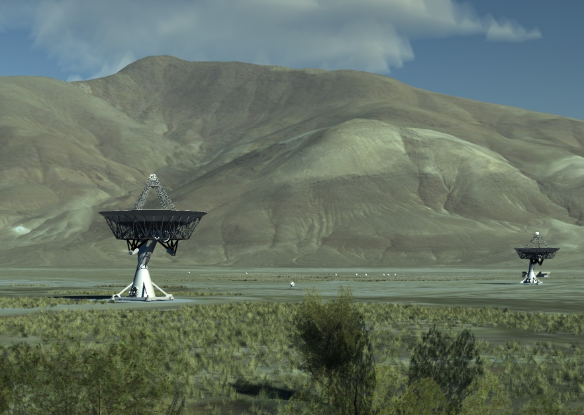
final array

