Slide 1
Front End and Back End analog subsystems
EOVSA Technical Meeting, 6-9 November 2011
W. Grammer, NRAO/NJIT

Slide 2
OUTLINE
Overview
System-level diagram
Ambient-Temp Front End (2-meter antenna)
Apex module
Control cabinet
Cryogenic Front End (27-meter antenna)
Analog Back End
Fiber RX and Block Downconverter
LO generation and distribution
Mechanical layout

Slide 3
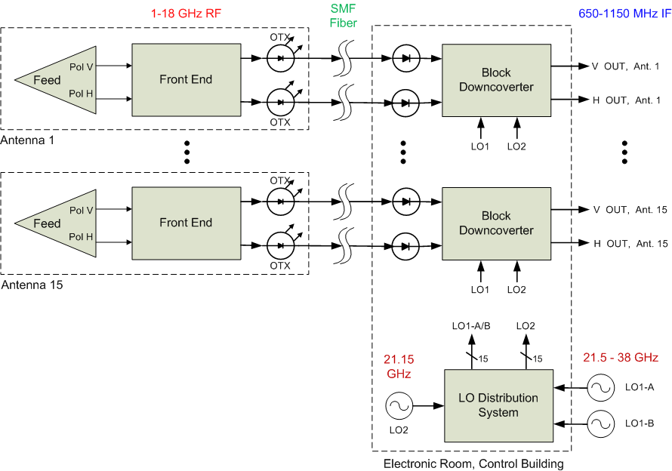
Analog system overview

Slide 4
General Characteristics
13 x 2-m + 2 x 27-m antennas
Ambient-temp. 2-m front end, Tsys < 400K
Cooled 27-m front ends, Tsys ~ 50K (goal)
Orthogonal linear polarization outputs
Tunable RF sky frequency range: 1 - 18 GHz
IF baseband output bandwidth: 500 MHz
Full RF BW analog transmission out of antennas, via SM optical fiber, ~ 1.2 km max.

Slide 5
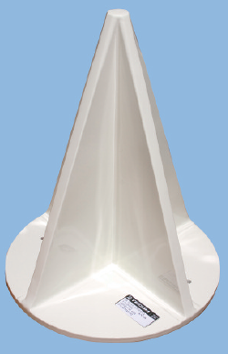
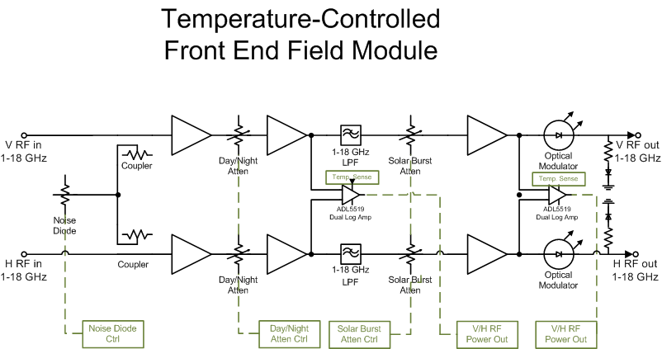
Feed and front end
Tecom 1-18 GHz Feed

Slide 6
Power budget in front end
−35 dBm
−50 dBm
−60 dBm
−70 dBm
0 dBm
−15 dBm
−25 dBm
−35 dBm
−10 dBm
−25 dBm
−35 dBm
−35 dBm
5 dBm
−10 dBm
−20 dBm
−20 dBm
−20 dBm
−20 dBm
−20 dBm
−20 dBm
+7 dBm
+7 dBm
+7 dBm
+7 dBm
0/10 dB
0-25 dB
35 dB
~15 dB
~27 dB
How do we use noise diode cal source? Assume only on blank sky, not during flares.
φ -switch inversion?

Slide 7
Front end component selection
System-level considerations
Dynamic range
High linearity
Requirement driven by RFI levels, detection limit
Min. gain ripple/slope, any 500 MHz segment
Depends on quantization level in Correlator?
Low gain and phase drift (small T_{C})
May require temp. control; one-sided (no TECs)?
Reliability
Elevated temp. environment (> 40 ºC); lightning protection ?

Slide 8
Front End Component selection
LNA
For Tsys < 400K, NF ~ 2 dB may be OK, if feed loss < 1.5 dB across band
Possible sources: Caltech, Microsemi, others ?
2nd/3rd Stage Amps
Need additional gain to compensate for loss of added output pads (for LF stability), and min. loss of filter, attenuators
Low Tc of gain desired – may require eval. testing
Could use a VGA for 2nd or 3rd stage, if available
Possible sources: PMI, Miteq, Microsemi, Hittite, Marki, AMI

Slide 9
Front End Component selection
Digital RF Attenuators
Step resolution: 1 dB is sufficient
Phase change w/atten. set is not an issue – calibrated out
Possible sources: Narda, JFW, Herley, Hittite
Couplers/Splitters
Possible sources: Narda, MCLI, M/A-Com?
1-18 GHz Lowpass Filter
Rejects RF signals at 20-20.5 GHz from leaking through
Possible sources: K&L
Noise Diode
Possible sources: Noise-Com

Slide 10
Front end module - mechanical
Envelope is a 12” dia. cylinder (or ~ 8.5” x 8.5” rectangular box), TBD length
Weight limit is 20 lbs., pref. center of mass close to mounting plate
Component layout and packaging a challenge:
Some components (e.g., couplers) are quite long
Heat-generating components within a sealed outdoor box make thermal management difficult
Recommend thermal modeling – NRAO has software (?)

Slide 11
Problematic In-band rfi at site
Known strong fixed source at ~1.95 GHz
May require a notch filter after LNA or 2nd stage amplifier, with >20 dB rejection
Passive notch filter properties
Need very high Q for a sharp, narrow-band response, combined with flat passband to 18 GHz.
May be difficult to design, as it also has to be compact
Interference cancellation could be an elegant alternative, but may add complexity and cost
Need to research both, determine which is viable

Slide 12
Antenna control cabinet
Primarily for vendor-equipped motor controllers, power distribution for 2-m antenna
Space was provided for cRIO M&C unit, not much else
Addition items for installation at each antenna:
Fiber breakout box, 6 conn. ports + 1 duplex cable
Ethernet switch (1 x optical, ~4 x RJ-45)
Optical demodulator for 1PPS timing signal
Front End temperature control electronics
Power supplies for Front End and all the above
May want a 2nd cabinet for above items.
Can easily be located on same stand as existing box, or back-to-back.

Slide 13
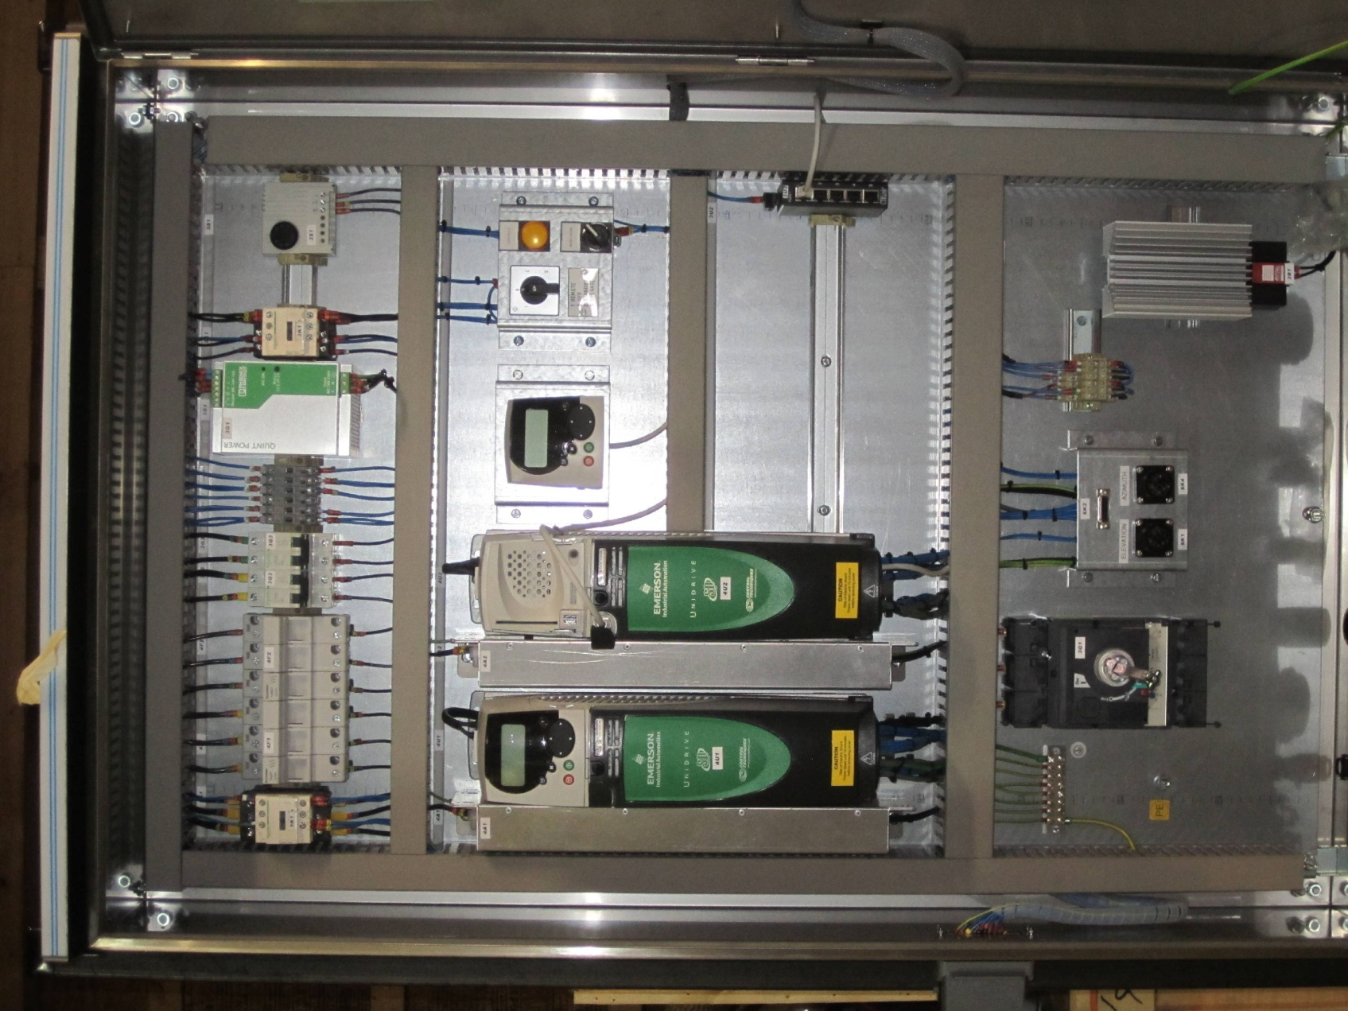
Photo of antenna cabinet

Slide 14
Ant. Cabinet component selection
Fiber breakout box
Details TBD
Ethernet switch
Min. (4) Cat5 + full duplex SM opt., 10/100 Mbps
1310 nm wavelength chosen; use same at other end
Extended temp. range (-20 to 70°C); high MTBF
Possible sources: Moxa, Phoenix Contact, Black Box, TC Communications)
Moxa unit is very competitively priced (~$400), rugged, and has EMI and other certifications.

Slide 15
Ant. Cabinet component selection
Optical RX/Demodulator for 1PPS, timing
How are they generated optically? BPSK or AM-modulated RF subcarriers over fiber?
COTS product or custom design, depending on reqs.
Should be fairly compact, low-power, robust
Other requirements?
Front End temperature control
Heat-only is simpler, more reliable, BUT only if OK to run at elev. temps (~50-55°C).. Can use PWM AC – no DC supply.
TEC requires hefty low-voltage DC supply, external heatsink, fans. Reliability a concern.
cRIO can be used for M&C, or separate COTS controller (remoted)
Mechanical thermal cutoff switch on heaters (Klixon), for safety

Slide 16
Ant. Cabinet component selection
Pointing telescope controller?
Is a temporary installation for a one-off measurement – do not need to support this
Power supplies
Recommend linear supplies for Front End module electronics, to avoid risk of spurious switching noise modulation on output signals
Switching supplies can be used for everything else
Recommend adding diagnostic M&C points for all supply outputs (voltage and currents)

Slide 17
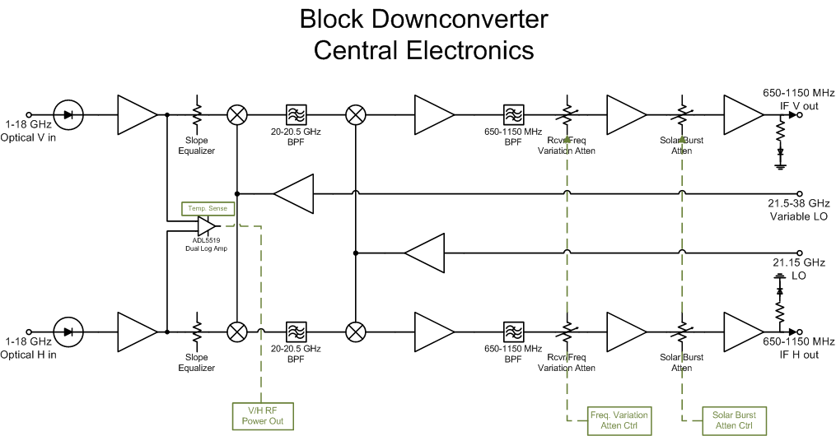
Analog downconversion

Slide 18
Power budget in back end
−35 dBm
−35dBm
−35 dBm
−35 dBm
−5 dBm
−5 dBm
−5 dBm
−5 dBm
solar + band variation
solar variation
−15 dBm
−30 dBm
−5 dBm
−15 dBm
−15 dBm
−15 dBm
−5 dBm
−5 dBm
30 dB

Slide 19
Back end component selection
Important considerations
Good dynamic range
High linearity (for in-band RFI)
Minimal passband gain ripple
Highly stable gain/phase with temperature
High spurious and image rejection

Slide 20
back End Component selection
Amplifiers
Need somewhat more overall gain, to compensate for addl. fixed pads on mixer and filter ports
Low Tc of gain desired – may require eval. testing
Could use VGA(s) w/integrated digital attenuator
Possible sources:
(RF): PMI, Miteq, Microsemi, Hittite
(IF): M/A-Com, Mini-Circuits, PMI, Hittite, Microsemi, RFMD, Analog Devices
(LO): Hittite, Marki, Microsemi, PMI
May need isolator on LO amplifier inputs, to reduce LO output ripple
Equalizer
Active “cable amp” with positive gain vs. freq. slope, compensates for negative slope from cables over ultra-wide 1-18 GHz band
Sources: PMI

Slide 21
back End Component selection
Digital RF Attenuators
Step resolution: 1 dB is sufficient
Phase change w/atten. setting a concern?
Possible sources: Narda, JFW, Herley, Hittite, Mini-Circuits
Mixers
Ultra-wide bandwidths might require triple-balanced design, for adequate higher-order rejection (TBC).
Minor downside of this is higher LO power requirement
Possible sources: Marki, Miteq, Hittite ?, M/A-Com ?
Microwave (1st IF) bandpass filter
Small fractional bandwidth (~2.5%) makes it more difficult to get sharp passband response. A cavity filter design might work well here.
What level of LO and spurious rejection is required?
Possible sources: K&L, Narda?, MCLI?

Slide 22
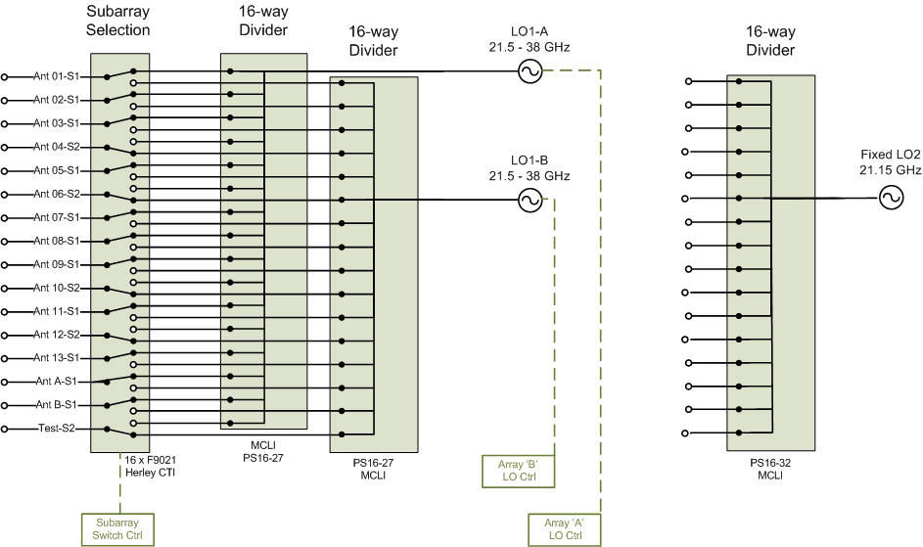
LO distribution system

Slide 23
LO distribution component selection
Hittite HMC-T2240 Synthesizer selected for LO1
Broad tuning range: 10 MHz – 40 GHz, 1 Hz resolution
+20 dBm min. output over LO1 tuning range
-52 dBc spurious subharmonics over LO1 tuning range, +10 dBm output
SSB phase noise (dBc/Hz @ f_offs), fo = 30 GHz:
-50 @ 10 Hz; -83 @ 1 kHz; -87 @ 100 kHz
-106 @ 1 MHz; -128 @ 10 MHz; < -140 dBc/Hz n.f.
10 MHz int/ext ref.; < 1 ppm/yr. drift, 1.5 ppm acc.
500 us freq. sw. time; not freq-agile
Manual or remote control via USB, GPIB or Ethernet
Dual-unit rack mount kit available

Slide 24
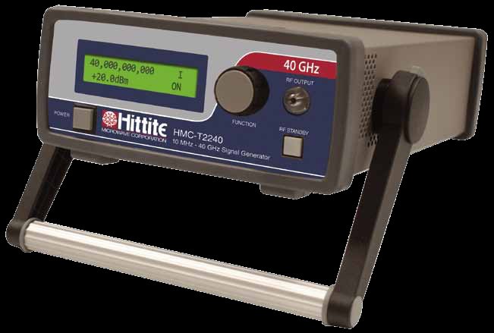
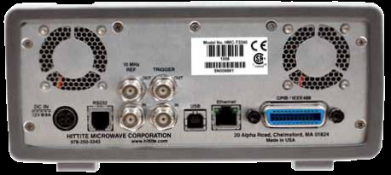
Hittite hmc-t2240 Synthesizer

Slide 25
LO distribution component selection
Fixed-tuned LO2 synthesizer (21.15 GHz)
Comparable phase noise, spurious specs to LO1
Assume +20 dBm minimum output (TBC)
Internal ref. not needed – locked to LO1 10 MHz reference output (+10 dBm available)
Compact box module w/ext. DC supply preferred, mounted close to 16-way splitter
M&C functions: Lock and Alarm outputs, output power monitor
Possible sources: Miteq, Frequency Sources ?

Slide 26
Lo distribution component selection
16-way Power Dividers
Possible sources: MCLI
Coupled RF detector on one output, remotely monitored
Cabling
2.9mm coax required for single-mode operation to 40 GHz on LO1 lines.
Higher unit loss than .141 semi-rigid SMA
More costly
Recommend same for LO2 lines
Length matching LO dist. cables on each subarray?
Greatly reduce differential phase drift over temperature
Need to check cable properties to quantify this effect

Slide 27
LO Distribution component selection
Suggest a non-reflective SP2T switch, if available
Reflections from unterminated switch ports degrade isolation between the splitter ports
Will reduce power reflected back into LO source
Consider using a mechanical coaxial switch
Much higher isolation, w/lower VSWR and insertion loss
100ms switching time, cycle life OK in this case (unless we opt for “ping-pong” LO1 A-B switching, to get around limitations of Hittite LO1 source).
Single DC supply, low power (if latching)
Possible candidate: Dow-Key 521Y series

Slide 28
Back End Power, M&C, packaging
Recommend linear DC supplies for analog components in signal path, for same reasons as in Front End
Rack-level monitor and control unit will be cRIO
Co-locate LO distribution network in the same rack, close to Downconverter modules, to keep cable lengths as short as possible
Lay out modules for flow-through cooling? More constrained, but more uniform temperature distribution across modules.

Slide 29
General questions & comments
Does construction budget include component spares? What level? (Ans: unknown)
What is the expected operational life of EOVSA? (Ans: assume 5 years, but could be longer)
Subsystem documentation standards? (Ans: None at the moment)

