Slide 1
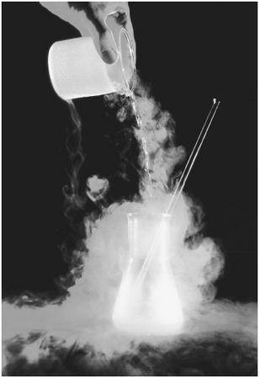
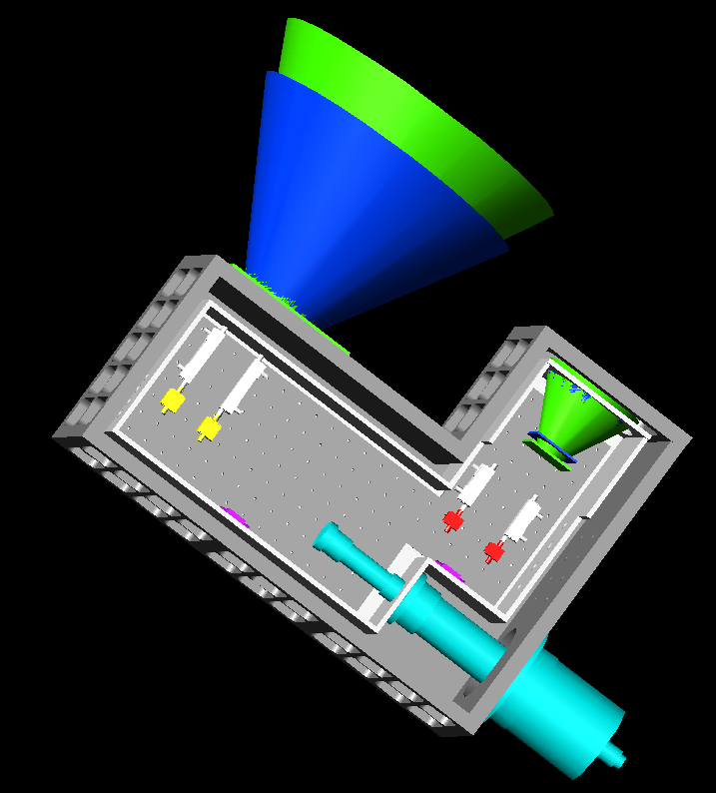
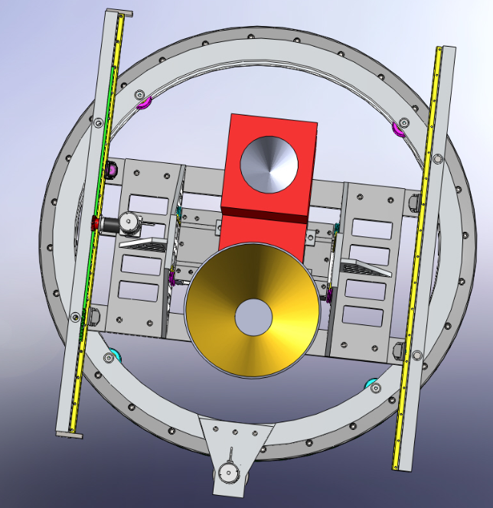
COLD FRONT END STATUS

Slide 2
OUTLINE
RF Cryo System
Mounting Apparatus
27-m cryo upgrades

Slide 3
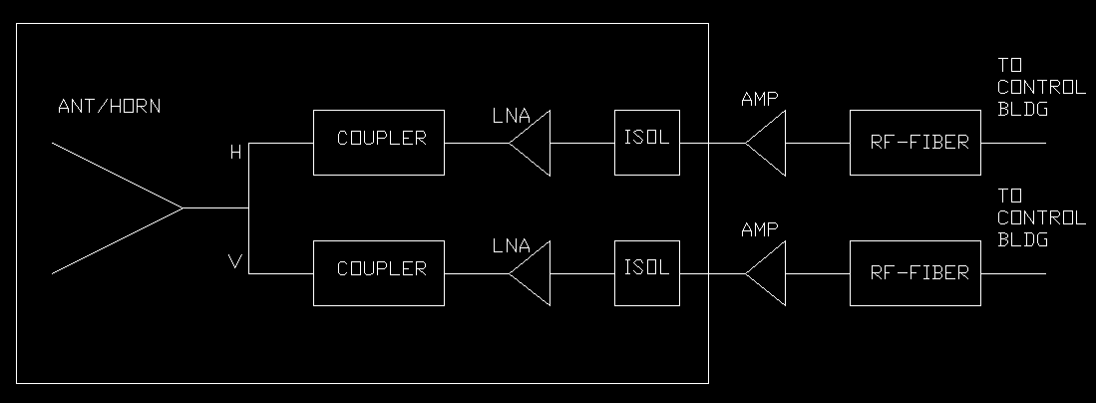
RF System
Noise temps of < 50K from 1-18GHz
1% Amp Stability, 1 degree phase stability
Polar accuracy: 15 dB isolation
Need as much amplification as needed to satisfy power requirements of RF-fiber converter (which is 7dBm, requiring about 86dB of gain). Most likely 2 amps in addition to the LNAs.
Notes:
In principle, it’s pretty simple.

Slide 4
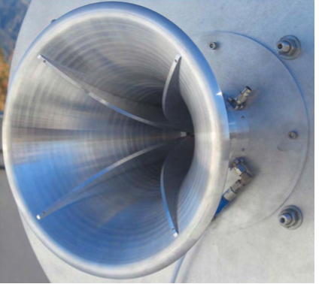
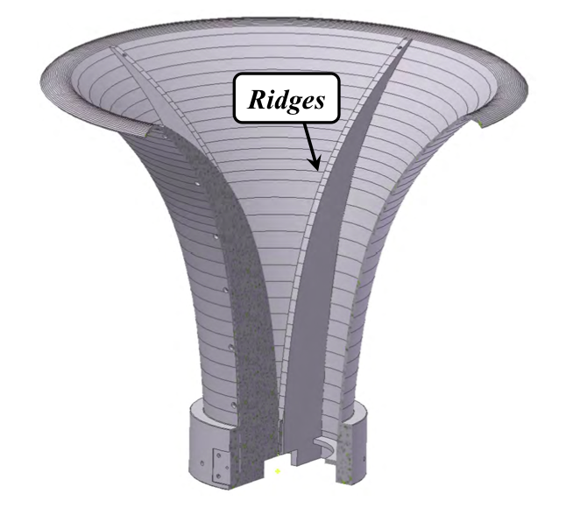
Horns
Single horn not available for cover full band.
Dual-Pol horns with low spillover available from Sandy Weinreb’s lab that operate over factors of 6 in frequency.
RF System
Notes:
In principle, it’s pretty simple.

Slide 5
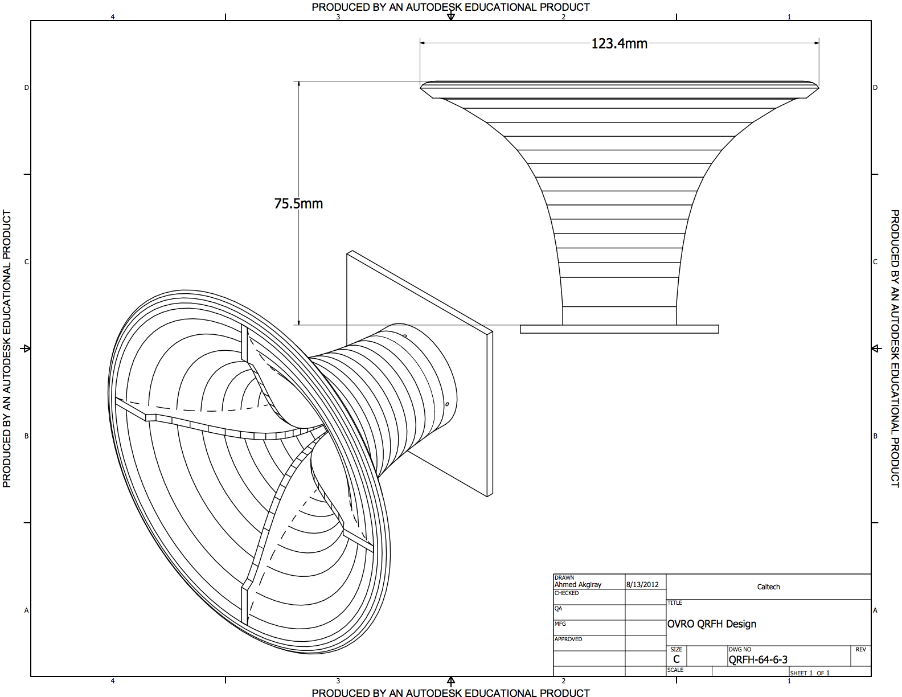
Horns
Split into 1-6GHz and 3-18GHz.
Physical size of 1-6GHz horn, means we can only easily cool the higher-frequency horn.
RF System
Notes:
In principle, it’s pretty simple.

Slide 6
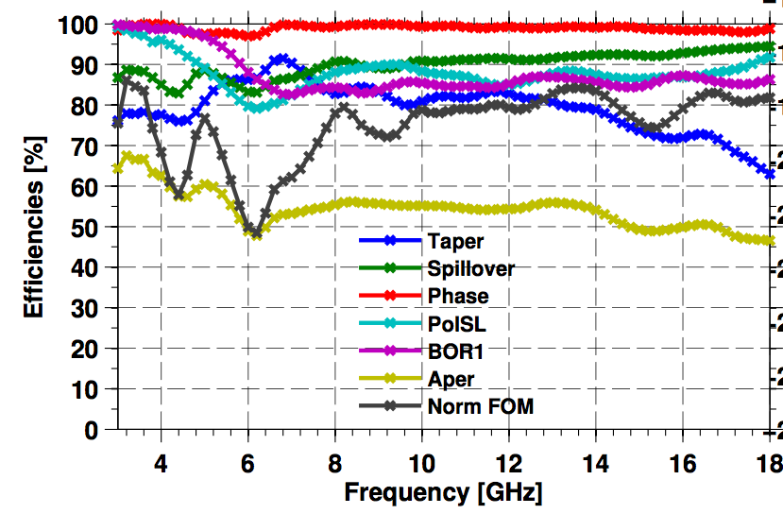
Horns
Ahmed Agkiray currently refining design (best design so far has aperture efficiencies of ~50% at highest frequency.
Once design is complete, they will be machined at OVRO by Tomi Hovatta/Stan Hudson.
Cost of tools for machining < $1K.
Cost for metal is < few $K (getting estimate)
Can make one large horn in 2 weeks.
RF System
Notes:
In principle, it’s pretty simple.

Slide 7


Couplers
Since there are before the LNAs, must have lowest insertion loss possible.
They must also work at cryo temps.
Available vendors are Krytar and Atlantec
Cryo testing last week showed both perform at cryo temperatures, and IL reduces by 0.1dB at low frequencies and up to 0.4dB at higher frequencies.
RF System
Notes:
In principle, it’s pretty simple.

Slide 8
Couplers for 1-6GHz system
The large size of Krytar 158020 requires a cable with right-angle connectors which increases the IL by 0.1dB. Resulting change in receiver temperature is 0.6-0.8K.
Using Atlantec 1-4GHz gives rx temps 3K lower, but sacrifices 4-6GHz.
Company | Model Number | Operating Frequency | Insertion Loss (dB) | Cost/ unit | Physical Dimensions (LxWxH in)
KRYTAR | 158020 | 0.5-8 GHz | <0.8 | 450 | 5.25x0.72x0.53
KRYTAR | 180120 | 1-18 GHz | <0.95 | 459 | 3.50x0.73x0.53
ATLANTEC | A2034 | 1-4 GHz | <0.45 | 965 | 2.90x0.60x0.38
ATLANTEC | A4238 | 1-18 GHz | <0.90 | 965 | 3.47x0.70x0.38
RF System
Notes:
In principle, it’s pretty simple.

Slide 9
Couplers for 3-18GHz system
In this case, Krytar seems like the better option.
NOTE: ATLANTEC components are manufactured in the UK.
Company | Model Number | Operating Frequency | Insertion Loss (dB) | Cost/ unit | Physical Dimensions (LxWxH in)
KRYTAR | 1824 | 2-18 GHz | <0.7 | 419 | 2.08x0.69x0.53
KRYTAR | 180120 | 1-18 GHz | <0.95 | 459 | 3.50x0.73x0.53
ATLANTEC | A4248 | 2-18 GHz | <0.90 | 965 | 2.09x0.70x0.50
ATLANTEC | A4238 | 1-18 GHz | <0.90 | 965 | 3.47x0.70x0.38
RF System
Notes:
In principle, it’s pretty simple.

Slide 10
Low-noise Amplifiers
Components with longest lead-time.
These have already been ordered (~4K each)
CIT1-12GHz amps have typical gain of 32dB and noise below 5K.
Measurements from first 3-18GHz amps already built show a gain of ~35dB and noise below 10K across whole band.
Should be delivered in December.
RF System
Notes:
In principle, it’s pretty simple.

Slide 11
Isolators
Isolators are analogous to RF diodes: they let power go through over a given band but reject most of what comes back.
These are necessary if the interaction of amps with subsequent components have poor matches → leads to high reflection.
This can cause standing waves which can induce oscillations.
There are NO isolators available which work over the frequency we need, so one way to deal with reflections is by using attenuators.
Depending on how much attenuation we need to use, this might require additional amplification to get to desired power levels.
RF System
Notes:
In principle, it’s pretty simple.

Slide 12
Secondary Amps
We will need at least one stage of secondary amplification (and most likely two)
Placing the secondary amp on the 77K radiation shield could lower the receiver temperature of the warm system by up to 5K**, so we would ideally want an amplifier that can be cooled to cryogenic temperatures.
To save cost (buy in bulk), these should operate over full band.
Product | Frequency | Typical Gain | Typical Noise | Unit Cost | Cryo-ready
Atlantec AOX | 1-20 GHz | 27 dB | 0.5-2.0 dB | 869 | YES
CIAO 16-349 | 1-6 GHz | 26 dB | <2.0 dB (300K) | 900 | YES
CIAO 118-366 | 1-18 GHz | 28 dB | 3.0 dB (300K) | 975 | YES
MINI ZVA-183+ | 0.7-18 GHz | 26 dB | 3.0 dB | 845 | NO
RF-LAMBDA | 1-18 GHz | 29 dB | 3.5 dB | 1040 | NO
RF System
Notes:
In principle, it’s pretty simple.

Slide 13
Filters (notch)
Due to Sprint signal, we need a notch filter for 1.93-1.98 GHz.
Rejection needed is >40dB (so it can go after 2nd stage amp)
Only 3 vendors said they could make a notch filter that would still preserve the 1-6GHz passband.
Vendor | Notch Depth | Lower passband | Lower IL | Upper Passband | Upper IL | Unit Cost
AMTI | 40dB | 0-1.8GHz | 2.0dB | 2.1-5.9GHz | 2.0dB | 492
Atlantec | 50dB | 1.0-1.9GHz | <1.5dB | 2.02-6.0 GHz | <1.5dB | 375
Q | 45dB | 0.1-1.78 | <1.0dB | 2.2-6.0 GHz | <1.0dB | 510
RF System
Notes:
In principle, it’s pretty simple.

Slide 14
Filters (bandpass)
The main advantage to having a bandpass filter is to reject RFI outside our band, which can be pretty severe.
4 vendors quoted us on bandpass filters.
Info for low-frequency bandpass (1-6GHz)
Vendor | Low-nu rejection | High-nu rejection | In-band IL | cost
Atlantec | DC-0.8GHz – 30dB | >7.0GHz – 30dB | <2.0dB | 300
AMTI | DC-0.8GHz – 40dB | 7.2GHz – 20dB >8.0GHz – 35dB | 2.0 dB | 486
Q | DC-0.8GHz – 30dB | >7.5GHz – 30dB | <1.5dB | 420
Reactel | DC-0.85GHz – 40dB | >6.9GHz – 40dB | <1.0dB | 952
RF System
Notes:
In principle, it’s pretty simple.

Slide 15
Filters (bandpass)
The main advantage to having a bandpass filter is to reject RFI outside our band, which can be pretty severe.
4 vendors quoted us on bandpass filters.
Info for HIGH-frequency bandpass (3-18GHz)
Vendor | Low-nu rejection | High-nu rejection | In-band IL | cost
Atlantec | DC-2.2GHz – 30dB | >19GHz – 30dB | <2.0dB | 450
AMTI | DC-2.4GHz – 40dB | >21GHz – 30dB | <2.5dB | 486
Q | DC-2.3GHz – 30dB | >25.0GHz – 30dB | <1.5dB | 420
Reactel | DC-2.5GHz – 40dB | >20.7GHz – 40dB | <1.0dB | 1077
RF System
Notes:
In principle, it’s pretty simple.

Slide 16
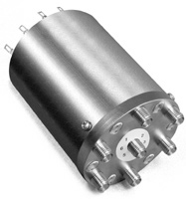
RF Switch
Over our wide bandwidth, we need a mechanical switch to change between the output between the two systems.
James Lamb has tested many different companies and says many are unreliable. He suggests we use Dow-Key.
Quote has been requested.
Will need one for each polarization.
RF System
Notes:
In principle, it’s pretty simple.

Slide 17
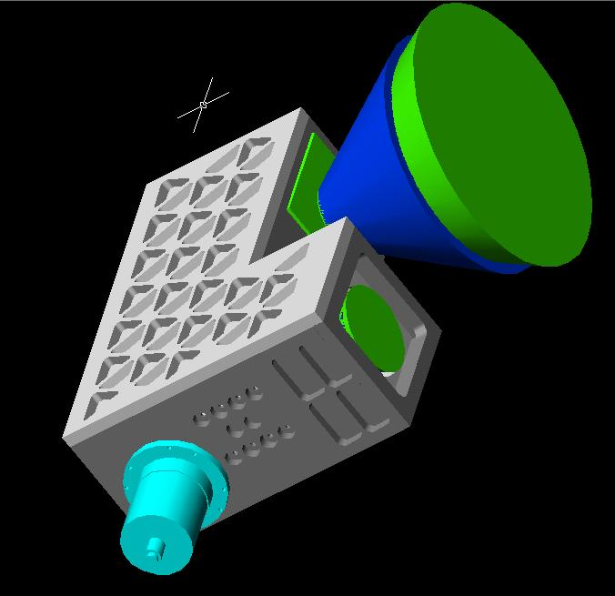
Cryostat Design
Cryostat must be able to house the full 3-18GHz system, and the components for the 1-6GHz system.
Will use a CTI 350 Fridge-head for cooling
Must allow for range of horn sizes.
Should be as compact as possible
3-18GHz horn + fridge-head are main elements in determining its size.
RF System
Notes:
In principle, it’s pretty simple.

Slide 18
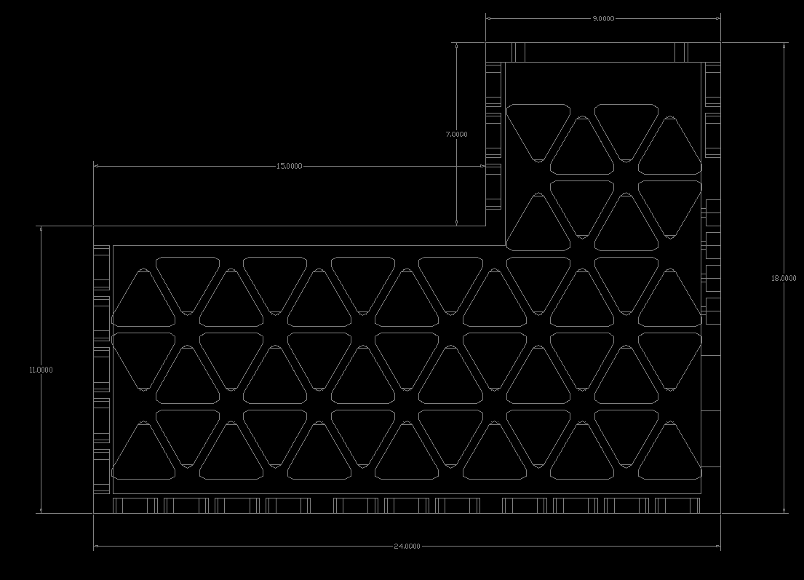
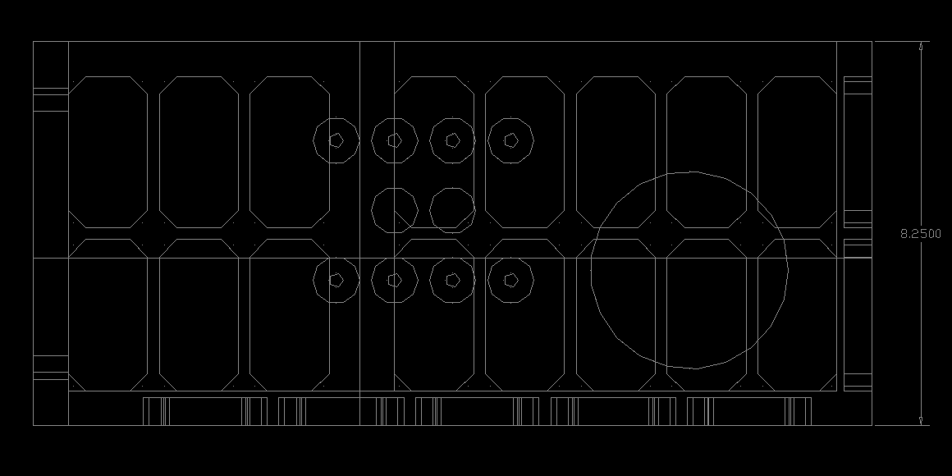
Cryostat – Physical Dimensions
Pretty big, but not unwieldy (QUIET cryostat weighed 800 pounds and was a cylinder of diameter ~4 feet)!!!
Ours is an L-shape rectangular box. 24”x18” with a 15”x7” rectangle chopped out of it.
9” total thickness. ~15” translation between horns, 1” focus diff.
RF System
Notes:
In principle, it’s pretty simple.

Slide 19
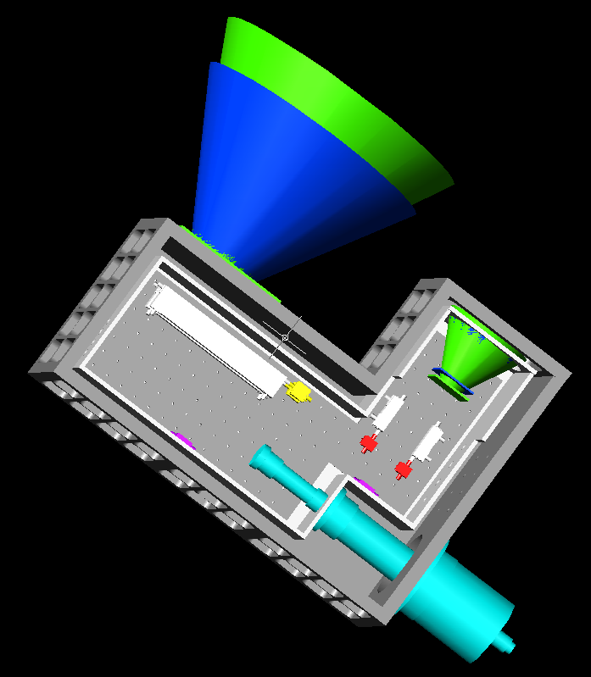
Cryostat – Walk Through
RF System
Notes:
In principle, it’s pretty simple.

Slide 20
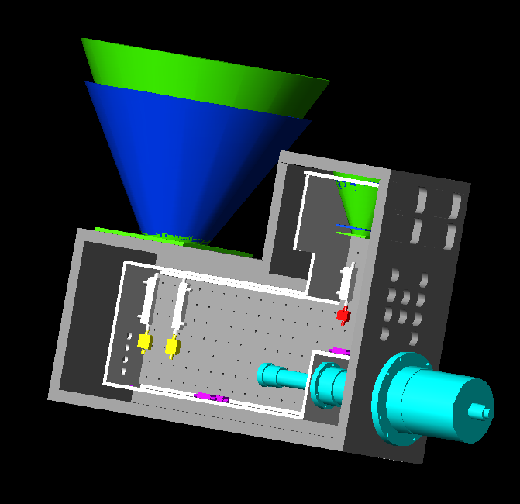
Cryostat – Walk Through
RF System
Notes:
In principle, it’s pretty simple.

Slide 21
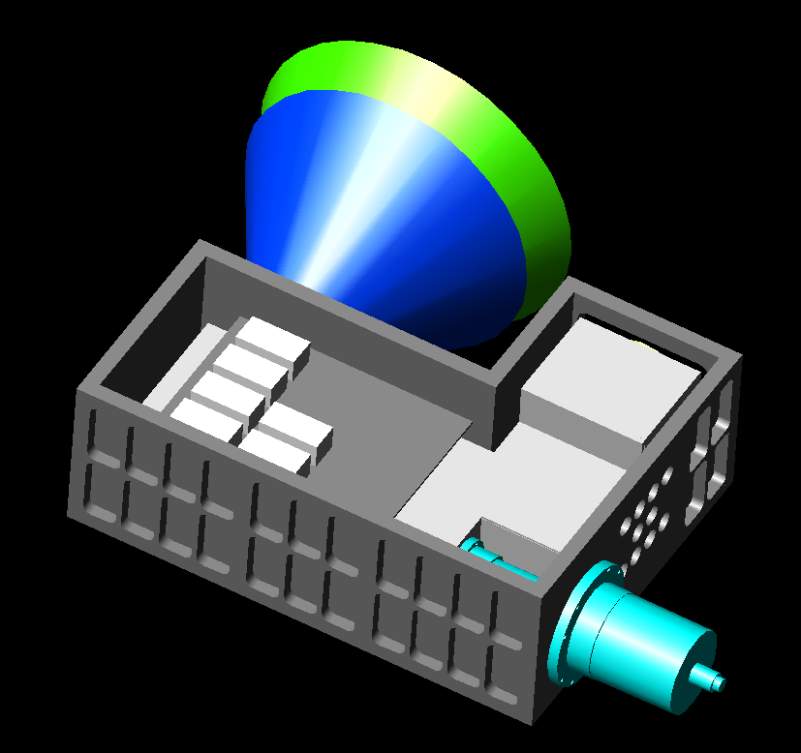
Cryostat – Walk Through
RF System
Notes:
In principle, it’s pretty simple.

Slide 22
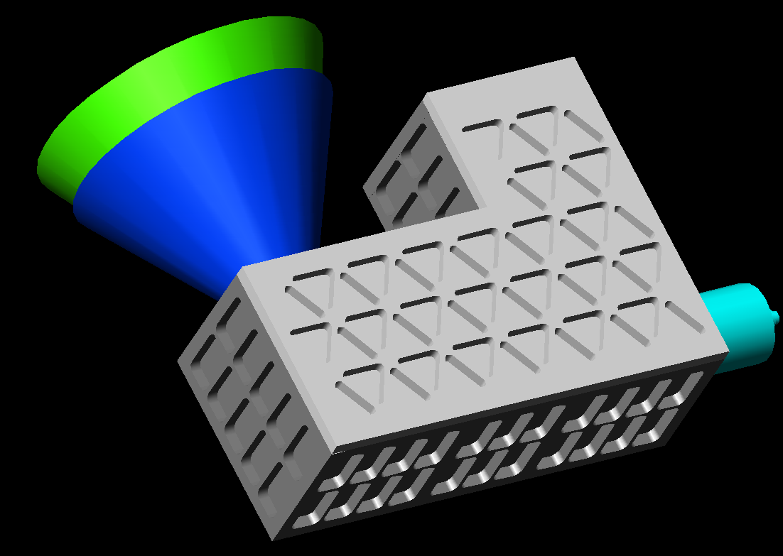
Cryostat – Walk Through
RF System
Notes:
In principle, it’s pretty simple.

Slide 23
Cryostat – Status
All pieces insides the cryostat (cold plate, radiation shield, filter bank, G-10 supports, bracketry for components, thermal connectors) will be machined at OVRO.
Cryo case too big for our machine shop.
Quote for cryo case was sent out last week -- should be in later this week.
Cryostat currently under review by James Lamb and Sandy Weinreb.
RF System
Notes:
In principle, it’s pretty simple.

Slide 24
Still to finalize
Whether location of horns is ok (from Sandy)
Horn design
Cost of machining.
Components to use.
Full Cost (including connectors and coax).
I plan on making the cables myself. (BeCu vs. SS).
Feed-throughs/connectors should be less than $1K.
Should have a lot more info next week.
RF System
Notes:
In principle, it’s pretty simple.

Slide 25
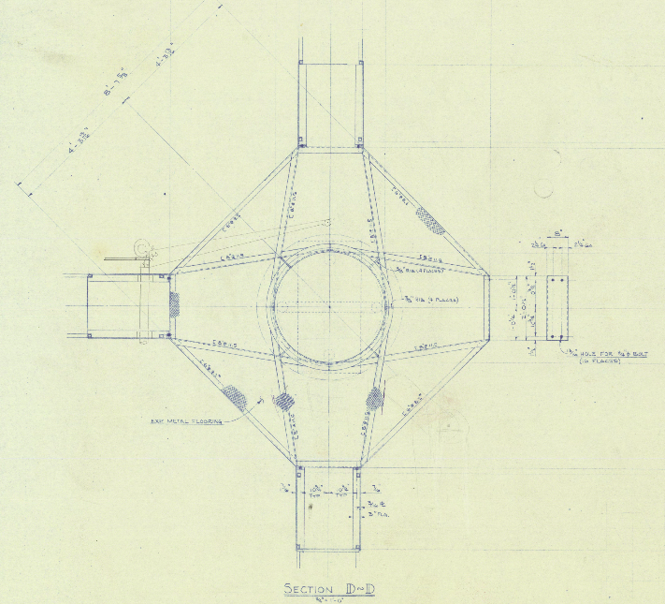
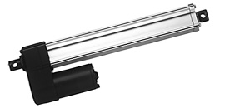
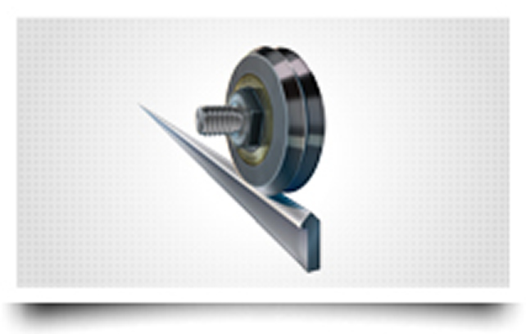
Prime Focus Apparatus
Install a new self-contained system that bolts onto the ring platform.
Uses tracks for linear (and vertical -- focus) translations with actuators in z, gears otherwise.
Uses a gear motor for rotation.
Adjust y once on installation.
Mounting Apparatus
Notes:
In principle, it’s pretty simple.

Slide 26
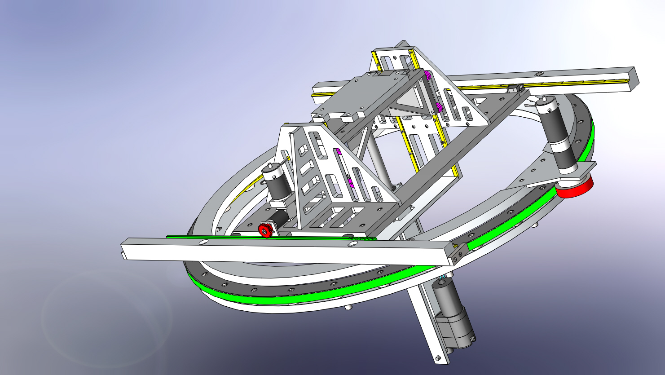
Apparatus Walk-through
Mounting Apparatus
Notes:
Green is the gear. The Inner surface is what moves. The outer ring is attached at the prime focus stand. Motor is pretty beefy: can move 90 degrees in 5 seconds. There are two rails to translate between the two. They are 48” long.

Slide 27
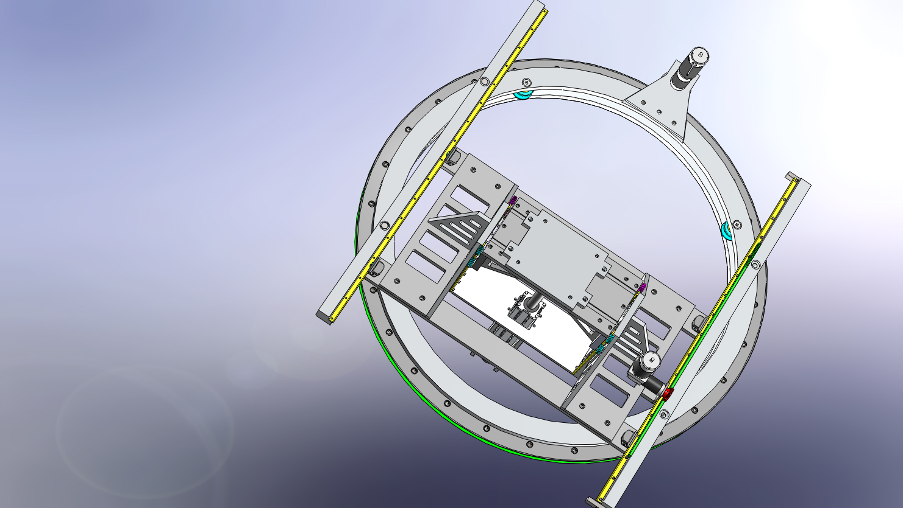
Apparatus Walk-through
Mounting Apparatus
Notes:
Green is the gear. The Inner surface is what moves. The outer ring is attached at the prime focus stand. Motor is pretty beefy: can move 90 degrees in 5 seconds. There are two rails to translate between the two. They are 48” long.

Slide 28
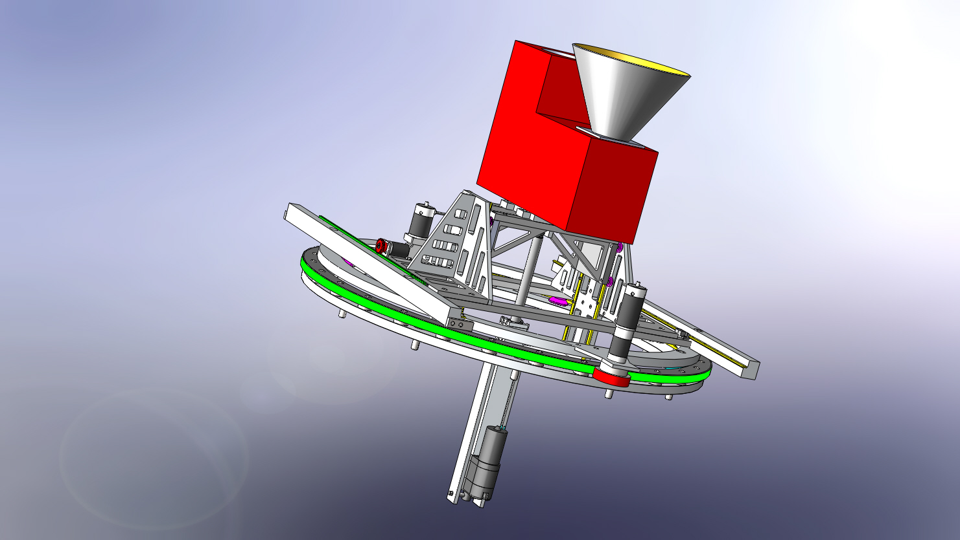
Apparatus Walk-through
Mounting Apparatus
Notes:
Green is the gear. The Inner surface is what moves. The outer ring is attached at the prime focus stand. Motor is pretty beefy: can move 90 degrees in 5 seconds. There are two rails to translate between the two. They are 48” long.

Slide 29
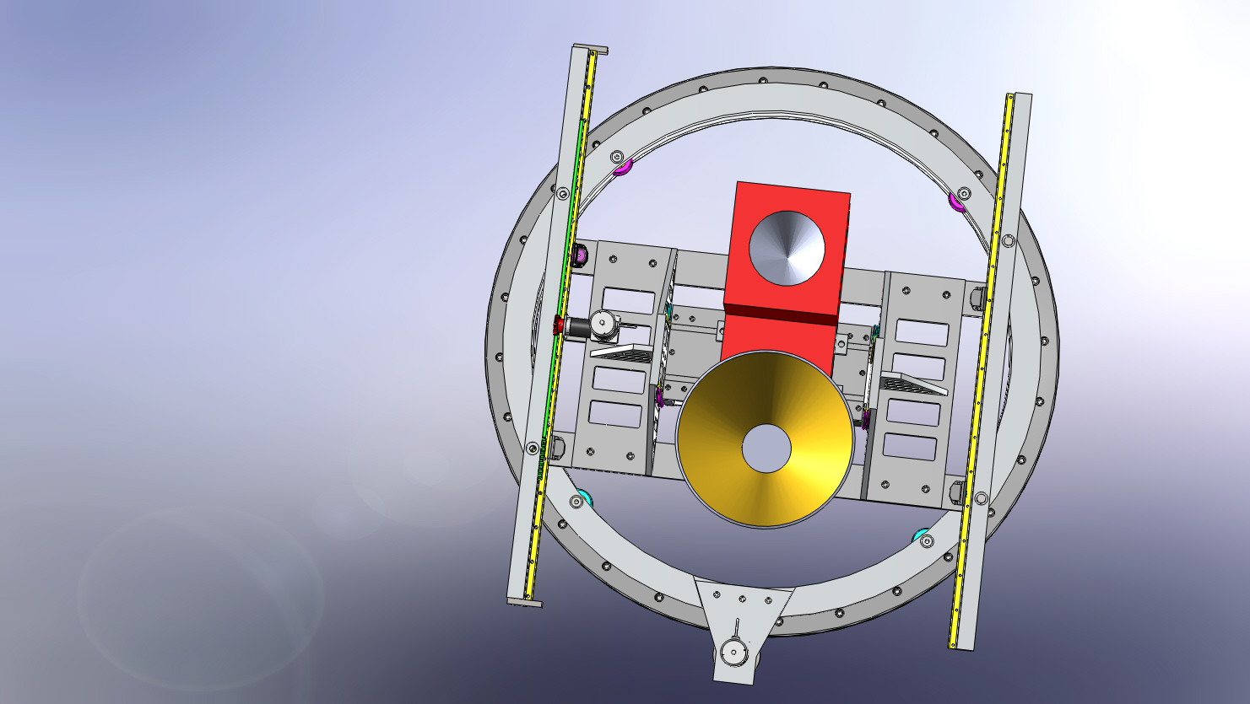
Apparatus Walk-through
Mounting Apparatus
Notes:
Green is the gear. The Inner surface is what moves. The outer ring is attached at the prime focus stand. Motor is pretty beefy: can move 90 degrees in 5 seconds. There are two rails to translate between the two. They are 48” long.

Slide 30
Apparatus Details
Minimal info on dish distortion/focus change – makes it hard to define translation/rotation tolerances. So…
Translation in x-axis: +-7”
Translation in y: +-3” (fix)
Translation in z: -4”->+7”
Hard stops in x, z-range limited by actuators (up to 3000 pounds).
Total weight (including screws) = 350lbs + receiver.
Cost: ~$35K total (Tomi’s document)
Still need Final PDR
Getting quotes on parts we can’t machine at OVRO
Mounting Apparatus
Notes:
Green is the gear. The Inner surface is what moves. The outer ring is attached at the prime focus stand. Motor is pretty beefy: can move 90 degrees in 5 seconds. There are two rails to translate between the two. They are 48” long.

Slide 31
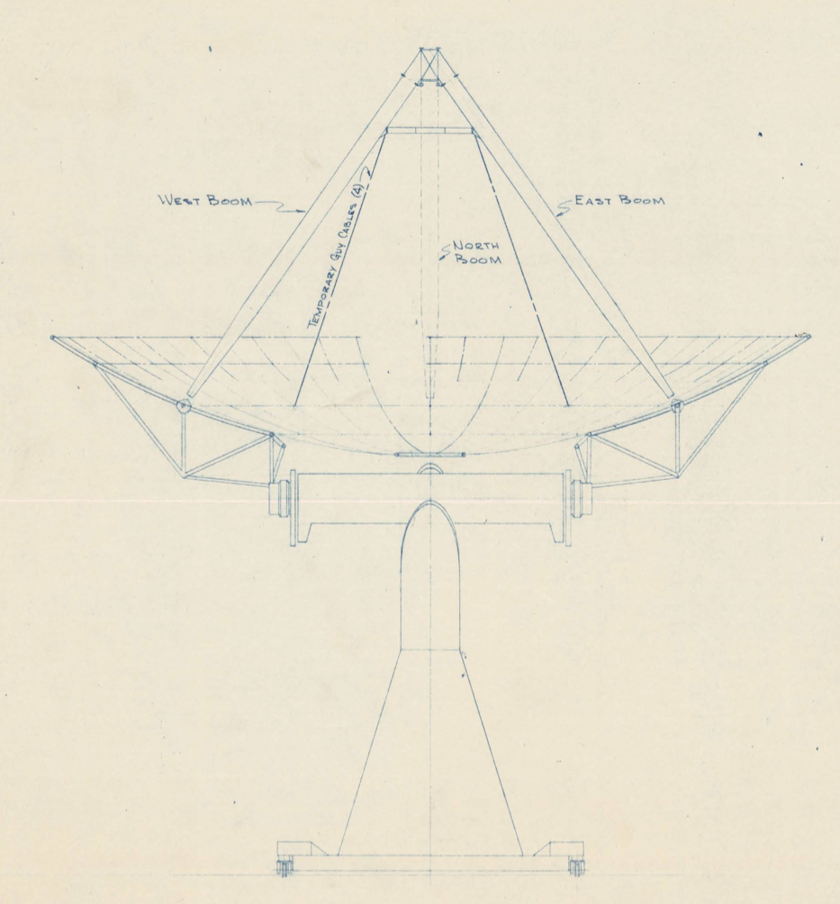
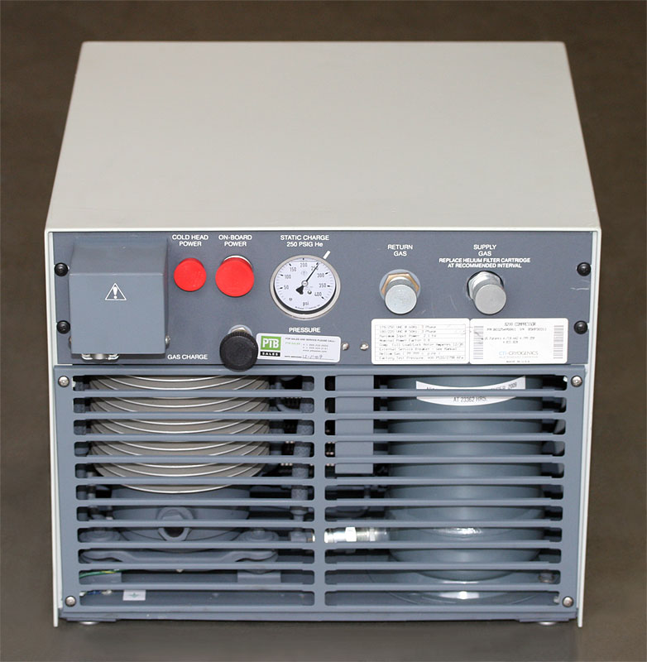
27-m Cryo Upgrades
Russ finishing up design of how to get cryo lines up to prime focus.
Compressor in pedestal.
He lines in the equatorial mount need a 4-port rotary union ($~5K)
2-port rotary union at exit
Most straightforward part of whole upgrade!
Cryo Upgrade

Slide 32
Cryo Upgrade Inventory
Receiver
Focus apparatus
Compressor/Cryo lines
Temp Controlled (TECA) box with:
Bias for amps
Temp Stable noise diode source
Temp monitoring
RF switch
Pre-amp module
RF-optical converter
Ethernet Switch
Ethernet controllable power supply
Small computer to control Noise Diode, Bias, and Alignment jig (rotation, x, and z)
Programming said computer/interface with CS.
Notes:
In principle, it’s pretty simple.

Slide 33
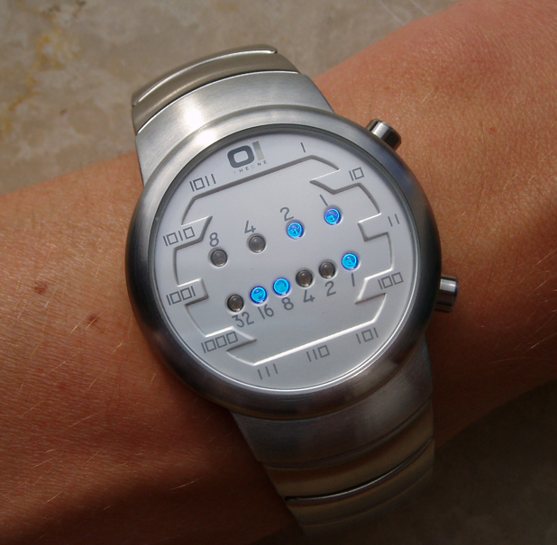
Timeline
September/October: Finalize Cryo design. Select (and order) RF components. Select rest of hardware inside TECA box. Purchase hardware needed for cryo upgrade. Start machining apparatus and cryostat.
November: Control subsystem development, testing of individual RF components (as they arrive), machining of rest of apparatus and cryostat. Begin machining horns.
December: Cryostat machining complete. Begin cryo testing in lab.
January: Apparatus machining complete. Begin testing of apparatus with control system. He line installation complete.
February/March: Extensive testing of Cryostat/Apparatus
April: Installation? Could be done earlier depending on results from Feb/March.
May: Science! ;-)
Notes:
In principle, it’s pretty simple.

