Slide 1

EOVSA timing sychronization
Dale E. Gary
Professor, Physics, Center for Solar-Terrestrial Research
New Jersey Institute of Technology

Slide 2
outline
Timing Distribution—NTP
Synchronization—1 PPS
Timestamps and State Frame

Slide 3
Timing specifications
The technology exists to essentially eliminate timing inaccuracies to much better than a ms, system-wide, and EOVSA’s timing system should be designed to take advantage of it.
If we assume a goal of 1 ms “dead-time” between tunings, we will need to control system timing to better than this—suggest 100 us as a specification for tuning synchronization.
This will require distributing a timing pulse, which we will specify at 1 PPS. This is conveniently available from GPS clocks and the Stanford Research Systems Rubidium Clock.
All other timing should be derived from this 1 PPS timing pulse, with time-of-day information distributed via NTP (Network Time Protocol).
Most systems can get their time-of-day information from the current State Frame, with the timestamp of the State Frame being written by the real-time control system.

Slide 4
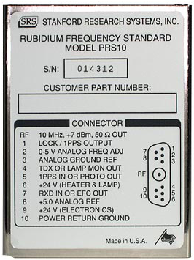
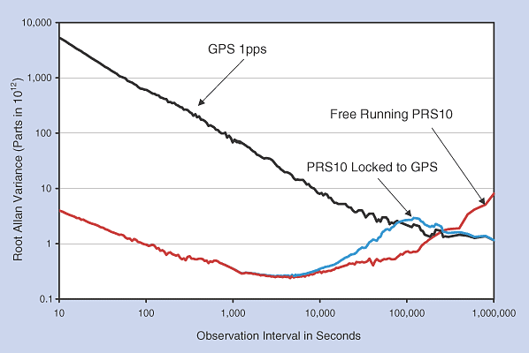
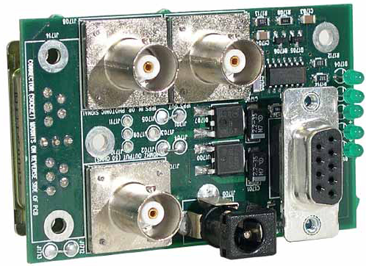
Srs prs10 rubidium Clock
The Stanford Research Systems PRS10 Rubidium Frequency Standard will be the heart of the timing system (because we already have one).
It can produce both a 1 PPS output and a 10 MHz stable reference frequency. It can phase lock to a GPS-derived 1 PPS for long-term stability and accuracy to 1 ns.

Slide 5
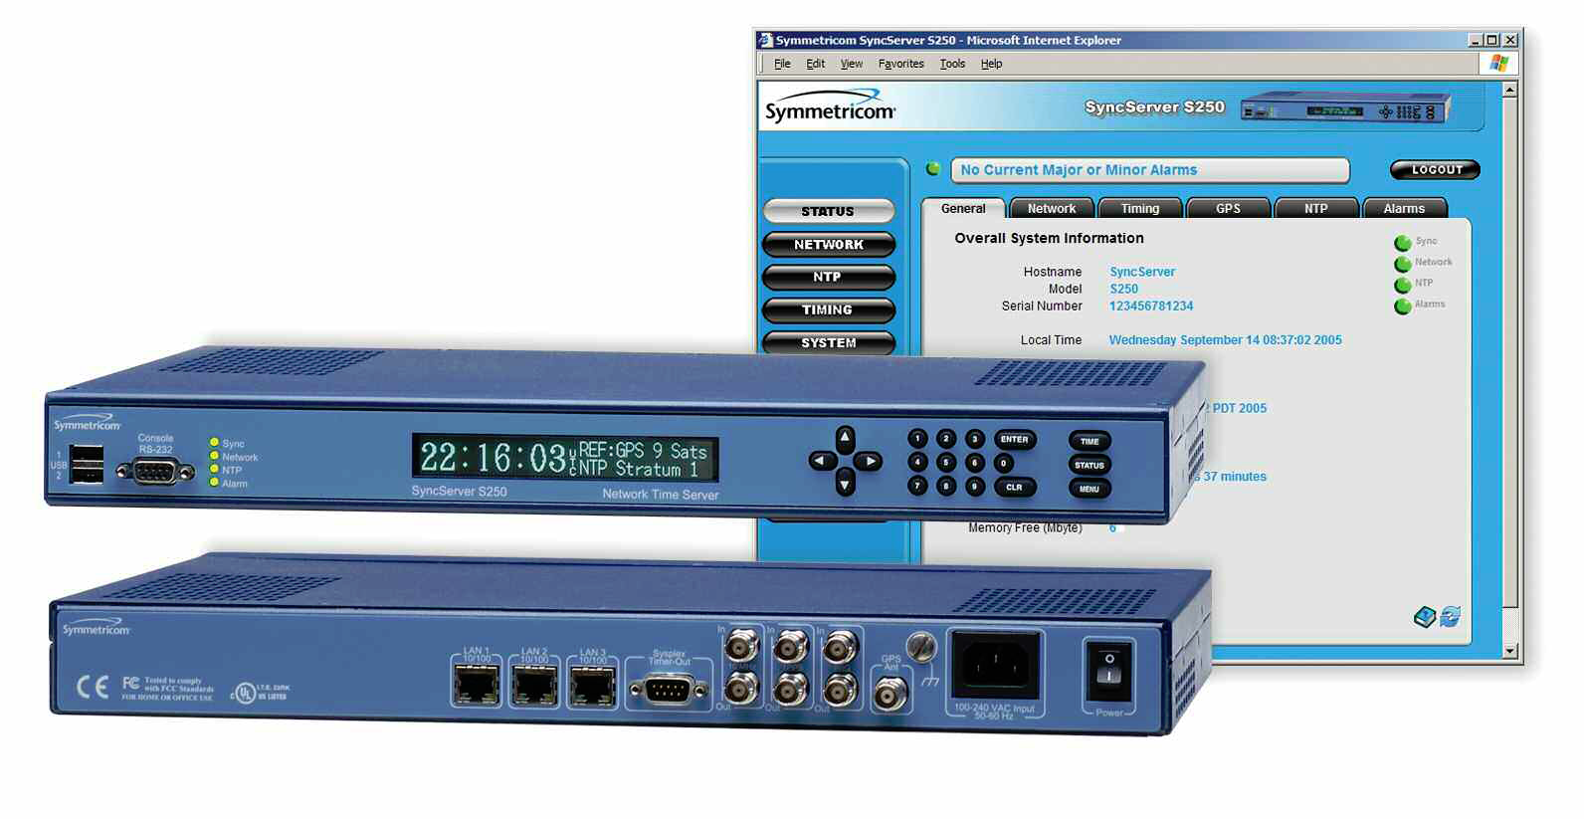
Gps clock/NTP Server
The two contenders for NTP serving are Symmetricom SyncServer S250, and Meinberg M300/GPS, both of which can synchronize a small network of NTP clients and have a 1 PPS output for use with external Rb standard.
Quotes have been requested for
each
Meinberg is probably cheaper, but
is not US-made, hence ARRA
restrictions may eliminate this
option
It is suggested to use at least three time servers so that there is a tie breaker in case one server suffers problems. We can use the CARMA high-site servers as tie breakers, but note that when the high-site is down we will not have this redundancy.

Slide 6
Timing distribution—ntp
The antenna controllers use SNTP for setting their time, so we must distribute NTP to the antenna controllers. PCs and other devices generally can also set their time to NTP, so it is a natural choice for distributing the absolute time.
However, the system-wide timestamp must derive from a single authority, which will be the real-time control system.
This system will get the time-of-day from NTP, and accurately generate a State Frame once per second, synchronized to the 1 PPS. Other subsystems will obtain the State Frame and write their information into it. For those subsystems that need to report with accurate timing, their information can be synchronized to the 1 PPS, and although written later, will correspond to the timestamp of the State Frame. If their information needs a separate timestamp, it can be provided as data into the State Frame. Alternatively, they could provide an offset to the State Frame timestamp (actually, an offset to the 1PPS).
The display system, fault system, and others need not rely on their own clock at all, but can work with the State Frame timestamp for all displayed information.

Slide 7
Synchronization—1 pps
The PRS10 1 PPS signal must be distributed to each antenna via half-duplex single-mode optical links. The cRIO in each antenna controller has a clock accurate to 1 us that can sync to such a pulse. We have yet to identify the link hardware.
The 1 PPS signal will need to be distributed also to key hardware subsystems in the control room, via copper coax. Signal amplitude will have to be specified, possibly differently for each subsystem.
Transmission times for the 1 PPS signal should be negligible, but this should be checked. Exact synchronization to the 100 us spec should be easily achievable.

Slide 8
From gordon re: accumulation timing
While it is essential that the 20 millisecond integration intervals be
locked with respect to the 1 second ticks, and that the correlator sum
an integral number of samples within the 20 millisecond interval, there
is a much looser requirement on when within the 20 millisecond interval
the sampling occurs. As a result, we have a third option, namely to
accumulate say 2750 spectra (in a little less than 19 ms), discarding
spectra at the beginning until the one that first begins after the 1
second tick (or after a 1second+1ms tick). This results in a small
variable but noncritical 'waste' of potential integration time at the
end, but this is of no consequence. It also decouples the need to synch
the sampling clock so carefully (to 1:10^10) to the 1 second tick. The
price we pay is that there is a +- 3.9 microsecond (effectively random)
uncertainty in that start time of the saved accumulations. This in turn
would cause a negligible phase error. An advantage of this approach is
that we are not locked into the 19+1ms division of the integration time
so that if necessary the 1 ms could be easily increased. Also, we have
freed ourselves from the rigidity of phase locked timing.

Slide 9
Timestamps and state frame
It has already been noted that the State Frame needs to have a timestamp written by a single authority, which is the control computer. It is critical that the NTP time be accurate for this computer. Typically NTP time is accurate to 2 ms on the LAN. The 1 PPS to the real-time control computer’s clock board will be used for a timestamp accuracy of 1 us.
Other subsystems that have to write into the State Frame, with time-critical information, can provide an offset to the time in the State Frame, calculated locally with reference to the 1 PPS.
No subsystem should write information to a State Frame with an offset more than 1 s—if information is more than 1 s old, it should be written into the appropriate previous State Frame, archived for the purpose.
Subsystems such as the correlator or DPP that need time-critical information may need to calculate or store it ahead of time and apply it at the correct moment in time.

