Slide 1
Digital FX correlator
Samuel Tun

Slide 2
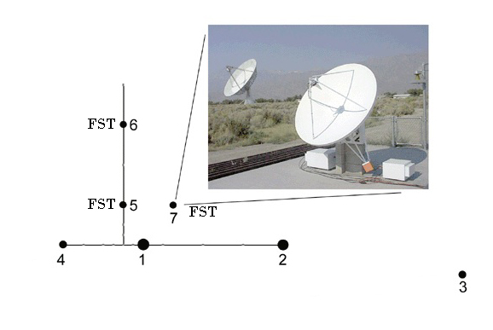
FASR Subsystem Testbed (FST)
1-9 GHz in 500 MHz band recorded at 1 GS/s from each antenna.
Correlation carried out offline via FOCIS (Z. Liu)

Slide 3
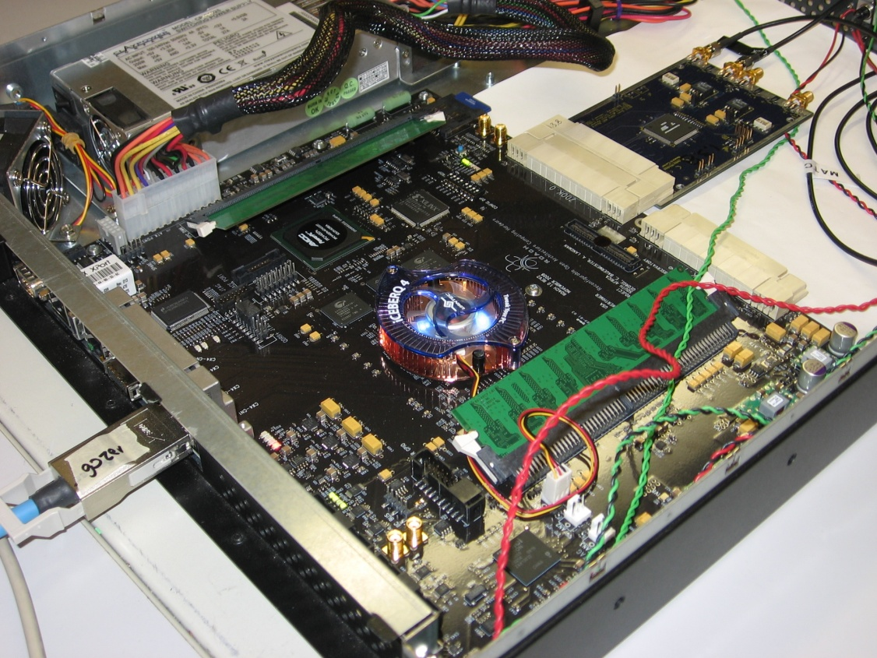
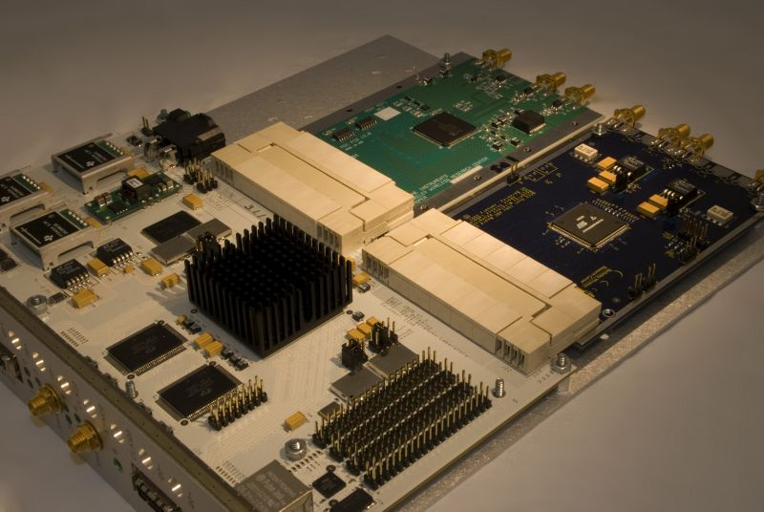
CASPER Group Software and Hardware
ROACH I
IBOB
Xilinx Virtex 5 SX95T FPGA
- 244 36-kbit BlockRAMs
- 4x CX4 10Gbps connectors
- Xilinx Virtex-II Pro 2VP50 FPGA
- 232 18-kbit BlockRAMs
- 2x CX4 10Gbps connectors

Slide 4
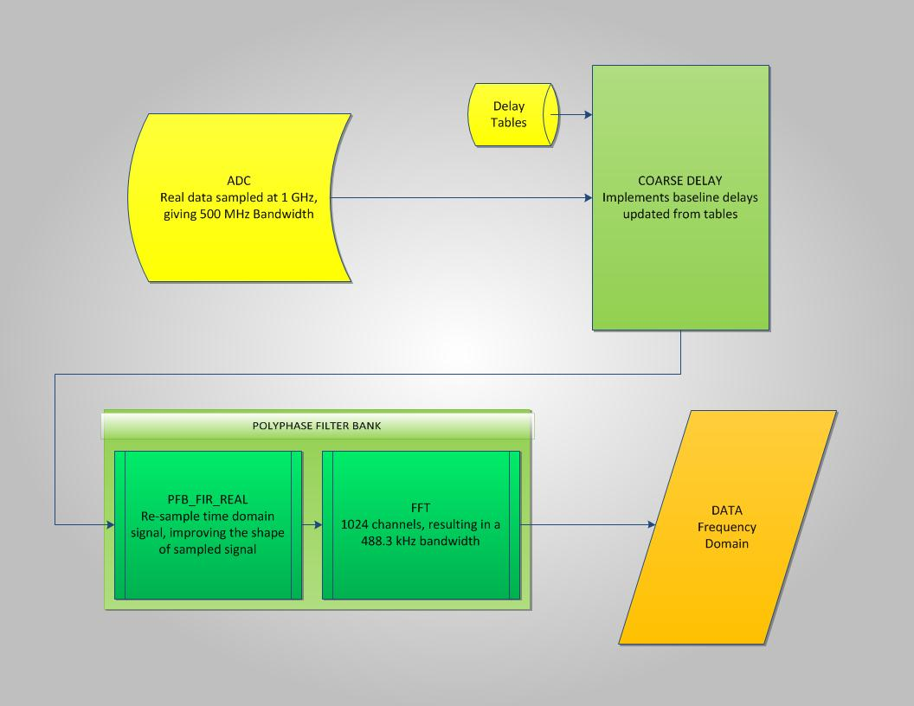
Current Design: f-engine on ROACH

Slide 5
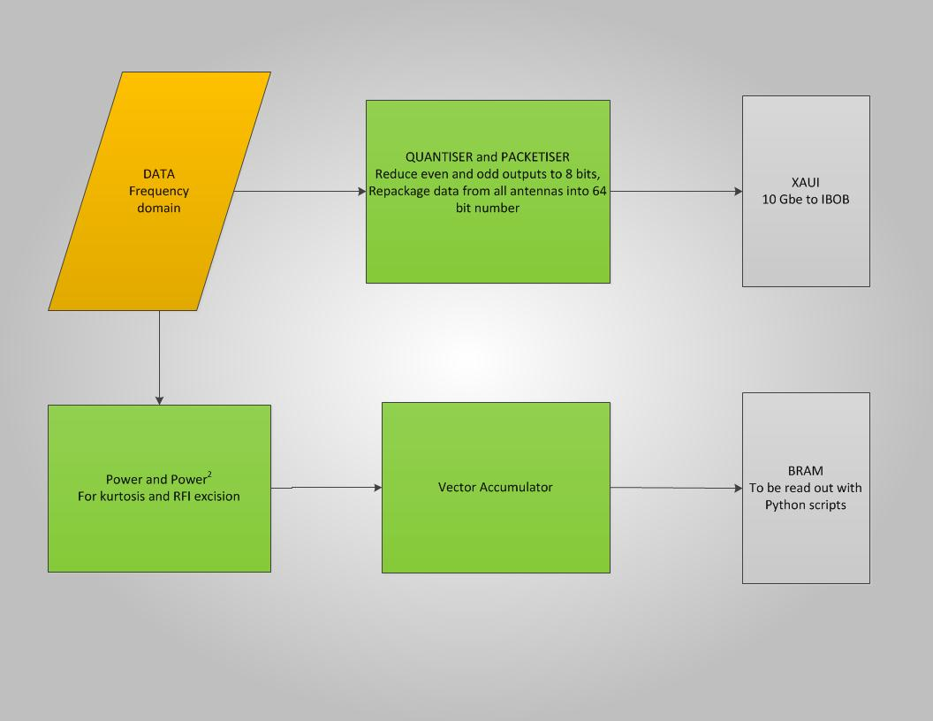
Current Design: f-engine on ROACH (cont.)

Slide 6
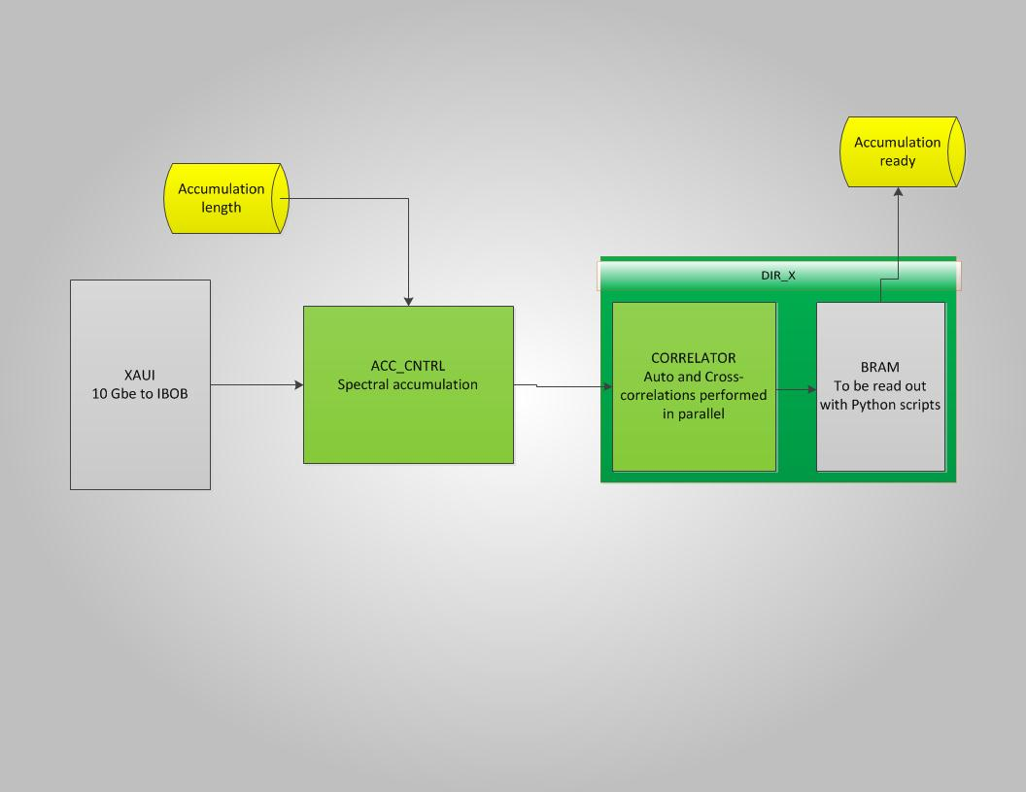
Current Design: x-engine on IBOB

Slide 7
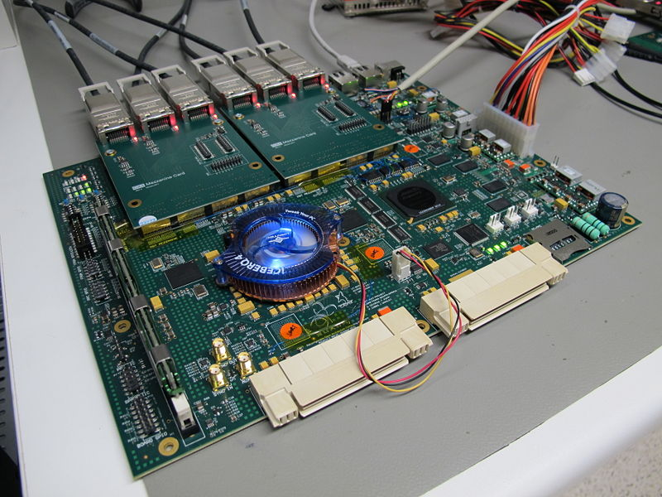
ROACH II

Slide 8
ROACH I
ROACH II
Xilinx Virtex 5 SX95T FPGA
- 1520 Kb max distributed memory
- 244 36-kb BlockRAMs
- 4 CX4 10Gbps connectors
Xilinx Virtex 6 SX475T FPGA
- 7640 Kb max distributed memory
- 1064 36-kb BlockRAMs
- Up to 8 CX4 10Gbps connectors

Slide 9
Salient Issues
Time delay implementation, including synchronized input from tables to register, fine delay implementation, and input flow disruptions
Power/power2 synchronization to FFT output, or where to put RFI excision logic.
Design on Fabric issues should not exist on ROACH II, although design optimization will be a goal of my visit to the CASPER group.

