Slide 1

EOVSA netWORK & Computer system
Dale E. Gary
Professor, Physics, Center for Solar-Terrestrial Research
New Jersey Institute of Technology

Slide 2
outline
Overview of Network Topology
  Antenna Network
  Optical Switch
  Copper Switch
Office/Lab Network Connections
10 Gbe Switch
Computing System
  Web Server
  Array Control Computer
  Schedule/Fault Computer
  Data Packaging Processor
  Pipeline
  RDBMS System

Slide 3
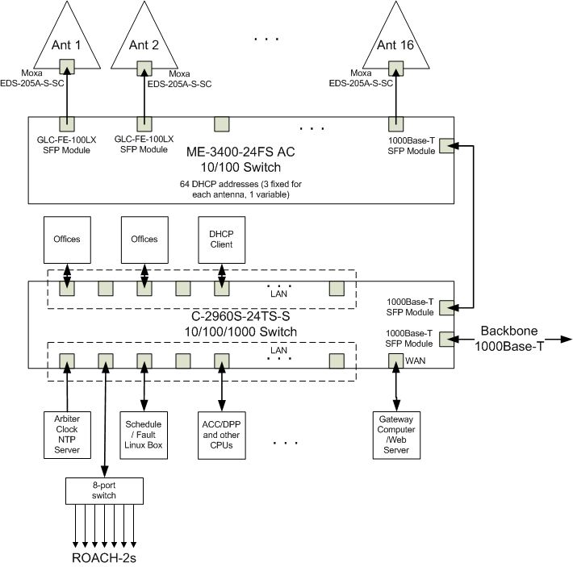
Network topology
Local copper switch in antenna controller, for extension of LANs in each antenna
(100Base-T).
Dedicated optical fiber switch for network between antennas and electronics room (100Base-LX)
Copper switch in electronics room, for rest of network and connection to back-bone (1000Base-T),
½ T1 line = 768 Mb/s.
8-port switches for office LANs, plus switch for ROACH-2s (need at least 9 ports)

Slide 4
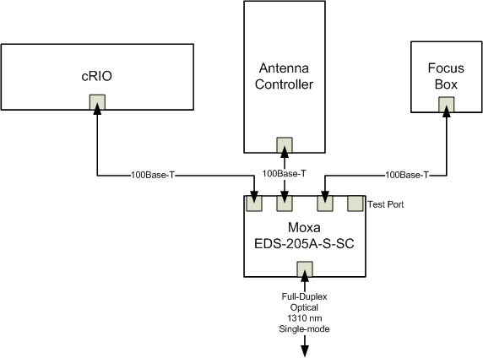
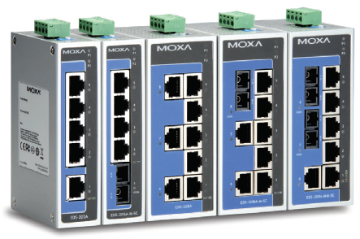
Antenna LAN
Moxa 4-port
unmanaged switch
Provides NTP to both cRIO and antenna controller.
Provides LAN for fast communication between controller and cRIO.
Addressed via nameserver addresses like:
  crio1.solar.pvt, ant1.solar.pvt, fe1.solar.pvt

Slide 5
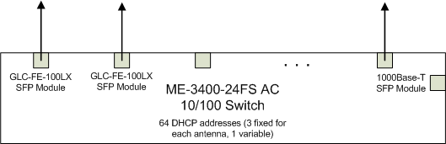
Fiber switch
Cisco fast ethernet (100 Mb/s) 24-port switch with SFP (small form-factor pluggable) module slots (24 fast ethernet + 2 Gbe).
16 GLC-FE-100LX modules (1310 nm, single-mode)
One 1000Base-T module for connection to copper switch
Currently have 3 Cisco SFP modules ($250 each), but later will buy Cisco-compatible to test ($80 each).
Addresses at antenna are DHCP, but with fixed assignments (mapped to MAC addresses).

Slide 6
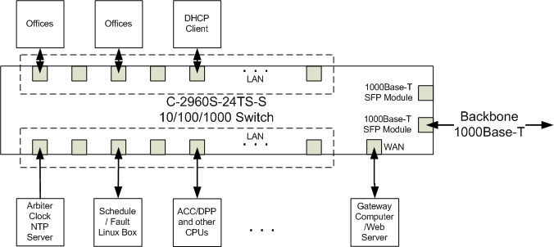
Copper switch
Cisco 1 Gb/s 24-port switch with RJ-45 connectors
Two 1000Base-T SFP modules, one going to the fiber switch and one going to the OVRO network (½ T1 line = 768 Mb/s)
Further fan-out in individual offices and lab, for non-critical systems and VOIP phone system
One port for gateway computer, which can also talk to private network.
Addresses like dpp.solar.pvt, acc.solar.pvt, etc., plus DHCP clients.

Slide 7
Office/lab connections
The offices and labs have voice (VOIP) and data connections.
There are 4 separate connections to the control room, 2 for Kjell’s office, 1 for second office, 2 for the lab, and 1 for storage room. Further fan-out for printers, etc., can be set up via 8-port switches in individual offices.
The nameserver addresses are like kn1.solar.pvt, etc. The pvt address space has 126 addresses. In addition, there are 127 dynamically allocated addresses (DHCP).
None of the .pvt addresses are visible from outside, but we will set up and document tunneling through the web server

Slide 8

10 Gbe switch
The correlator will use a 10 Gbe switch to interconnect the F-engines and X-engines, and also to provide two ports for connection to the DPP.
For the prototype, we will use CX-4 cables, so we require an 8-port switch (3 from each ROACH plus 2 to DPP). We expect to borrow this from Dan Werthimer. For the final configuration, we will need at least 18 ports, but it would be easiest to use 26 ports (3 from each ROACH plus 2 to DPP). We currently plan to get an Arista 48-port switch (with SFP+ connectors), but will re-evaluate when the time comes.
Arista 7148S 48-port SFP+ 10 Gbe Switch

Slide 9
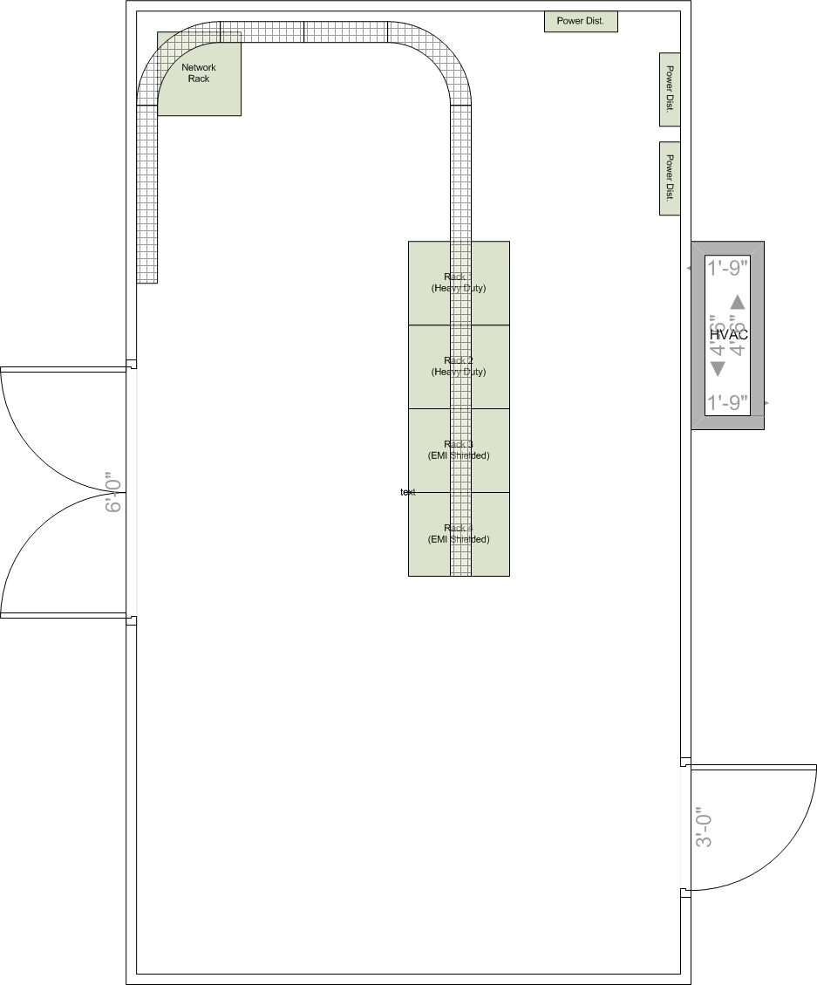
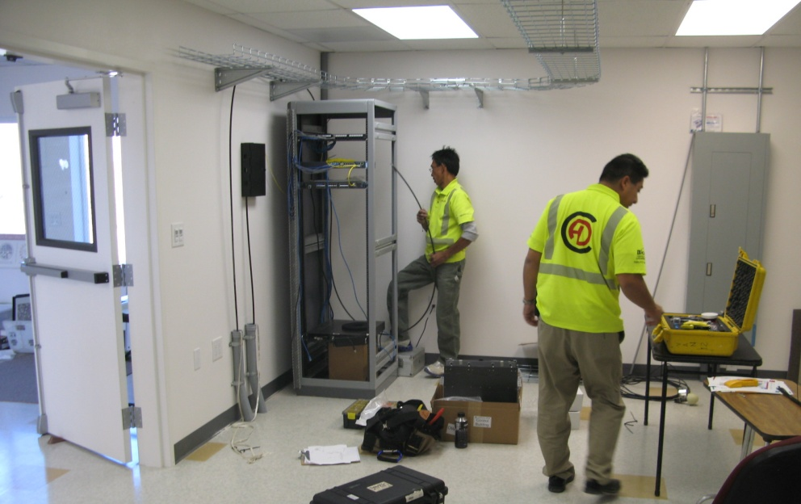
Computer system ground rule
A ground rule is that in the electronics room we will only put computers that require hard-wired connections to other subsystems.
Any computer that has only internet connections will be placed in the control room next door.
Computers in the electronics room will be rack mounted, and have no monitor, keyboard, mouse, etc.

Slide 10
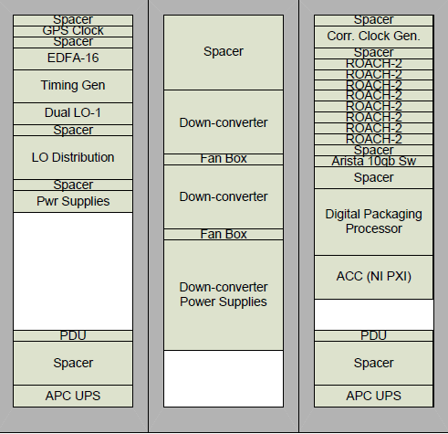
Computers (Electronics room)
Rack mounted Digital Packaging Processor (Linux system) (connects to 10 Gbe switch, timing generator 1pps, 50 Hz, pvt network)
Rack mounted ACC (LabVIEW RT system) (connects to timing generator 1pps, GPS clock IEEE-1588, RS485 Bus x 2, pvt network)

Slide 11
Computers (control room)
Web Server (linux OS):
  Serves as gateway computer (only computer available directly from the outside). Provision will be made for secure tunneling through this machine to the rest of the pvt network.
  Serves the on-site web access to real-time data products.
Schedule and Fault Computer (linux OS):
  Serves as NFS boot server for correlator ROACH boards (has DNS/DHCP/TFTP/uboot)
  Runs the schedule
  Maintains source catalogs
  Calculates coordinates
  Controls the correlator
  Sends schedule commands to ACC
  Examines State Frame and sets flags
Database Computer (Windows OS):
  Runs SQLServer software for monitoring database
  Records State Frame information into RDBMS
  Serves as user machine for MS Office
Pipeline Computer (linux OS):
  Runs Miriad
  Workhorse for calculating real-time data products

