Slide 1
EOVSA Monitor and Control System
Gelu M. Nita
NJIT

Slide 2
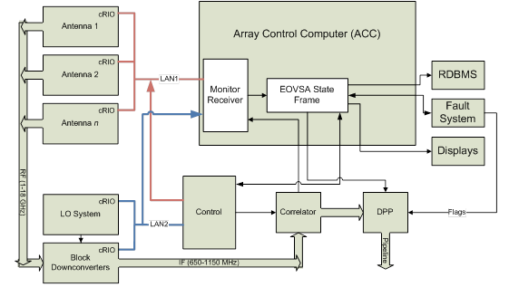
A Possible EOVSA System

Slide 3
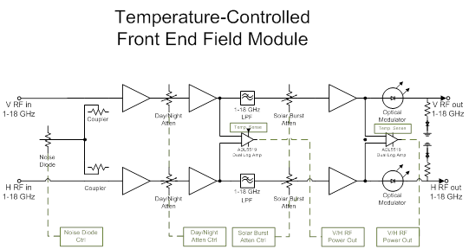
Temperature-Controlled Front End Field Module
Temperature Sensors
Noise Diode
Control
Day/Night
Attn. Ctrl.
Solar Burst
Attn. Ctrl.
V/H RF Power Out
Attn. Ctrl.

Slide 4
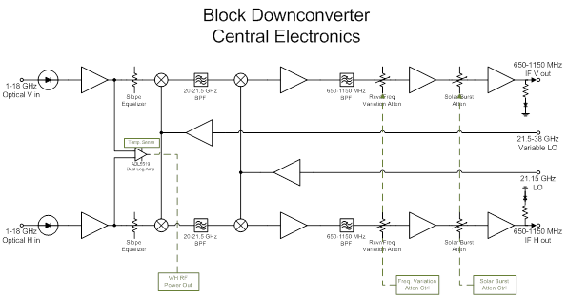
Block Downconvertor Module
Solar Burst Attn. Ctr.
V/H Power Out
Freq. Var. Attn. Ctrl

Slide 5
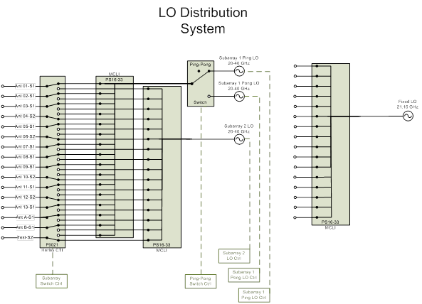
Possible LO Distribution System
Ping/Pong LOs
Subarray 2 LO
Subarray Switch Ctr.
Ping-Pong Switch?

Slide 6
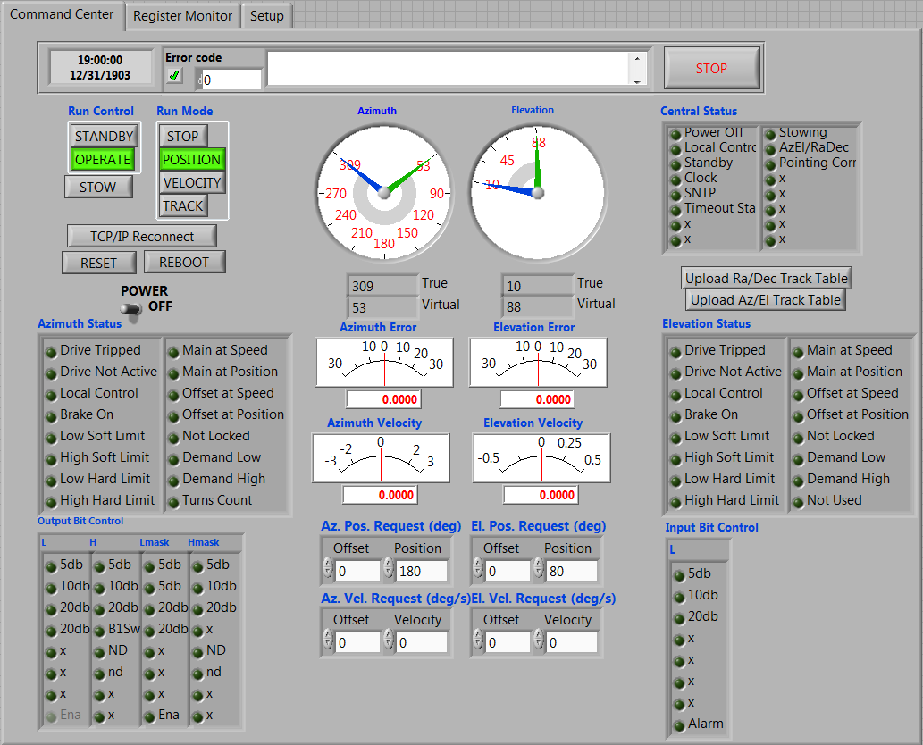
Patriot Antenna Control and Monitor LabVIEW Implementation of the KSRBL system

Slide 7
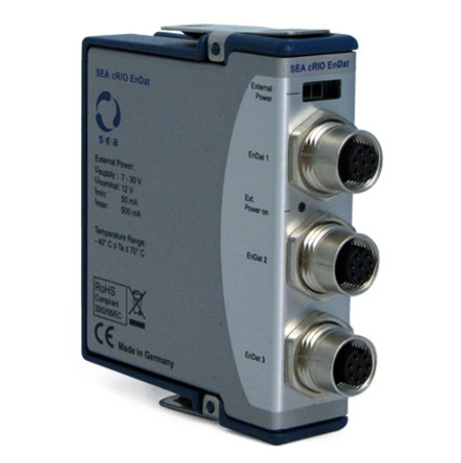
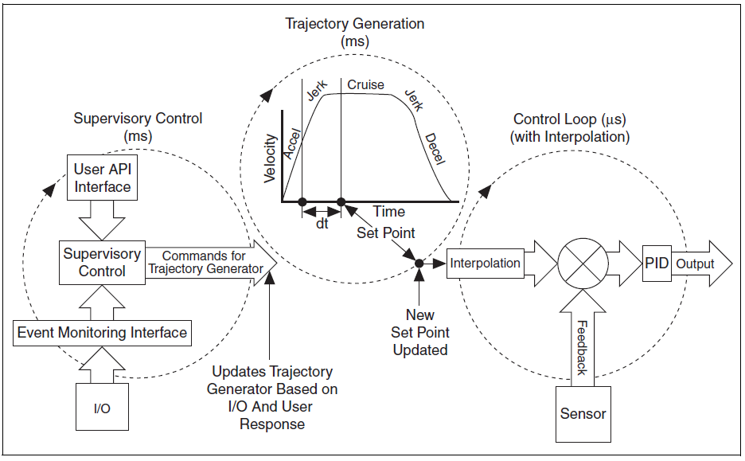
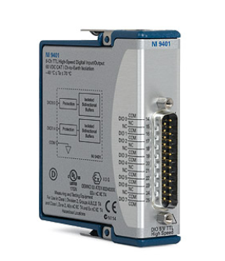
New task: Building a Motion Control System for the refurbished OVSA antennas
Solution:
NI Soft Motion toolkit in conjunction with reconfigurable NI compact real time controllers

Slide 8
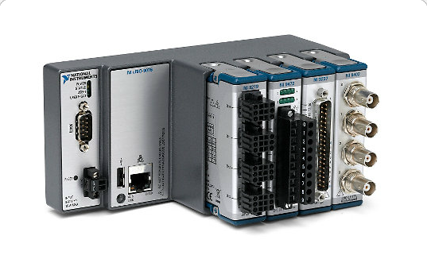
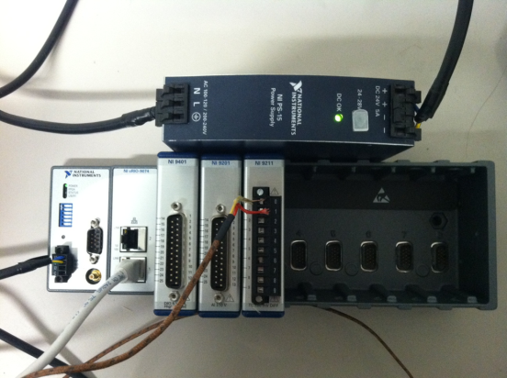
Compact Reconfigurable Input/Output (cRIO) Real Time Module: flexible solution for implementing the control/monitor of the EOVSA Antennas
NI cRIO-9076: To implement Patriot antenna front end modules
Rugged, embedded control and monitoring system with -20 to 55 °C operating temperature range
400 MHz industrial real-time processor for control, data logging, and analysis
4-slot LX45 FPGA chassis for custom I/O timing, control, and processing
10/100BASE-T Ethernet port, USB 2.0 port, and RS232 serial port for connection to peripherals
Single 9 to 30 VDC power supply input
Small footprint . Price: $600/controller+ $$$$ for the DIO/AIO modules
NI cRIO-9074: To implement the refurbished OVSA antennas motion control and front end modules.
Rugged, embedded control and monitoring system
400 MHz industrial real-time processor for control, data logging, and analysis
2M gate, 8-slot FPGA chassis for custom I/O timing, control, and processing
Two 10/100BASE-T Ethernet ports; RS232 serial port for connection to peripherals
-20 to 55 °C operating temperature range; single 19 to 30 VDC power supply input . Price: $840/controller +$$$$ for the DIO/AIO/Motion modules

Slide 9
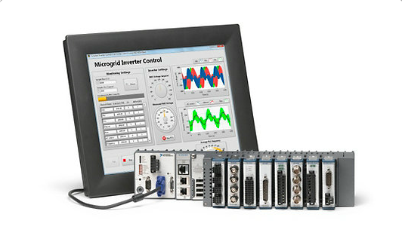
cRIO-9082: A possible solution for implementing the EOVSA ACC including the LO and DC interfaces
High-performance multicore system for the most intense embedded control and monitoring applications
1.33 GHz dual-core Intel Core i7 processor, 32 GB nonvolatile storage, 2 GB DDR3 800 MHz RAM
LabVIEW Real-Time for determinism or Microsoft Windows Embedded Standard 7 for VGA graphics
1 MXI-Express, 4 USB Hi-Speed, 2 Gigabit Ethernet, and 2 serial ports for connectivity and expansion
8-slot Spartan-6 LX150 FPGA chassis for custom I/O timing, control, and processing
0 to 55 °C operating temperature range
Price range: $8000-$9000
The Real-Time OS may provide deterministic interaction with its peripheral modules used to control/monitor the LO and DC subsystems and the antenna frontend cRIO modules, and may host and publish on a TCP/IP port the EOVSA state frame

Slide 10
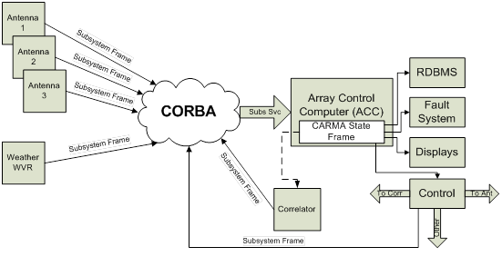
CARMA like Architecture?
NI-SVE

Slide 11
Overview of the EOVSA Control/Monitor Communication Protocols
Patriot Antenna Controller: MODBUS over TCP/IP between the Antenna Controller and its Field Point dedicated cRIO-RT Module.
Field Point Modules: TCP/IP between the Antenna Control Computer (ACC) and the field point cRIO-RT modules
LO and DC control systems: direct communication as being hosted on the same RT target as the ACC system.
ACC to other EOVSA subsystems (e.g. DPP) and observer interface: TCP/IP to read/write the EOVSA state frame in a TBD self describing format (XML, Variant, custom binary format?)

