Slide 1

Eovsa Site development
Kjell Nelin
OVSA Site Manager, Center for Solar-Terrestrial Research
New Jersey Institute of Technology

Slide 2
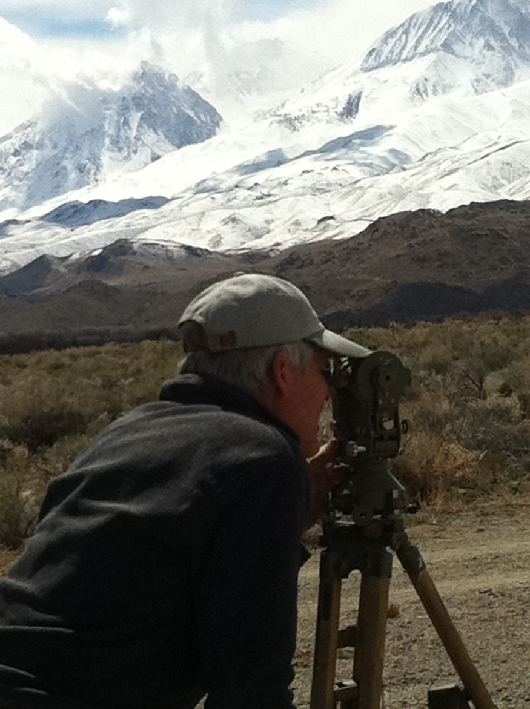
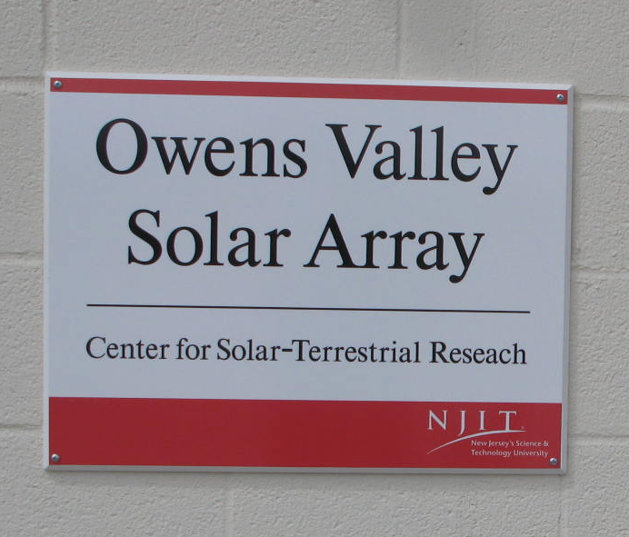
Eovsa Site development
Sign for Building
Surveying Inner Antennas

Slide 3
Before contacting contractors
Design conduit runs for entire system
Determine diameter and length of all runs
Determine possible expansion/future needs
Design concrete pads
13 antenna sites
Breakout shed
Transformer platforms at shed & building
Pads for solar power systems at 12 & 13?

Slide 4
Before work starts
Caltech/NJIT MOU (now in progress)
DWP final go-ahead (by July 1, hopefully earlier)
Obtain EPA permit for SWPPP (by July 1)
Identify and schedule biologist (bird nesting)
Arrange archeologist schedule
Identify and schedule contractors, with all paperwork done to permit them to work
Identify and purchase materials not provided by contractors.

Slide 5
contractors
To be contacted in May:
Grading/Road contractor
Trenching/conduit contractor
Concrete contractor
Fencing contractor
Building contractor (handled by NJIT/CIT?)

Slide 6
Schedule of construction
Construction period Aug. 5 – Dec. 15
Above dates may be modified due to weather
Once ground disturbances are over, we can proceed with construction of breakout shed, installation of cables, solar power, etc.
Task | Date | Duration | Arch/Tribe Monitor?
Bird Survey | 1-Aug | 1 day | No
Grading/Clearing | 8-Aug | 5 days | Yes, 1 day
Trenching/Conduit | 15-Aug | 5 days | Yes, 1 day
Road Improvement | 22-Aug | 5 days | No
Excavate for concrete | 29-Aug | 5 days | Yes, 1 day
Pour concrete | 5-Sep | 5 days | No
Install fences | 14-Sep | 3 days | No

Slide 7
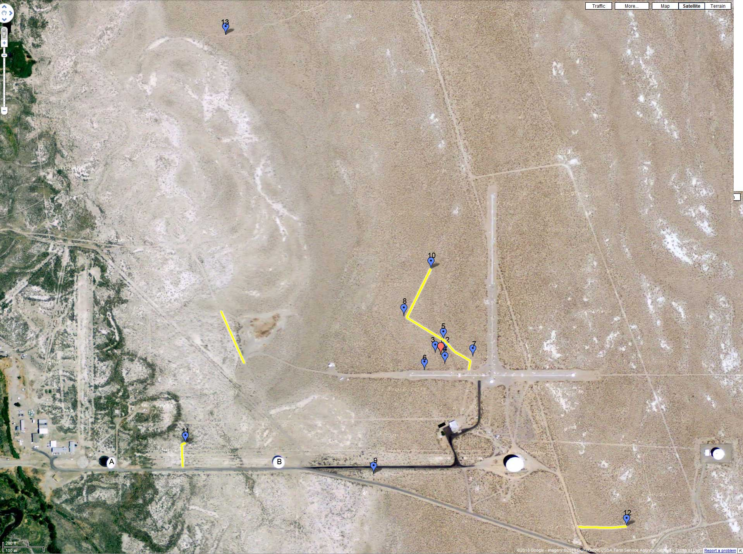
New roads

Slide 8
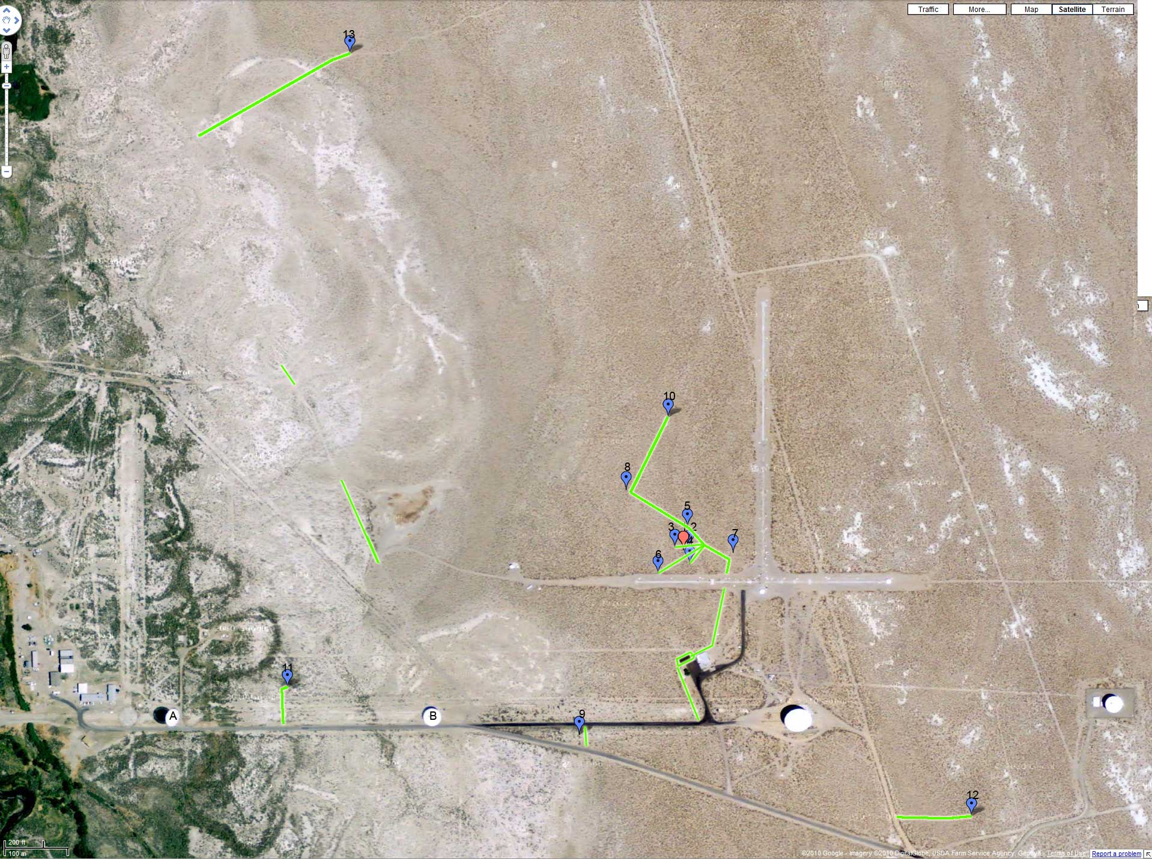
grading

Slide 9
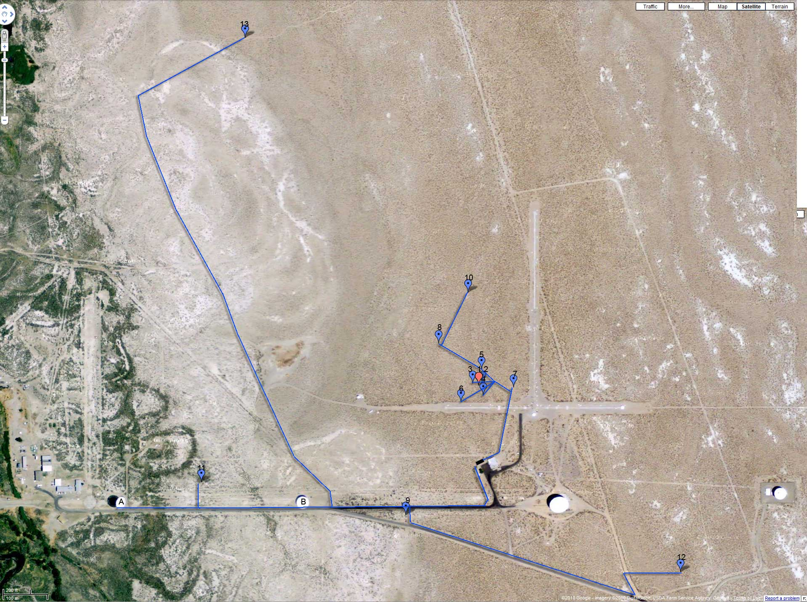
Trenches/conduit

Slide 10
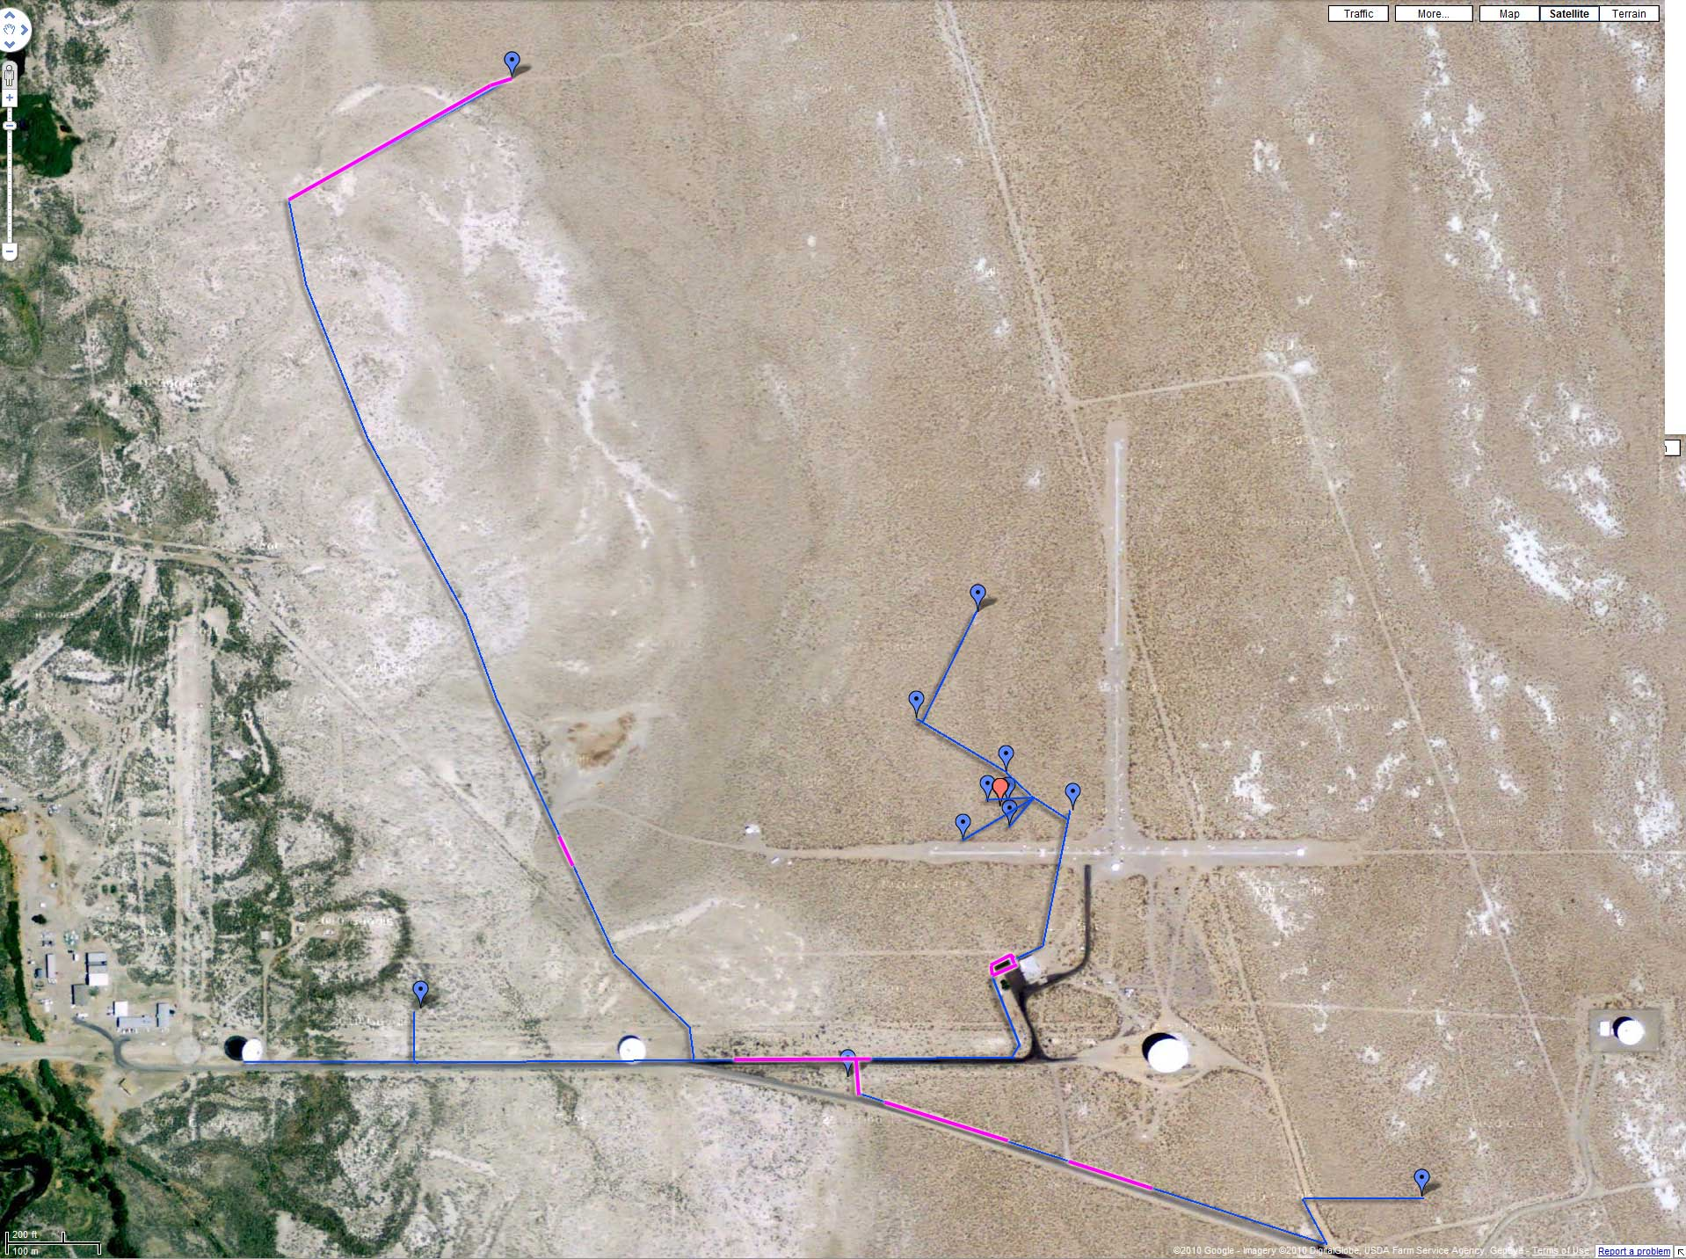
Trench + Archaeologist

