Slide 1

EOVSA fiber-optic transmission system
Dale E. Gary
Professor, Physics, Center for Solar-Terrestrial Research
New Jersey Institute of Technology

Slide 2
outline
Optilab RF optical Links
Multiplexing
RF Link Budget
Ethernet over Fiber
Fiber Choices
Fiber Handling
https://ovsa.njit.edu/svn/eovsa/trunk/doc/EOVSA%20Fiber%20Optic%20Link%20Issues.docx

Slide 3
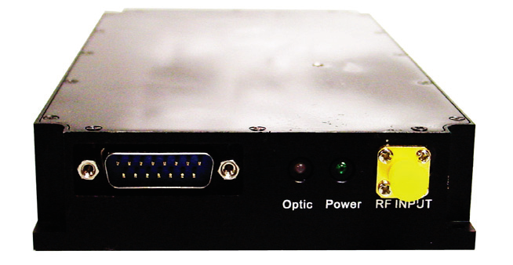
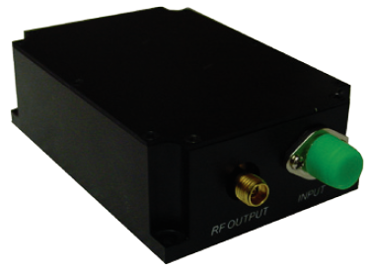
Optilab RF optical links
Optilab LT-25-M transmitter—1550 nm, 0.01-30 GHz
Optilab LR-30-M receiver—0.01-31 GHz
Adopted for use in Caltech’s KuPol system, characterized by O.G. King and K.S. Karkare in “KuPol Optical Link Report, rev. 2”
Significant advantage in cost over competing units
We have purchased two links with multiplexing for testing, but have not yet started working with it—suggest that we ship it to Wes for characterization at NRAO.
http://www.optilab.com/images/datasheets/LT-25-M_Productsheet.pdf
http://www.optilab.com/images/datasheets/LR-30-M_Productsheet.pdf
https://ovsa.njit.edu/svn/eovsa/trunk/doc/OptilabRFoverOptReport_v2.pdf

Slide 4
multiplexing
Optilab provides the option to tune the transmitters to slightly different frequencies, which then allows use of mux/demux units for multiplexing two RF signals on the same fiber.
We have plenty of fiber, so do not have to do this, but the cost is low and there could be advantages to putting both X and Y polarization signals on a single fiber.
  It will give a stable differential phase against thermal variations between the two polarizations, which could simplify calibration and polarization correction.
  It will provide additional fiber spares in case they are needed.
Potential downsides are additional space needed in the front end, and slight ($600/link-pair) extra cost.
Using the mux/demux, only one RF fiber is needed per antenna.

Slide 5
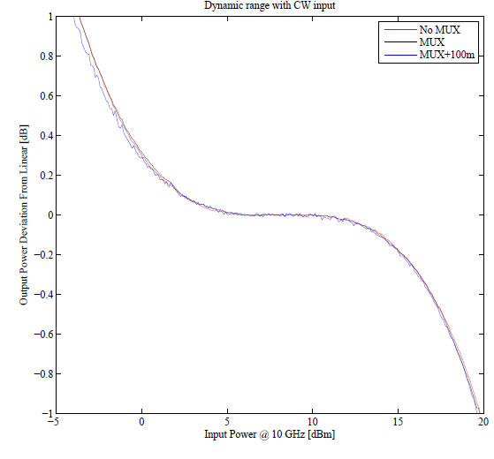
Rf link budget
Identical links will be used for the 2.1 m antennas and the 27-m antennas. When pointed off the Sun, and assuming nominal 400 K and 50 K system temperature, the input power on blank sky will be
According to Oliver King’s measurements, the “sweet spot” in linearity for the link is about 7 dBm
Thus, we need 77 dB of gain in the 27-m front
ends, and 86 dB in the 2.1 m front ends.
On the Sun, the 2.1 m front ends must have
excellent gain control to keep the power within
5 dB to stay in this linear range.
The fiber link gain is -26 dB ± 2 dB.

Slide 6
Ethernet and 1 pps over fiber
The design calls for ethernet over fiber to all antennas, with a minimum three-port switch in the antenna control boxes.
Wes Grammer has found a number of options, with one from Moxa being the cheapest ($419) and best fit (DIN-mounted, 24 VDC) for this application.
The four 10/100 ports of the Moxa EDS-205A-S-SC-T will permit the creation of a LAN in each controller, one to cRIO, one to antenna control module, and one to connect a laptop for local debugging. The fourth port could be available for ethernet to the focus, if we wish to use this option.
The fiber link with be full-duplex single-mode (requires two fibers), 1310 nm.
We also require an optical link to transmit the 1 PPS sync pulse. Details for this have not been explored.
Total number of fibers per antenna: 1 RF, 2 Ethernet, 1 PPS = 4 fibers needed.

Slide 7
Fiber choices
With each antenna requiring 4 fibers, and using a spares margin of a factor of 2, the fiber cable to each antenna will have 8 single-mode fibers.
The 9 inner 2.1-m antennas (numbers 1-8 and 10) will combine at the breakout shed, where they will connect into a single trunk line of 9*8=72 fibers running back to the building.
The 4 outer 2.1-m antennas (9, 11, 12, 13), and the two 27-m antennas (A and B) will combine near antenna B, where they will connect to another trunk line of 6*8=48 fibers. We will need to investigate the design for the 27-m antennas to ensure that 8 fibers to each provides enough signals and spares, given the potentially greater complexity of the cryo-receiver operations.
Ron Lawrence, at OVRO, suggests that we purchase our fiber through Anixter. As a costing exercise, however, I looked up some possible fiber choices at CablesPlusUSA.com. Criteria were: outdoor, burial in conduit, single-mode (9/125), PE—outside plant.
8-fiber cable: General Cable (#AQ0084M1A-DWB),
$336/1000 ft x 18000 ft = $6050
72-fiber cable: General Cable (#AQ0724M1A-DWB), $904/1000 ft x 3000 ft = $2712

Slide 8
Fiber handling
Ron Lawrence suggested use of the Coyote series of cable splice kits, which are designed for maintenance-free splicing of large numbers of fibers such as we will see at the breakout box and near antenna B, where the individual antennas mate with the trunk lines.
I was initially concerned with the many splices and connections needed between the focus and the backend, where I counted up to 1-3 dB losses. However, Wes Grammer suggests that this is far too pessimistic. If so, perhaps multiple splices and connectors is no problem.
We need to rent a fiber pulling system, and purchase splicing kits. For mating the trunk lines to individual 8-fiber cables, we can use the Coyote splice kits. For splicing connectors to fiber, we are looking at the Corning UniCam tools.
Hopefully someone with more experience than I can coordinate this.
Transmitter (connector)
Focus (splice)
Controller (splice + connector)
Breakout Shed (splice)
Building (splice + connector)
Receiver (connector)

