Slide 1

EOVSA CAlibration
Dale E. Gary
Professor, Physics, Center for Solar-Terrestrial Research
New Jersey Institute of Technology

Slide 2
outline
Calibration Task List
EOVSA Control Language
  Atomic Commands
  Macro Commands
Examples
  Solar pointing calibration
  Phase calibration
Source and array coordinates with Aipy

Slide 3

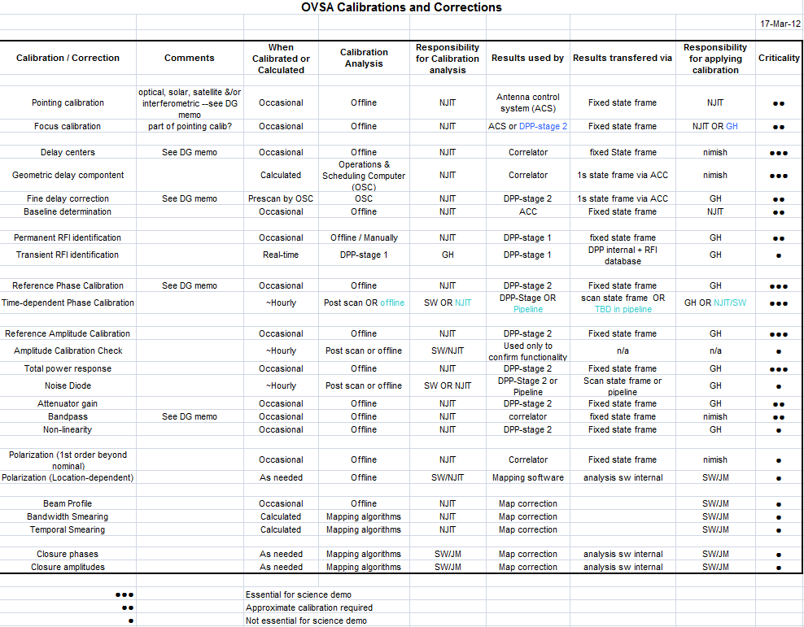
Calibrationsummary-postpdr.xls

Slide 4
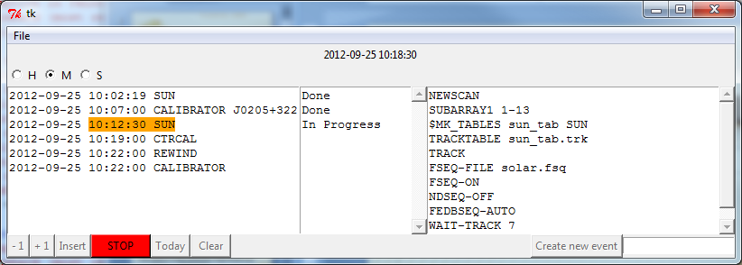
EOVSA control language
Defined in “EOVSA Control Language.doc”
Atomic Commands
  Leading $ means Schedule computer handles it, otherwise the line is sent directly to ACC (e.g. SUBARRAY1 1-13 puts ants 1 through 13 into subarray 1, $MK_TABLES sun_tab SUN is handled locally to create a track table for the SUN called sun_tab.trk)
  Each atomic command does one thing, and those referring to antennas can be followed by <antlist>, e.g. IDLE <antlist> will idle the antennas in antlist, while IDLE alone idles all antennas in the current subarray.
Macro Commands
  These are associated with files that contain lists of atomic commands, e.g.
  SOLPNTCAL <fseqfile> <trajfile> <ndseqfile>
  refers to a file SOLPNTCAL.SCD, which contains the atomic commands needed to perform a solar pointing calibration. The items in <> are arguments that refer to other files used by the atomic commands.
  Macro commands appear in the left-hand window of the schedule, while atomic commands appear in the right-hand window.
  The currently active macro and atomic commands will appear in the stateframe.

Slide 5
ACC and stateframe handling
Schedule Action
  When the start time of a macro command is reached, the schedule will send the macro command and some subset of atomic commands to the ACC. The schedule will read subsequent stateframes and display (via color highlight) which current macro and atomic command is in progress. For time-critical commands, the schedule will wait until the preceding atomic command is complete before sending others.
ACC Action
  The ACC will act only on atomic commands, merely putting macro commands in the stateframe. The ACC will perform the defined actions of the atomic commands as fast as possible. If there is a need to wait for an action to complete, that will be determined by the schedule using stateframe contents. It is possible that multiple atomic commands could be performed so quickly that they do not all appear in the stateframe—this may compromise logging.
NEWSCAN
  This is an atomic command that begins each macro command and tells the data system to stop recording the previous scan (if running) and prepare for a new scan.

Slide 6
Example: solar Pointing calibration
SOLPNTCAL solpnt.fsq solpnt.trj solpnt.nsq
NEWSCAN ; start new scan
SUBARRAY1 1-13 ; use ants 1 through 13
$MK_TABLES sun_tab SUN ; make tracktable locally (ftp)
TRACKTABLE sun_tab.trk ; tell ACC to load tracktable
TRACK ; tell ACC to execute tracking
FSEQ-FILE #1 ; set fseq. file (given by arg1)
FSEQ-ON ; tell ACC to begin frequency seq.
NDSEQ-FILE #3 ; set noise diode seq. file (arg3)
NDSEQ-ON ; tell ACC to begin noise diode seq.
FEDBSEQ-AUTO ; trigger start of dynamic attn
TRAJ-FILE #2 ; set trajectory file (arg2)
WAIT-TRACK 7 ; wait until at least 7 antennas track
TRAJ-ON ; trigger start of trajectory

Slide 7
Example: phase calibration
PHASECAL 0157+747 pcal.fsq
NEWSCAN ; start new scan
SUBARRAY1 1-15 ; use all ants 1 through 15
$MK_TABLES pcal_tab #1 ; make tracktable for 0157+747
TRACKTABLE pcal_tab.trk ; tell ACC to load tracktable
TRACK ; tell ACC to execute tracking
FSEQ-FILE #2 ; set fseq. file (given by arg1)
FSEQ-ON ; tell ACC to begin frequency seq.
NDSEQ-OFF ; turn off noise diode sequencing
FEDBSEQ-OFF ; turn off attn sequencing
FEDB 0 ; set front end attn to 0
WAIT-TRACK 7 ; wait until at least 7 antennas track

Slide 8
File formats
TRACKTABLE
RA Dec MJD Time
(deg*) (deg*) (day) (ms)
3246805 -109310 55160 3600000
3247212 -109173 55160 3900000
3247617 -109037 55160 4200000
3248018 -108901 55160 4500000
3248415 -108764 55160 4800000
3248810 -108628 55160 5100000
3249202 -108491 55160 5400000
3249591 -108355 55160 5700000
3249976 -108218 55160 6000000
3250359 -108081 55160 6300000
*user coords = deg x 10000
TRAJECTORY FILE
Az Off El Off MJD Time
(deg*) (deg*) (day) (ms)
-50000 0 55160 3600000
-20000 0 55160 3660000
-10000 0 55160 3720000
-5000 0 55160 3780000
-2000 0 55160 3840000
-1000 0 55160 3900000
0 0 55160 3960000
1000 0 55160 4020000
2000 0 55160 4080000
etc.

Slide 9
File formats
FREQUENCY SEQUENCE FILE*
DWELL 1000ms,,,,,,,,,,,,,,,,,,,,,,,,,,,,,,,,,
SEQUENCE 5, 7, 9, 11, 13, 15, 17, 19, 21, 23
NOISE DIODE SEQ FILE**
DWELL 10,,
SEQUENCE 0, 1
FRONT END ATTENUATION SEQ FILE**
DWELL 10,,,,,,,,,,,
SEQUENCE 0, 1, 2, 4, 8, 16, *0, *1, *2, *4, *8, *16
*This is the language of the Hittite Synthesizers, and sets all 34 bands to 1000 ms
dwell, then selects a set of 10 bands
**Borrows syntax of Hittite Synthesizers—time units in seconds

Slide 10
questions
Is this approach general enough to accomplish everything we need to control?
Is anything missing? Do we need an ABORT command that would put the array into a predefined state?
What do we do about logging of atomic commands when they take less than 1 s?
What, exactly, will the NEWSCAN atomic command do? What actions are taken by DPP? How do we signal start of a new data acquisition? Do we need a separate command? Perhaps the NEWSCAN

Slide 11
Special case real-time pipeline
The correlator boards have a 1200 MHz ADC clock, and a 300 MHz FPGA clock (1/4 of digitizer speed). This means that on startup, each ROACH has a 1 in 4 ambiguity as to where in the time-domain data stream it starts. Each digitizer sample is 0.833 ns, so the different boards will have delay offsets up to 3 delay steps.
The suggested way to handle this is to track a geostationary satellite (e.g. XM radio), take data, and examine the phase slope on each baseline to set delay offsets.
This means that every time a ROACH board is restarted, this standard calibration must be performed before observing. Obviously, this should not require human intervention, which means pipeline processing (initiating an automatic Miriad script) to determine these delay offsets.

Slide 12
Source catalogs and coordinates
The schedule, written in Python, will dynamically calculate source coordinates, delays, and u,v,w “triplets” using Aipy, which was developed by Aaron Parsons for the PAPER array, and which in turn is built on the pyephem package. Will write an interface to VLA catalog.
Here is an example:
  aloc = (lat, lng, elev) # array center geographic coordinates
  aa = aipy.phs.AntennaArray(ants=ants,location=aloc) # create antenna array object (aa), using xyz ant coords
  aa.horizon = '10:00:00' # 10 degree minimum elevation
  aa.pressure = 1000.0 # 1000 mBar nominal pressure
  aa.set_ephemtime(‘2012/09/24 18:59:00’) # time at which to evaluate (or blank for current time)
  srcs = [] # empty list of sources
  srcs.append(aipy.phs.RadioSpecial('Sun')) # append coordinates for Sun
  cat = aipy.phs.SrcCatalog(srcs) # create “catalog” from source list
  cat.compute(aa) # compute coordinates for source given aa object
  for j in range(16):
  for i in range(16):
  u[i,j], v[i,j], w[i,j] = aa.gen_uvw(i,j,cat['Sun']) # calculate u,v,w coordinates for current time
  # delay is –w term

