Slide 1
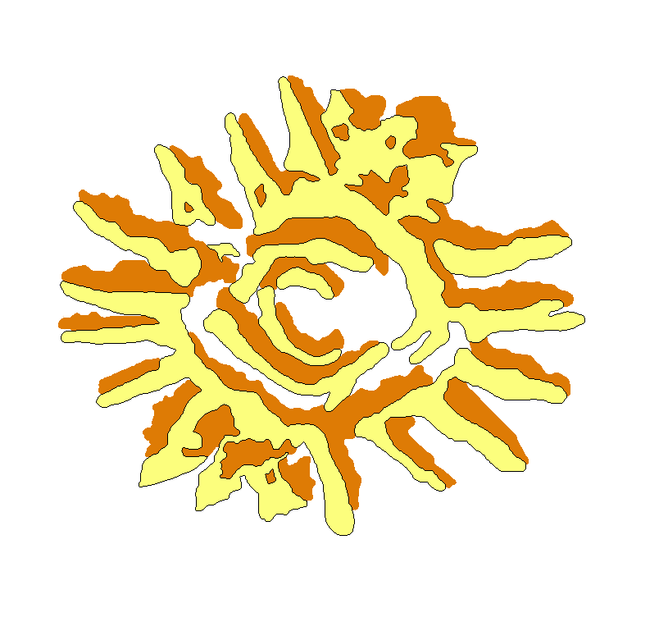
EOVSA Geometry/coordinate calculation and distribution
Dale E. Gary
Professor, Physics, Center for Solar-Terrestrial Research
New Jersey Institute of Technology

Slide 2
outline
Software overview
Tasks for geometry/coordinate software
Distribution of information

Slide 3
Software overview
The software is written in Python 2.6.7 on Linux (Ubuntu). The software can be made largely platform independent, except…see below
It is based on C++ code from SZA (courtesy of Erik Leitch)
Uses SLALIB for coordinate transformation, precession, etc. Unfortunately, I have not found a platform-independent Python library for it, so any routines that require SLALIB are Linux-only.
Will have integrated connection to web resources
IERS Bulletin
JPL Horizons for planetary/solar coordinates
NORAD and JPL for satellite coordinates (for test observations)

Slide 4
Source coordinates
Solar coordinates as daily (0 h Terrestrial Time) Earth-centered apparent positions, quadratically interpolated, from JPL Horizons system, converted to EOVSA center using SLALIB. We will use Sun-center coordinates only.
Other planetary bodies in the same format, but with appropriate Δt (e.g. hourly for Moon) to maintain accuracy.
Calibrators from VLA Calibrator list plus a few others (e.g. Cas A), in J2000 coordinates, precessed to apparent place using SLALIB.
Bright Star Catalog (for optical pointing), precessed as for calibrators.

Slide 5
Base classes and objects
These are described in detail, with examples, in EOVSA_Python.doc:
datim (date/time object with native units of modified Julian Day; mjd, as day + fraction of day) with methods for setting, getting, printing in hexigesimal to ms precision, e.g. ‘2011-12-25 03:20:35.287’
Angle (generic angle object with native units of radians—derived classes RA_Angle, Dec_Angle, with ranges 0 to 2π and –π to π, respectively) with methods for setting and getting, in hms, dms, or degrees
Length and Vector (1 and 3-element length objects with native units of meters) with methods for setting and getting in km, cm. Vectors also have magnitude and rotate methods.
Coordinates (a location with default LLA [latitude, longitude, altitude] units—two Angle objects and a Length object) with methods for setting, getting in ENU (east-north-up), XYZ (local Earth-oriented), ABSXYZ (Earth-center), and UVW units. Functions in the Coordinates library can be used to calculate location differences (e.g. baselines), directions (az, el), uvw coordinates and delays (–w term)—see complete example in EOVSA_Python.doc.

Slide 6
EST Example
import Coordinates as Coords
c = []
# Array Center
longitude = Dec_Angle(-118.286952892965,'degrees')
# latitude = Dec_Angle(37.233169890102602,'degrees')
latitude = Dec_Angle('37:13:53.8','dms')
altitude = Length(1207.1339)
c.append(Coords.Coordinates(longitude, latitude, altitude))
c.append(Coords.llaenu2lla(lla=c[0], east=13.87, north=128.120, up=-12.530))
c.append(Coords.llaenu2lla(lla=c[0], east=13.87, north=371.960, up=-12.340))
c.append(Coords.llaenu2lla(lla=c[0], east=149.962, north=127.903, up=-12.304))
# These are the xyz vectors to various ants relative to array center
xyz1 = Coords.getxyz(lla=c[0],enu=c[0].getenu(lla=c[1]),geocentric=False) + Vector([0.2534,0.0967,-0.3054])
xyz2 = Coords.getxyz(lla=c[0],enu=c[0].getenu(lla=c[2]),geocentric=False) + Vector([0.4678,0.2568,-0.2883])
xyz3 = Coords.getxyz(lla=c[0],enu=c[0].getenu(lla=c[3]),geocentric=False) + Vector([-0.1526,0.1033,0.3937])
b56 = (xyz2-xyz1) # Baseline 5-6
b57 = (xyz3-xyz1) # Baseline 5-7
b67 = (xyz3-xyz2) # Baseline 6-7

Slide 7
Example-cont’d
The UVW coordinates are obtained from the source HA, Dec, and these baselines by
uvw1 = Coords.hadecxyz2uvw(ha=ha_c, dec=dec_c, xyz=b56)/0.29979
uvw2 = Coords.hadecxyz2uvw(ha=ha_c, dec=dec_c, xyz=b57)/0.29979
uvw3 = Coords.hadecxyz2uvw(ha=ha_c, dec=dec_c, xyz=b67)/0.29979
where the division by 0.29979 converts UVW in meters to UVW in nanoseconds. Finally, the delays are obtained from the -W term, so the delays are
d56 = -uvw1.get()[2] # Baseline 5-6 delay, nanoseconds
d57 = -uvw2.get()[2] # Baseline 5-7 delay, nanoseconds
d67 = -uvw3.get()[2] # Baseline 6-7 delay, nanoseconds

Slide 8
systems that need coordinate info
Examples of subsystems that require coordinate or delay information:
Antennas—local (RA-Dec) pointing information (Controllers can convert to Alt-Az and interpolate to track Alt-Az, as needed).
Correlator—coarse delays (integer ADC steps), fine delays needed?
DPP—uvw triplets for interpolation; feed parallactic angle (?)
Control system—information about source (name, coordinates or interpolation triplets), solar ephemeris, tracking offsets, for entering into State Frame

Slide 9
Distribution of coordinate info
Antennas—source information is sent to the control computer as RA-Dec table, regenerated on source change.
Correlator—need to calculate worst-case effect of coarse delay errors, but if possible, correlator can update only on 1 PPS tick, with delays sent via TCP-IP socket connection (this is what is done with EST). Coarse delay state will also be recorded in State Frame and in ROACH header.
DPP—will receive uvw triplets for quadratic interpolation via State Frame, updated every 20 s (this is what is done with EST). The same can be done for parallactic angle. What else is needed?
Control system—will receive source, ephemeris, tracking offsets, etc., via TCP-IP socket connection

