Slide 1

Analog and digital systems OVSA Expansion Project
Dale E. Gary
Professor, Physics, Center for Solar-Terrestrial Research
New Jersey Institute of Technology

Slide 2
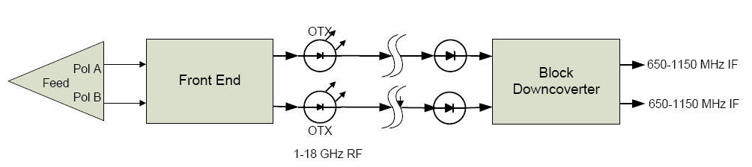
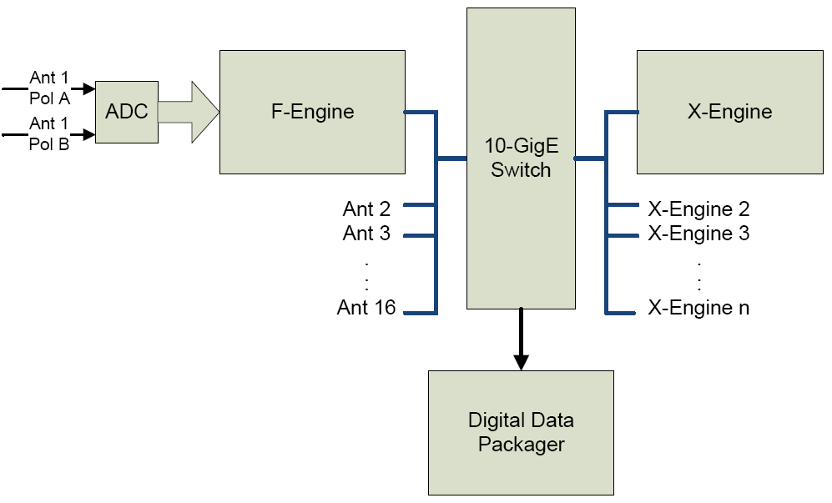
outline
Analog System
Feeds and front-end
Optical links
Block downconversion
Digital System
F-engines with Spectral Kurtosis
X-engines
Data packaging system
Conclusion

Slide 3
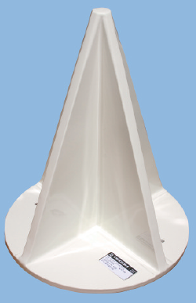
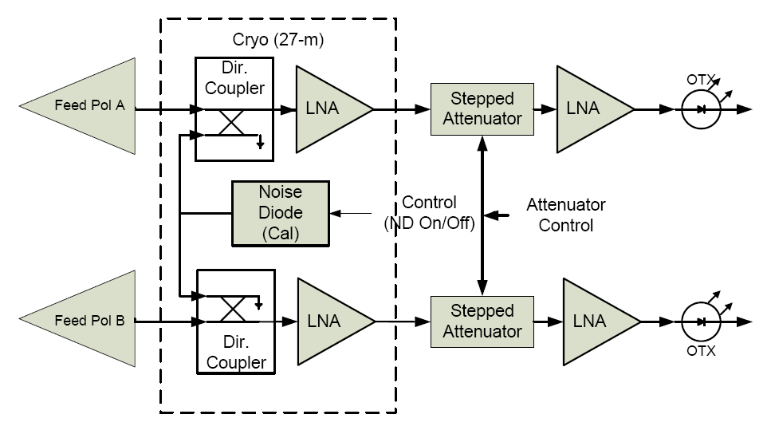
Feed and front end
Simplified Front-End Block Diagram
Tecom 1-18 GHz Feed

Slide 4
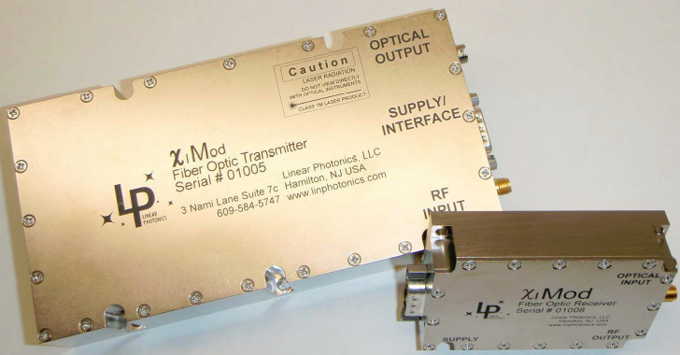
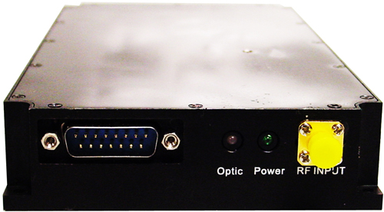
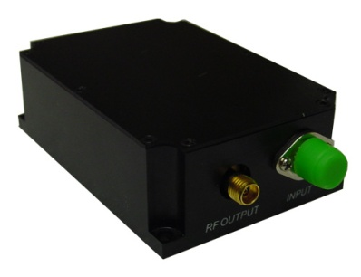
Optical links
Linear Photonics link tested by NRAO
($13,250/link)
Optilab link tested by Caltech
($7.6 k/link)
Both links tested well, and appear to be suitable for our application. Budgeted $14,500 per link. Note, transmitter must be thermally stabilized.

Slide 5
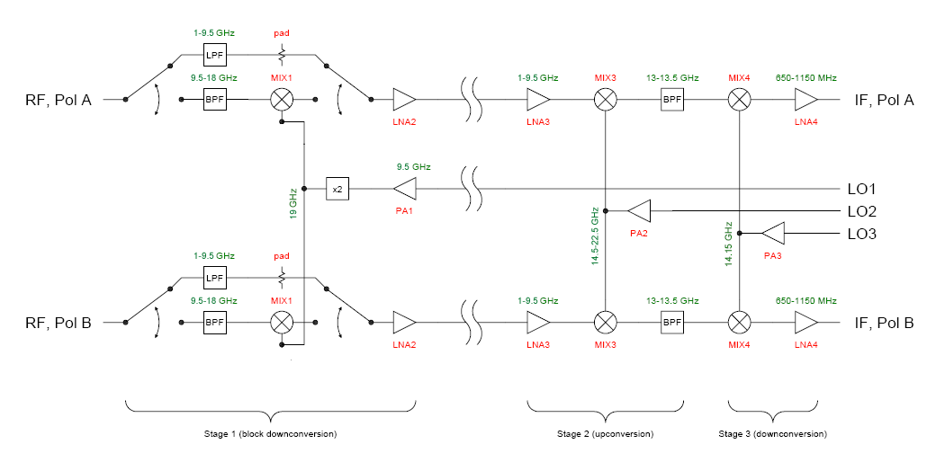
Analog downconversion
Saini - 1
Conservative (traditional) approach—requires 3 LOs and large parts count

Slide 6
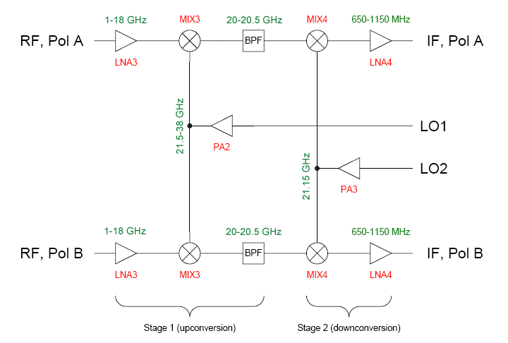
Analog downconversion
Saini - 2
Alternative 1: Two LOs, lower parts count, requires FO transmission of RF

Slide 7
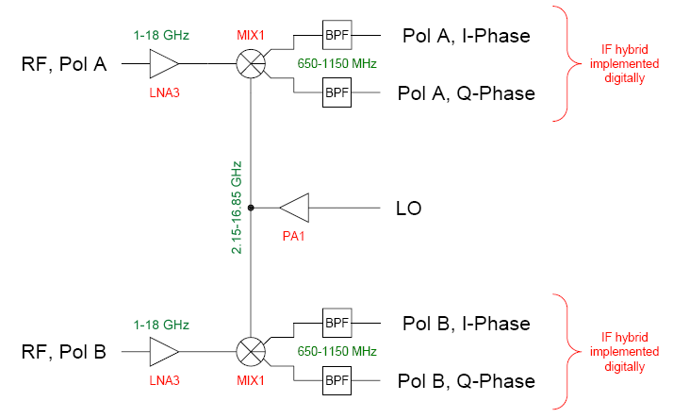
Analog downconversion
Saini - 3
Alternative 2: One LO, broadband sideband-separating mixer, digital hybrid,
requires FO transmission of RF. Doubles # inputs to correlator.

Slide 8
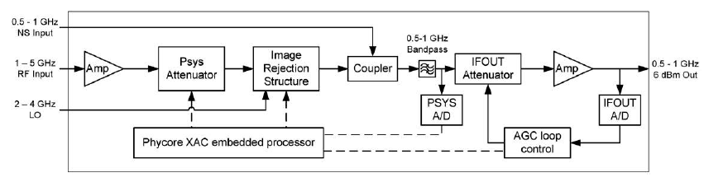
Analog downconversion
None of the previous plans address gain stabilization. We have used the Caltech Spectral Line Downconverter for KSRBL and FST:
Problem: P_{SYS} measurement (needed to determine gain of AGC loop) is slow (20 ms), and asynchronous with data sampling.
Also, Phycore XAC is obsolete.
New design is necessary.

Slide 9
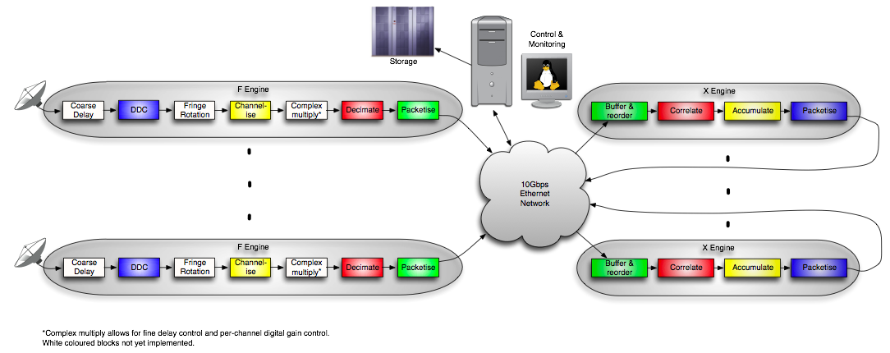
Digital system
The ROACH board approach was baselined in the proposal, and requires 24 ROACH boards (1 for each antenna—dual polarization F-engine, plus 8 for the X-engines). Budgeted $160 k for correlator.
Our tests with ROACH indicate F-engine may not fit at 500 MHz BW and full-resolution SK calculation. Suggests ROACH2 may be needed.

Slide 10
Digital system
Update on ROACH2—from Jason Manley:
ROACH-II is coming along nicely. The first prototype PCBs have been ordered (5 days ago) from DDI in California and we expect two populated boards in November. We'll probably fiddle with those till year end. Our production prototypes are expected in the first quarter of 2011. That will go through another round of evaluations and we'll need to ready a production test suite and supporting software which will likely take a couple of months. I expect ROACH-II boards will be on sale and available around mid-2011 so this should suite your timelines perfectly, barring any unforeseen roadblocks.

Slide 11
Digital system
However, I also received a message from Dan Werthimer:
We recently built several spectrometers for Roach I: single 3 GHz spectrometer (6 Gsps ADC), dual 1.5 GHz spectrometer (dual 3 Gsps ADC); we learned a lot of tricks to optimize the FFT and get the FPGA clocking at 375 MHz. These might be applicable to your F engine, so it might be possible to use Roach I, but Roach II would be nice if you can wait for a bit.
Perhaps you can start testing with Roach I, and then port to Roach II next year.
We need to understand the digital design sufficiently to determine what is the division between firmware functions and the Digital Data Packaging unit, which will likely be implemented as a compute cluster. Note that another option is GPUs, which have received a lot of attention recently (and are being used in MWA, for example).

Slide 12
conclusion
We have several options for analog design, which will drive the specifics of the digital design.
The budget calls for hiring an RF engineer and a digital engineer—they need to be in place quickly so that the design trades can be investigated in detail.
How much help can we get from NRAO, UC/Berkeley, Caltech and elsewhere in design work?
The interface between correlator output and ultimate computer database (input to pipeline processing) also needs to be fleshed out, and decisions made as to whether it is implemented in FPGA hardware, GPUs, or software.
These decisions will not be made at this meeting, but we can begin the discussion and lay out a strategy (and schedule).

