Slide 1
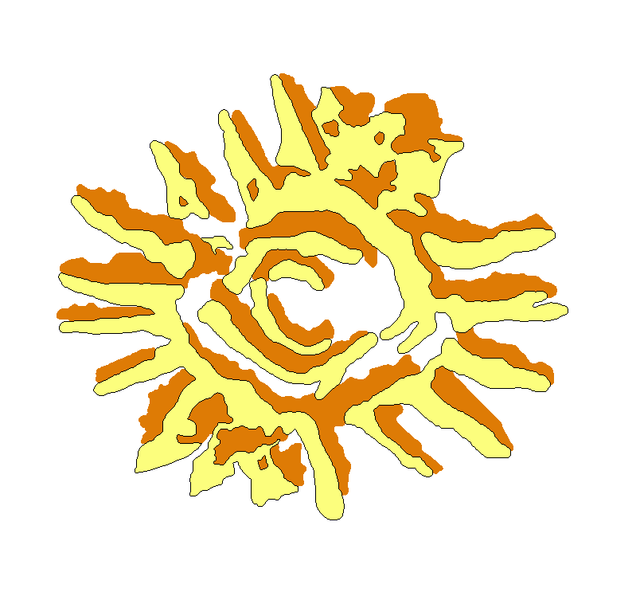
Antennas and Array configuration OVSA Expansion Project
Dale E. Gary
Professor, Physics, Center for Solar-Terrestrial Research
New Jersey Institute of Technology

Slide 2
outline
2-m Antennas
Eight new antennas
Five existing antennas
27-m Antennas for Calibration
Array Configuration
Imaging Study
Conclusion

Slide 3
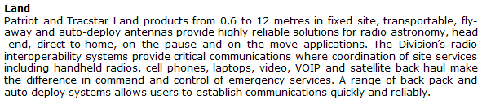
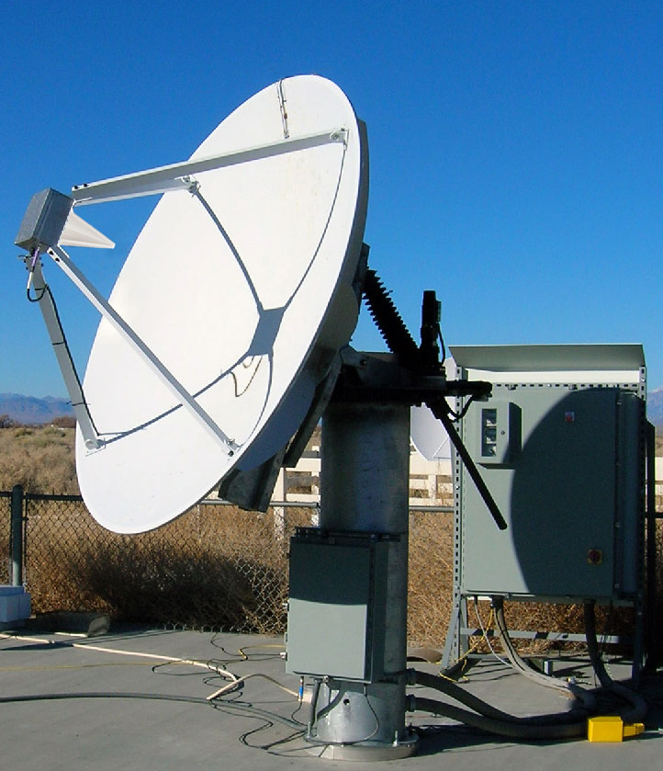
New 2-m antennas
Patriot (now Cobham)
Alt-Az mount
2.1 m reflector
Precise pointing (of order 20”)
Modbus over TCP/IP control system
Specifications needed, to be discussed this afternoon

Slide 4
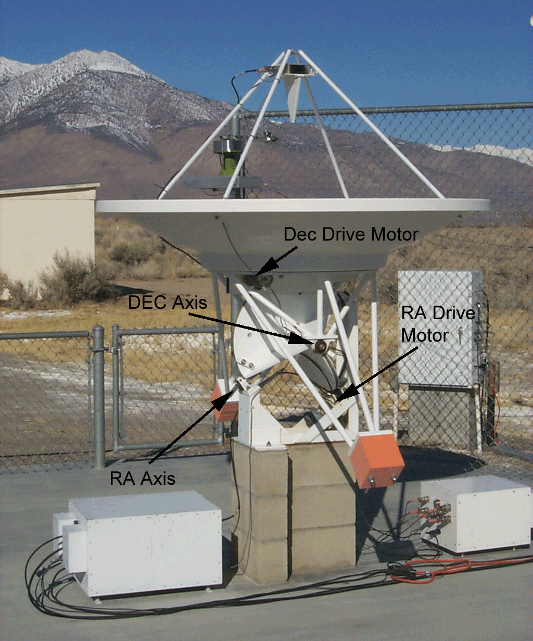
Existing 2-m antennas
Need upgrade for common control
Equatorial Mount – implies rotation of feed relative to new antennas, and restricted sky coverage.
1.8 m reflector – will upgrade reflector and feed support to Patriot style.
Pointing open-loop, based on stepper motor steps – will upgrade to Heidenhain encoders.
Home-grown control system – will upgrade to functionally equivalent control system (current EE student senior project).
Possible target for future proposal, $275-325 k, to buy 5 Patriot dishes.
EE Students:
Shaneka Banks
Kate Boardman
Dante Castillo
Paul Dupiano
Jakub Kolodzeijski
Joe Mitchko
Michael Stefanyak

Slide 5
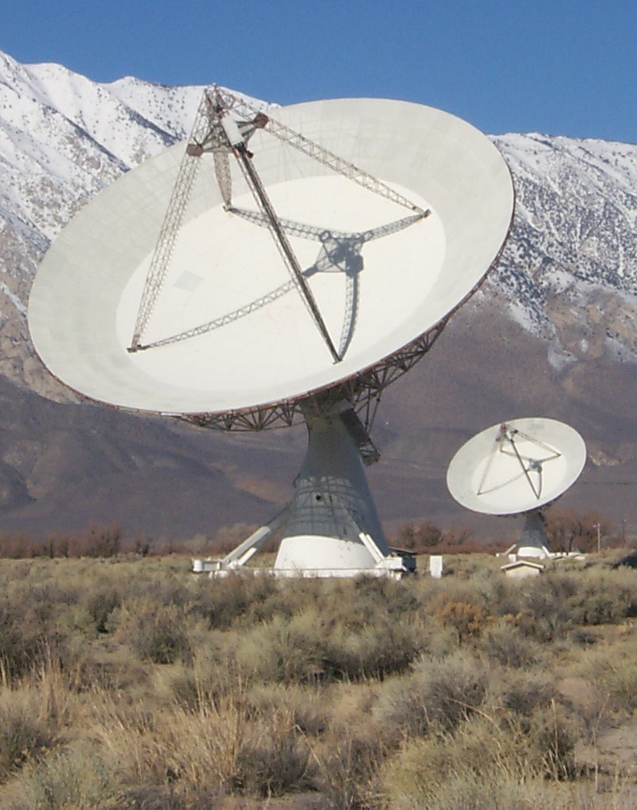
27-m refurbishment
Kjell has already described the refurbishment plan.
The dishes, for solar work, will nominally be used for calibration only.
However, the correlator will accept both 2-m and 27-m inputs, so in principle they could be used for the Sun.
Such a plan impacts design considerations, and possibly would be an unacceptable hit to the system temperature.

Slide 6
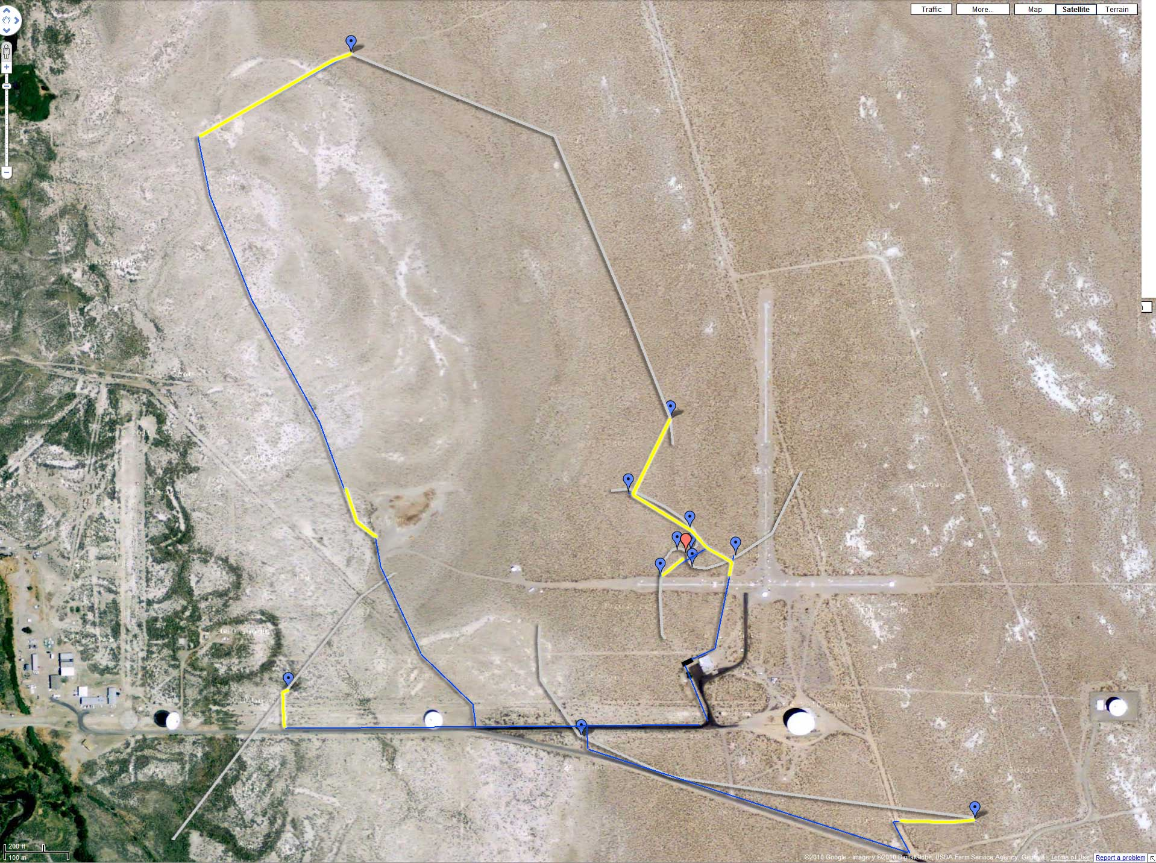
Array configuration
5 “old” antennas on outermost pads

Slide 7
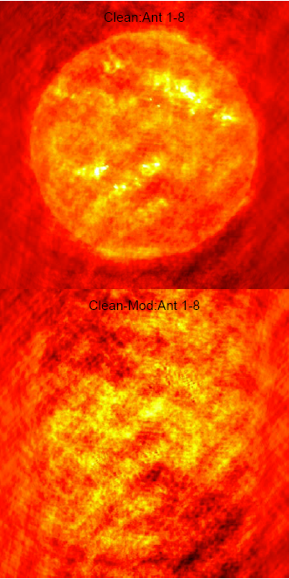
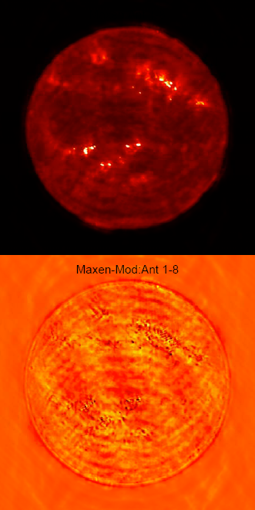
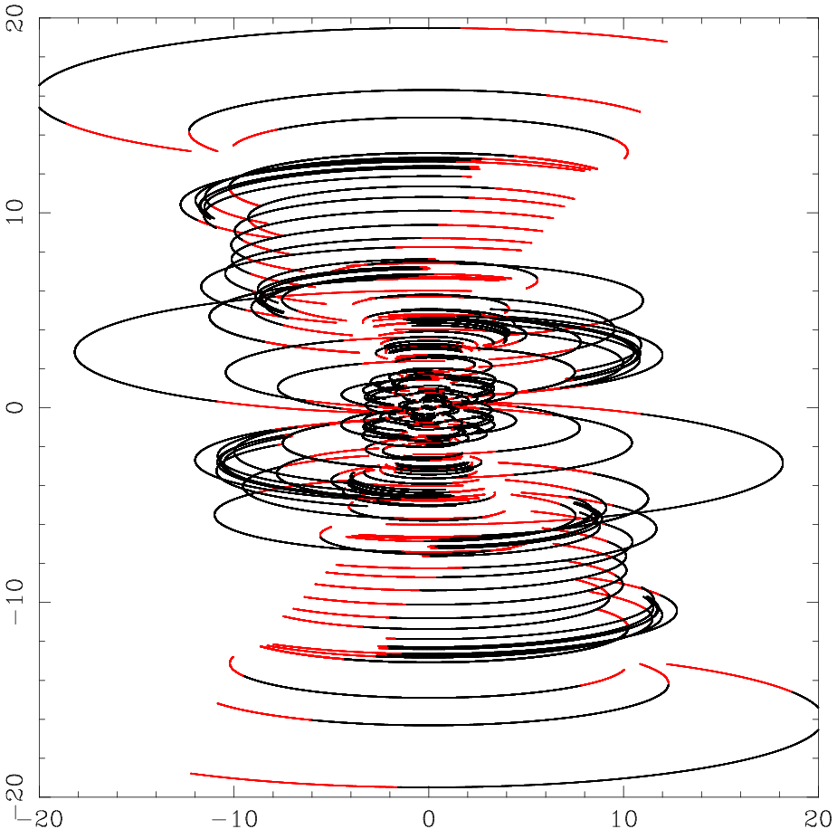
1-8

Slide 8
Array configuration
5 “old” antennas on innermost pads

Slide 9
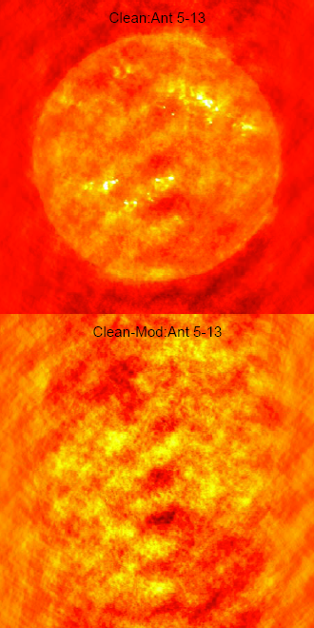
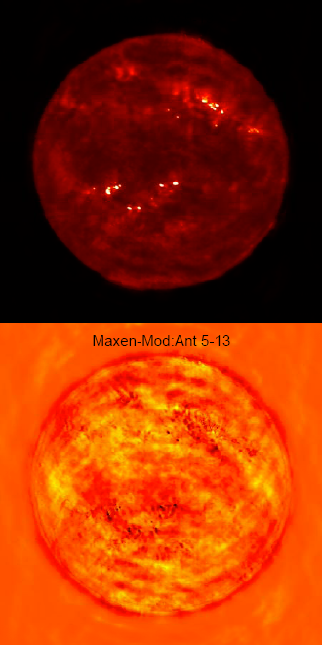
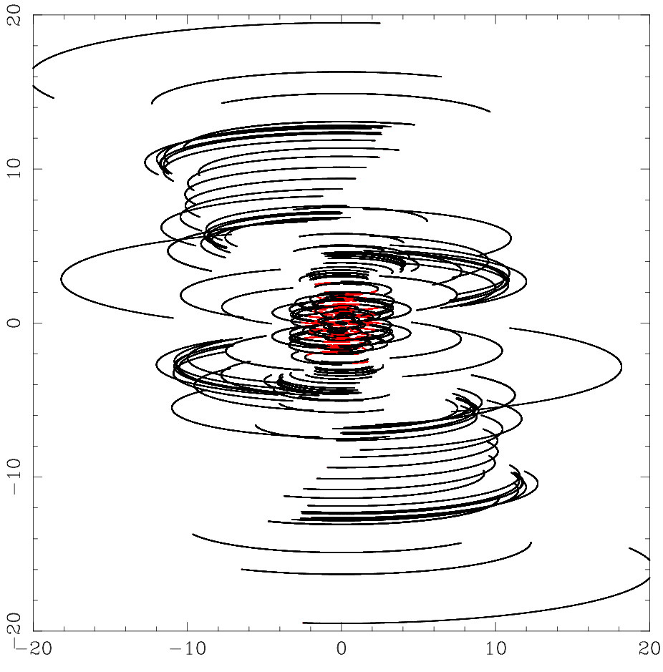
5-13

Slide 10
Array configuration
5 “old” antennas on odd-numbered pads (3,5,7,9,11)

Slide 11
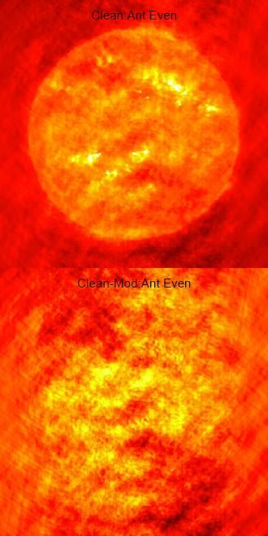
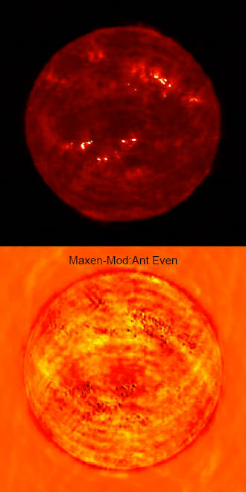
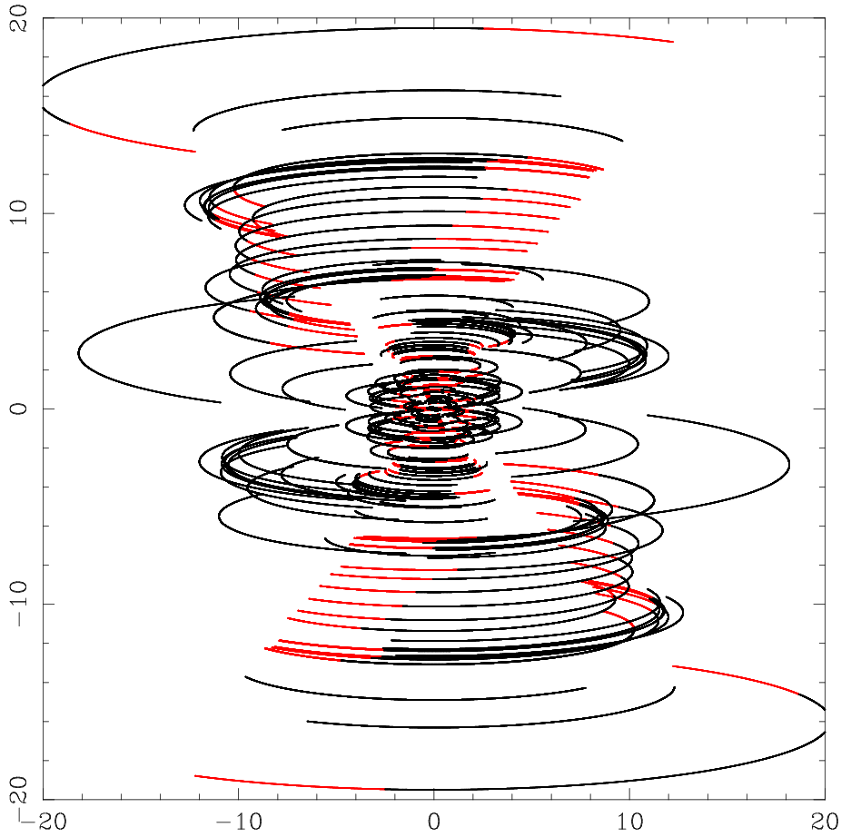
Even

Slide 12
Array configuration
5 “old” antennas on even-numbered pads (2,4,6,8,10)

Slide 13
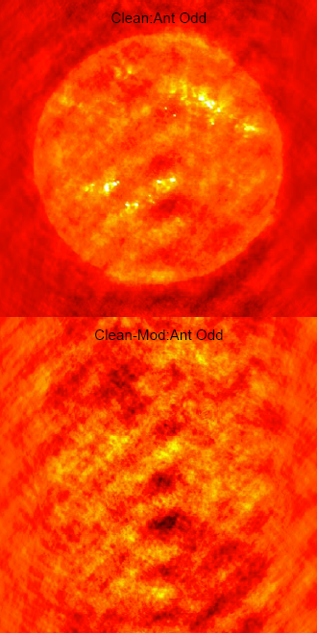
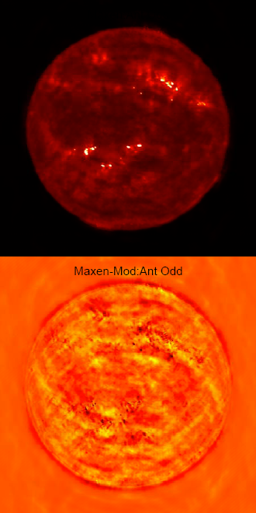
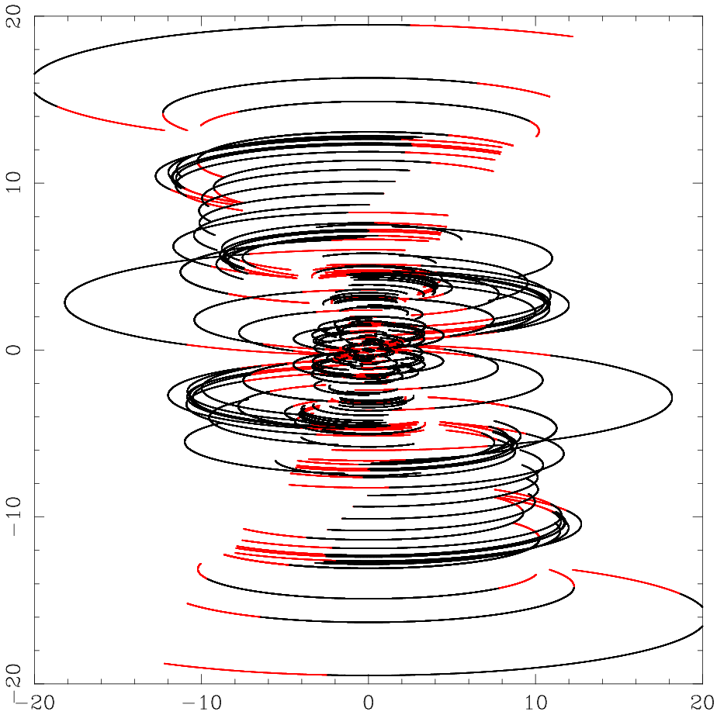
odd

Slide 14
1-8

Slide 15
5-13

Slide 16
Even

Slide 17
odd

Slide 18
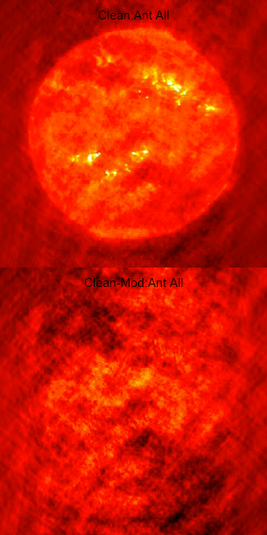
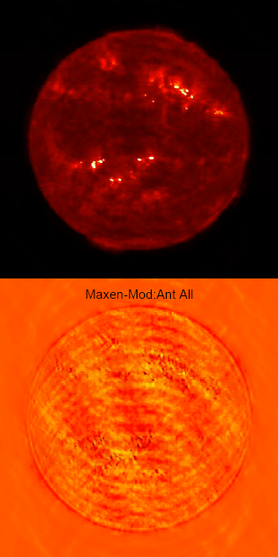
all

Slide 19
Conclusion
The restricted coverage of the old dishes (at some times of year) will impact quality of all-day synthesis images.
A more careful study is needed to determine where to put the old dishes. Depending on reliability, there may be a maintenance advantage to having them closer to array center.
Replacing them with new antennas is a worthy goal.

