Slide 1

GOALs of the meeting
OVSA Expansion Project
Dale E. Gary
Professor, Physics, Center for Solar-Terrestrial Research
New Jersey Institute of Technology

Slide 2
goals
Gather the team for an overview of the project, to provide a common global viewpoint.
Explain my vision at the time of writing the proposal, now 15 months ago!
Flesh out the vision to turn it into a realizable project, to be done on schedule and in budget.
Make sure that the larger goal of FASR is kept in mind.
Begin to drill down to details of task, resources, schedule.
Establish specifications for parts of the project with long lead times, which have to be started immediately.
Discuss instrument, software, modeling and community efforts needed to achieve science goals
Get people started on the tasks they are responsible for.

Slide 3
The team
Gather the team for an overview of the project
NJIT Team:
  Dale Gary
  Kjell Nelin
  Felicia Margolies
  Gelu Nita
Berkeley Team:
  Gordon Hurford
  Jim McTiernan
FASR Collaborators
  Stephen White
  Tim Bastian
  Haimin Wang
  Jeongwoo Lee
  Gregory Fleishman
  Students
  Dave DeBoer

Slide 4
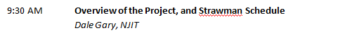
goals
Explain my vision at the time of writing the proposal, now 15 months ago!

Slide 5
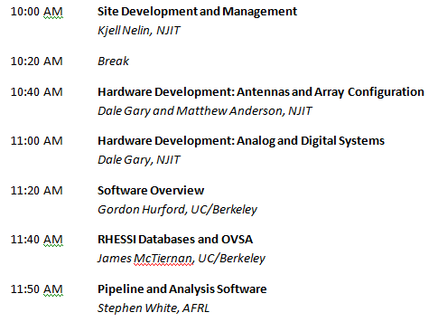
goals
Flesh out the vision to turn it into a realizable project, to be done on schedule and in budget.

Slide 6
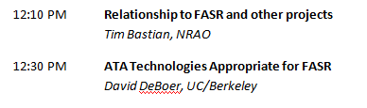
goals
Make sure that the larger goal of FASR is kept in mind.

Slide 7
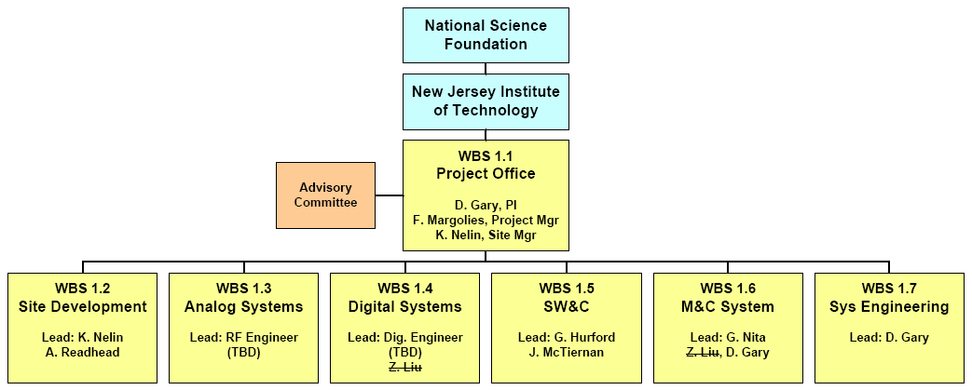
The team
Begin to drill down to details of task, resources, schedule.

Slide 8
goals
Establish specifications for parts of the project with long lead times, which have to be started immediately.

Slide 9
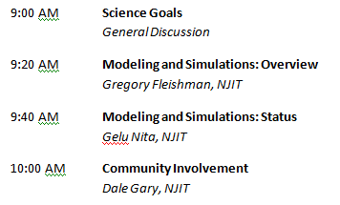
goals
Discuss instrument, software, modeling and community efforts needed to achieve science goals.

Slide 10
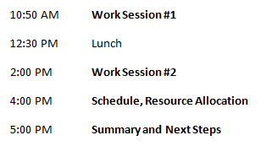
goals
Get people started on the tasks they are responsible for.

Slide 11
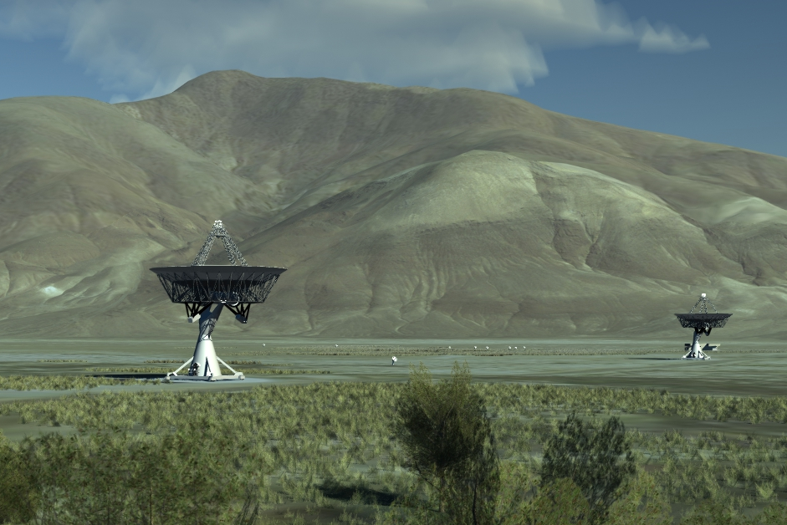
The final goal of the meeting

