Slide 1

OVERview and schedule
OVSA Expansion Project
Dale E. Gary
Professor, Physics, Center for Solar-Terrestrial Research
New Jersey Institute of Technology

Slide 2
outline
History and Motivation
Opportunity to Jump-Start FASR
Science Goals
Site Development
System Overview
Strawman Schedule

Slide 3
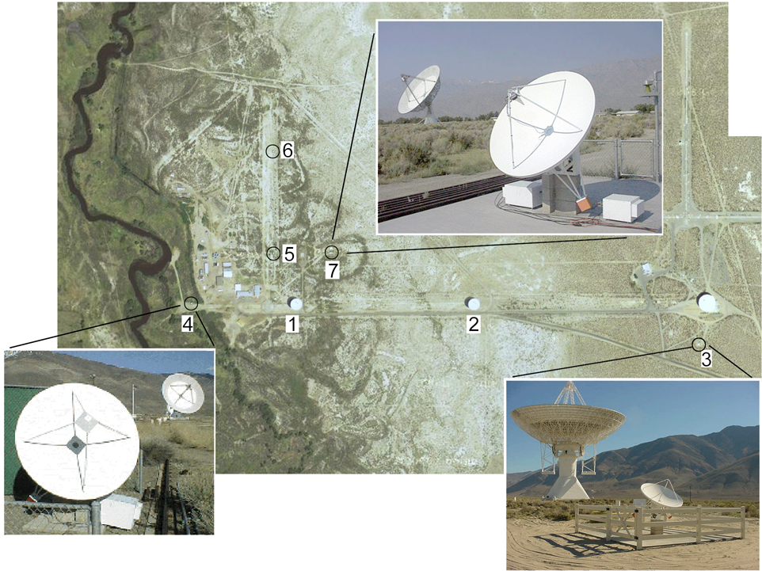
History and motivation
Existing OVSA—Old and Obsolete
NJIT’s existing radio array
7 antennas (two 27-m antennas and five 2-m antennas)
21 baselines
1-18 GHz frequency range.
Infrastructure needs replacement

Slide 4
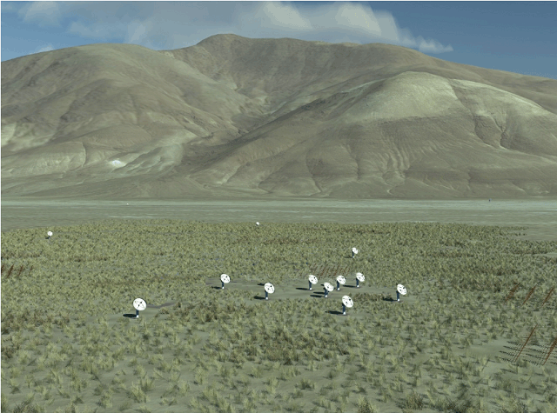
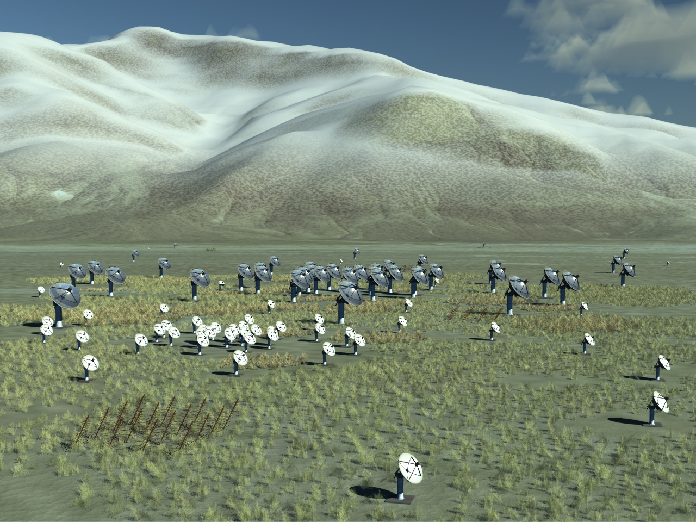
History and motivation
Table 1: FASR Instrument Specifications
Angular resolution | 20/ν_{GHz} arcsec
Frequency range | 0.05-21 GHz
Frequency resolution | 1%
Time resolution | 1 s
Polarization | Stokes I & V (Q/U selectable)
Number of antennas | 2-21 GHz: ~100 0.2-3 GHz: ~60 < 0.3 GHz: ~40
Size of antennas | 2-21 GHz: 2 m parabolic 0.2-3 GHz: 6 m parabolic < 0.3 GHz: log-periodic dipoles
Maximum antenna spacing | 4.25 km
Proposed Site | Owens Valley (Big Pine, CA)
The incredible shrinking FASR
15 15 0
45 15 15
Isaac Gary

Slide 5
History and motivation
When it was clear that FASR Pathfinder would not go forward, the MRI-R2 opportunity appeared as part of ARRA.
We decided to put an OVSA Expansion forward for several reasons:
  To increase resources for FASR Pathfinder (?)
  To get something going to support and keep together the FASR team
  MRI –R2 matching rules were favorable to NJIT (although not to Berkeley, Caltech, U VA)
  This was an opportunity to get Caltech more closely involved, through night-time science
  OVSA really needs upgrading!
However, the long delay (Aug. 2009 to Oct. 2010) and the FASR placement in Astro2010 has potentially changed the motivation.

Slide 6
Opportunity to jump-start fasr
FASR seems more likely, now, to become a new start within the next few years.
The OVSA upgrade is an excellent vehicle to get an early start on FASR by:
  Providing a good sized (10% of FASR) project similar to FASR-A
  Allowing modest increase in personnel and technical capability
  Providing a testbed for relevant hardware, software, and database development
  Producing science and data products for community awareness of FASR capability

Slide 7
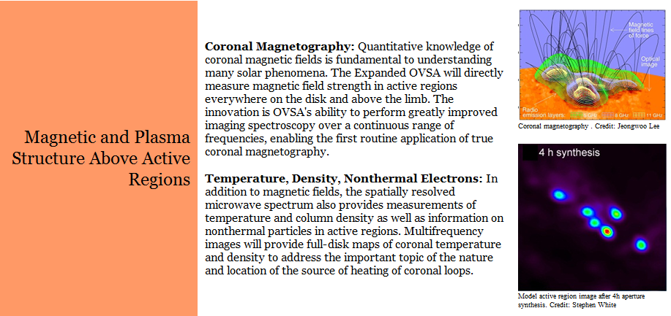
Science goals
Collected from http://www.ovsa.njit.edu/expansion

Slide 8
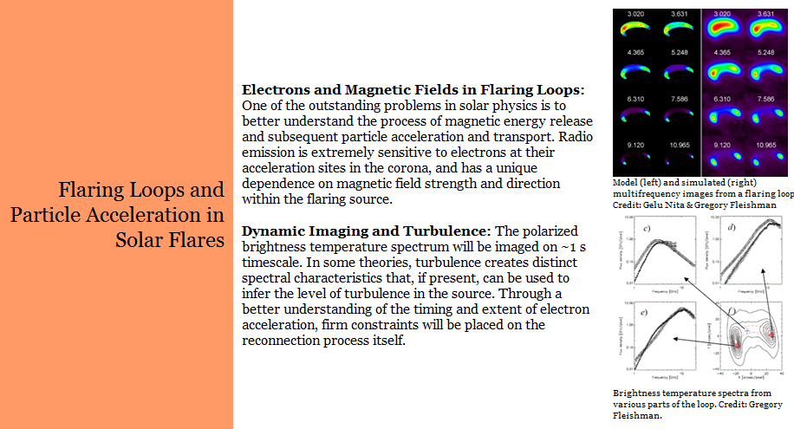
Science goals

Slide 9
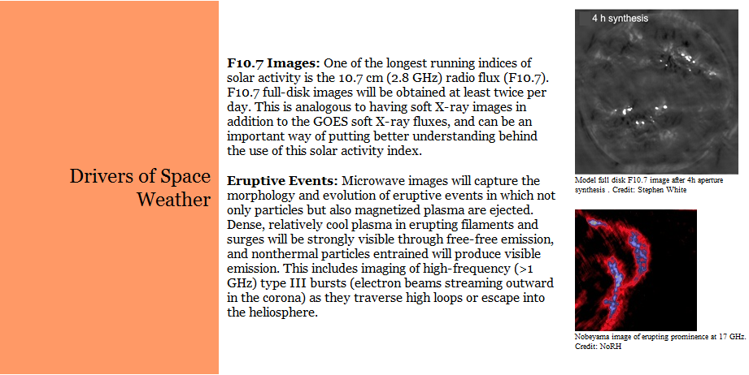
Science goals

Slide 10
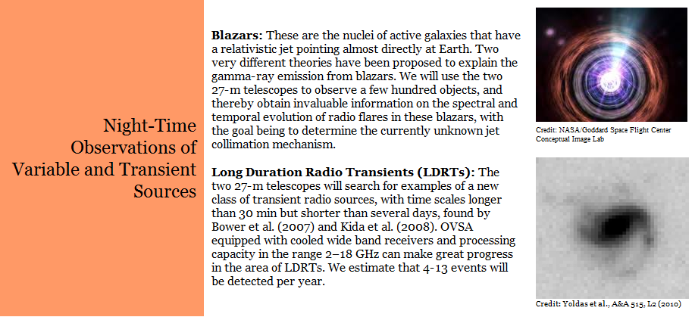
Science goals

Slide 11
Site development
Add 8 new 2-m antennas in expanded array
Move existing five 2-m antennas to new locations within the array (and upgrade)
Refurbish and upgrade the two 27-m antennas for calibration and night-time science
New control building
Entirely new receiver/correlator design using “FASR technology”

Slide 12
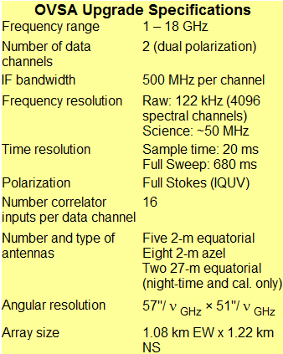
Instrument specifications
The specs in this table have been updated from that described in the proposal, based on new array configuration

Slide 13
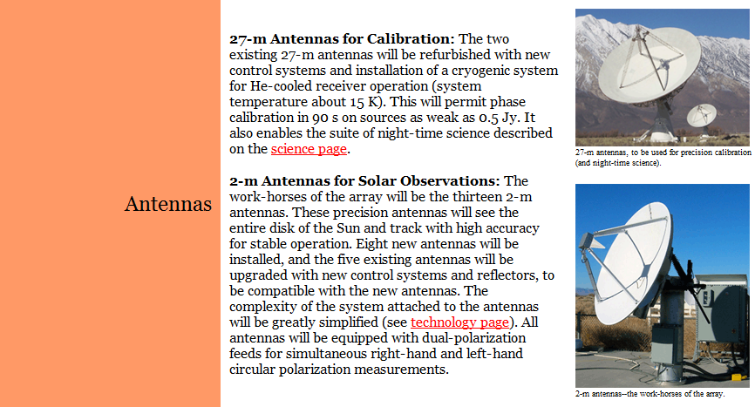
Antennas

Slide 14
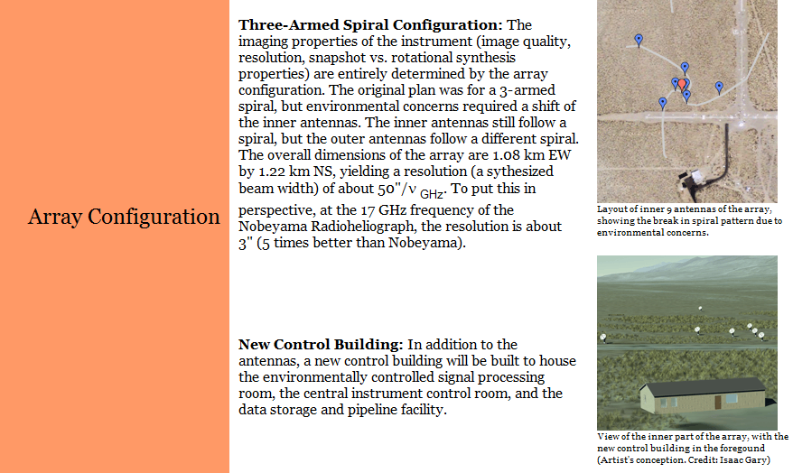
Array configuration

Slide 15
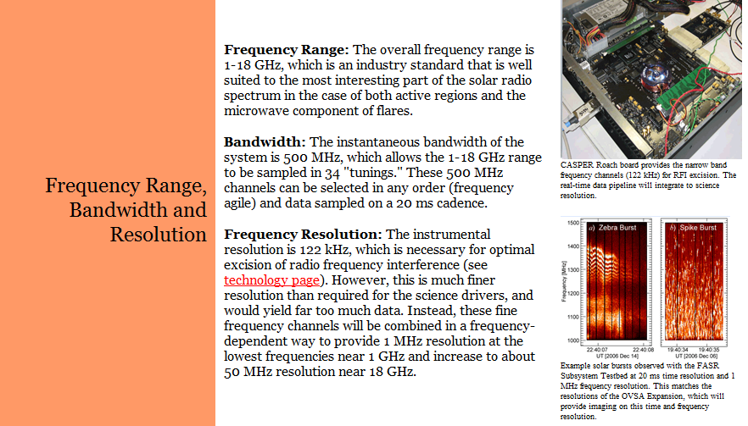
Frequency parameters

Slide 16
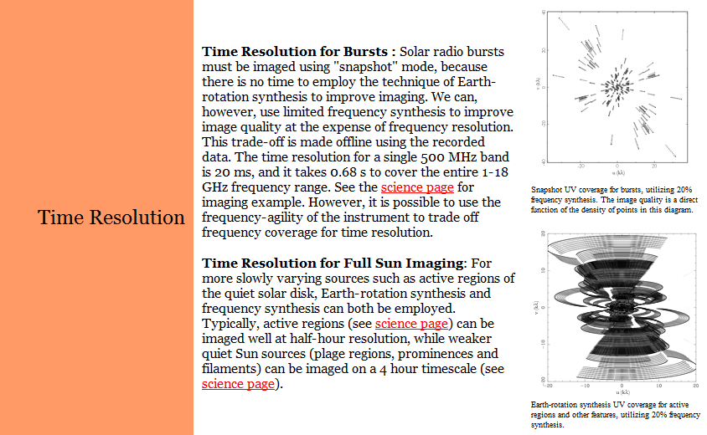
Time resolution

Slide 17
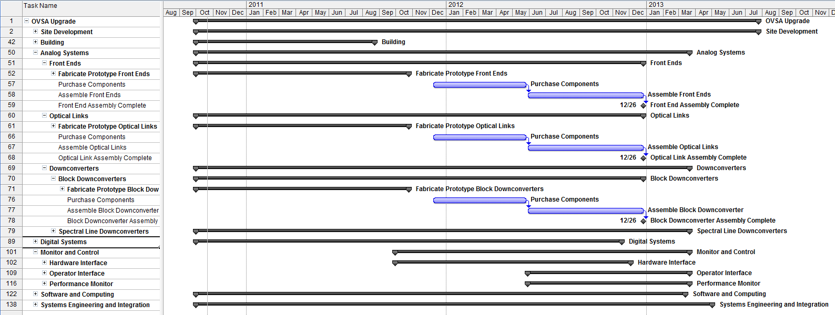
Schedule (entire project)

Slide 18
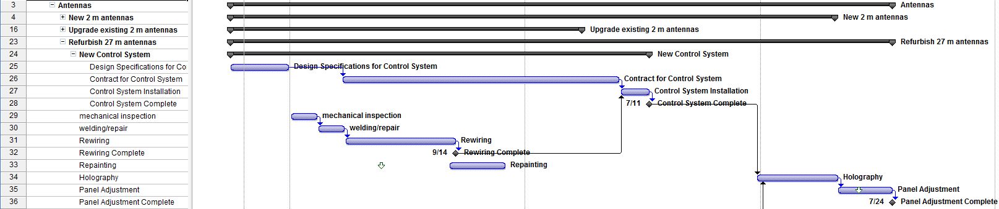
Schedule (antennas example)

Slide 19
Schedule (entire project)
Start: Oct 1, 2010
End of Construction: Aug 31, 2013
Need input from individual task leaders about workable schedule for each task
Need input from individual task leaders about linkages between tasks (what depends on what?)
Need research from task leaders about resource/vendor availability, lead times, cost (e.g. Patriot, CASPER/Roach-II, Tecom, building mfr. etc.)

Slide 20
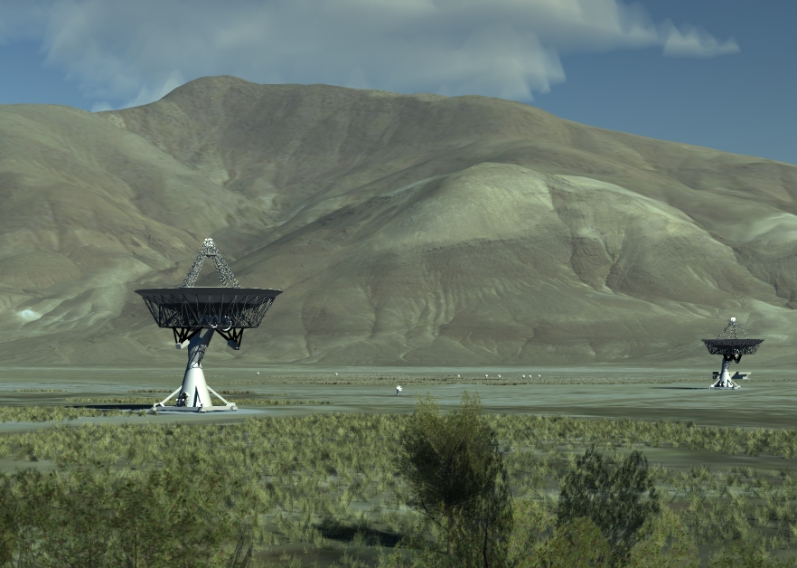
final array

